Slide 1
Reducing Workplace Injuries

Slide 2
Our Footprint
We have 380+ employees
Over 40 group homes and apartment complexes

Slide 3
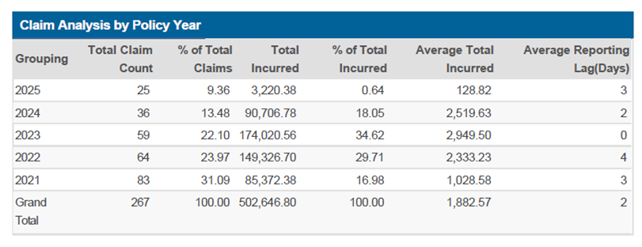
Our Best Year Ever
Fewer Injuries
Fewer Claims
Minor Cost

Slide 4
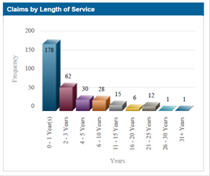
Data
Injury trend
Is there a pattern?

Slide 5
How we got there
Preventing injuries
Identifying risk early
Post-accident drug screen
PPE
Info Posters
Increased communication with insurance reps

Slide 6
Injury Prevention Starts Before the Injury
Key Message: Most workplace injuries are predictable.
Injuries rarely come “out of nowhere”
Risk builds over time
Early identification = early intervention

Slide 7
Risk Intersection
Work Areas
New Employees
“If we can identify risk in both places, we can prevent most injuries.”

Slide 8
Work Area Risk Levels

Slide 9
Work Area Risk Levels
Risk Levels:
Elevated Risk
Moderate Risk
Low Risk
Key idea: Every work area fits somewhere on this spectrum—and it can change.

Slide 10
Elevated Risk Work Areas
Characteristics may include:
Frequent physical transfers
History of injuries or near misses
High behavioral intensity
Equipment use (lifts, wheelchairs, etc.)
Staffing shortages or turnover
Talking point: “Elevated risk doesn’t mean ‘bad’—it means ‘needs more support.’”

Slide 11
Moderate Risk Work Areas
Characteristics may include:
Occasional physical demands
Infrequent injuries
Tasks that vary day to day
Some new or rotating staff
Talking point: “These areas benefit most from observation and refresher training.”

Slide 12
Low Risk Work Areas
Characteristics may include:
Minimal physical demands
Stable routines
Strong staff consistency
Few or no prior injuries
Talking point: “Low risk still requires attention—complacency creates risk.”

Slide 13
Why This Matters
Benefits of Work Area Risk Identification:
Training where it’s needed most
Better use of time and resources
Fewer injuries and claims

Slide 14
New Hire Risk Levels

Slide 15
New Hires Are the Highest Risk Group
Key message: Length of service matters.
New hires are more likely to be injured
Learning curves + confidence gaps
Unfamiliar routines and individuals

Slide 16
Classifying New Hire Risk
Risk Levels:
Elevated Risk
Moderate Risk
Low Risk
Clarify: This is not a disciplinary label — it’s a support tool.

Slide 17
Elevated Risk New Hires
Possible indicators:
No prior experience
History of injuries (previous employers)
Difficulty following body mechanics
Overconfidence or reluctance to ask for help
Support strategies:
Increased observation
More frequent check-ins
Hands-on coaching

Slide 18
Moderate Risk New Hires
Possible indicators:
Some experience
Good engagement but inconsistent technique
Learning pace is steady
Support strategies:
Targeted refreshers
Supervisor feedback
Skills reinforcement

Slide 19
Low Risk New Hires
Possible indicators:
Relevant experience
Strong situational awareness
Consistent safe practices
Support strategies:
Periodic observation
Encourage peer mentoring

Slide 20
Matching the Two Risk Types
Key concept:
High-risk employees + high-risk work areas = predictable injuries
Elevated-risk hires should not be placed alone in elevated-risk areas
Risk pairing matters
Smart assignments prevent injuries

Slide 21
Post-accident drug screens
Number of reported injuries stayed the same
Number of employees requesting treatment decreased

Slide 22
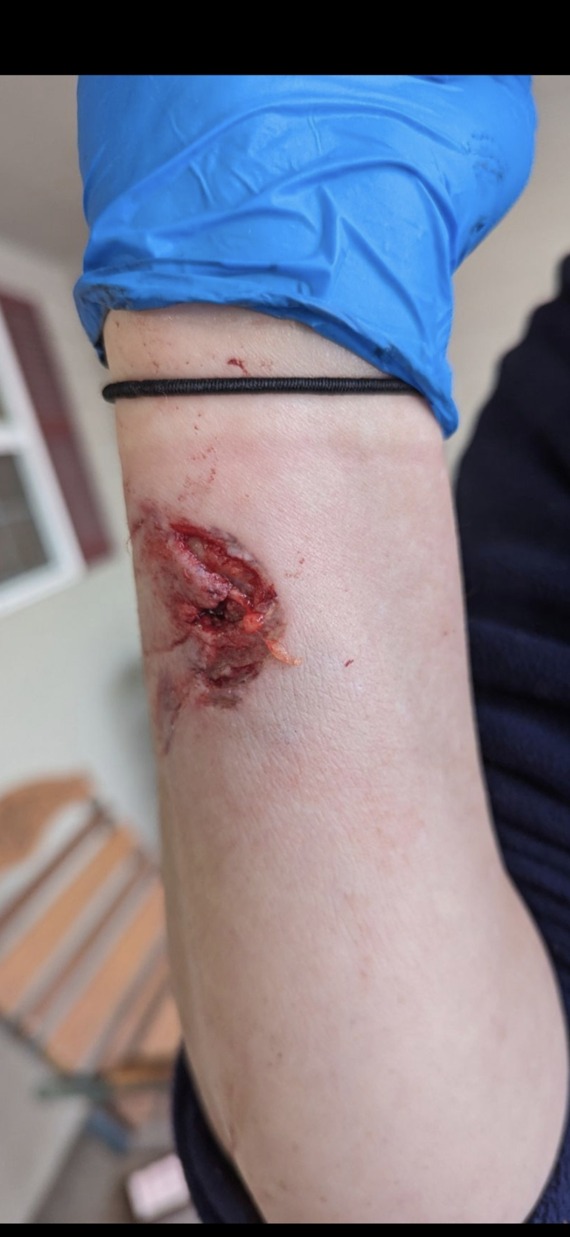
PPE
Gloves
MMA guards
Fencing Helmet
Falconer Sleeves

Slide 23
Info Posters

Slide 24
Loss Control Consultant/Claim Coordinators
Ergonomic assessments
Targeted risk assessments
Idiopathic Injuries

Slide 25
Closing
Closing points:
Injury prevention is proactive, not reactive
Risk identification is about support, not blame
Small adjustments prevent big problems
“The safest injury is the one that never happens.” - ChatGPT

Slide 26
Thank you

