Slide 1

Active Aging
Promoting Mobility and Strength for Independence and Fall Prevention in Older Adults with Intellectual and Developmental Disabilities
Joe Sherman
Clinical Exercise Physiologist
Community Health Improvement Program for Intellectual Disabilities (CHIP-ID)
University of Kansas Medical Center

Slide 2

What does life expectancy look like?
  20-30 years in the 1950s
  To nearly 70 years now¹
    Deinstitutionalization, living at home or in assisted care environments
    Better medical management of co-morbidities
    Better community supports and programs
    Increased employment opportunities leading to self-fulfillment
    Increased autonomy in decision making
This Photo by Unknown Author is licensed under CC BY-NC-ND
¹Perkins EA, Moran JA. Aging Adults With Intellectual Disabilities. JAMA. 2010;304(1):91–92. doi:10.1001/jama.2010.906

Slide 3
Aging Risks
Face the same age-related risks as anyone else¹
  Cardiovascular disease, diabetes, thyroid disorders and obesity
  Vision/hearing loss, arthritis, osteoporosis
  Alzheimer’s disease and other dementias
  Highest risk factor for falls is increased age
Unrecognized or Poorly Managed Conditions²
  Different presentation of symptoms
  Higher disadvantage of accessing necessary care
Up to a 70% fall risk³
¹Pimlott N. Aging with intellectual and developmental disabilities: Family physicians can make a difference. Can Fam Physician. 2019 Apr;65(Suppl 1):S3. PMID: 31023768; PMCID: PMC6501715.
²Shooshtari, S., Naghipur, S. and Zhang, J. (2012), Unmet Healthcare and Social Services Needs of Older Canadian Adults With Developmental Disabilities. Journal of Policy and Practice in Intellectual Disabilities, 9: 81-91. https://doi.org/10.1111/j.1741-1130.2012.00346.x
³Axmon A, Ahlström G, Sandberg M. Falls resulting in health care among older people with intellectual disability in comparison with the general population. J Intellect Disabil Res. 2019 Mar;63(3):193-204. doi: 10.1111/jir.12564. Epub 2018 Nov 8. PMID: 30407691; PMCID: PMC7379981.

Slide 4

Fall Risk and Consequences
Risk Factors¹
  Vision impairment
  Gait abnormalities
  Equilibrium issues
  Anxiety from previous falls or imbalance
  Decreased physical capacity
More likely to fall during a vital activity (ADLs)²
More likely to injure head and legs as opposed to arms/thorax
Falls are more likely to end in inpatient care with higher readmission in 30 days
Fallers have lower levels of physical activity and lower physical performance³
Caregivers
  Feelings of guilt and increased support demands
  Increased reliance on external support
  Greater physical and verbal assistance required
This Photo by Unknown Author is licensed under CC BY-ND
¹Cahill, S., Stancliffe, R.J., Clemson, L. and Durvasula, S. (2014), Reconstructing the fall. J Intellect Disabil Res, 58: 321-332.
²Axmon A, Ahlström G, Sandberg M. Falls resulting in health care among older people with intellectual disability in comparison with the general population. J Intellect Disabil Res. 2019 Mar;63(3):193-204. doi: 10.1111/jir.12564. Epub 2018 Nov 8. PMID: 30407691; PMCID: PMC7379981.
³Poram Choi, Tianlan Wei, Robert W. Motl, Stamatis Agiovlasitis. Risk factors associated with history of falls in adults with intellectual disability. Research in Developmental Disabilities. Volume 106. 2020. 103748. ISSN 0891-4222

Slide 5
Blood Sugar
Cholesterol
= MORE INDEPEDENCE AND LESS FALL RISK
Endurance
Blood Pressure
Body Composition
Mobility
Balance
Exercise/Physical Activity
Mood
Strength
ADL Performance
Cognition/Memory
Vocation Performance
¹Bouzas, S., Martínez-Lemos, R. I., & Ayán, C. (2019). Effects of exercise on the physical fitness level of adults with intellectual disability: a systematic review. Disability and Rehabilitation, 41(26), 3118–3140.
²Jacob etal. (2023). A systematic review of physical activity: benefits and needs for maintenance of quality of life among adults with intellectual disability. Front Sport Act Liv, Vol 5, 7 June 2023.

Slide 6
Exercise Safety
Any older adult who is about to begin an exercise program should first consult their physician.
Monitor for these concerns:
Neck discomfort or pain
Joint pain or unusual clicking/popping
Excessive fatigue or breathing difficulty
Changes in gait or movement patterns after exercise
Unwillingness to participate (may indicate pain or discomfort)
Stop exercise immediately if:
Participant reports pain, especially neck or joint pain
You observe changes in coordination or balance
Participant shows signs of unusual fatigue or distress
Any sudden changes in behavior or movement occur

Slide 7
Exercise Safety
Form and safety principles
Avoid hyperextension of joints
Control the motion in both directions (lifting and lowering)
Maintain neutral spine positioning during exercises
Progress gradually - rushing increases injury risk
Prioritize quality over quantity - proper form is more important than completing all repetitions

Slide 8
Maintaining Realistic Expectations
The key to success is consistency, patience, and individualization.
Every participant will progress at their own pace, and that's perfectly appropriate.
Celebrate all progress, no matter how small.
The goal shouldn’t be to have everyone reach the same level, it should be to have each person reach THEIR peak level.

Slide 9
Communication approach
  Use simple, concrete language with 1-2 step instructions at a time
  Demonstrate exercises - showing is more effective than telling
  Provide visual and verbal cues as often as necessary to help participants perform exercises safely and correctly
  Use consistent terminology each session to build familiarity
  Give frequent positive feedback and encouragement
  Be patient - learning may take longer, but consistency leads to success
  Break down complex movements into smaller, manageable steps

Slide 10
Making Exercise Successful
Keep activities fun and social —this dramatically improves participation and reduces dropout
Use clear, simple instructions with visual demonstrations and hands-on guidance
Establish consistent routines —structured programs have much higher success rates
Set participants up for success —choose appropriate difficulty levels and celebrate progress
Start slowly and progress gradually —remember that everyday activities may be more demanding
Focus on functional movements that translate to real-world independence
Consider the participant's learning style —some may benefit from pictures, others from repeated practice
Make it meaningful —connect exercises to activities they want to do (like playing with friends, going shopping, or participating in family events)

Slide 11
Importance of Strength Exercises
Strength training is not just about building muscle - it's about building independence, confidence, and quality of life.
Added strength makes the participant more independent in transfers, walking, and daily activities.
Focus on functional movements that support daily tasks
Add resistance bands or light weights if you want to increase the challenge
Progress gradually—research shows significant strength gains are possible with just 10 weeks of twice-weekly training
Stronger muscles help improve posture
May improve mood, self-esteem, and confidence

Slide 12
Importance of Strength
Priority muscle groups
  Lower body: Quadriceps, hamstrings, gluteal muscles, and hip stabilizers - critical for walking, transfers, and independence
  Core/trunk: Abdominal and back muscles - essential for posture and balance given higher rates of scoliosis
  Upper body: Shoulder, chest, and arm muscles - support daily activities like dressing, reaching, and lifting
Functional, multi-joint movements (squats, step-ups, modified push-ups, bridges) rather than isolated single-muscle exercises
Bodyweight exercises with support (wall squats, chair squats, supported lunges)
Resistance band exercises (safe, adjustable, versatile)
Core stabilization exercises (planks, bird-dogs, bridges)
Balance integration - combine strengthening with balance challenges when appropriate

Slide 13
Importance of Strength
Strength exercises will follow the endurance/balance exercises when feasible, as part of a comprehensive 45-60 minute session.
Frequency: Exercises will be performed on 2-3 non-consecutive days each week (e.g., Monday, Wednesday, Friday). This allows adequate recovery time while building strength effectively.
Sessions will last approximately 10-15 minutes for strengthening exercises, as part of the full exercise session.
Progressive resistance approach: Strengthening will use a gradual progression system. Research shows that moderate-intensity resistance training (60-80% of maximum ability) performed 2-3 times weekly produces the best results for people with Down syndrome.
Initial goal: Participants will work toward 2-3 sets of 10-12 repetitions for each major muscle group. Start with what is comfortable and build gradually.

Slide 14
Starting point and progression: Participants will begin exercises with body weight or minimal resistance (such as resistance bands). Progression will be individualized based on:
  Proper form and control
  Participant comfort and confidence
  Absence of joint pain or instability
  Consistent completion of target repetitions
When ready, resistance can be increased gradually using:
  Thicker resistance bands
  Light ankle weights (starting with 0.5-1 lb)
  Modified body positions that increase challenge
Progress only when the participant can complete exercises with good form and without discomfort. Some participants may need several weeks at one level before advancing.
Supervision and support: Participants will be observed and assisted by trained staff while learning the exercises. Staff will:
  Demonstrate each exercise clearly
  Provide hands-on guidance for proper positioning
Monitor for signs of fatigue or joint stress

Slide 15
Balance Exercise
Balance naturally declines as people age due to changes in muscle strength, joint flexibility and sensory changes.
Balance exercises reduce falls and improve stability during daily activities like dressing and bathing and can even build confidence for daily activities like walking, climbing stairs, and reaching for objects. .
Balance training is especially beneficial for this population and can significantly improve safety and confidence in movement.

Slide 16
Balance Exercise
Transfer Exercises
Level 1
Transfer from seated to standing position, then reverse. You may use furniture for assistance.
Repeat 5 times
Level 2
Transfer from seated to standing position, then reverse. Complete without assistance.
Repeat 5 times
Level 3
Transfer from seated to standing position holding a 5 to 10 pound weight, then reverse; Complete without assistance.
Repeat 5 times

Slide 17
Balance Exercise
Functional Base-of-Support Exercises
Level I
While seated: lean forward, raise arms, then lean backward, lean sideways, and turn to each side
Repeat 5 times
Level 2
Same exercises as Level 1 but movement is done standing
Repeat 5 times
Level 3
Same as Level 2 but with eyes closed
Repeat 5 times
Level 4
Same as Level 2 but with 5 lb. weight in hand
Repeat 5 times

Slide 18
Balance Exercise
Advanced Walking Skills Exercises
Level 1
Hold onto a handrail, wall, table edge or countertop and complete the following 5 times each:
  Step up one stair and reverse the sequence
  Step over an obstacle
  Walk backwards
  Tandem walk
  Toe-only walk
  Heel-only walk
Level 2
Perform step up and down and same walks as Level 1. This time, do not touch handrail, wall, table edge or counter, except intermittently if necessary to maintain balance
Repeat 5 times
Level 3
Perform step up and down while holding a 5 to 10 lb. weight without assistance. Then, perform all other walks as Level 2 but with eyes closed
Repeat 5 times

Slide 19
Endurance
Endurance activities improve overall fitness, mood, and may help reduce boredom and agitation. Benefits include:
  Better cardiovascular health
  Reduced need for certain medications
  Improved sleep
  Weight management
  Enhanced cognitive function
Recommended activity levels: Aim for at least 150 minutes of moderate-intensity activity per week (or 75 minutes of vigorous activity). This can be broken into smaller sessions—even three 30-minute walking sessions per week can produce meaningful improvements in fitness and function.

Slide 20
Example Weekly Activity Schedule
 | Monday | Tuesday | Wednesday | Thursday | Friday | Saturday | Sunday
Strength | 15 minutes 10 exercises 2 sets of 10 Full body |  | 15 minutes 10 exercises 2 sets of 10 Full body |  | 15 minutes 10 exercises 2 sets of 10 Full body |  | Rest Day
Balance | 5 Minutes, Level 1 Exercises | 10 Minutes, Level 2 Exercises | 5 Minutes, Level 1 Exercises | 10 Minutes, Level 2 Exercises | 5 Minutes, Level 1 Exercises | 10 Minutes, Level 2 Exercises | Rest Day
Endurance | 20 Minute walk | 30 minute walk |  | 30 minute walk | Youtube Exercise Video | 15 minute walk | Rest Day
Other |  |  | Special Olympics Practice |  |  | Special Olympics Game | Rest Day

Slide 21
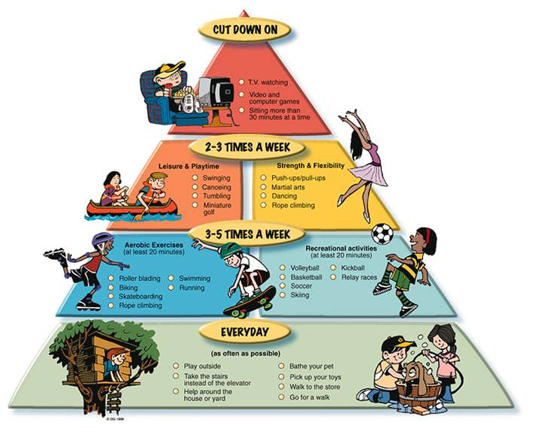
This Photo by Unknown Author is licensed under CC BY-NC-ND

Slide 22
Fall Prevention Strategies
Prevention is easier than reaction - anticipate changes
Their reality might be different - what seems normal to you may be frightening to them
Environment must change, not the person - harder to adapt to our environment as we age
Balance independence with safety - modify rather than restrict when possible
What works today may not work tomorrow - stay flexible
Simple changes make big differences - start with easy modifications
"Keep the environment calm, predictable, obvious, familiar, safe and failure-free."

Slide 23
Tips for a Safe Living Space:
Clean up Clutter – Try to keep the home neat and tidy to prevent tripping on clutter.
Repair or Remove Tripping Hazards – Examine the home, looking for lose carpet, slippery rugs, floorboards that stick up, and repair or remove hazards.
Install Handrails – Having handrails near hazardous areas can help reduce the risk of falling. Some hazardous areas include stairs, stepping out of the bathtub, and by the toilet.
Avoid Loose Clothing – Baggy clothes can increase the risk of falling. Instead opt for better-fitting and properly hemmed clothing that doesn’t bunch or drag on the ground.
Adequate Lighting – Make sure the rooms are adequately lit. You may also want to install night-lights in hallways and other places that need better lighting.
Wear Shoes – Socks are comfortable but are a slipping risk. Try to wear shoes around the house, or socks with grips on the soles.
Make Surfaces Nonslip – Bathtubs, showers, porches, kitchen and bathroom floors can be dangerous when wet. Use nonslip mats on problem surfaces.
Live on One Level – Stairs can present a falling hazard. Try to live on one floor as much as possible to avoid stairs.
Move Carefully – Encourage self-advocates to take their time when walking around, or standing up after sitting down for a while.

Slide 24
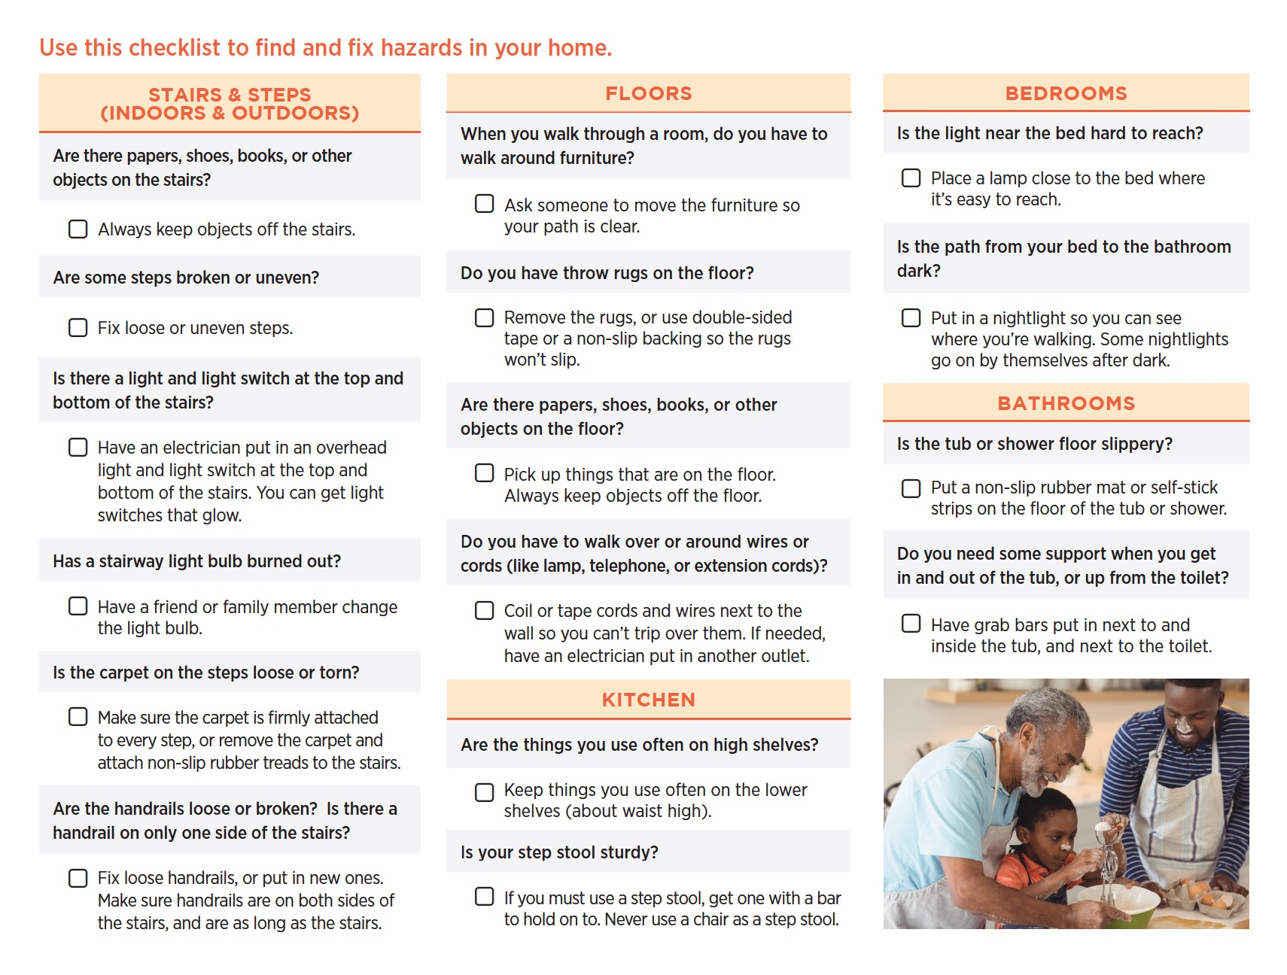
CDC STEADI Brochure, 2017

Slide 25
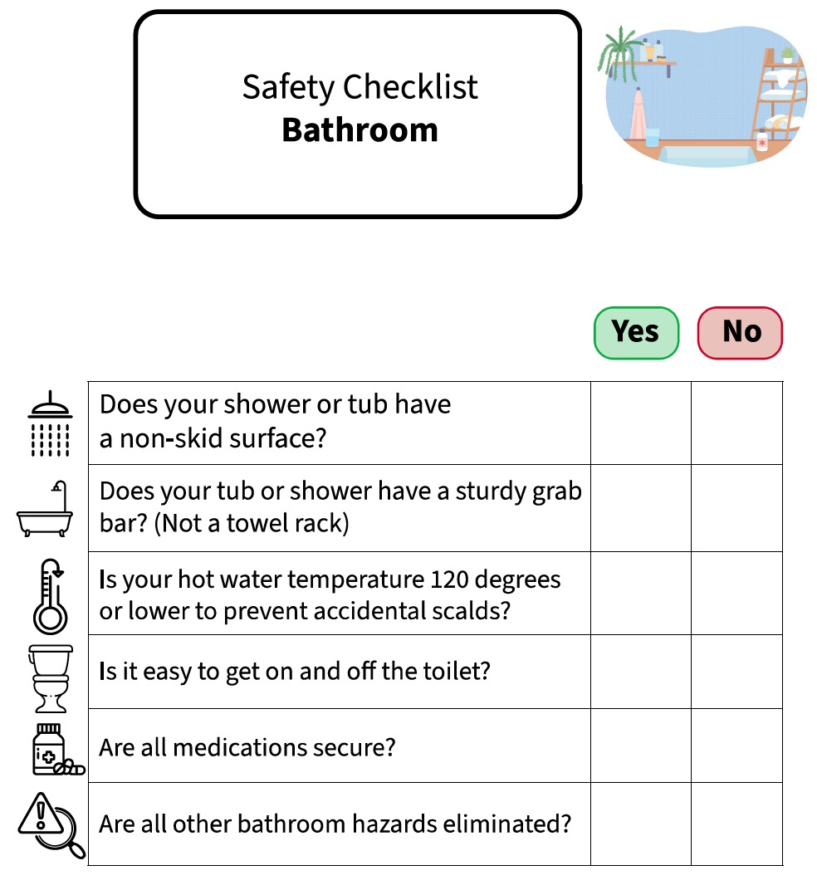
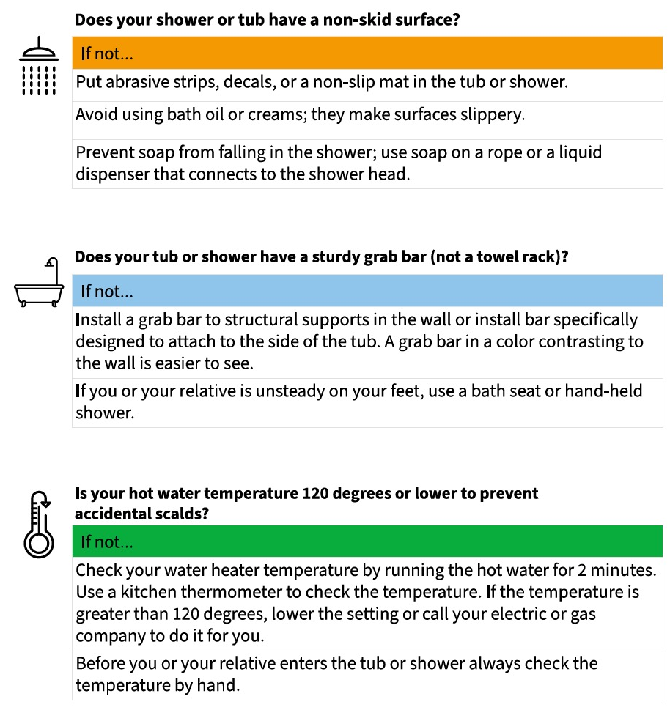
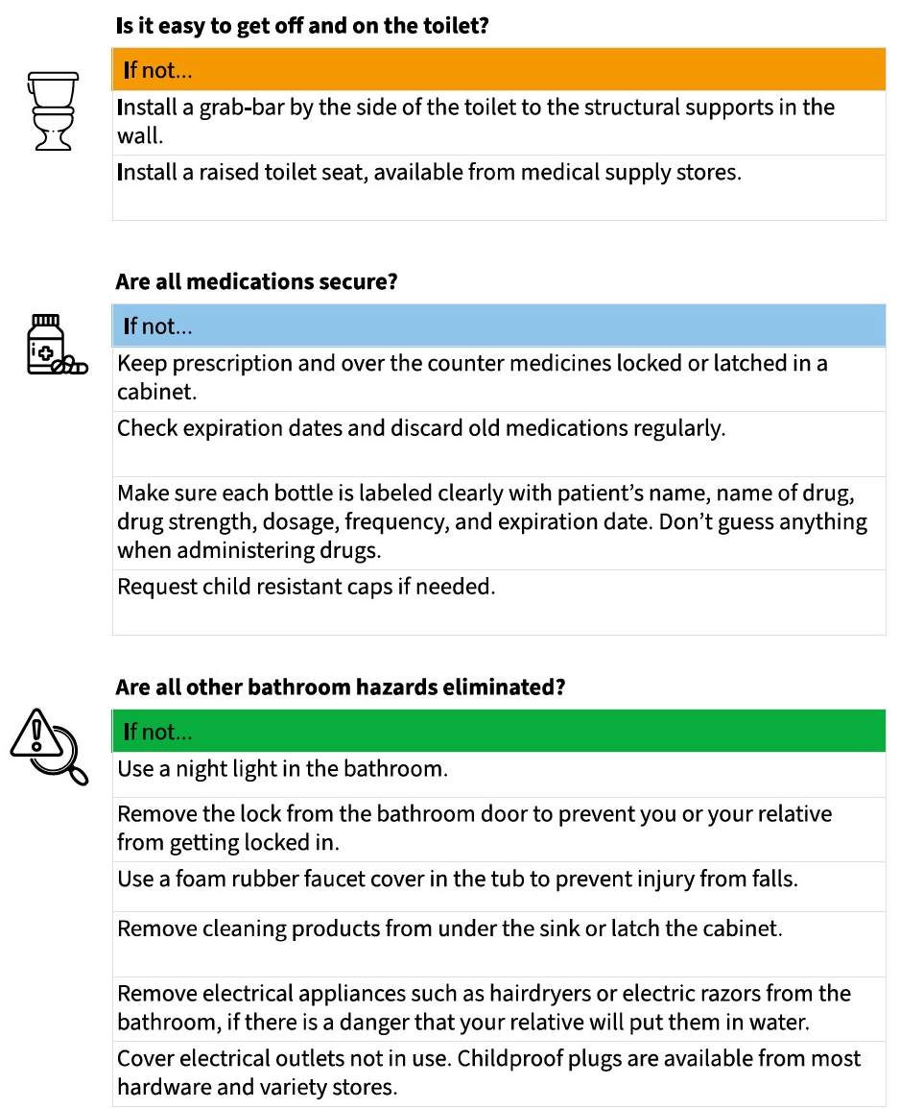

Slide 26
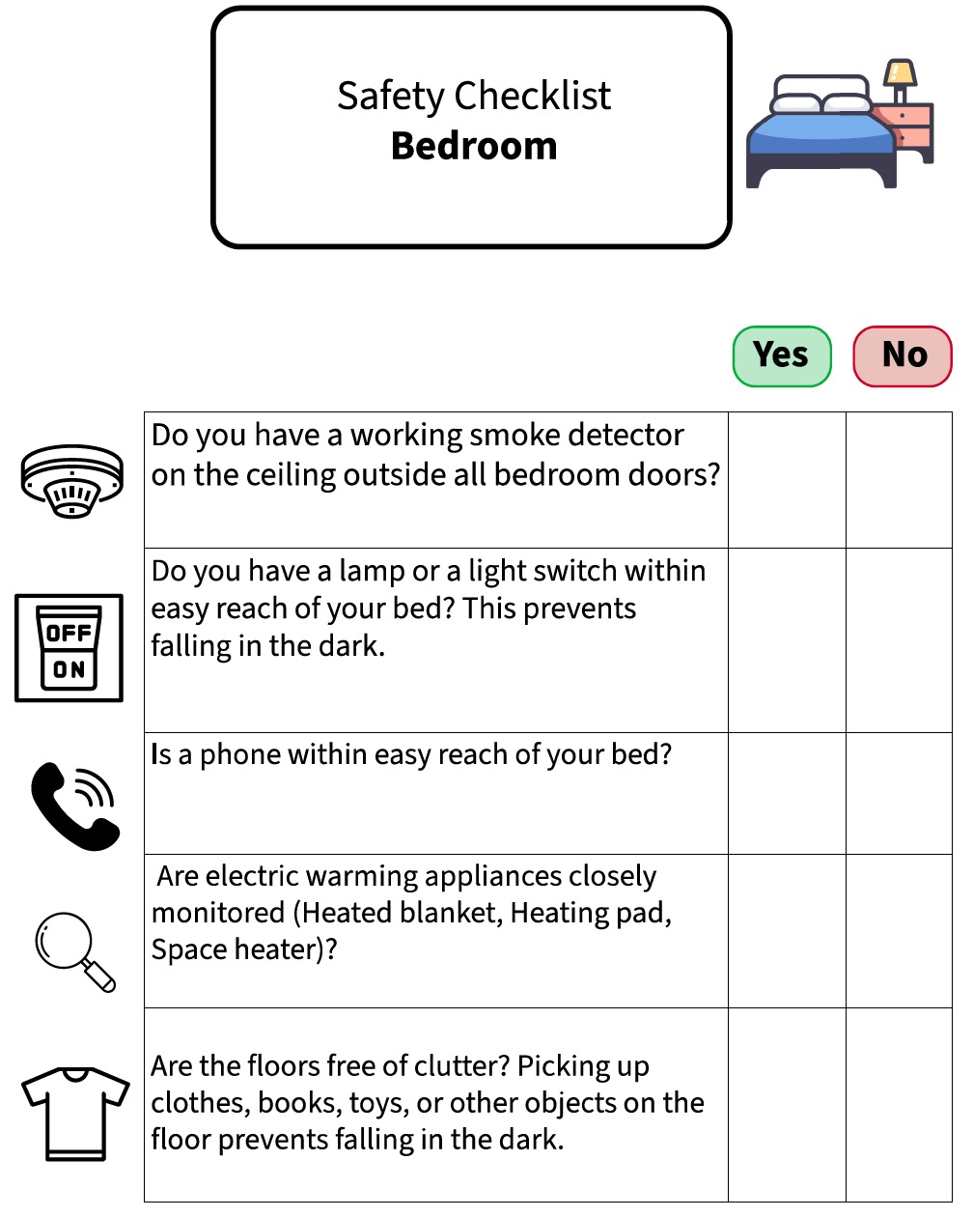
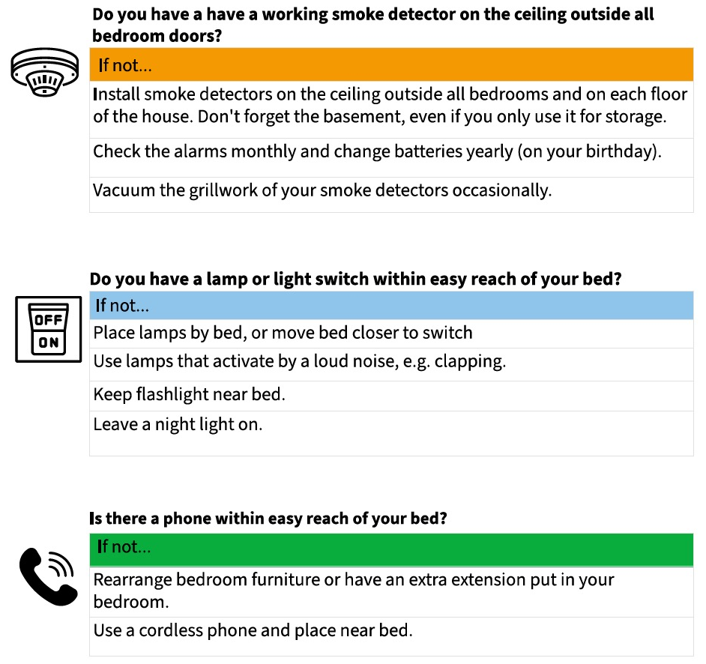
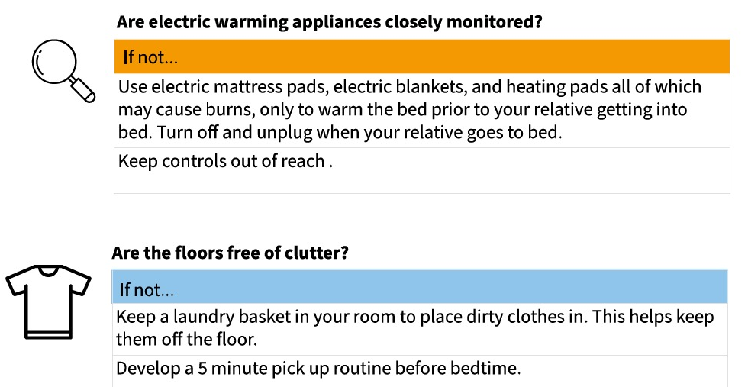

Slide 27
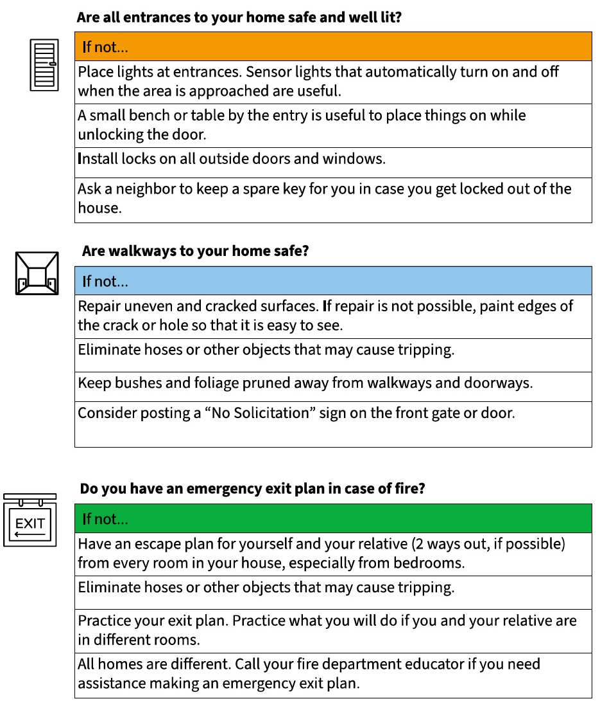
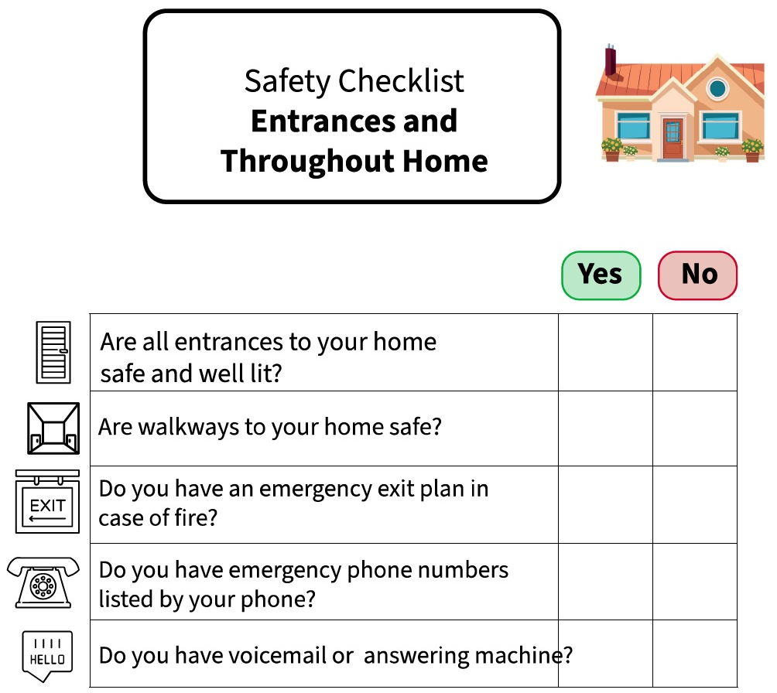
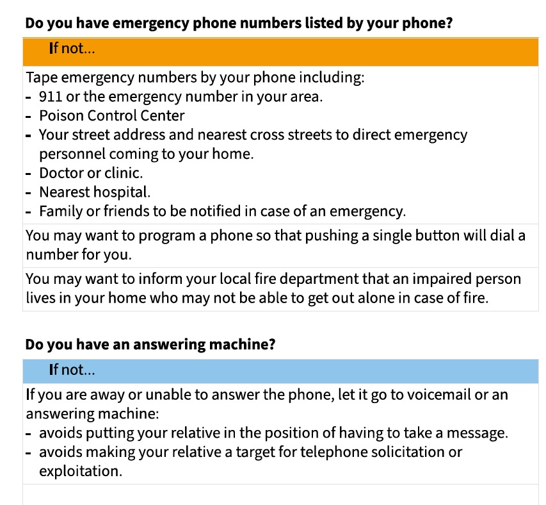

Slide 28
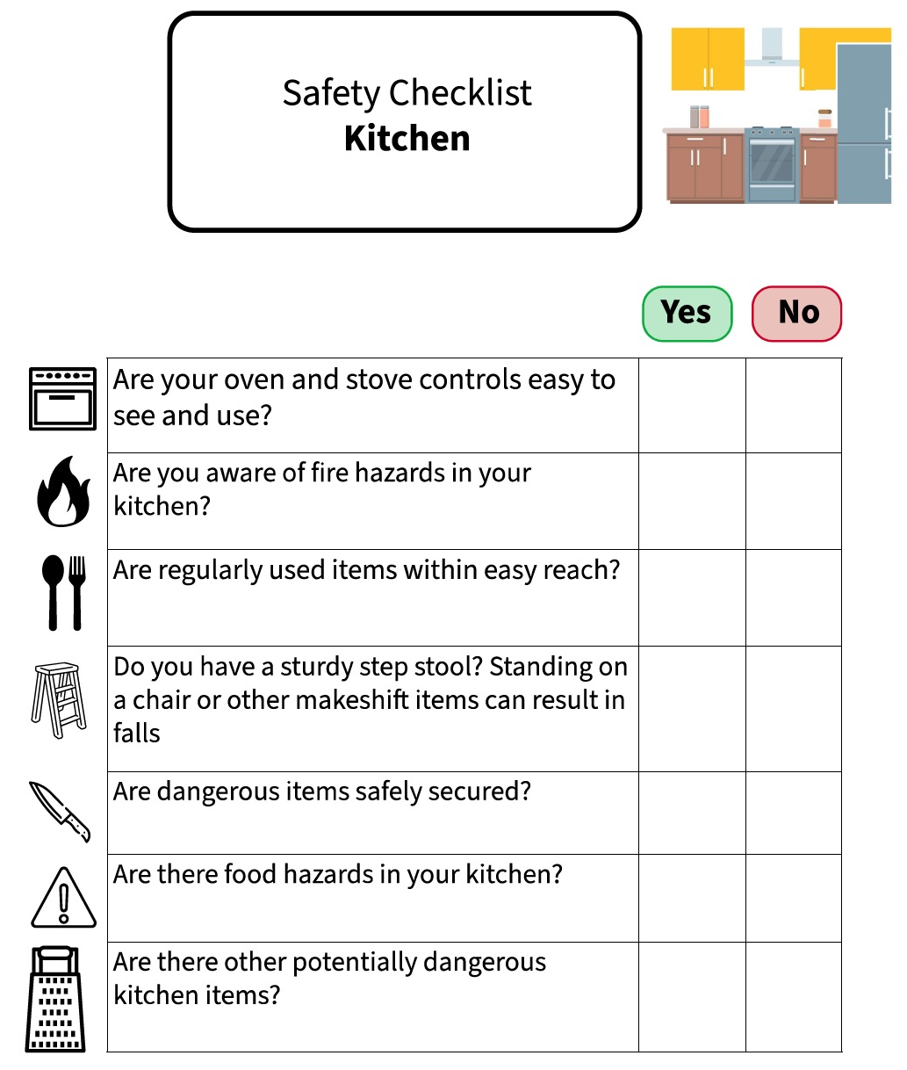
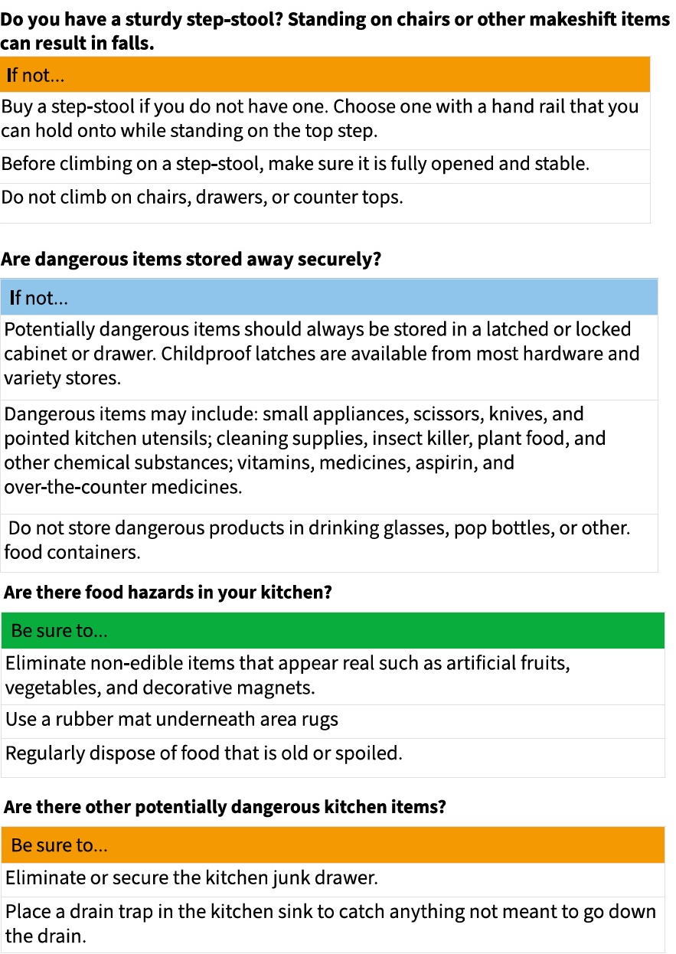
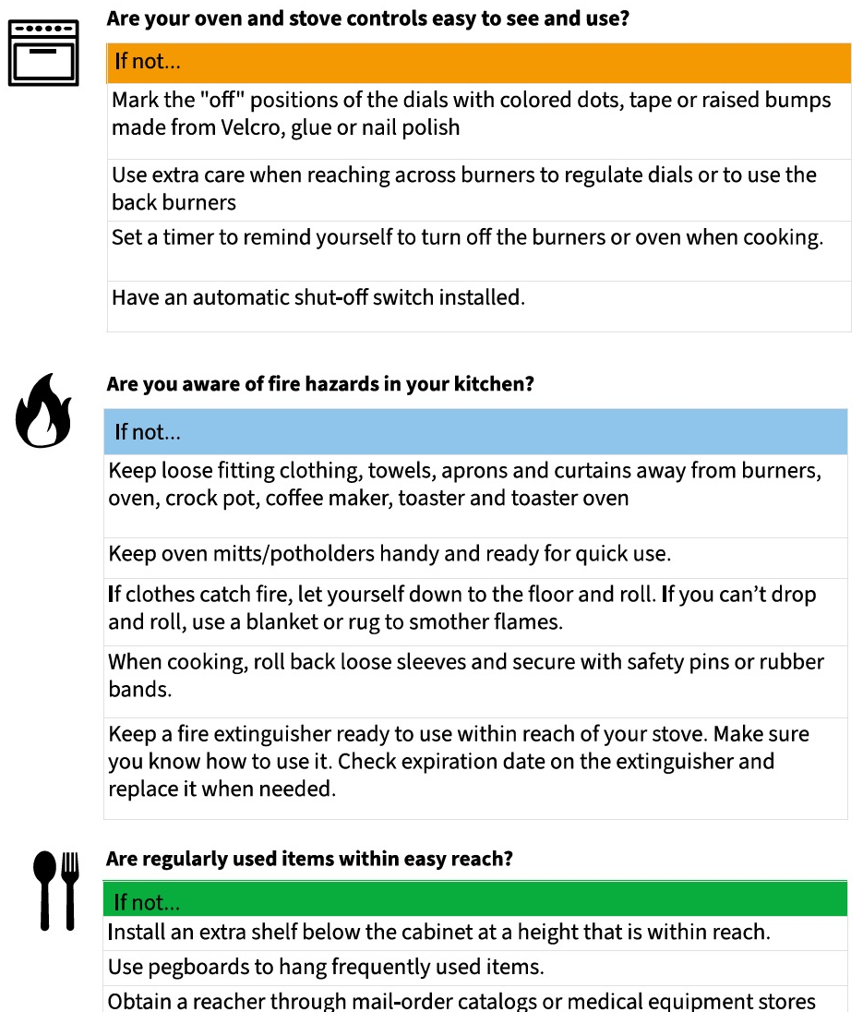

Slide 29
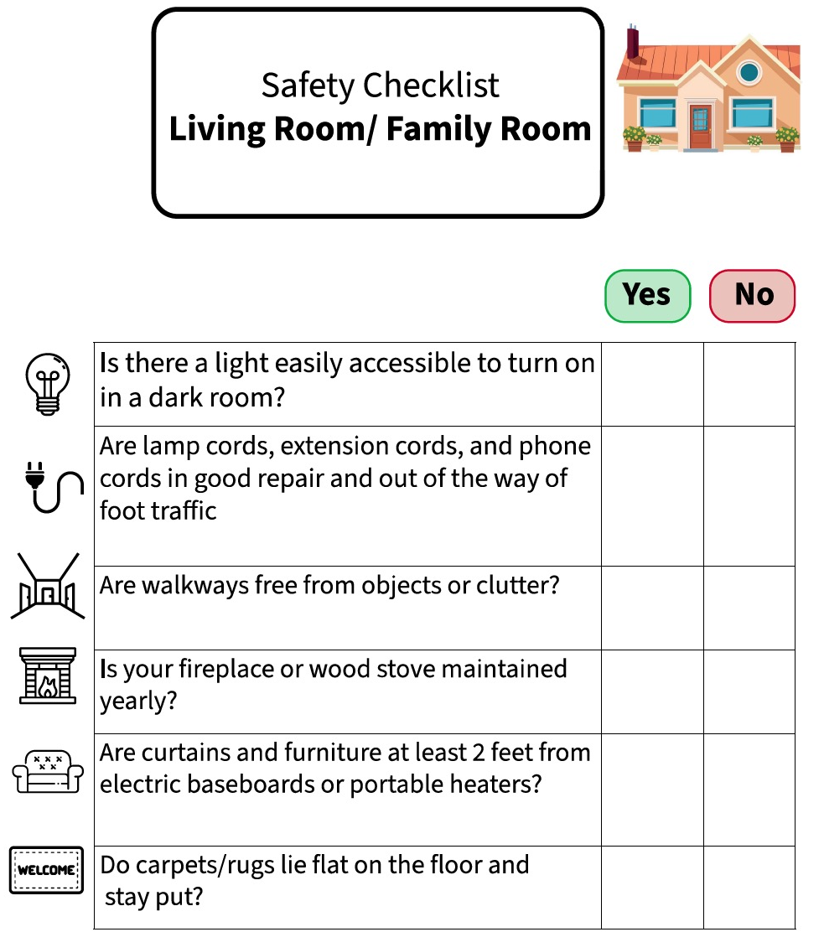
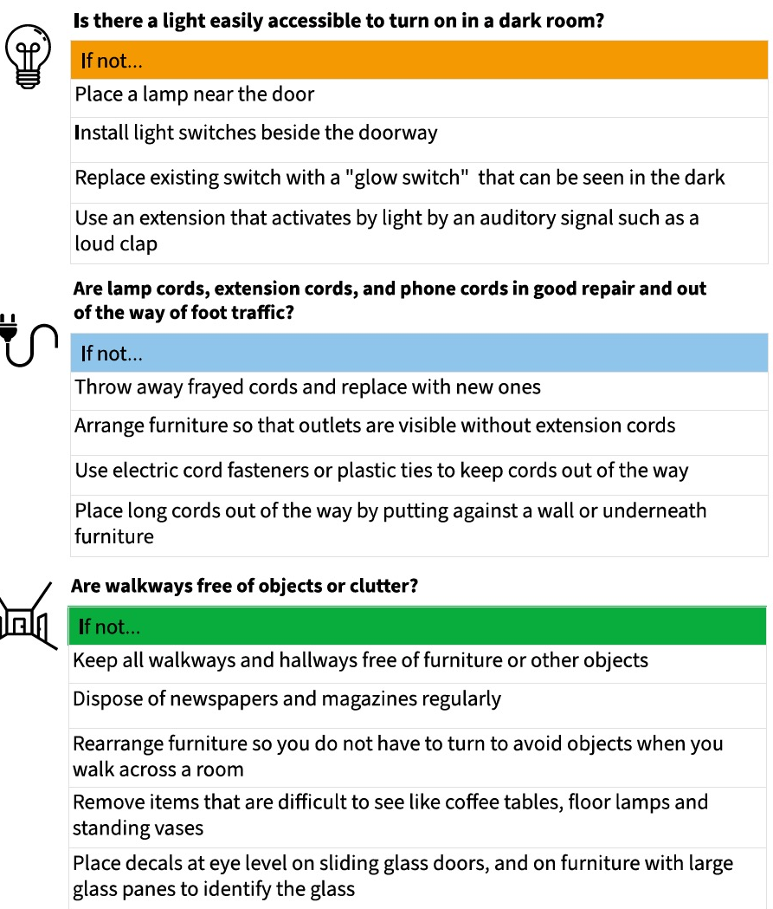
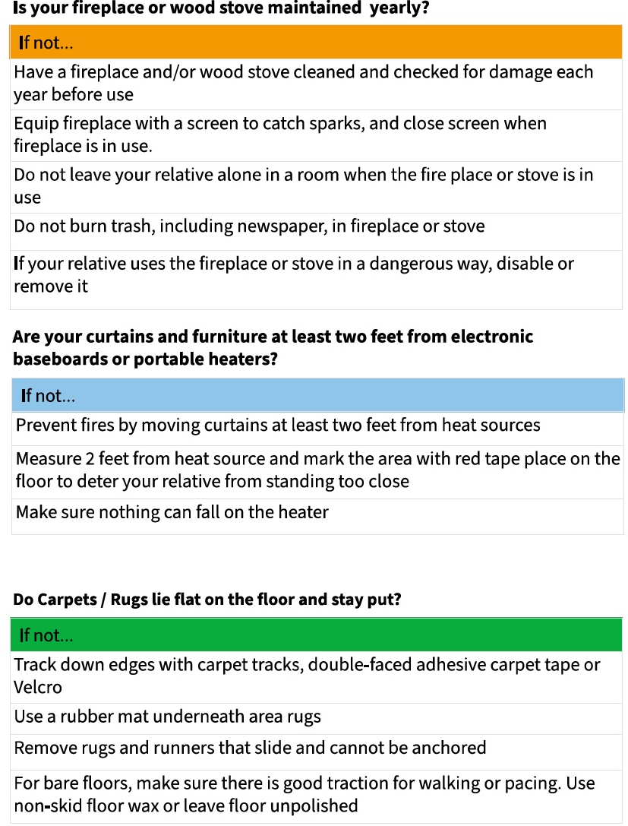

Slide 30
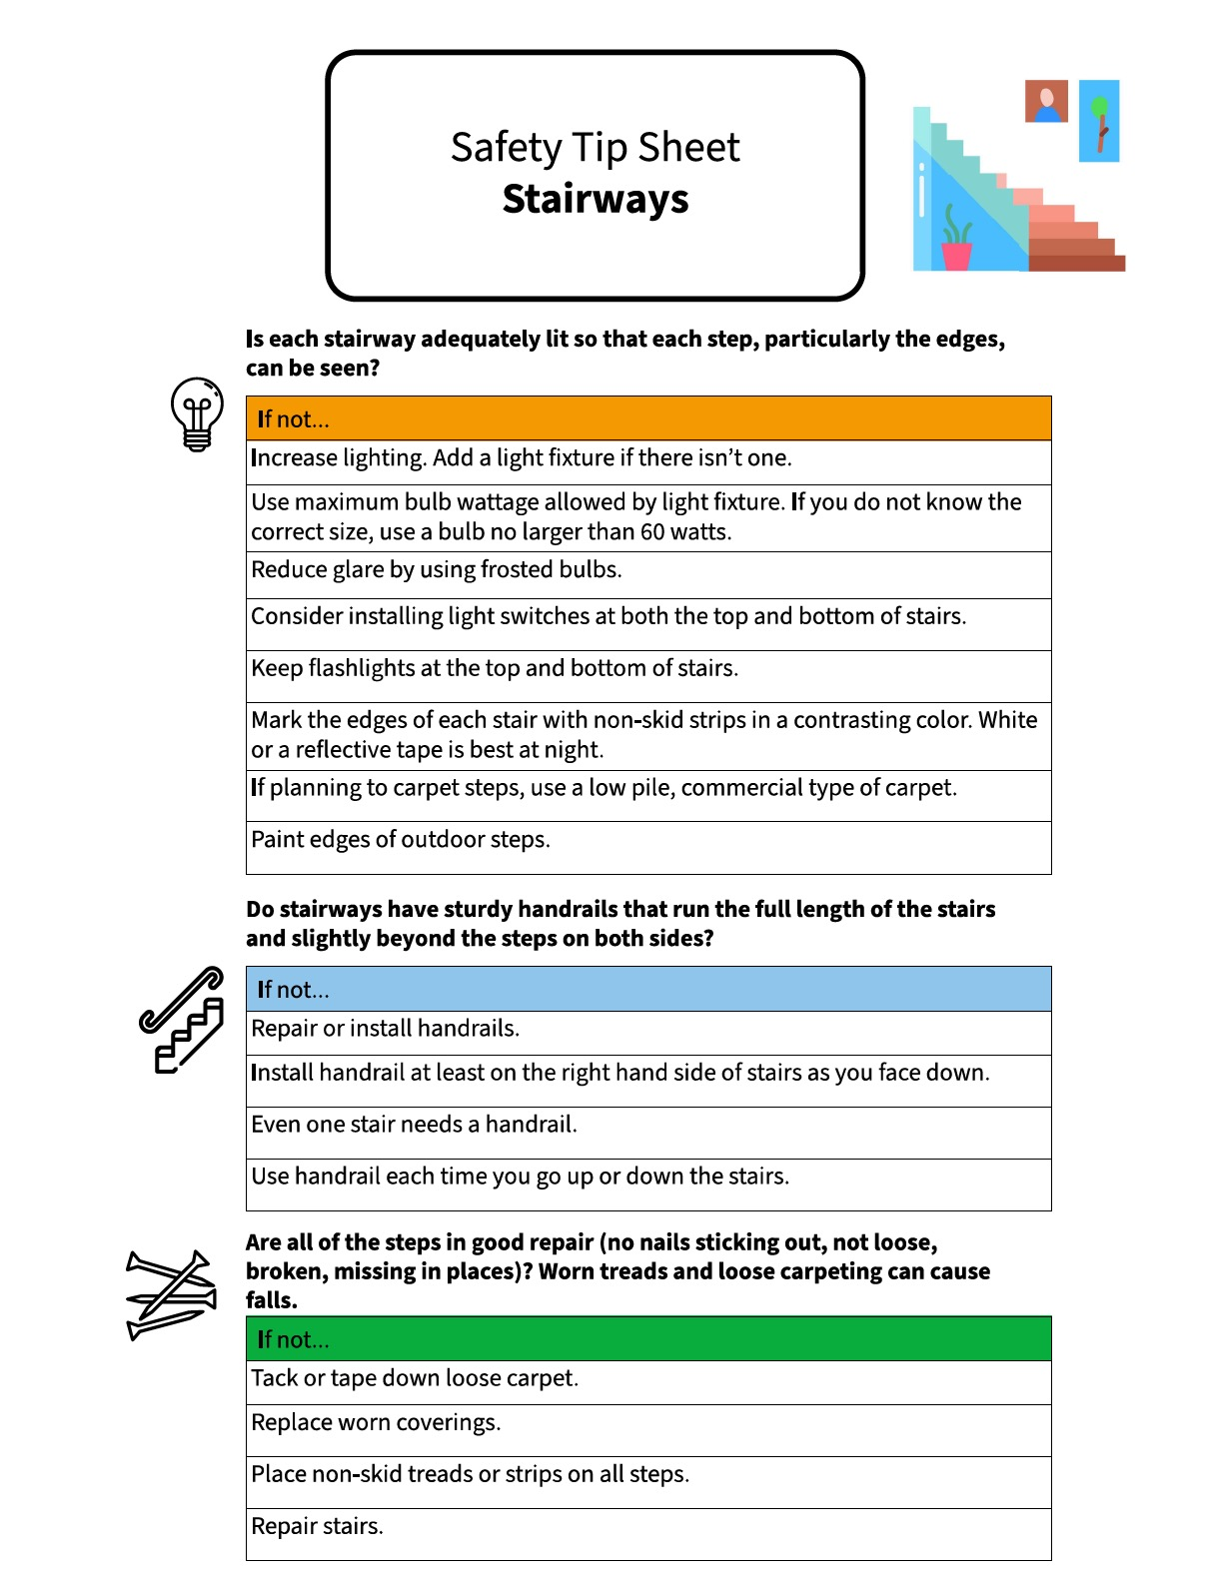
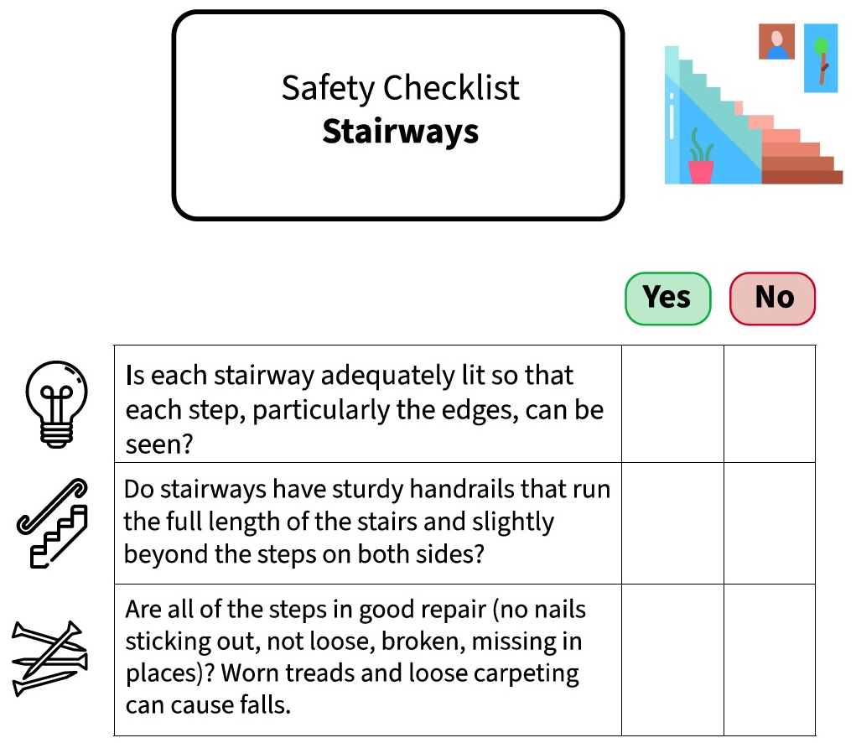

Slide 31
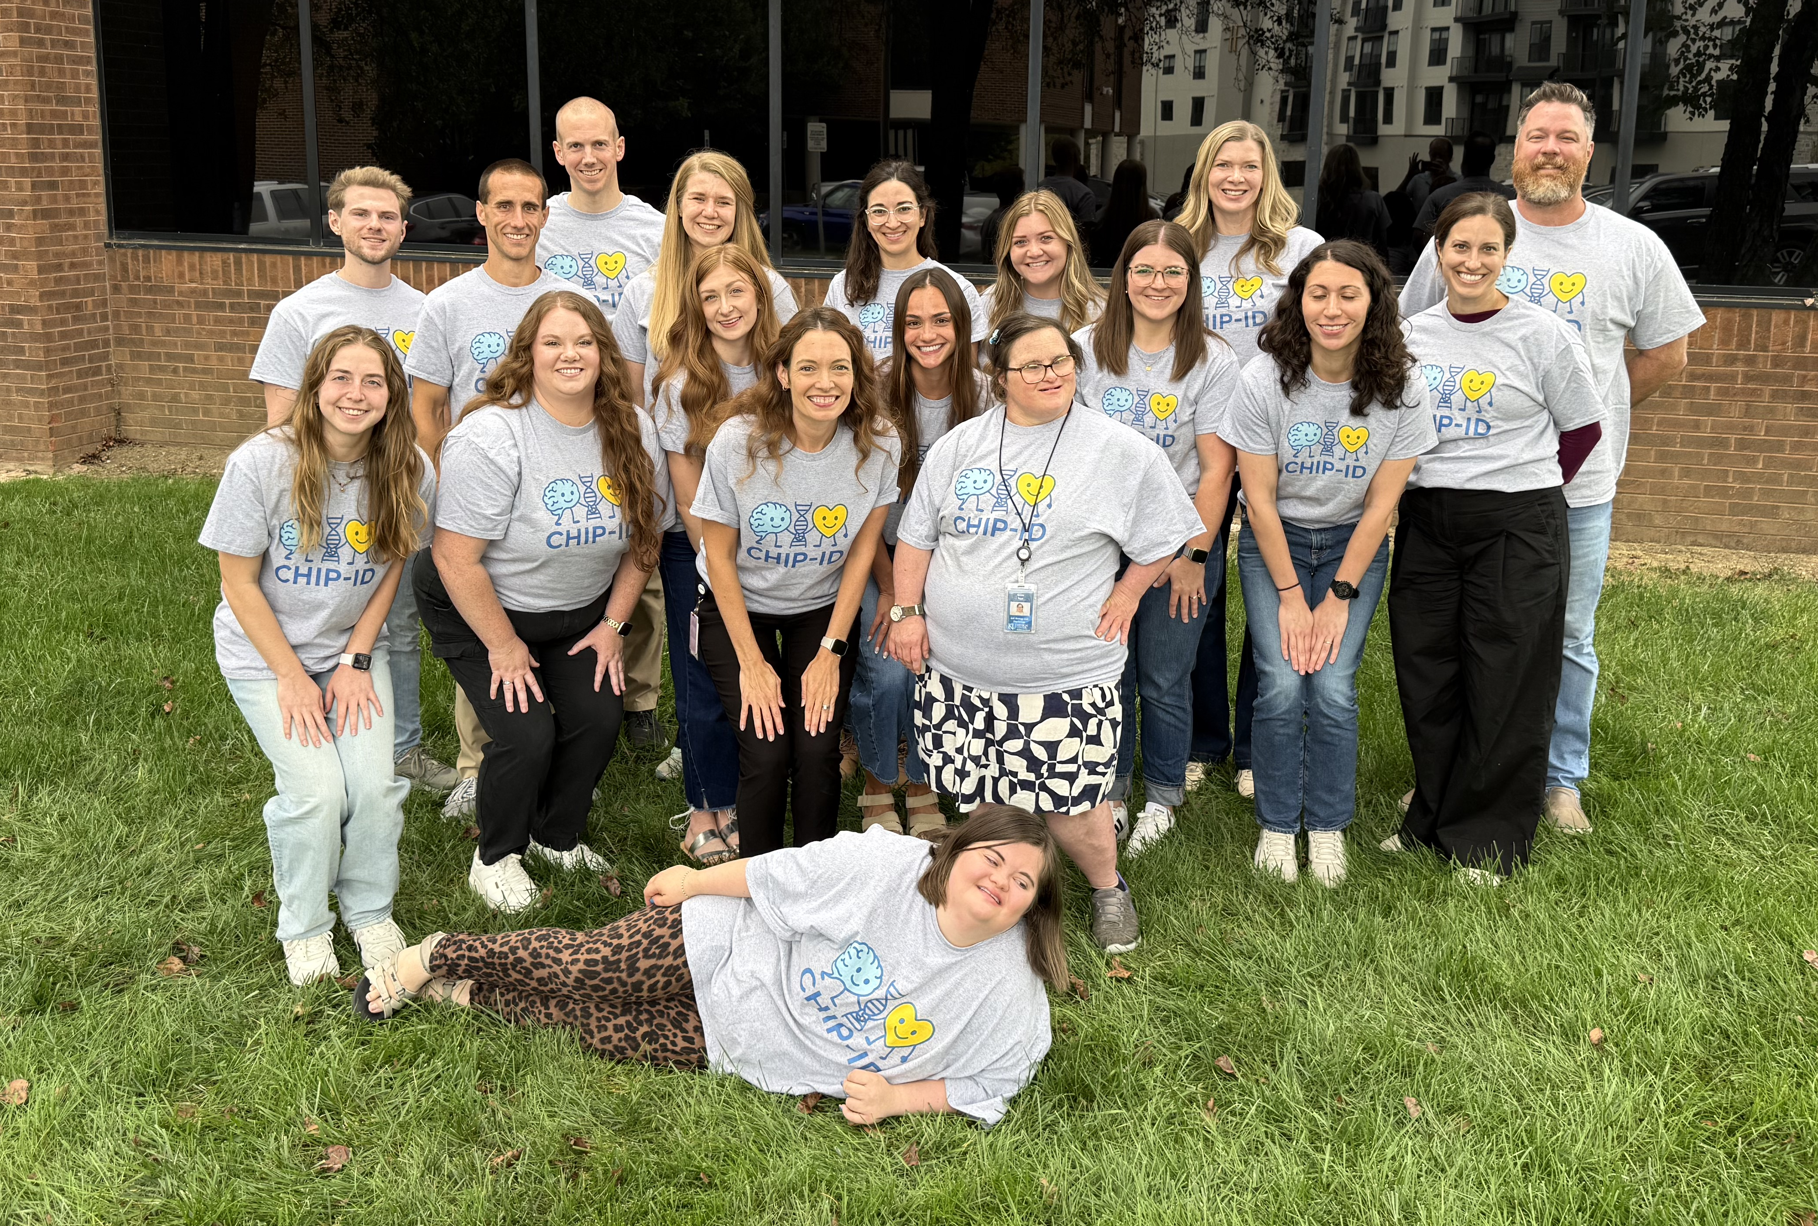
Resources
NIA Workout to Go
NIA Exercise Guide
Special Olympics Fit5
CDC STEADI Brochure
Home Safety Checklist
KU V-FIT Virtual Exercise

