Slide 1
Fall Prevention Strategies – A Team Effort
Planning – Preventing – Training
Presented By: Brenda Rice, Risk Control Advisor
IMA Financial Group

Slide 2
agenda
INTRODUCTION
PHYSICAL MOBILITY
MEDICATION MANAGEMENT
ENVIRONMENTAL SAFETY
SAFE PATIENT HANDLING
FALL PREVENTION TASK FORCE
Notes:
Fall prevention is a Team Effort! Understanding why falls or other adverse events occurs is key to minimizing risk to staff and Person Served. The presentation will focus on four primary fall prevention risk factors and how to manage them – Physical Mobility – Medication Management – Home Safety – Safety in the Community. The training will cover safe assistive methods and devices to help with walking, transferring, and assisting from fall to the floor. Along with implementation of a Fall Prevention Task Force with goals to enhance incident investigation and continued education factors for everyone.

Slide 3
Focus – Concerns
Falls in DDS Population
Nationally about 30% of the population with I/DD fall each year
Approximately 2/3 of the population will have more than 1 fall a year
15% of the falls result in serious injury
Over half of the falls happened to Females
The 3rd week of September is Fall Prevention Week in the United States.
Notes:
Communication and Fall assessments are important to continue to mange the increase. Covid was a setback along with basic aging population. Assisted Living organizations are also dealing with a high increase in falls.

Slide 4
Physical Mobility
Fear of Falling Eye-sight or hearing issues
Attention Focus
Balance / Strength
Medication Change
Dehydrated
This Photo by Unknown Author is licensed under CC BY-NC-ND
Notes:
Some days better than others. . . Be prepared to make modifications daily.

Slide 5
Medication Management
Quick Movement – Change in Vitals
Multiple Medications
New Medication
Communication
This Photo by Unknown Author is licensed under CC BY-SA
Notes:
Stand up and quickly fall – change in vitals?
Multiple medications given at one time and the side affects may make Clients unsteady on their feet.
Communication to all staff involved with care of the medication change.

Slide 6
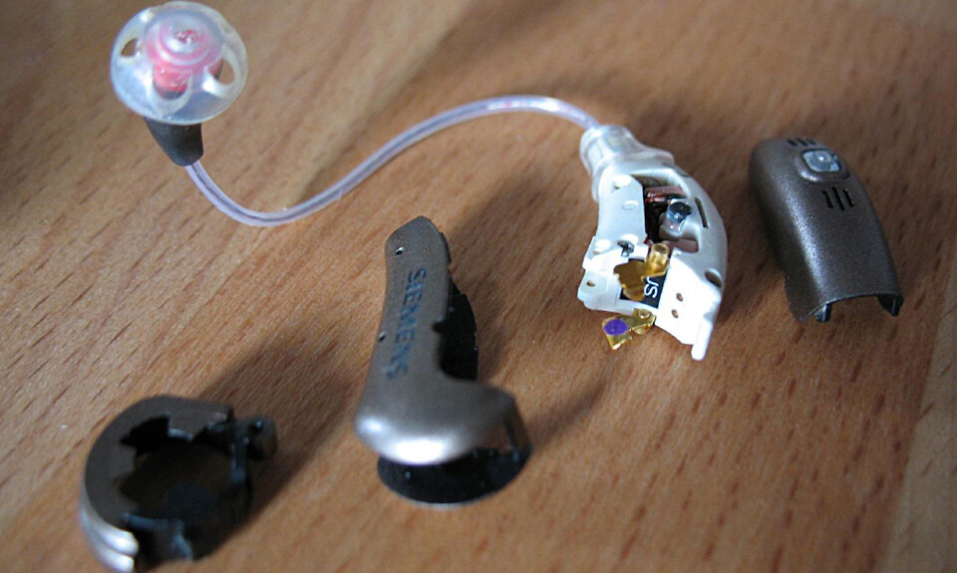
Vision & Hearing Impairment
Impaired Depth Perception
Poor edge contrast sensitivity
Inability to communicate concerns
Don’t hear communication
Loss of hearing – loss of balance
This Photo by Unknown Author is licensed under CC BY-SA
This Photo by Unknown Author is licensed under CC BY-SA-NC
Notes:
Hearing & Eyes can impact fall incidents the fall prevention assessment form can do quarterly games to challenge eyes and ears.
Example – think about situations where dental work causes issues and the consumer has difficulty communicating – how do they know they can’t see correctly or that blurred is not normal?

Slide 7
Other Risk Factors
Dizziness can be in place for as long as 25-30 minutes after moving from lying or sitting to standing
Dizziness
Low Blood Pressure
Fatigue
Nutrician
Delirium (sudden confusion)
Dehydration
Urinary Tract Infection
Daily Events

Slide 8
Environmental Safety
Rugs
Cords
Shoes vs barefoot at home
Routes clear and easily accessible
Unstable furniture
Bed and Toilets not the correct height
Floor texture change
Not enough grab bars
Inadequate lighting
This Photo by Unknown Author is licensed under CC BY-SA-NC
Notes:
Home and work safety assessments – involve the consumers with safety walks – teach them to identify concerns who to tell and how to correct. The more they communicate with us the better.

Slide 9
Different Levels
Stepping Up or Down
Uneven building entrances
Vehicle Safety
Wheelchair vs Walking on
Communication

Slide 10
Personal Cares
Rugs
Grab Bars
Footwear for Consumers
Dry Mopping
Shower Chairs
Cloth Lined Gait Belt
Notes:
Aqua socks for Consumers to wear to allow them to feel safe and have additional fall protection
Line a gait belt with a towel to allow for protection on bare skin

Slide 11
Rehabilitative Strategies
Walking
Training geared toward – balance – gait – strength – flexibility
Good footwear with slip resistant surface and fits properly
Sitting Exercise Program
Notes:
options for day activities – hand eye coordination

Slide 12
Safe Patient Handling
Resident feet reach the floor for balance
Walking assistive devices – gait vs. walking belt
Walkers, half rails, poles, shepherds hook, grab bars
Ability Assessments – admission, annually, after fall, etc.
This Photo by Unknown Author is licensed under CC BY-SA-NC
Notes:
Goal to prevent a liability claim by keeping individual safe and adhere to dignity guidance – body parts and clothing are not handles. Abuse and neglect come into play more when we improperly handle when assisting.

Slide 13
Liability Exposure
Improper Lifting Techniques
Injury to Consumer
Enhance Fear
Workers Compensation Exposure

Slide 14
Assisting a Falling Resident
1. Protect yourself. 2. Control the fall. 3. Protect the head. 4. Get help.
Notes:
if the resident starts to fall, move behind and grab the transfer belt or pants. Get in a lunge position with your knees bent and back straight. Pull the resident close to your body. Let them slide down your torso, front leg. Go to the floor don’t hold them

Slide 15
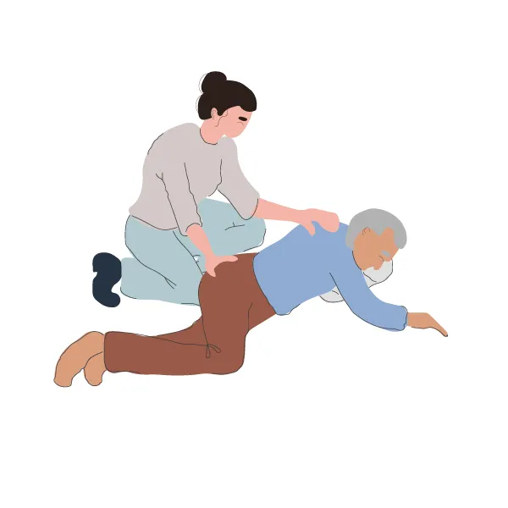
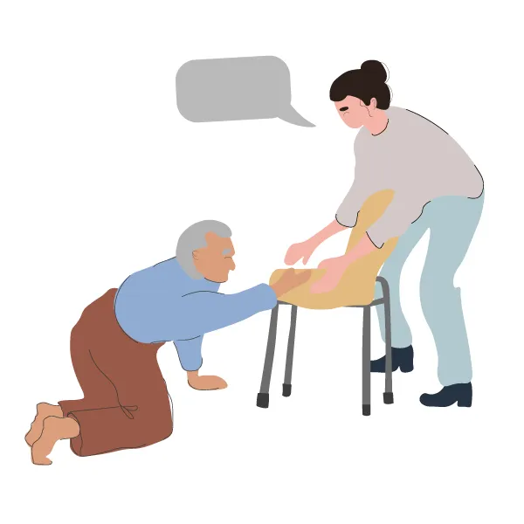
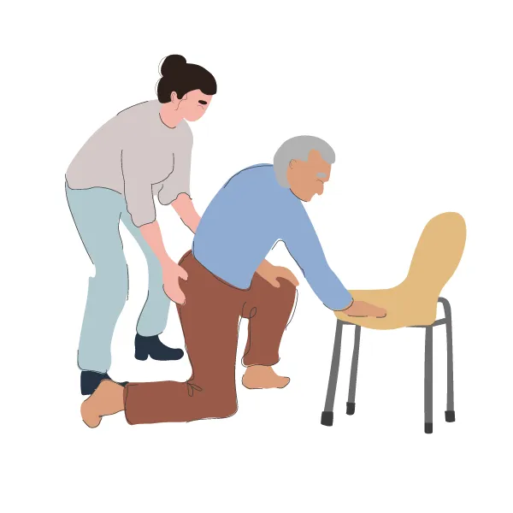
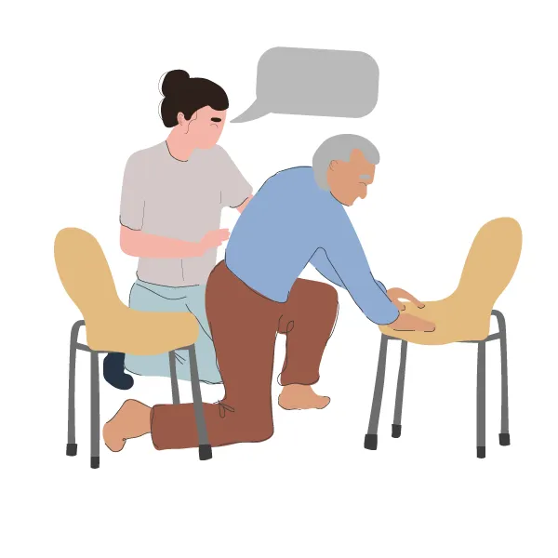
Assisting Up
Notes:
Goal to give back independence. Behaviors create challenges of Individuals Served to place themselves on the floor – no harm – leave them there as they may be able to get up. Work with communication cues to have them assist themselves up in this similar manor with a gait belt to prevent injury and preserve dignity.

Slide 16
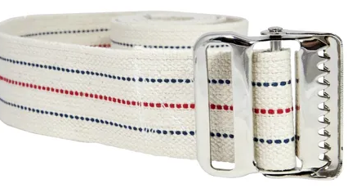
Gait Belt
Utilized to prevent injury
Provides dignity
Assist to lower to the floor
Does not require a doctor's approval
Variety of belts
Notes:
Gait Belt Training Video
https://www.youtube.com/watch?v=1ElLzPnOYsg

Slide 17
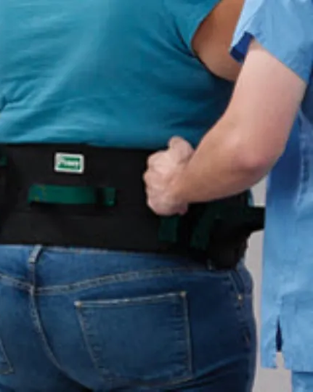
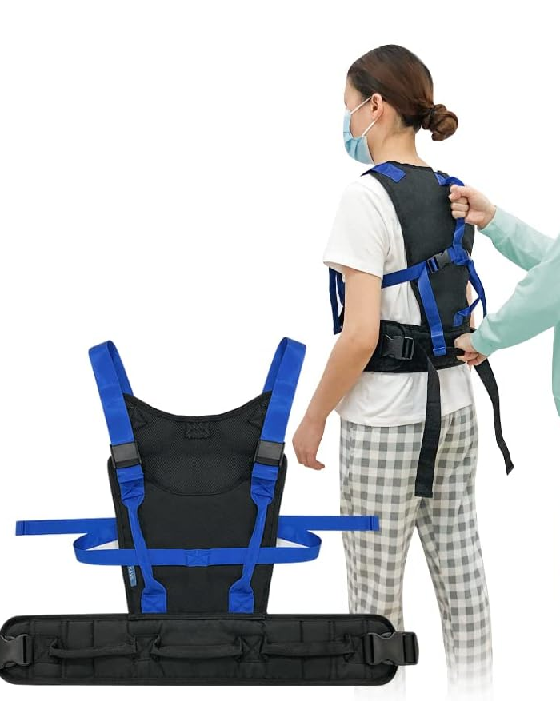
Walking Belt & Vest
Notes:
Variety of tools – not all vendors are familiar with them – utilize additional resources like CDC Steadi program or VA Safe Patient Handling program

Slide 18
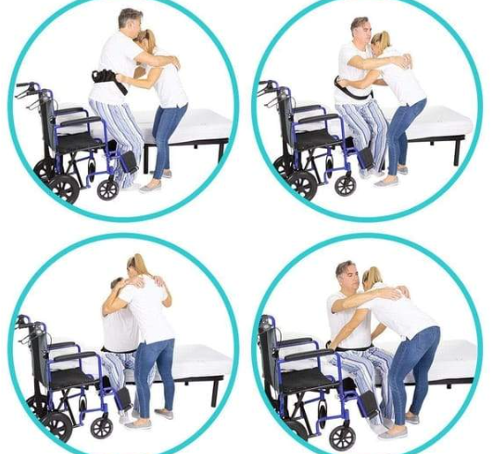
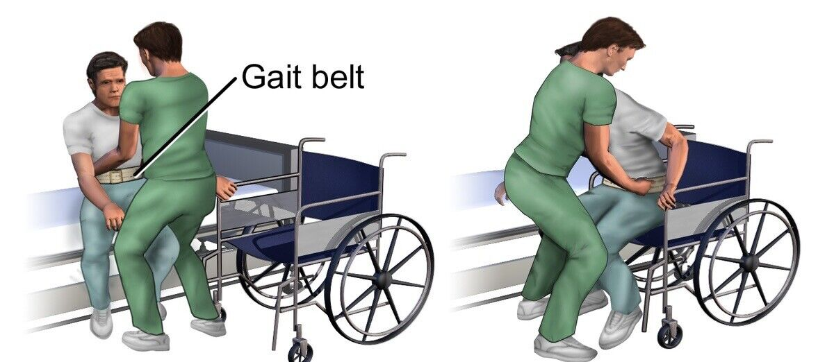
Gait Belt Transfer
Notes:
Correct vs Incorrect plays a big part in preventing falls, injuries to both parties.

Slide 19
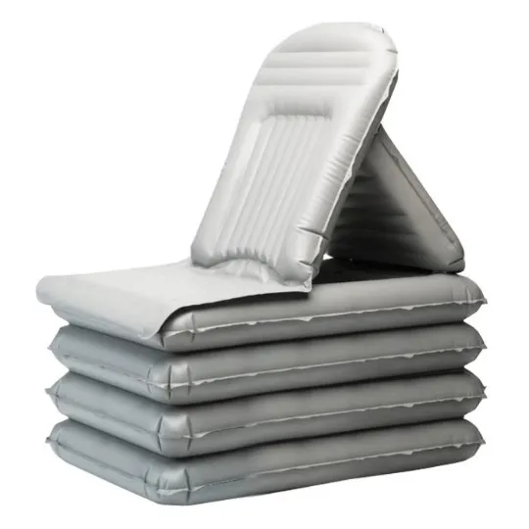
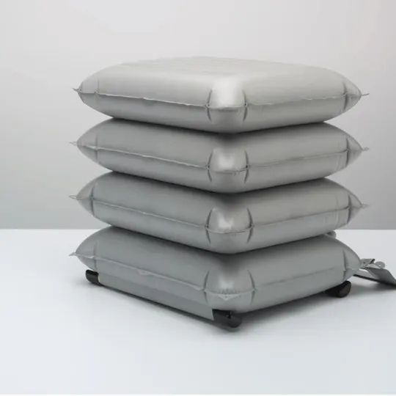
Transfer from Floor
Full Body Lift
Air Chair Devices
Call 911
Notes:
Best option from floor is full body lift – they do go low enough – obviously takes about 3 people to assist someone from the floor

Slide 20
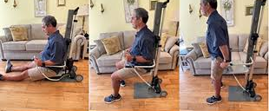
InDeelift

Slide 21
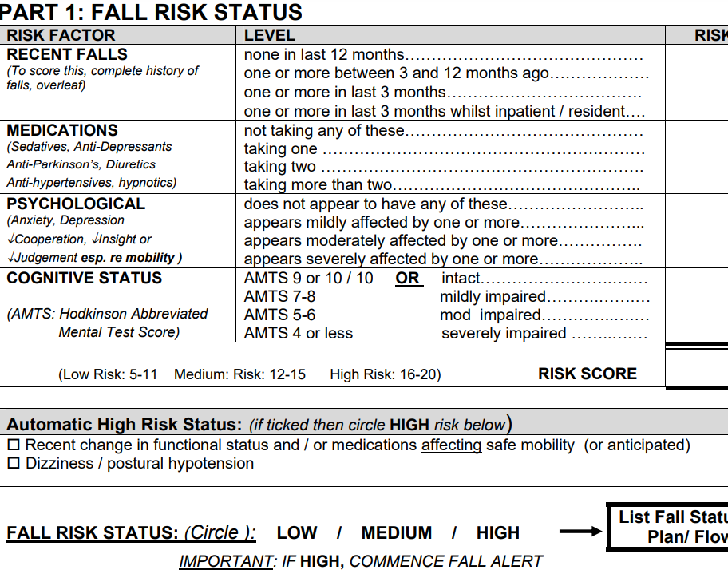
Fall Prevention Task Force
Fall Assessment
Timed get up and go test
Person rises from seated position
walks about 10 feet
turns
walks back and sits down
Watch for unsteady gait and balance
Post Fall Huddle Form
Notes:
include direct support staff, case worker, transportation, maintenance, day program for an overview of everyones opinion on a Consumers capability . Everyone has a different level of care to provide and different obstacles.

Slide 22
S.T.O.P
S Stop
T Think
O Observe
P Prevent
Notes:
Utilize Data to create an Care Plan for each consumer
Routine testing for site, hearing, balance,
Communication

Slide 23
Resources
Centers for Disease Control and Prevention (n.d.). STEADI Older Adult Fall Prevention Online Training for Providers. Retrieved from https://www.cdc.gov/steadi/training.html
Centers for Disease Control and Prevention (2013). STEADI: Webinar for health care providers [Webinar]. https://www.cdc.gov/steadi/training.html
Gait Belt Training Video
https://www.youtube.com/watch?v=1ElLzPnOYsg
RehabMart Supplies
https://www.rehabmart.com/post/transfer-belts-vests-choosing-the-best-for-your-needs
Association of University Centers on Disabilities
https://www.aucd.org/docs/publications/2016_0801_falls_brief_print-hi.pdf
Falls Risk Assessment Tool
file:///C:/Users/BKR/Downloads/b2b_1a_frat_pdf.pdf

Slide 24
Thank You
Brenda Rice, Risk Control Advisor
913-912-2932
Brenda.rice@imacorp.com

