Slide 1
HIPAA Haiku: Helping You Navigate HIPAA Privacy, Security, and Breach Notification Rules
Brooke Bennett Aziere

Slide 2
Brooke’s HIPAA Haiku
Enforcement will continue
Access is still a problem
Beware of breaches

Slide 3
Agenda
Introduction to HIPAA
The HIPAA Privacy Rule
The HIPAA Security Rule
The Breach Notification Rule
How does this all apply to I/DD service providers?
Good Privacy Practices
Hot Button Issues

Slide 4
Exchanging Health Information in the 21st Century

Slide 5
The Health Insurance Portability and Accountability Act of 1996 – HIPAA
Creates national minimum standards to protect patient health information (PHI)
Goal: Improve the efficiency and effectiveness of electronic information transfers used in the provision, management, and financing of health care
Rules under HIPAA:
The Privacy Rule
The Breach Notification Rule
The Security Rule

Slide 6
HIPAA – The Terminology
Covered Entity
Protected Health Information (PHI)
Electronic Protected Health Information (EPHI)
Use and Disclosure
Minimum Necessary
Business Associate
This Photo by Unknown Author is licensed under CC BY-SA-NC

Slide 7
Covered Entities
The individuals or organizations who must comply with HIPAA rules and regulations
Health Plans
Healthcare Clearinghouses
Healthcare Providers who conduct electronic transactions related to third-party billing

Slide 8
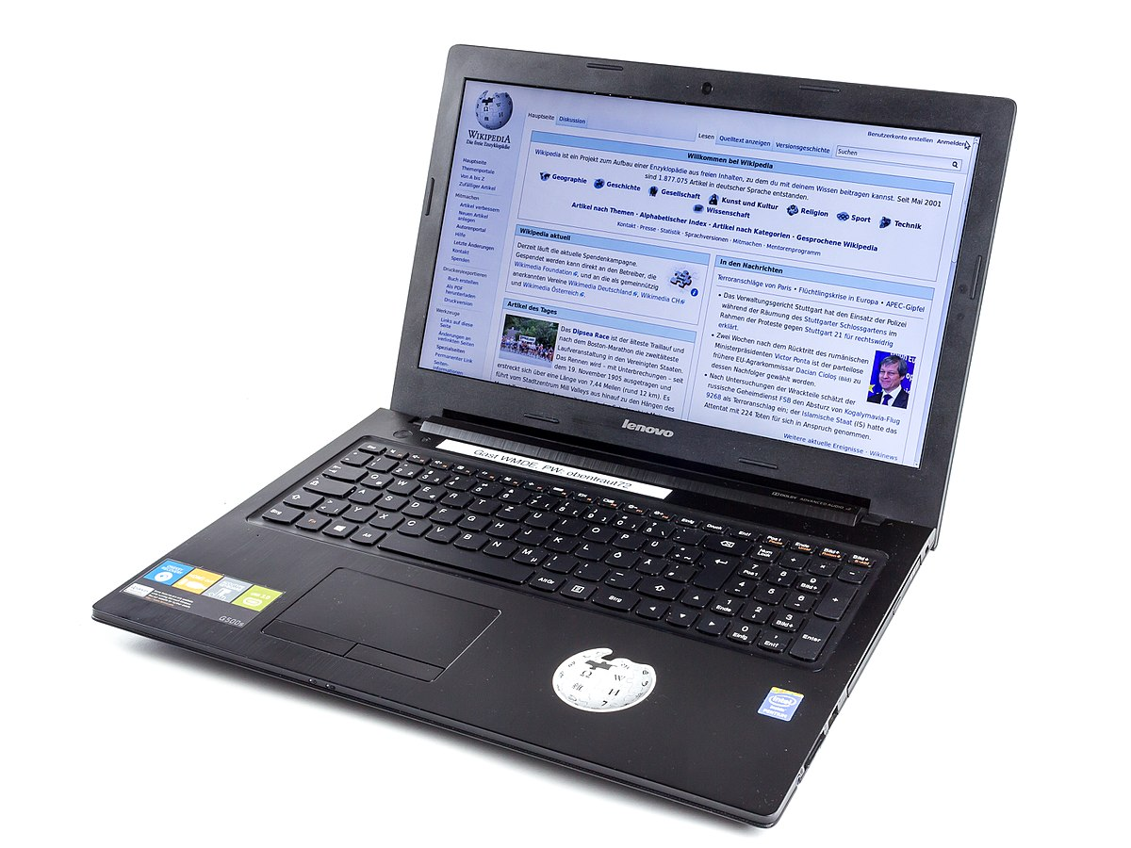
Protected Health Information – What is it?
This Photo by Unknown Author is licensed under CC BY-SA-NC
Individually Identifiable Information (including a
client’s name, birth date, SSN, health insurance ID number,
and medical record number)
Created or received by a covered entity
Relates to past, present, or future health, health care, or payments for health care
Identifies the individual directly or indirectly
PHI can be paper, electronic, or oral.
Examples:
Conversations with clients
Info in Patient-Centered Support Plan
documents
Info in Targeted Case Management
documents
This Photo by Unknown Author is licensed under CC BY-SA

Slide 9
The 18 HIPAA Identifiers
Names
All geographic subdivisions smaller than a State
All elements of dates (except year)
Telephone numbers
Fax numbers
Electronic mail addresses
Social security numbers
Medical record numbers
Health plan beneficiary numbers
Account numbers
Certificate/license numbers
Vehicle identifiers and serial numbers, including license plate numbers
Device identifiers and serial numbers
Web Universal Resource Locators (URLs)
Internet Protocol (IP) address numbers
Biometric identifiers, including finger and voice prints
Full face photographic images and any comparable images
Any other unique identifying number, characteristic, or code

Slide 10
Use and Disclosures
“Use”: the sharing, employment, application, utilization, examination, or analysis of such information within an entity that maintains such information
“Disclosures”: the release, transfer, provision of access to or divulging in any manner of information outside the entity holding the information

Slide 11
Minimum Necessary
Covered entities must limit the PHI used or disclosed to the minimum necessary to achieve the purpose of the use or disclosure
Identify which members of workforce require which items of PHI and limit access accordingly

Slide 12
Protected Health Information – Minimum Necessary
Minimum necessary standards do not apply:
Disclosure to the clients themselves
Disclosures necessary for treatment, payment, and healthcare operations
Disclosures authorized by the client
Certain disclosures required by law
This Photo by Unknown Author is licensed under CC BY-SA

Slide 13
Business Associates (BA)
A person or entity who, on behalf of a covered entity, creates, receives, maintains, or transmits PHI
BAs do not include members of the covered entity’s workforce.
With limited exceptions, a covered entity may not disclose PHI to a BA without “satisfactory assurance” that the PHI will be appropriately safeguarded. → Business Associate Agreements
The BA Rules do not apply to disclosures
by one covered entity to another healthcare provider concerning treatment of the client, or
by one covered entity to a second covered entity for payment activities of the second covered entity.

Slide 14
Business Associates
OCR holds Business Associates directly liable for HIPAA violations, but in limited circumstances:
Impermissible uses and disclosure of PHI
Failing to
provide records and compliance reports
cooperate with investigations and compliance reviews
permit HHS Secretary access to information
comply with the Security Rule
provide breach notification to covered entity or BA
disclose EPHI to covered entities when appropriate
make “minimum necessary”
provide accounting of disclosures
enter BAA with subcontractors
comply with implementation standards for BAA
take reasonable steps to address material breach or subcontractor’s violation of BAA
This Photo by Unknown Author is licensed under CC BY-SA-NC

Slide 15
How does this apply to you?
Business Associate Agreements (BAA)
Covered entities must enter into contracts with their BAs to ensure that their BAs appropriately safeguard PHI.
Service contracts include non-medical services as HIPAA-covered services.
By signing BAAs, I/DD service providers become subject to the HIPAA requirements for BAs.

Slide 16
How does this all apply to you?
By entering BAAs and becoming business associates, I/DD service providers become directly liable for HIPAA violations.
This Photo by Unknown Author is licensed under CC BY-NC-ND

Slide 17
The HIPAA Privacy Rule
Regulates how and when covered entities
may use and disclose PHI
Prohibits the use and disclosure expect as expressly permitted or required by HIPAA
Substantial barriers to uses and disclosures for purposes other than healthcare
This Photo by Unknown Author is licensed under CC BY-SA-NC

Slide 18
The HIPAA Privacy Rule – Basic Rules
Permitted Uses and Disclosures
Make “good faith” effort to receive patient’s acknowledgement of Notice of Privacy Practices
Obtain Authorization for uses and disclosures unless an exception exists
No Authorization required when
use and disclosure is for public policy reasons
PHI is de-identified or part of a limited data set
This Photo by Unknown Author is licensed under CC BY-SA-NC

Slide 19
Patient Right to Access
HIPAA guarantees several patient rights.
OCR Right to Access Initiative
Vigorous enforcement of patient right to access copies of records promptly and without being overcharged.
45 Right of Access cases settled since 2019

Slide 20
The HIPAA Security Rule
Only applies to electronic protected health information (EPHI)
Requires accurate and thorough risk analysis and documentation
To comply, covered entities must:
Ensure the confidentiality, integrity, and availability of all EPHI;
Protect against reasonably anticipated threats to the security or integrity of the EPHI;
Protect against reasonably anticipated impermissible uses or disclosures; and
Certify compliance by entire workforce.

Slide 21
Security Risk Assessment Tool
Security Risk Assessment
A covered entity or business associate must conduct an accurate and thorough assessment of the potential risks and vulnerabilities to the confidentiality, integrity and availability of EPHI held by the organization.
45 CFR 164.308(a)(1)(ii)(A)

Slide 22
Security Risk Assessment Tool
Components of Security Risk Assessment
Identify all EPHI within your organization
Identify sources of EPHI
Identify Identifying human, natural, and environmental threats to information systems that contain ePHI.

Slide 23
Security Risk Assessment Tool
Security Risk Assessment Tool - https://www.healthit.gov/topic/privacy-security-and-hipaa/security-risk-assessment-tool
A place to track practice locations, assets, Business Associates, attached documents, etc.
Assessment with guidance related to the responses and references to the HIPAA Security rule citation
Threats & Vulnerabilities
Rating section presents the vulnerabilities that may apply to a practice
List of related threats that must be rated for the likelihood they may occur and the impact they would have should they occur
Summary lists: Areas of Success and Areas for Review
Summary and Risk reports

Slide 24
Security Risk Assessment Tool
Enhancements in Version 3.4
Glossary Page and Embedded Definitions
Remediation Report
Place to respond to risk and outline plan to move forward
Updated references for HICP 2023 Edition
Content version warning
Ability to copy text and improved PDF format
Alternative excel workbook

Slide 25
Scenario 1
Dan, an I/DD staff member, was leaving work to go to his son’s baseball game. He was running late but made it to the game just in time. Upon arriving, he slid his briefcase under the bleacher so that he could focus on watching his son play. As he got home that night, Dan realized that he had left his briefcase underneath the bleacher. He raced back to the baseball field, only to realize it was gone—including his unencrypted laptop which had the PCSPs that he had just completed on it. Dan mentioned to his boss that he needed a new computer and that a few documents were on the one that he had lost, but Dan’s boss did not take any further action on the matter.
Question: What should the boss have done in order to comply with HIPAA and the Business Associate Agreement to which the I/DD service provider was bound?
Notes:
Upon learning that the documents were lost, Dan’s boss should have notified both the beneficiary to whom the PCSPs belonged and the HHS Secretary that the breach had occurred. Within 60 days of the breach, Dan’s boss should have notified beneficiary. To comply with the BAA, Dan’s boss should have notified KDADS of the security incident within 10 days of learning about the lost PHI. Here, it is unlikely that the I/DD service provider needed to notify the media.

Slide 26
The Breach Notification Rule
Breach – the acquisition, access, use, or disclosure of PHI in a manner not permitted by the Privacy rule which compromises the privacy or security of PHI
Covered entities and their BAs must provide notification that a breach of unsecured PHI has occurred.
Notice must be given to the individual, the HHS Secretary, and sometimes even the media.
Must notify individual in no more than 60 days after the earlier of actual discovery of the breach or the date on which the covered entity or BA would have known with reasonable diligence

Slide 27
The Breach Notification Rule
KDADS Business Associate Agreement requires that its BAs
Notify KDADS of any security incident which compromises the PHI within 10 days of becoming aware of such incident, and
Notify KDADS of a security breach or disclosure of PHI within 10 days of learning of the breach.
I/DD service providers must comply with these notification requirements.

Slide 28
When do I/DD service providers encounter PHI?
I/DD service providers encounter PHI in their relationships with the following entities:
COMCARE
CDDOs
Kansas Dept. on Aging and Disability (KDADS)
Emergency Medical Services (EMS)
Any other departments that collect, maintain, and transmit PHI in its daily provision of care to the public.
This Photo by Unknown Author is licensed under CC BY-ND
This Photo by Unknown Author is licensed under CC BY-SA-NC

Slide 29
When do I/DD service providers encounter PHI?
Person-Centered Support Plans (PCSPs)
Beneficiary name
Beneficiary address
Social security number
Health insurance ID number
Medical record number
Medical assistance (ex: administering medication or assisting with cathing)
Personal care services

Slide 30
When do I/DD service providers encounter PHI?
Targeted Case Management (TCMs) – provide beneficiary with access to medical, social, educational, and other needed services
Documenting an activity log as required by KMAP
Gathering information from beneficiary’s family members, medical providers, social workers, and educators to form a complete assessment
Identifying beneficiary needs and documenting such needs
Providing referral and related activities that link the beneficiary with medical, social, and educational providers

Slide 31
When do I/DD service providers encounter PHI?
Documentation and storage of the information gathered from the PCSPs and TCMs
Have you taken privacy and security measures?
Communication among providers regarding care and assessments provided through PCSPs and TCMs
Are you careful about where and to whom you discuss the beneficiary’s PHI?
How are I/DD service providers communicating amongst themselves?
Poses serious risk of PHI getting stolen.

Slide 32
Disclosure of PHI as Required by Law
May disclose PHI to a state-designated Protection and Advocacy (P&A) system that requests access to records in carrying out their protection and advocacy functions
Disability Rights Center of Kansas (DCR)
May disclose PHI to P&As where another federal, state, or other law mandates such disclosures
Minimum necessary standard does not apply.
Disclosures about abuse, neglect, or domestic violence entail additional privacy requirements.

Slide 33
Scenario 2
Barbara was an I/DD staff member who had provided services to Rebecca, an older beneficiary, for several years. The two formed a friendship, but Barbara was retiring soon. On Barbara’s last day at Rebecca’s house, the two took a picture together. That night, Barbara posted on Facebook, including a caption that explained how much Rebecca had impacted Barbara’s life and the growth she had seen in Rebecca while working with her. Barbara included Rebecca’s full name and marked Rebecca’s address as the location of the photo.
Question: Under HIPAA, has Barbara improperly disclosed PHI?
Notes:
Yes, Barbara has violated HIPAA by exposing PHI in several ways. First, the photo of Rebecca can be considered PHI. (see Slide 8 – HIPAA Identifiers) “Full face photographic images” are HIPAA identifiers and can be considered PHI. Even if Barbara posted nothing else, a photo of Rebecca’s face taken in Barbara’s work capacity could be considered exposure of PHI. Second, Barbara included Rebecca’s full name and address. This clearly demonstrates a HIPAA violation. Even when relationships feel personal, exposing information like this on social media constitutes a HIPAA violation.

Slide 34
What do you need to do to comply with HIPAA?
Be aware of your clients’ rights to access, amend, and restrict their PHI
Increase security measures for protecting client records
Ensure that your business associates uphold the same duty to protect your clients’ PHI
Encourage employees to treat all records, medical and non-medical, as confidential
Under the BAA, they may be HIPAA-covered!
Establish standards not to disclose financial or other client information except as necessary for authorized purposes
Document. Document. Document the measures that you take!

Slide 35
Scenario 3
Amy, an I/DD staff member, was providing services to a beneficiary during the day and needed to leave five minutes prior to the next staff member, Sarah, coming to provide services at night. Because Amy had to leave before Sarah arrived, Amy texted Sarah on both of their personal cell phones to provide an introduction to the beneficiary and his Person-Centered Support Plan, including the beneficiary’s name, address, and instructions for administering his medication. Sarah received the text message and was able to provide the proper services to the beneficiary, just as he needed.
Question: Has this communication between Amy and Sarah complied with HIPAA requirements?
Notes:
No, Amy and Sarah’s communication did not comply with HIPAA, because the two were sharing PHI on their personal cell phones. Under the HIPAA Security Rule, EPHI should not be shared on an unencrypted device. I/DD service providers must take security measures to ensure that PHI is not exposed in situations like this. Sharing beneficiary information on personal devices will constitute a HIPAA violation.

Slide 36
What do you need to do to comply with HIPAA?
Security Obligations
Make Security Risk Management and Risk Assessment a priority NOW
Conduct an accurate and thorough assessment of the potential risks and vulnerabilities to the confidentiality, integrity, and availability of EPHI.
The HIPAA Security Rule requires that you protect against reasonably anticipated
Threats and hazards to the security or integrity of the EPHI that is created, received, maintained, or transmitted, and
Any impermissible uses or disclosures.

Slide 37
Scenario 4
An I/DD service provider recently updated its website. During the update, one of the provider’s internal applications was moved from a private, secure server to a public server. Moving the application from the private to public server caused a flaw in the provider’s software code, allowing internet users to access all the EPHI of the provider’s beneficiaries, including names, addresses, social security numbers, and treatment information.
Question: While this is clearly a HIPAA violation, what could and should the provider have done differently to ensure something like this did not happen?
Notes:
The provider could have avoided this HIPAA violation by practicing security risk management and conducting a risk assessment. If the provider had done the following prior to updating the website, he could have anticipated the breach: installing firewalls for data integrity, encrypting internet transmissions of PHI, maintaining password protections on files containing PHI, and limiting access to patient files based upon job duties. If the provider had conducted a risk assessment, he could have informed the person updating the website that there was PHI that could not be exposed. The provider should have been proactive!

Slide 38
What do you need to do to comply with HIPAA?
Security Risk Management
Identify all EPHI and systems storing EPHI, including equipment, servers, copy machines
Identify and prioritize risk
Protect EPHI against those risks via Risk Management process
Coordination between IT, HIPAA/Compliance, Materials/Equipment Manager
Reasonable and appropriate administrative, physical, and technical safeguards
Physical – facility access controls
Technical – access controls (user ID; automatic logoff)

Slide 39
What are you contractually bound to do?
BAA General Obligations
Comply with HIPAA – 45 C.F.R. parts 160 and 164
Only use and disclose PHI to perform functions, activities, or services for, or on behalf of KDADS
Take disciplinary action against workforce members that violate the BAA
Ensure compliance by workforce, agents, and subcontractors
May not release, reproduce, distribute, or publish PHI without prior written permission of KDADS (unless acting as a covered entity)

Slide 40
What are you contractually bound to do?
BAA Security Obligations
Ensure security safeguards are in place
Adopt written policies and procedures to implement the safeguards
Implement technical policies and procedures as required by the Secretary of Health and Human Services’ most current guidance
Ensure compliance by subcontractors
Comply with 45 C.F.R. 164.306 and 164.316
This Photo by Unknown Author is licensed under CC BY-NC-ND

Slide 41
What are you contractually bound to do?
Privacy Obligations
Use and disclose of PHI only as described in the BAA
Implement administrative, physical, and technical safeguards to protect PHI
Recognize KDADS’s ownership of PHI
Notify KDADS of any security incident which compromises the PHI within 10 days of becoming aware of such incident
Notify KDADS of unauthorized use or disclosure of PHI within 10 days of learning of the breach
Comply with HIPAA transmission standards
Designate an employee as custodian of PHI
Provide access to PHI
Provide HHS with documents verifying HIPAA compliance
Record disclosures and provide record to KDADS

Slide 42
I/DD Service Providers – Good Privacy Practices
Put papers with PHI in a secured area
Do not leave PHI exposed where others can see the content
Discuss PHI in private
Do not discuss in a public area where people can overhear you
Use passwords to minimize access to computer files
Ensure computers are locked when leaving desks
Minimize PHI in emails and include as little info as possible
Protect fax machines that will receive PHI and put them in a secure area
Train employees
This Photo by Unknown Author is licensed under CC BY

Slide 43
Hot Button Issues – OCR Enforcement + Compliance Actions
United Healthcare Insurance Company (Aug. 24, 2023)
Did not respond to an individual’s request for copy of their medical record until 7 months later after OCR initiated its investigation
$80,000 settlement
David Mente, MA, LPC (May 8, 2023)
Denied a father (personal representative) a copy of his three minor children’s medical records in two instances, even OCR provided technical assistance
$15,000 settlement

Slide 44
Hot Button Issues – OCR Enforcement + Compliance Actions
Life Hope Labs (Jan. 3, 2023)
Daughter acting as a personal representative on behalf of her deceased father was did not receive timely access to father’s medical records
$16,500 settlement
Health Specialists of Central Florida (Dec. 15, 2022)
Daughter acting as a personal representative on behalf of her deceased father was denied access to father’s medical records
$20,000 settlement

Slide 45
Hot Button Issues – OCR Enforcement + Compliance Actions
iHealth Solutions, LLC (June 28, 2023)
Advantum Health – Kentucky-based BA that provides coding, billing, and onsite IT services
Unauthorized transfer of PHI from an unsecured server and failed to perform a security risk assessment
$75,000 settlement
MedEvolve, Inc. (May 16, 2023)
Data breach where a server containing PHI of 230,572 individuals was left unsecure and accessible on the internet
Failure to enter into a BAA with a subcontractor
$350,000 settlement

Slide 46
Snooping
Yakima Valley Memorial Hospital (June 15, 2023)
23 hospital security guards working in the emergency department used their login credentials to impermissibly access the medical records of 419 individuals without a job-related purpose
$240,000 settlement

Slide 47
Hot Button Issues – OCR Enforcement + Compliance Actions
Manasa Health Center, LLC (June 5, 2023)
Provides adult and child psychiatric services
Posted a response to the patient’s negative online review that included information regarding the patient’s diagnosis and treatment of their mental health condition
$30,000 settlement
New Vision Dental (Dec. 14, 2023)
Disclosed PHI, including patient names, treatment, and insurance information, in response to patients’ online reviews of the practice
$23,000 settlement

Slide 48
Brooke Bennett Aziere
baziere@foulston.com
316.291.9768
This information is not a legal opinion; it does not provide legal advice for any purpose; and it neither creates nor constitutes evidence of an attorney-client relationship. If you have questions or want more information, contact your legal counsel. If you do not have regular counsel for this type of legal assistance, Foulston Siefkin LLP would welcome the opportunity to work with you to meet your specific business needs.

