Slide 1
SPECIAL OLYMPICS KANSAS
The Programs and
Impacts of Special
Olympics Beyond Sports

Slide 2
This year marked 55 years of empowerment & growth for Special Olympics.

Slide 3
Unified
Age
School aged children
All ages can participate in Special Olympics Kansas events.
Young Athletes
& beyond
Age 2 - 7
No maximum age

Slide 4
Ability
All abilities can participate in Special Olympics Kansas events.

Slide 5
Not just a track meet
Special Olympics Kansas has long been more than a track meet and offers many sports year round.

Slide 8
Structure
Local Program
Region
State

Slide 9
WHY SPECIAL OLYMPICS

Slide 10
Philosophy & Vision
The results of participating in Special Olympics are:
Personal growth
Stronger families
United communities
An environment of equality, respect and acceptance

Slide 11
Athletes who participate in Special Olympics have:
Better health
Improved self-esteem and self-confidence
Improved strength, stamina, and motor skills
Greater rate of employment
Greater independent participation in their community

Slide 12
More than sports
Starting at a young age with inclusive programming that benefits both our athletes and their peers.
Young Athletes
Unified Champion Schools
Inclusive Health Programming
Health Education
Health Screenings
Developing skills that transfer beyond the field of play
Athlete Leadership
Creating a Unified Leadership approach

Slide 13
UNIFIED CHAMPION SCHOOLS

Slide 14
LEADERSHIP

Slide 15
HEALTH AND FITNESS

Slide 16
YOUNG ATHLETES

Slide 17
Friends and Fun

Slide 18
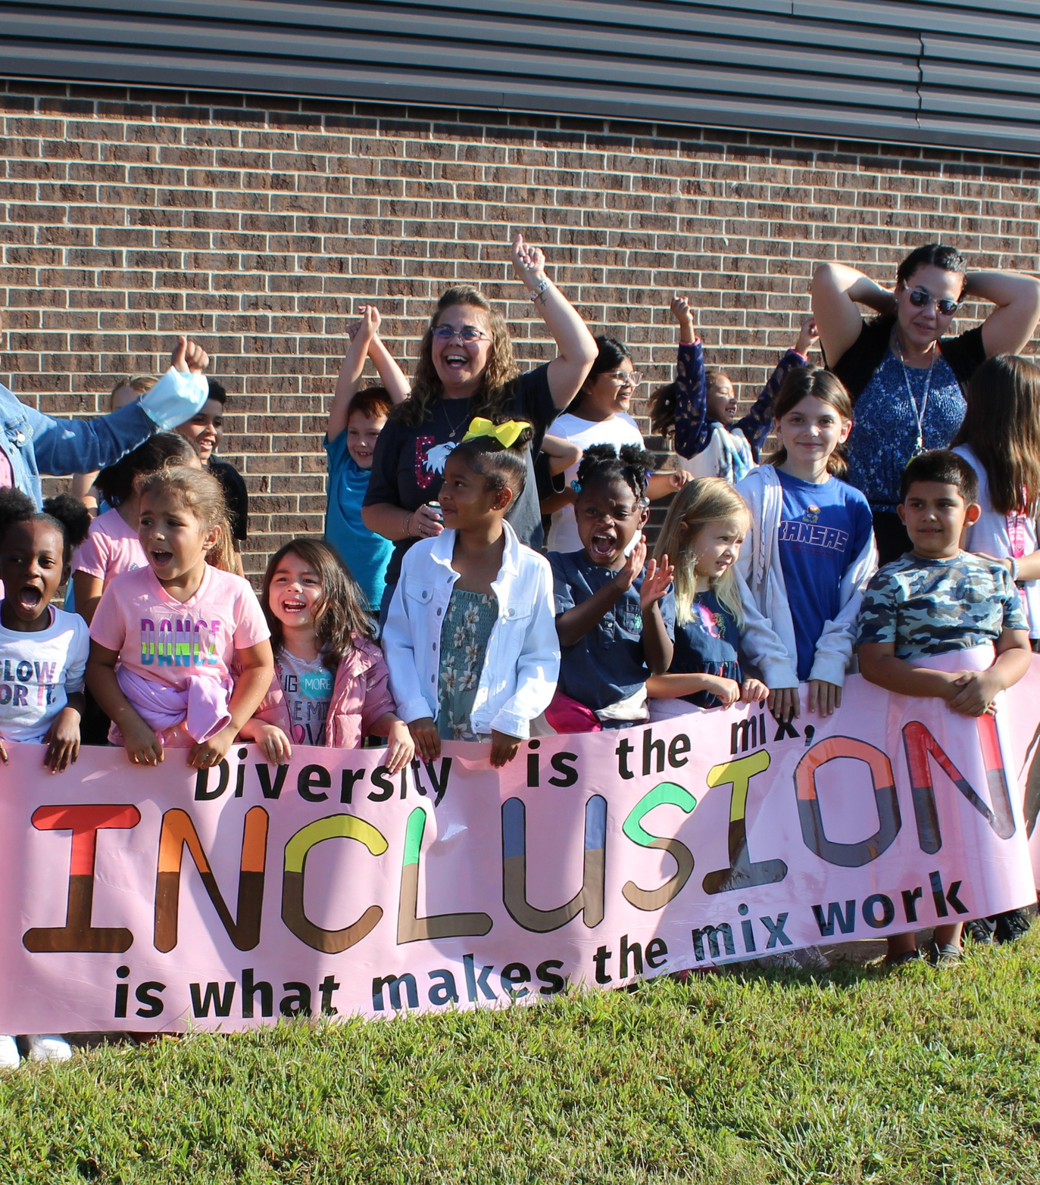
Barriers to Participation
Transportation/Location
Time
Cost
Physical limitations
Lack of interest…physical activity.
Other?
Challenges

Slide 19
SERVING ALL!
Everyday. Everywhere. Every age.

Slide 20
THANK YOU
SOKS.ORG

