Slide 1

The Wrap Around Impact of Revenue Cycle
Management on the IDD Provider Agency Mission
October 12, 2023

Slide 2
Agency Mission
Strategic Priorities
Profitability
Agency Growth
Client Care

Slide 3

Agenda
Revenue Cycle Management
General Concepts
Payment Timeline Impactors
Payment Throughput Impactors
Process Management
RCM Management Metrics and KPIs
RCM and Care Quality?
Technology Support
Q&A

Slide 4
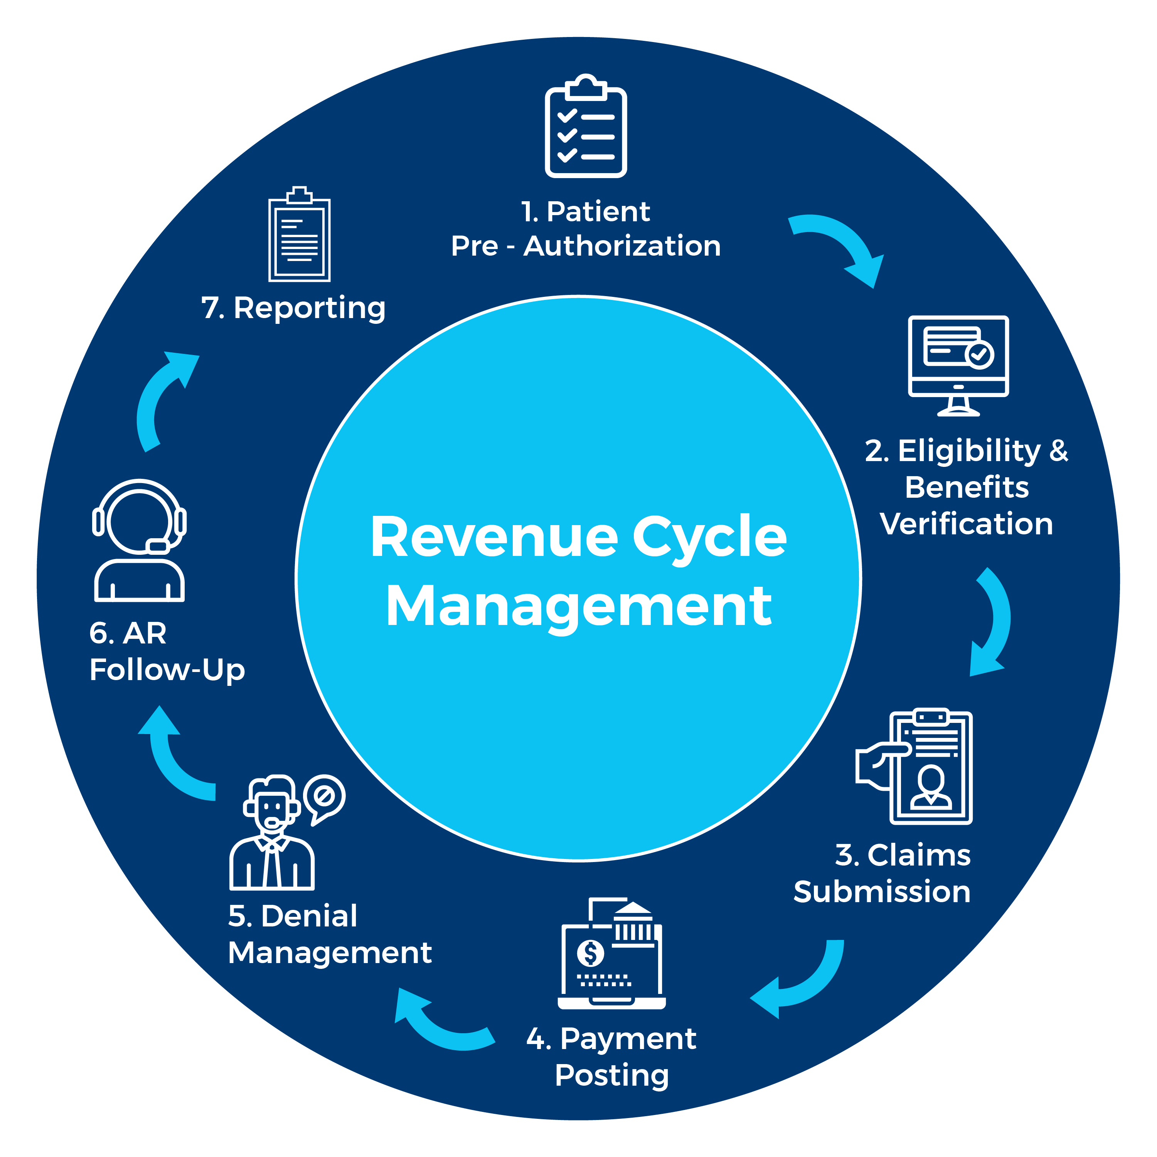
General Concepts
Revenue Cycle: the series of steps that must be executed to ensure you are paid for services quickly and completely
Revenue Cycle Optimization:
  Minimize Payment Timeline
  Maximize Payment Throughput
  Maximize the provision of authorized services

Slide 5
What impacts the payment timeline?
How quickly and correctly caregivers submit time – EVV/paper
How quickly you resolve unconfirmed shifts
How quickly you bill
Volume/timeline to resolve held billing (unconfirmed chists, system edits)
Method of billing (paper vs electronic)
Clean claims/invoices
Payment method used (paper checks vs EFT)
Processing time for payments (get the paper in the bank)
Cash posting (paper vs ERA; posting discipline)
Denials/exceptions volume
Denials/exceptions management
Advice: Shave off days wherever possible

Slide 6
What impacts payment throughput?
Contracts administration/compliance/enforcement
Clean claims/invoices
Timely submission
Correct payer
Authorization management
Service issues (private pay)
Advice: Goal should be to get paid 100% for services provided

Slide 7
Contracts Administration

Slide 8
Payer Contracts
No executed contract or no single case agreement?
  You will be paid at a lower out-of-network rate
Ensure the latest contract/amendment is loaded into the system
  Many payers pay at billed rates
  Back-bill to the effective date for new rates
Follow up on expiring agreements
  Chargemaster tool

Slide 9
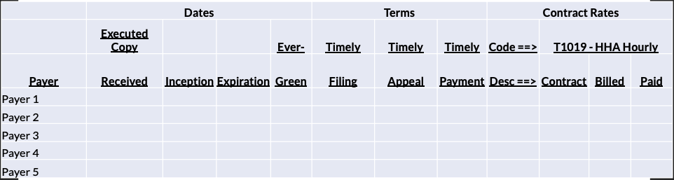
Contracts Summary (Chargemaster)

Slide 10
Eligibility

Slide 11
Eligibility Tips
Significant dollar risk for billing incorrect payer or ineligible client
  Up to 6 weeks of billing at risk
Obtain Medicaid/Insurance ID# prior to admission
Check Payer Eligibility at least semi-monthly
  SCDHHS says eligibility may change on a daily basis
Payer switches – need authorization from the new payer (may be retro)
An auth is not a guarantee of payment – eligibility is critical

Slide 12
Eligibility Complexities
Know the rules for Kansas LTSS/HCBS IDD Waiver Program:
  Must be 5 years of age or older
  Have Intellectual Disability that began before the age of 18
  Have a diagnosis of a Developmental Disability that began before the age of 22
  Must be determined program eligible by the
  Community Disability Determination Organization
  Meet the Medicaid long-term care institutional threshold score
  Be financially eligible for Medicaid

Slide 13
Eligibility Complexities
Managed Care Organization:
  Selected within 90 days of initial enrollment date
  Switches only allowed during annual open enrollment period

Slide 14
Authorizations

Slide 15
Authorizations
Second largest denial category after eligibility
Your intake and coordination staff should:
  Understand how to read and interpret authorization data elements.
  Understand the importance of verifying what is on the authorization to enter your system.
  Understand that the service you provide, and the schedule must match the authorization.
  Understand varying authorization formats to ensure that you understand what to look for on each authorization.
  Establish a process to maintain changed and expiring authorizations.

Slide 16
When in Doubt?

Slide 17
Claims Filing

Slide 18
Billing and Claims Submission
Refer to the payer’s billing manual
Bill on the correct form
Bill consistently on time – especially private pay
Put correct data in the correct format in the correct fields
Bill electronically when possible
Work EDI rejections
Get paid electronically when possible
  EFT, ERA, Credit Card

Slide 19
Payments and Denials

Slide 20
Payments
Enroll in electronic payment and remittance advices
Post payments promptly
Reconcile payments to invoices and follow up on discrepancies

Slide 21
Denials
Review as part of payment reconcilement process
Examples
  Eligibility, authorization disconnects
  Expired auths
  Other authorization discrepancies
Appeal promptly – timely appeal deadlines

Slide 22
Metrics and KPI’s

Slide 23
Metrics and Management
Aging Report
Billed vs Deposits vs Applied Payments
DSO
Expiring and Expired Auths

Slide 24
AR Aging Reports
The Aging Report will help you see which claims remain outstanding.
  If you missed working rejections or denials, these claims will be caught on your Aging Report. However, if applicable, your pre-billing held claims may not appear on the Aging Report since they have not yet been submitted for billing.
  This report is a tool for you to use to follow up on all open balanced claims.

Slide 25
Payment Peformance

Slide 26
Days Sales Outstanding (DSO)
AKA – Average Daily Billing in Accounts Receivable
Measures the speed at which a company collects its cash
Lower DSO = quicker collections
Higher DSO = slower collections
Formula:
    Accounts Receivable / Average Billing Per Day
Allows “apples to apples” comparisons across payers and providers
Ask your revenue cycle department:
If our contract says clean claims are paid in 30 days, why isn’t our DSO 30 days?

Slide 27
Days Sales Outstanding (DSO)
Example DSO Computation:
Formula:
Accounts Receivable
Average Daily Billing (Annual Billing / 360)
Computation:
100,000
(1,000,000 / 360)
DSO = 36 days

Slide 28
Takeaways
Develop your metrics – Excel and Report Filters are your friend
Try out reports, filter in different ways, see what works for you
Keep your eyes on the metrics – build and watch your dashboard
Examine your “care-to-cash” cycle and try to shave days where possible
Measure and track / pull levers / watch for results

Slide 29
RCM and Care Quality

Slide 30

Avoid Underserviced Clients
Missed Services
  Will show up as unconfirmed
Underserviced and Lost Clients
  Authorized but not scheduled cases
  Missed and short-served shifts
  Late shift starts /early clock-outs
Reports:
  Proposed vs. Actual Times
  Hours authorized and not scheduled
  Hours scheduled vs. served
  Client Discharges
  Client list with last scheduled date
  Hospitalization and other absent status

Slide 31

Authorization Compliance
Foundation for authorization
  Dx and Assessment
    Understand that the service you provide, and the schedule must match the authorization.
    Establish a process to maintain changed and expiring authorizations.
    Set up case correctly – e.g. procedure code/modifier and unit type per auth/contract/reality (schedule and services).
    Reauths – expiring, absence returns
      Service level changes – appropriate?
Medicaid Eligibility – gap period
Reauth – gap period
Hospitalizations / Incarcerations – need a new auth?

Slide 32

Eligibility Opportunities
Program switches may occur depending on waiver program or Medicare qualification resulting in payer change – qualify for new benefits?
Payer switches – need auth from new payer (may be retro) – re-assess?

Slide 33

Agency Benefit of Effective RCM
Focus
Resources
Finance
Effective/efficient RCM process affords staff and management the time to focus on quality
RCM resources can be re-purposed to support client care (intake, coordination, customer service, caregiver support)
Full and on-time payment provides resource for investments in training, clinical management, technology

Slide 34
Technology

Slide 35
Support Care Quality
Staff Scheduling
and Time Tracking
Gain real-time visibility into open shifts and reduce your unstaffed schedules and overtime expenses. Use a HIPAA-compliant messaging platform to communicate with caregivers. Allow staff to clock in/out, record billable time, and view and maintain schedules in one streamlined solution.
HR/Compliance
Use our easy and customizable module to track HR and compliance requirements, integrated exclusion verifications, and optional e-Learning.Z
Client Care
Manage client information and care plans.

Slide 36

Support Care Quality
Integrate billing with time tracking to isolate discrepancies, maximize contracted services, and improve cash flow. Bill and apply cash electronically to eliminate hours of manual effort, while reducing rejections and denials.
Billing
Electronic Visit Verification (EVV)™
Electronically capture and verify visit and task data in the home and community in real-time, and capture electronic customer signature on the device.
Plan of Care
Create, update, and manage the client’s plan of care and document tasks performed at the point of service.

Slide 37
Support Care Quality
Reporting
Use our fully integrated solution for reporting to ensure your organization can have access to the data needed to streamline operations.
Underserved and Lost Clients
  Reports:
    Proposed vs Actual Times
    Hours authorized and not scheduled
    Hours scheduled vs served
    Client Discharges
    Client List With Last Scheduled Date
    Hospitalization Status

Slide 38


Agency Management System Benefits
Reduce lost hours
    Real-time alerts for no-shows and short visits
Manage authorization utilization
    Track unused authorization units
Minimize denials for auth non-compliance
    Communication with field staff
    Directions, new cases, shift changes
On-demand data analytics
    Caregiver metrics
Fill difficult cases
    Scheduling efficiency tools

Slide 39
Questions?

Slide 40


Questions?

