Slide 1
IDD Dual Diagnosis: Collaborations in the Sunflower State: Kansas Statewide Sequential Intercept Mapping for Individuals with Intellectual and Developmental Disabilities

Slide 2
Welcome
Megan Shepard (She/Her),
Policy and Program Oversight Director- LTSS
Kansas Department of Aging and Disability Services
Nanette Perrin (She/Her),
Sr. Director of Special Populations
Sunflower Health Plan
Nick Wood
Associate Director
Interhab

Slide 3
There is no place like home…
Kan Care Managed Care Organizations
Sunflower
Aetna
United
Community Developmental Disability Organization (CDDO)
27 across 105 counties

Slide 4
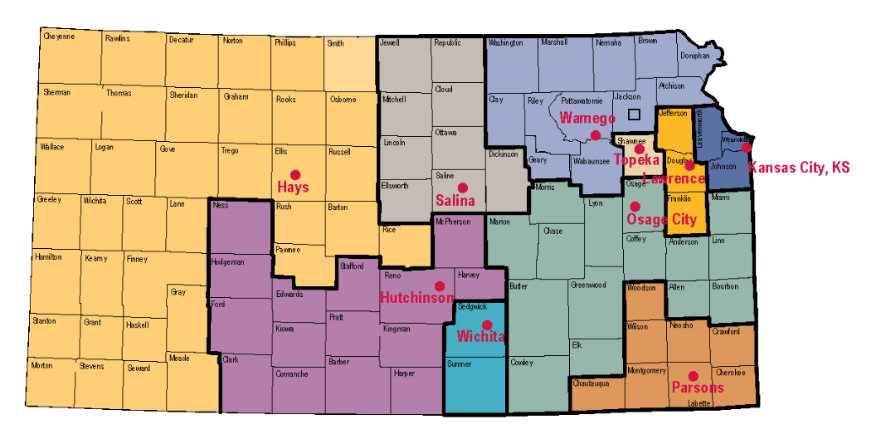
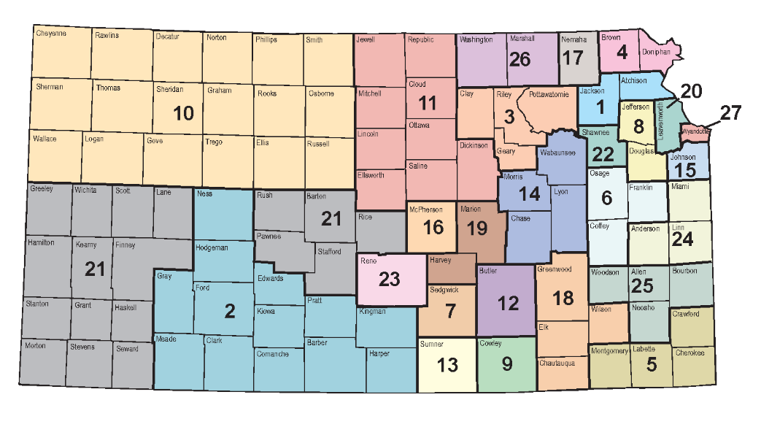
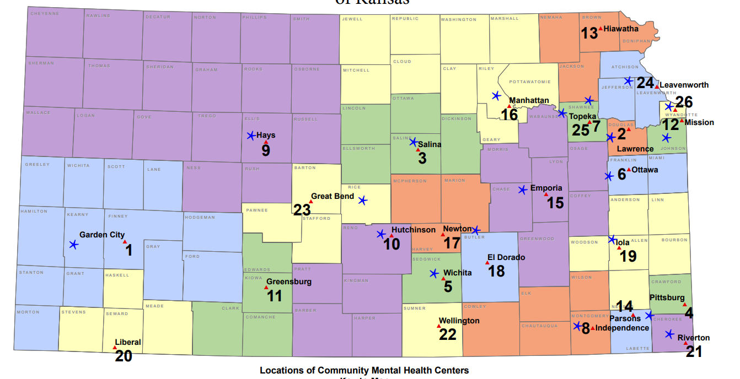
Kansas Supports
10 Centers for Independent Living
27 CDDO’s
26 CMHCs
Notes:
27 Community Dev. Disability Organizations are the gatekeeping agency for the IDD Waiver. 26 Community Mental Health Centers (20 are currently CCBHCs as well – with the remaining 6 to join in 2024) 10 Centers for Independent Living, 11 AAAs, ADRCs
https://kcdcinfo.ks.gov/resources/service-maps
cmhc-ccbhcs-of-ks-map-revised-5-12-2022.pdf

Slide 5
SIM Goals
Create a mapping process to bring change in services to individuals living with developmental disabilities and co-occurring behavioral health challenges
Evaluate current trends and processes
Understand the barriers of access in our systems
Identify solutions to create better policies and programs
Implement a form of cross-system collaboration
Notes:
The Sequential Intercept Model was developed as a conceptual model to inform community-based responses to the involvement of people with mental and substance use disorders in the criminal justice system. It was developed over several years in the early 2000s by Mark Munetz, MD and Patricia A. Griffin, PhD, along with Henry J. Steadman, PhD, of Policy Research Associates, Inc.

Slide 6
History of SIM in Kansas
Advocates spoke of need for Statewide study
2020 – Douglas County Kansas and Sedgwick County facilitated a SIM identifying intercepts for individuals with co-occurring behavioral health/justice involved individuals
July 2022- Sedgwick County with PRA facilitated first SIM for individuals with I/DD and co-occurring behavioral health/justice involvement
2022- Johnson County facilitated individuals with co-occurring behavioral health/justice involved individuals
2022- 2023 Western, Southern, Northern- Behavioral Health with Justice Involved Individuals, Stepping Up initiative

Slide 7
Collaboration for Solutions
Sunflower, KDADS, and Interhab, Inc. (an association of providers and community developmental disability organizations across Kansas) collaborated to provide funding for SIM Conference
This collaboration aided in high level of stakeholder involvement

Slide 8
Sequential Intercept Model (SIM)
Policy Research Associates, Inc. (PRA) primary focus is on expanding access to community-based services for adults with complex needs at all points of contact with the justice system.
PRA emphasizes the provision of consultation and technical assistance to help communities achieve integrated systems of mental health for individuals with Intellectual Developmental Disabilities and complex needs in contact with the justice system.
Mental health and criminal justice systems often collide, creating significant barriers to treatment and support services. Sequential Intercept Mapping helps communities develop and implement plans for community change through cross-system collaboration, organizational change, and enhancing practice, utilizing innovative and dynamic tools to map systems, identify gaps in service, and clarify community resources and opportunities.

Slide 9
Sequential Intercept Model (SIM)- Need
Studies have shown that 6.4% of men and 12.2% of women entering U.S. jails have a severe and persistent mental illness, compared to less than 2% of the general population. Of these individuals, 72% have a co-occurring substance use disorder.
This problem is especially pronounced in rural communities, where the availability, accessibility, and acceptability of behavioral health services prevent many from receiving the help that they need.
With more than 650,000 individuals returning to communities each year from US prisons and seven million individuals returning from jails, effective linkage and access to community services for people with a mental illness and co-occurring substance use disorder is critical to reduce an often repetitive cycle of justice involvement.
Kansas Department of Corrections states “41% of adults and 75% of youth residents have behavioral health needs”.

Slide 10
Sequential Intercept Model (SIM)-Goals
SIM is customized to the very specific needs and desired outcomes of individuals with Intellectual Developmental Disabilities and complex needs .
Sequential Intercept Mapping to Identify Cross-Systems Gaps in Service and Collaboration
Identifying and Setting Community Priorities
Making Recommendations for a Local Action Plan
Further the delivery of appropriate services to people with mental illness and/or substance use disorders involved in the criminal justice system
Assist individuals with intellectual developmental disabilities in identifying gaps in service
Optimize use of local resources and opportunities

Slide 11
Sequential Intercept Model (SIM)- FAQ’s
What does a successful SIM Conference look like?
A successful Sequential Intercept Model Conference (SIM) includes bringing all important voices to the table to discuss how to improve responses to individuals with complex needs. During the two-day conference in November, we have invited stakeholders to look at these systems at a higher level. Drawing on their experience and discussing how people with I/DD navigate mental health and criminal justice systems. Another aspect of a successful SIM is making important connections with people across Kansas that work and advocate for individuals living with I/DD.
Why is it important to have a SIM in Kansas?
Previous SIM conferences have been done in county and regional areas; this SIM will discuss Kansas as a whole. It is important to identify gaps and barriers statewide and create a systematic plan to overcome these challenges. As a state we need to support individuals with complex needs in complex systems and prevent hospital placement as much as possible to keep people in their community.

Slide 12
Sequential Intercept Model (SIM)- FAQ’s
Describe how the SIM is different from other collaborative efforts.
The SIM Conference will allow stakeholders to take a step back and view the entire system as a whole. Viewing the system through a new lens will allow us to identify barriers and set action plans. The SIM will also facilitate communication between those of various levels of experience and representation.
How will Kansas use the data developed from the SIM Conference?
Kansas will use this information as a starting point to develop action plans, recommendations, create committees, and recommend policy. Following the SIM Conference, we plan on keeping the momentum going by using the information for future programs and initiatives.

Slide 14
Expand Mobile Behavioral Intervention Teams and follow up equipped for broad responses (family, staffing, homes, etc.) Targeted Case Managers

Slide 15
Expand Mobile Behavioral Intervention Teams and follow up equipped for broad responses (family, staffing, homes, etc.) Targeted Case Managers
Identify an effective model to replicate including rural and frontier areas
Research states and their models- Iowa
Determine provider criteria
Establish Review Team and identify standards and definition
Draft Criteria
Capacity analysis
Crises now calculator and look at a regional level.
Look at hospital utilization data.
Early Intervention and referral and off-site support.
Research partnerships and collaborations
Facilitating conversations between
Training for DSWs
Research options
Develop a program
Develop T4T

Slide 16
Expand Cross Training

Slide 17
Expand Cross Training including trainings on alternative ways of communicating for Families, DSPs, Healthcare, Crisis Line, First Responders, payors, corrections. Create policies and practices to address IDD and Diversion. How to get someone out of the system
Include Voices of lived experiences, diversity, identify training needs. Talking about disability 101, utilizing leadership, accessibility is critically important.
Looking at how the training is done. It means a lot is the trainer has personal experience. SACK will do this
Identify the stakeholders in the state-six regions-look at traditional as well as non-traditional such as action clubs
Identify the existing training, is it accessible.
Look at gaps in training from transitions from the education system. What are educators and family’s expectations.
Develop a cross training committee including people with lived experience.
By 11/18 they will contact KDADS to start

Slide 18
Improve timely access to care

Slide 19
Improve timely access to care including crisis beds, not excluded to those with IDD
Crisis diversion level
Creation of regional crisis stabilization centers. Not based on diagnosis or funding stream. Accepts all.
Convene stakeholder advocates
Look for opportunities to make sure the crisis act is funded
Finalizing and making sure that IDD pop is included and no wrong door is included
Ensure connection to ongoing support
Prevention
Diagnosis
Pre-curser
Provider is struggling/KDADS brings the no Wrong Door discussion
CCBHC case management making that available timely for member with IDD.

Slide 20
Workforce development, recruitment, cultivation, etc.

Slide 21
Workforce development, recruitment, cultivation, etc.
Goal of collaboration/partnerships with organizations that have growth.
Incentivizing credentials in the RFPs for Workforce development
Minimal credentials required
High schools/universities to offer credentialing and a career ladder.
Immigration status changes/allowing formerly incarcerated people providing care.
Have all stakeholders at the table.
Reviewing and revising licensing standards and the floor for base pay.
Mitigating the conflict of interest with perceived pay
Have one of the MCOs be a non-profit org.
Basic needs for workforce are not being met through the compensation.

Slide 22
Track & Measure Success

Slide 23
Track, measure success. Use claims and other data (such as DOC data), crosswalk for outcomes assessments and improvements and develop preventions strategies, e.g. prevention of criminal involvement
Barrier is trying to figure out who has the bandwidth for executing this. Need positions funded and need a lot of people at the table.
Handout in PRA's packet about data sharing--turning that model into a state specific framework would be a large part of that.
Have data scientist to analyze and assess it.
Facilitating meetings and conversations to get the right people together. Convene executive leadership between KDADS, DCF, DOC, courts to talk through this to make sure they are onboard in order to move forward.
Data sharing agreements an analysis of existing to find gaps and see where they can be filled.
Do a study of what is out there already so they are not re-inventing the wheel.

Slide 24
Build a statewide leadership team for Mental Health/IDD

Slide 25
Build a statewide leadership team for Mental Health/IDD
Accomplish the goals we developed at this meeting.
Composition of the team with recommendations to the secretary after reporting.
Determine resources needed to accomplish the goals.

Slide 26
SIM Leadership Committee

Slide 27
SIM Leadership Committee
KDADS and Secretary Howard invited law enforcement, judges, managed care organizations, self-advocates, mental health providers, and other stakeholders.
This committee is leading and defining priority areas and develop metrics to measure success.
This committee is developing data points to push for a person-centered data base that allows the client to be at the front of the processes. Pulling data points from various intercepts will allow a data map of where an individual is in various systems.
The leadership committee is working with state leaders and other agencies to make this a reality.
Currently we are surveying the CDDO’s for informal relationships to gather data points.

Slide 29
Community Services
Crisis lines and community mental health centers offer services for individuals living with IDD.
How can we improve informal relationships with CMHC's to better serve the IDD population?
How can we avoid using Law Enforcement as a response?
What current response are you using for crisis response?

Slide 30
Criminal Justice
Interactions with the criminal justice system can cause further harm to individuals living with I/DD.
What current methods does your organization have in place to avoid criminal justice involvement?
What have you learned when working with individuals involved in the CJ system?

Slide 31
Court Hearings
Court hearings can be overwhelming for individuals with IDD.
How do you help keep track of hearings?
What additional information would you like to see?

Slide 32
Jail/Prison
An individual living with I/DD can struggle within jails and prisons.
They can have increased health and behavioral health issues. It is often hard to track movements while they are incarcerated.
What current system do you use to track clients?
Do you have a relationship with the jail?
How do you know if someone is released?

Slide 33
Reentry into Community
An individual living with I/DD can struggle with reentry into the community. Working with jail/prison staff can increase success for reentry.
Are you currently collaborating with jail/prison reentry staff?
Are individuals able to resume services after release?
What does successful reentry look like to you?

Slide 34
SIM Leadership Committee
Current ideas for data points…
988 response
Hospitals
Jails
Court systems

Slide 35
Next steps
Utilize FMAP funding to continue initiatives
Future sustainability
Continue to engage key stakeholders
Cross-system engagement
Focus on key areas
Behavioral Health
Direct Service Workers

Slide 36
Resources
Policy Resource Associates, https://www.prainc.com
Kansas Department for Aging and Disability Services, Federal Medical Assistance Percentage, https://kdads.ks.gov/kdads-commissions/long-term-services-supports/federal-medical-assistance-percentage-(fmap)
Kansas Department of Corrections, https://www.doc.ks.gov/publications/Reports/kdoc-fy2022-annual-report

