Slide 1
Emergency Preparedness and Response for IDD Organizations: What to Know and How to Move Forward
Christina Marsack-Topolewski, Ph.D., LMSW
Associate Professor - Social Work, Eastern Michigan University
Michigan Developmental Disabilities Institute – Research Affiliate
cmarsack@emich.edu

Slide 2
Presenter Information
Dr. Christina Marsack-Topolewski is an associate professor of Social Work in the College of Health and Human Services at Eastern Michigan University. She received her master’s in Social Work from the University of Michigan and her PhD in Social Work with a dual title in Gerontology from Wayne State University. She has worked with individuals with various intellectual and developmental disabilities for over 20 years. Her research focuses on individuals with IDDs, their caregivers, advance care planning, service delivery, and service utilization. She has over 50 publications in national and international journals, mainly focusing on individuals with IDDs, caregiving, and aging. Her work has been presented locally, nationally, and internationally. Dr. Marsack-Topolewski has been the lead on multiple grant-funded programs tailoring services to individuals with IDDs, older adults, and chronic illnesses. In 2019, she was appointed to the National Task Group on Intellectual Disability and Dementia Practices. She serves as both a board member and co-chair of Membership Affairs. Over the past 4 years, she has provided testimony at the state-level (Michigan) to advocate for three house bills that would provide protections against exploitation and abuse for vulnerable adults, such as individuals with IDDs.

Slide 3
Welcome!
Thanks for being here today! In the chat, please provide the following information:
State of employment / residence
Name or type of organization you are affiliated with
If you are a family member of an individual with an IDD or attending for your own knowledge, welcome!

Slide 4
Today’s Focus
Preparing for and responding to emergency situations is challenging for anyone, especially for individuals with intellectual and developmental disabilities (IDD). Due to the unique needs of individuals with IDD, there are different emergency preparedness needs and strategies that must be considered.
Overall aims:
How to prepare for a possible future emergency
How to maintain quality and continuity of care
Understand strategies to integrate to best support individuals with IDD in the event of an emergency or crisis

Slide 5
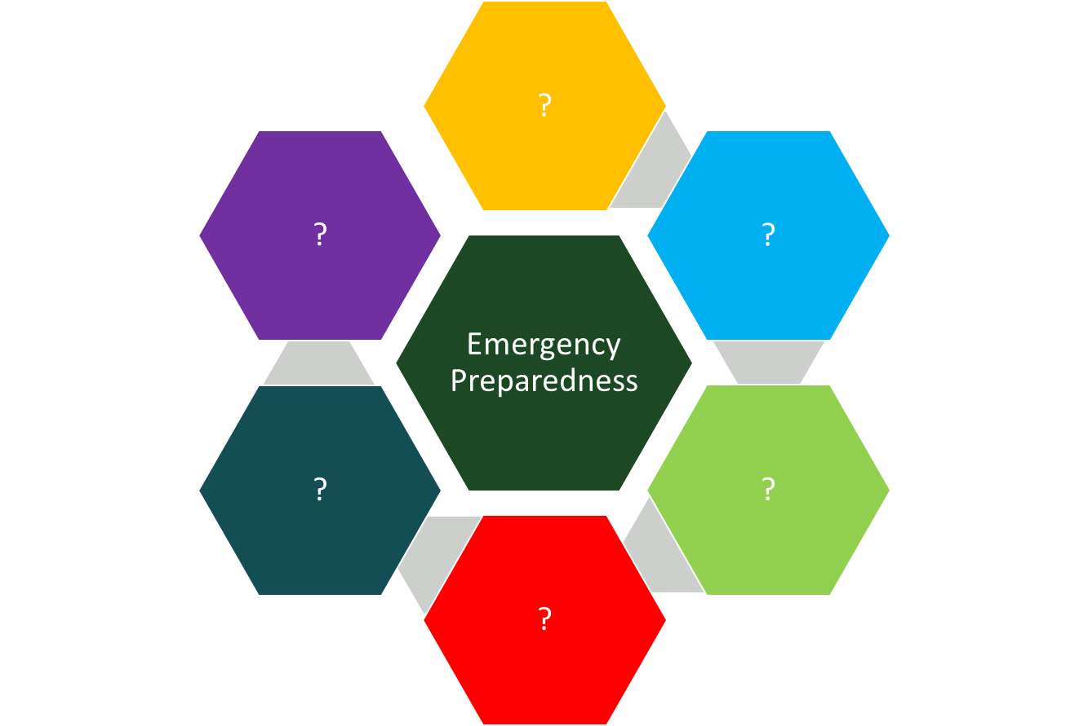
“Emergency Preparedness” – What comes to mind? *Please put thoughts that come to mind in the chat.
Notes:
What comes to mind when you hear the term “emergency preparedness”? ____________________________________
You might think… of having food, water, adequate shelter… you might think about electrical and energy needs… you might think of having the appropriate clothing and weather gear… or even means for appropriate transportation…
Some might think about having medication available and handy, or a bag of clothing and relevant items packed in the trunk of a car.
According to the State of New York’s Department of Health, less than 20% of Americans viewed themselves as being fully prepared should an emergency arise. But in a poll taken after the aftermath of Hurricane Katrina… 96% of Americans believed in the importance of emergency preparedness.
https://www.health.ny.gov/environmental/emergency/people_with_disabilities/preparedness.htm

Slide 6
Emergency Preparedness:
Considerations and Steps to Prepare for the Next Crisis or Emergency

Slide 7
How do we prepare for emergencies? How do we prepare for the unknown?
Photo by DDP on Unsplash

Slide 9
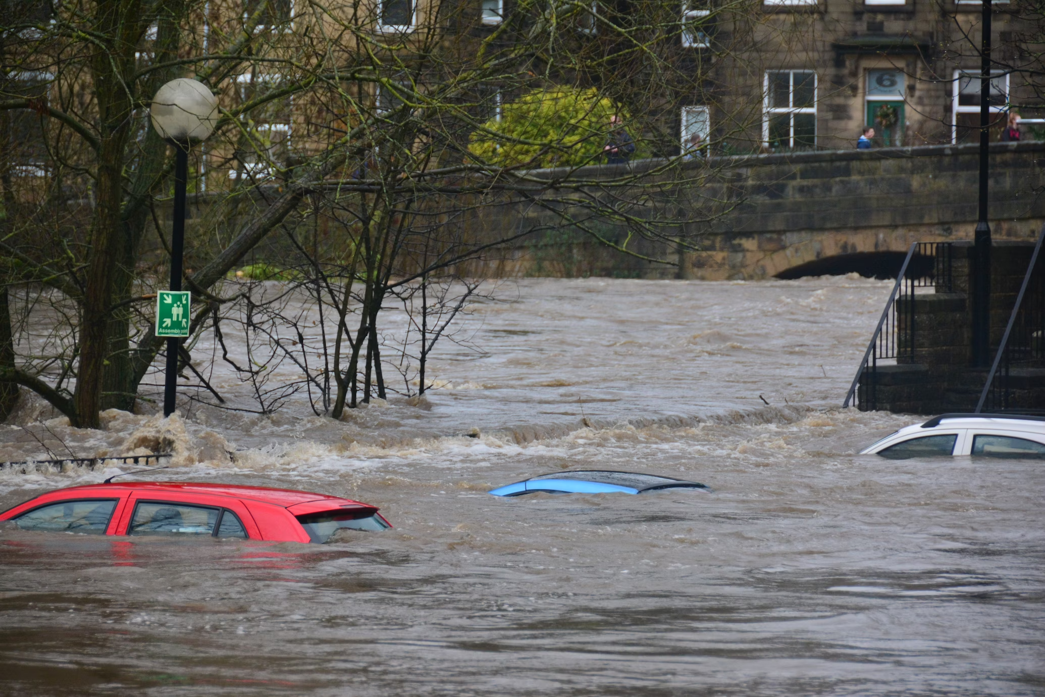
Types of Emergencies
There are many types of possible emergencies:
Natural (e.g., tornadoes, floods, hurricanes, wildfires)
Technological
Fire, Hazardous material accidents, Chemical / Biological / Radiological Emergencies, Aircraft crashes
Human-caused
War, terrorism, civil emergency, active shooter
Medical / health
Photo by Chris Gallagher on Unsplash

Slide 10
Emergencies & Vulnerabilities for Individuals with IDD
There are many factors to consider.
Care & medical needs
Environmental factors
Accessibility
Other considerations
Staff (ability, availability / shortages)
Transportation
Communication
Shelter / relocation options

Slide 11
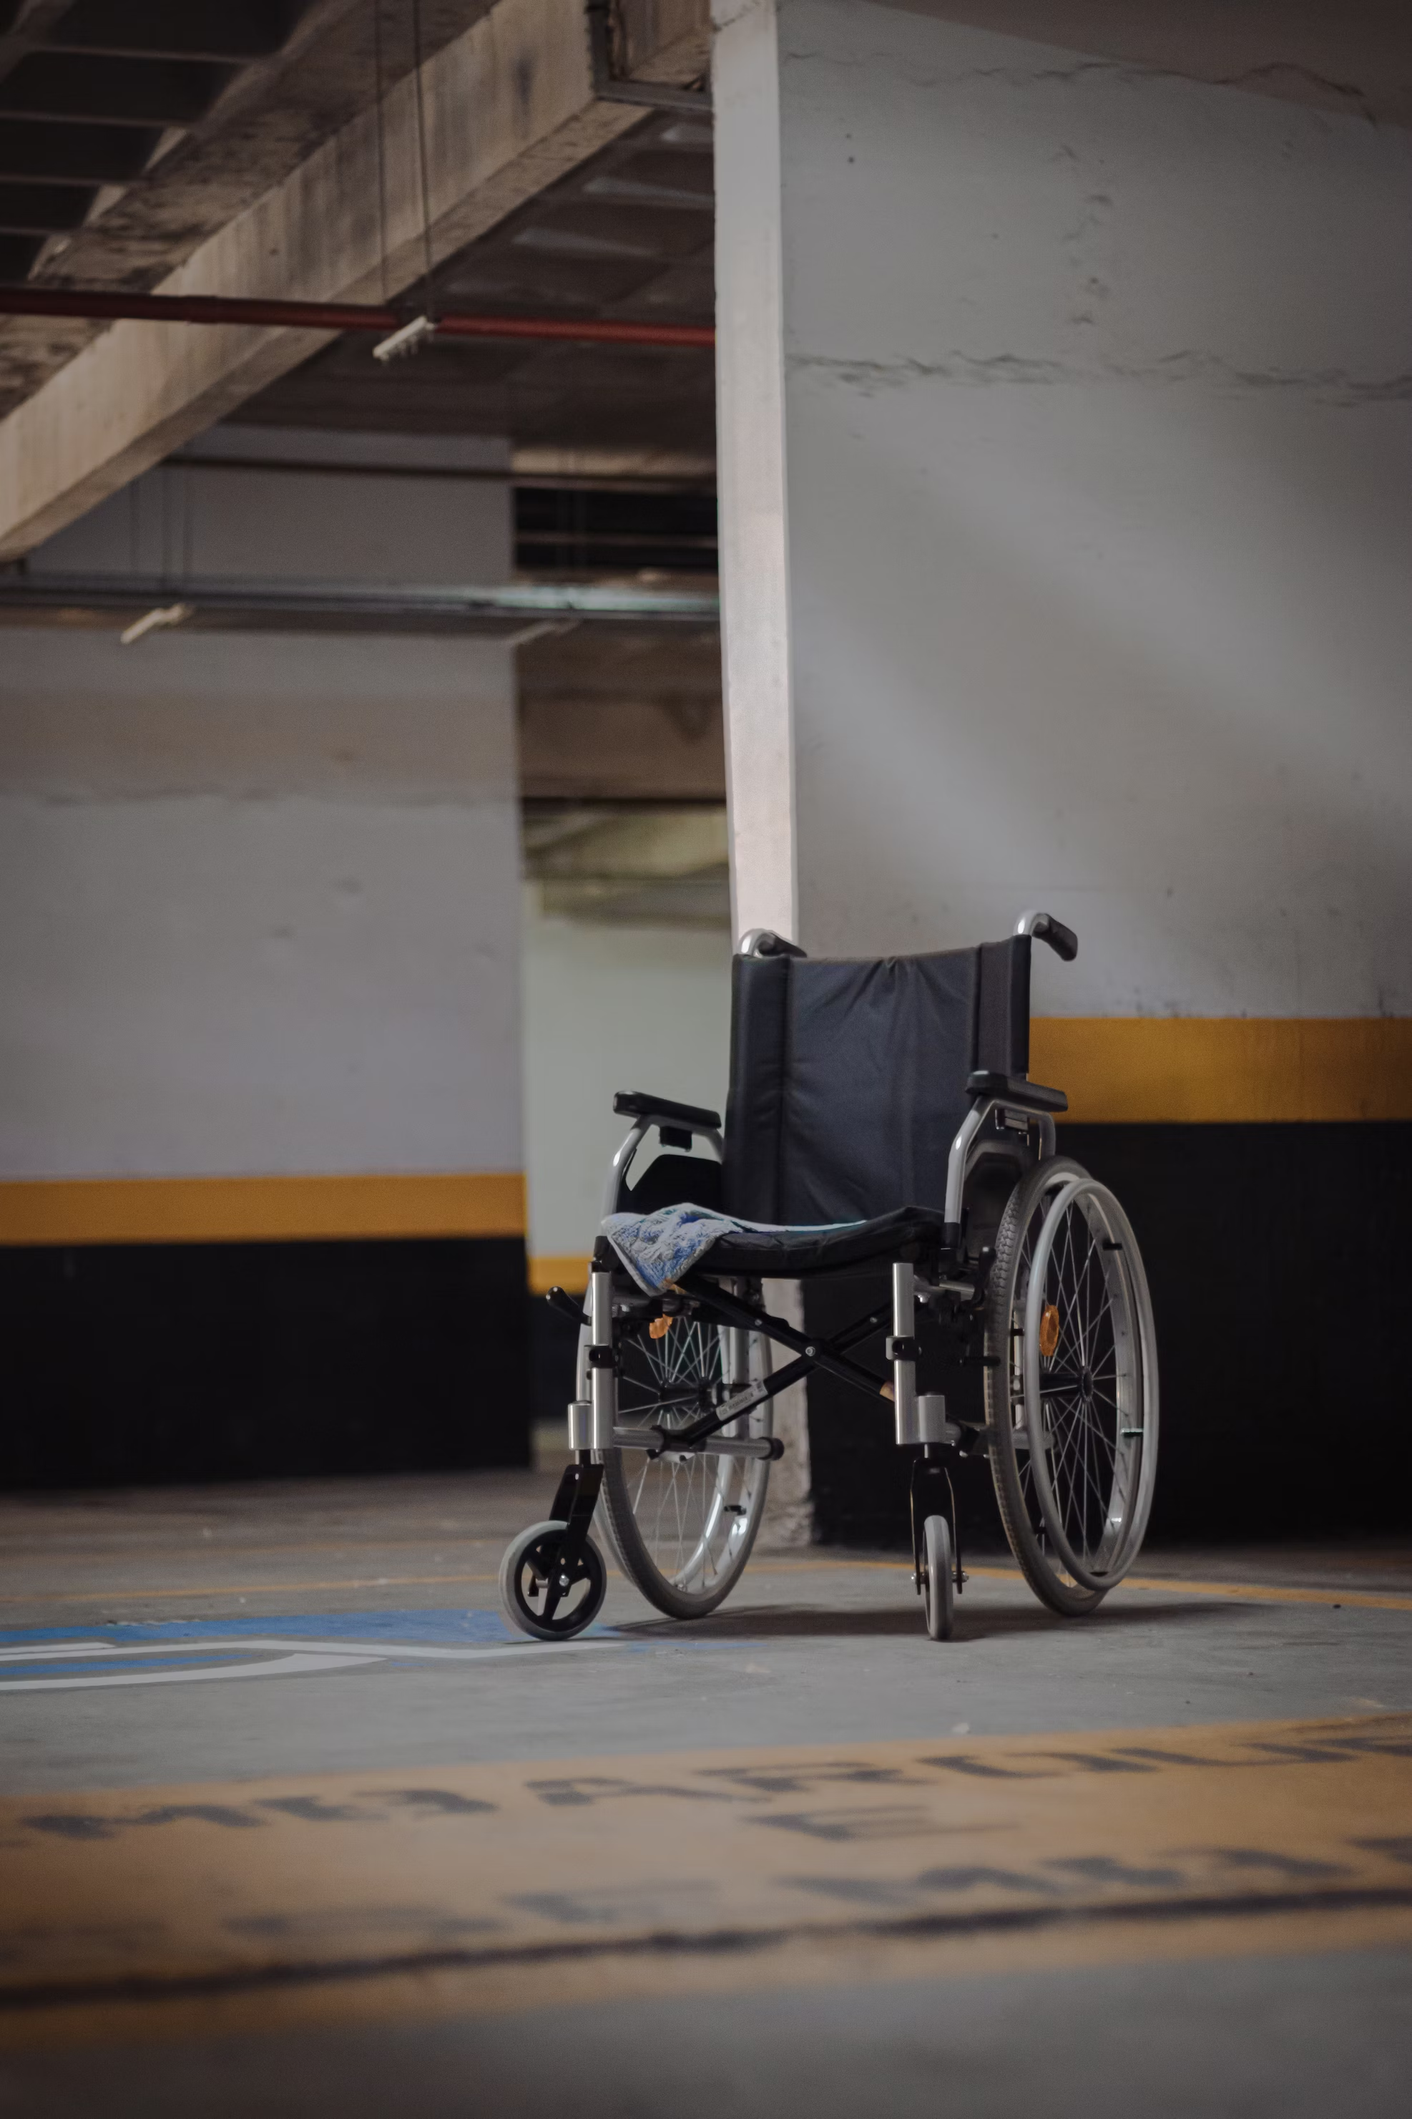
Profile and Presentation
Other factors to consider:
Mobility skills and limitations
Intellectual functioning
Comorbid conditions
Behavior (e.g., presentation, triggers)
Sensory needs
Communication skills, supports, and needs
Photo by vitor camilo on Unsplash

Slide 12
Common Medical Conditions for those Aging with IDD
Here are some common conditions:
Dental pathologies
Sensory deficits (vision, hearing)
Obesity
Pain
Osteoporosis and increased fracture risk
(Moran, 2017).

Slide 13
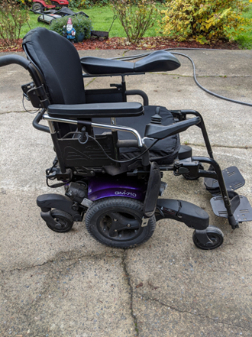
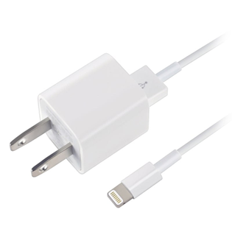
Learning from Common Planning Pitfalls
Emergency Preparedness

Slide 14
Poll – Q1: Does your organizations have an emergency plan in place? -a. yes -b. no Poll – Q2: How often is your organization / agency’s plan revisited or updated: -a. quarterly -b. yearly -c. not that I’m aware of

Slide 15
Tips for Planning
Things to keep in mind:
Consider the needs of all
Take into account direct caregivers’ (paid and unpaid) perspectives on planning & preparedness
Prepare all staff and consumers
Use language & approaches that make sense and are sensitive to individual needs
Have easily retrieved written guidelines
Ensure easy awareness and access for backup / fill in staff

Slide 16
Tips for Planning
Things to keep in mind…
Training and preparation
Safely prepare individuals with IDD
Identify and train staff
Consider communication (e.g., How will you communicate in the event of an emergency? Do you have contact names / numbers? Do you have supplies, medication, etc. easily retrievable?)
Prepare all staff and consumers
Use language & approaches that make sense and are sensitive to individual needs
Have easily retrieved written guidelines
Know where to go for resources
Ensure plans are revisited, reviewed, and updated

Slide 17
Recognize the Moving Target!!! – Things change… planning is sometimes a moving target.

Slide 18
Other Planning Considerations for Individuals with IDD
Things to keep in mind…
May have multiple caregivers
Often have multiple prescribers, supports, staff members
As they age, normative and non-normative aging-related changes often occur
→ Create effective opportunities for collaboration and communication
→ Update plans based on changing needs and factors
→ These steps can be used to maintain quality and continuity of care

Slide 19
Emergency Preparedness: Planning for Long-Term Needs
What to consider for individual’s long-term needs?
Photo by Marissa Grootes on Unsplash

Slide 20
Emergency Planning and Advance Care Planning
The pandemic has provided a visible reminder of the need for emergency planning.
Medicaid requires recipients with IDD to have a person-centered plan (PCP)
No requirement exists for advance care planning (ACP) to be a component of the plan
COVID-19 provides a real reminder to incorporate ACP within the PCP for people with IDD
Crises can dramatically alter access and delivery of care
The use of an ACP can be helpful in diminishing the impact of crisis situations
(Church, Marsack-Topolewski, McGinley, & Knocke, 2021).

Slide 21
Chat Input: What comes to mind when you think of advance care planning?

Slide 22
What is Advance Care Planning
Advance care planning is… the development of a care plan for when an individual cannot take part fully in their own decision-making (Perkins & van Heuman, 2018).
Advance care plans should consider the following:
Wishes for one’s future,
Residential decisions,
Financial considerations,
Occupational and recreational preferences,
Supportive measures to support daily living and life-course transitions,
Maintaining a social support network.
(Church et al., 2021).

Slide 23
Low Rates of Advance Care Planning
A few things to keep in mind:
Older adults with IDD are a growing population
ACP is a recommended best practice for adults with IDD
To date, there are low rates of ACP adoption
Maintaining a social support network.
(McGinley et al., 2021)

Slide 24
WHY?... Low Rates of Advance Care Planning
Many families and individuals prolong planning for these reasons…
1) Difficulty identifying caregiving support for the future (e.g., future caregiver[s])
2) Barriers to making plans/ decisions (e.g., time)
3) Fear of the unknown
4) Feeling the need to make plans and decisions now (BUT not acting)
(Marsack-Topolewski & Graves, 2020)

Slide 25
Keep in mind… the number of individuals with IDD reaching advanced age is rapidly increasing. Projections indicate a doubling by 2030 and tripling of the population in the foreseeable future. – Acharya, Schindler, & Heller (2016).
This Photo by Unknown Author is licensed under CC BY-SA-NC

Slide 26
Emergency Planning and Advance Care Planning
ACP typically results in better-informed care during crises and other situations (Church et al., 2021).
Notes:
Federally legislated Medicaid requirements for recipients with intellectual and/or developmental disabilities (IDD) to have a person-centered plan (PCP) do not specifically state that advanced care plans (ACP) be a component of the plan. However, coronavirus disease 2019 (COVID-19) has provided a salient reminder of the importance of incorporating ACP within the PCP for people who have IDD. As demonstrated by situations arising from COVID- 19, emergencies and crises can dramatically alter access to care for people with IDD. This paper synthesizes results from an environmental scan related to ACP for adults with IDD. Findings suggest that the use of ACP, particularly when such planning processes result in the delineation of roles and documentation of preferences, can be helpful in mitigating the impact of these crisis situations on the person with IDD and their caregivers.

Slide 27
Emergency Planning and Advance Care Planning
Takeaways
Incorporate ACP within an individual’s PCP
This should be a collaborative process and be informed by key stakeholders
Make sure to delineate roles and responsibilities
Use this as a tool for promoting continuity of care
This can be used to decrease the impact when crises situations arise.
(Church et al., 2021).
Notes:
Federally legislated Medicaid requirements for recipients with intellectual and/or developmental disabilities (IDD) to have a person-centered plan (PCP) do not specifically state that advanced care plans (ACP) be a component of the plan. However, coronavirus disease 2019 (COVID-19) has provided a salient reminder of the importance of incorporating ACP within the PCP for people who have IDD. As demonstrated by situations arising from COVID- 19, emergencies and crises can dramatically alter access to care for people with IDD. This paper synthesizes results from an environmental scan related to ACP for adults with IDD. Findings suggest that the use of ACP, particularly when such planning processes result in the delineation of roles and documentation of preferences, can be helpful in mitigating the impact of these crisis situations on the person with IDD and their caregivers.

Slide 28
Employees with IDD
Key considerations for emergency planning for employees with IDD
Photo by Jess Bailey on Unsplash

Slide 29
Chat Input: What considerations and accommodations should be explored to support employees with IDD?

Slide 30
Photo credit – taken from: https://evaculife.com.au/blog/evacuation-of-people-with-a-disability/

Slide 31
Planning for Planning
Set a roadmap to plan gradually.
Set manageable goals.
Use a team approach to inform the process.
Take breaks.
Make a mental note of progress (big & small).
Keep in mind factors to consider.

Slide 32
Factors to consider:
Employees with IDD to be involved in planning process
Using a team approach
Consider hidden and visible disabilities
Other aspects to consider – physical, medical, mental health conditions; service animal
Plan for mobility needs, if relevant (e.g., evacuation plan; evacuation chair)
Consider the likely type of emergencies, based on location and geographic threat
Plan for materials, supplies, and medications that would need to be available
Review, revisit and update based on changing needs
Know where written plan is stored
Key players should be aware and involved in planning process

Slide 33
Non-Visible (or “Hidden”) Disabilities:
Make sure planning and emergency kits make people aware of non-visible disabilities
Such disabilities may include the following:
Communication
Cognitive
Sensory
Mental Health
Learning or intellectual disabilities
Other conditions: allergies, seizure disorders, diabetes, cardiac diseases, etc.
Further recommendations to support specific disability subtypes can be found at the following: https://www.getprepared.gc.ca/cnt/rsrcs/pblctns/pplwthdsblts/index-en.aspx

Slide 34
In general, all planning should consider the following:
KNOW the risks
MAKE a plan
GET an emergency kit
Relevant planning information can be found at the following link: https://www.getprepared.gc.ca/cnt/rsrcs/pblctns/pplwthdsblts/index-en.aspx

Slide 35
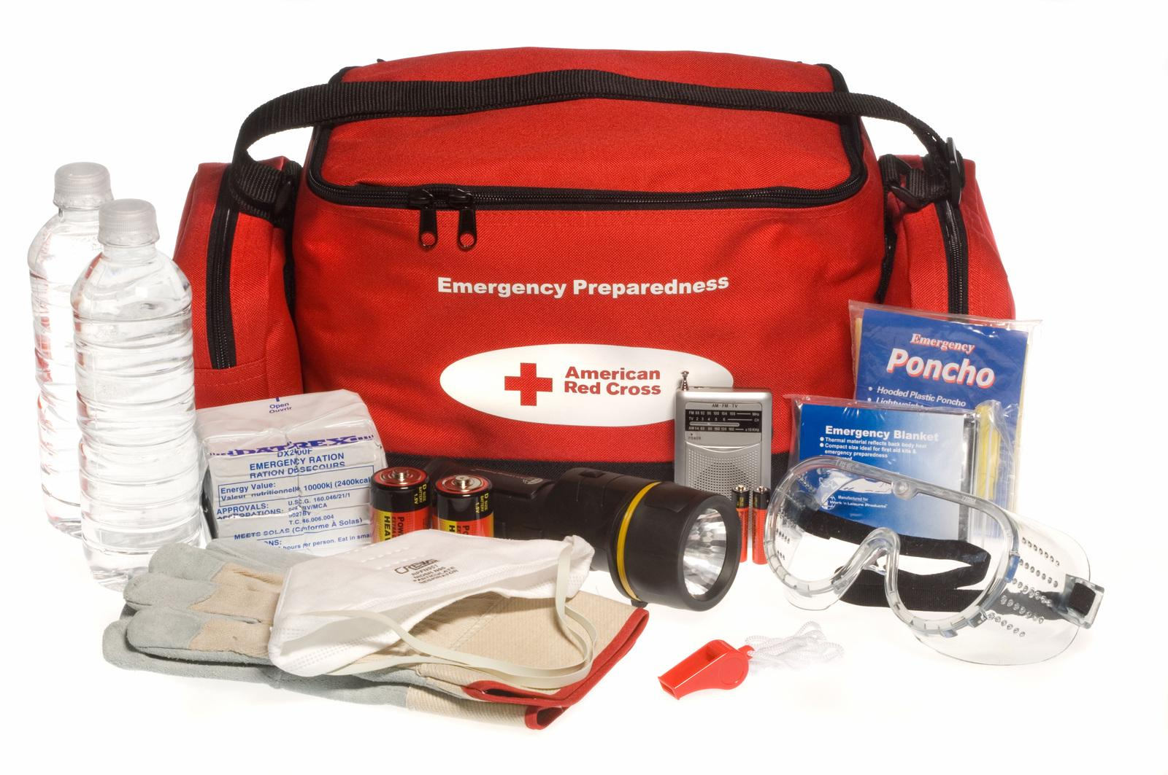
Emergency Kits for Individuals with IDD:
Key considerations and tips:
Store kits in 1 organized, easy to find place
Tag all special needs equipment & include instructions (e.g., how to use)
Bracelet wearing to alert for food / drug allergies
List current medications (with condition; name / dosage / frequency; name / contact of treating doctor)
Provide a list of contact names (e.g., family members, caregivers, providers)
Have an emergency plan for equipment (in the event of a power outage)
Consider including other safety items in emergency kit (e.g., flashlight, personal alarm to emit noise to draw attention for help)
Include information related to all aspects of need (e.g., medical, physical, communication) in emergency kit
Emergency numbers / contacts
Information adapted from: https://www.getprepared.gc.ca/cnt/rsrcs/pblctns/pplwthdsblts/index-en.aspx

Slide 36
Continuity & Quality of Care
Photo by National Cancer Institute on Unsplash

Slide 37
Poll – Q3: Based on your geographic location, what type of natural disaster is most common? -a. tornado -b. fire -c. hurricane -d. earthquake -e. flood -f. other

Slide 38
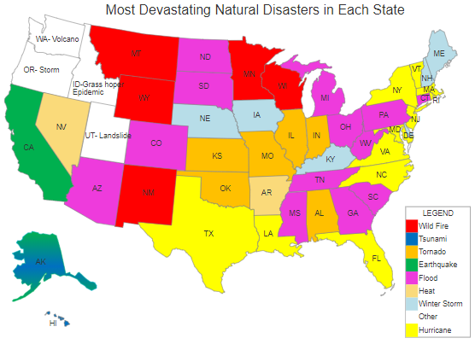
Common Disasters Based on Location
Prepare accordingly
https://www.redcross.org/get-help/how-to-prepare-for-emergencies/common-natural-disasters-across-us.html#all
Taken from: https://vividmaps.com/natural-disasters-in-the-united-states/

Slide 39
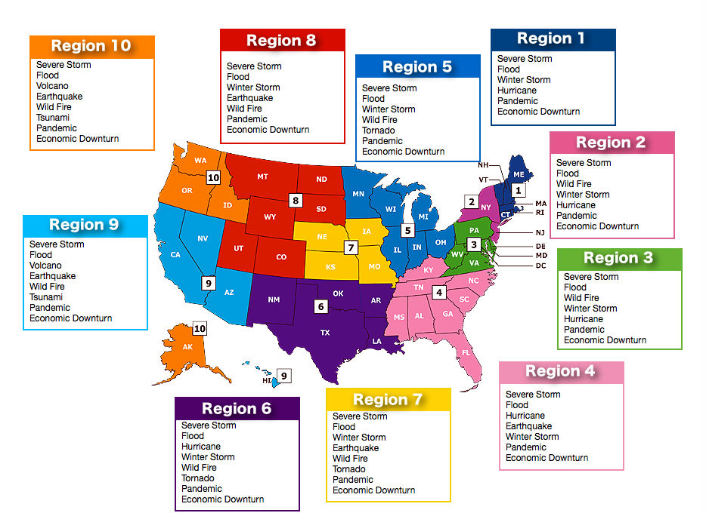
Regionality and Disasters
Taken from: https://vividmaps.com/natural-disasters-in-the-united-states/

Slide 40
Other planning considerations:
Plan for the knowns and unknowns
Plan for natural disasters based on geographic location
Use a collaborative process
Conduct training and exercises
Prioritize planning, communication, practice, and revisiting / updating based on changing needs
https://www.cdc.gov/cpr/documents/aging.pdf

Slide 41
“An hour of planning can save you 10 hours of doing.” – Dale Carnegie
This Photo by Unknown Author is licensed under CC BY

Slide 42
References
Acharya, K., Schindler, A., & Heller, T. (2016) Aging: Demographics, trajectories and health system issues. In I. L. Rubin, J. Merrick, D. E. Greydanus, & D. R. Patel (Eds.), Health care for people with intellectual and developmental disabilities across the lifespan (pp. 1423–1432). Springer International Publishing.
American Red Cross. (2020). Common Disasters Across the U.S. https://www.redcross.org/get-help/how-to-prepare-for-emergencies/common-natural-disasters-across-us.html#all
Church, H. L., Marsack-Topolewski, C., McGinley, J. M., & Knoke, V. (2021). Advance Care Planning Within Individualized Care Plans: A Component of Emergency Preparedness. Developmental Disabilities Network Journal, 2(1), 3.
Marsack-Topolewski, C. N., & Graves, J. M. (2020). “I worry about his future!” Challenges to future planning for adult children with ASD. Journal of Family Social Work, 23(1), 71-85.
McGinley, J., Marsack-Topolewski, C. N., Church, H. L., & Knoke, V. (2021). Advance care planning for individuals with intellectual and Developmental Disabilities: A State-by-State content analysis of person-centered service plans. Intellectual and Developmental Disabilities, 59(4), 352-364.
Moran, J. (2017). General aging in intellectual and developmental disabilities: Aging with an intellectual and developmental disability. Center for Developmental Disabilities Evaluation and Research. Presented January 2017.

Slide 43
Questions?

Slide 44
Photo by Courtney Hedger on Unsplash

