Slide 1

Autism Spectrum Disorder
For
Direct Support Professionals
Jill Murphy
Behavioral Health Specialist
Johnson County Developmental Supports

Slide 2

A Realistic look at the Autism spectrum

Slide 3

Picture someone you know with Autism
“If you’ve met one person with Autism, you’ve met one person
with Autism.”
Stephen M. Shore

Slide 4
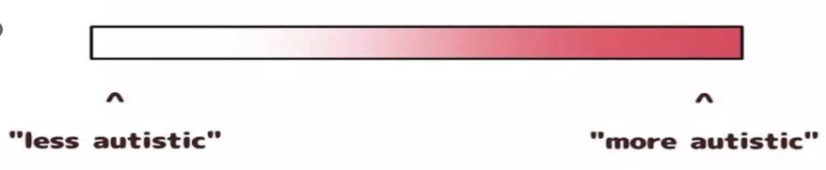

What people think the autism spectrum looks like

Slide 5

What the autism spectrum really looks like
Instead of considering autism as a gradient, think of it as a spectrum.
A person doesn’t start at one end and move up depending on the intensity of symptoms

Slide 6
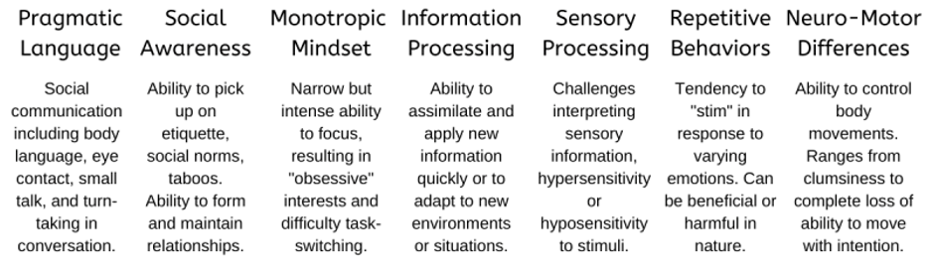
What the autism spectrum really looks like

Slide 7
A person doesn’t have to have difficulty in every area to have ASD but they do have to be affected in multiple areas that impact their lives. Everyone’s color palette will have different components.

Slide 8
Symptoms
No matter a person's symptoms there are two things that are always present and that must show persistent deficits to be diagnosed
1) Social communication and social interaction deficits
2) Restricted and repetitive patterns of behavior

Slide 9
Social Communication and Interaction Differences
Difficulty expressing emotions verbally in an understandable/accurate way, or understanding the emotions of others
Understanding the facial expressions, tone of voice, and body language of others
Understanding personal space
May be overwhelmed in social situations (social and communication differences, sensory issues)
Echolalia, other idiosyncratic speech differences (may increase during times of stress)
Difficulty with humor and metaphors
Lack of eye contact
May have difficulty with back-and-forth conversation and small talk

Slide 10
Social and Communication Strategies
Use clear and concrete words when communicating giving time to process.
Pay attention to your verbal and non-verbal communication components.
Avoid open-ended questions instead, utilize direct questions with concrete language.
Don’t overload the individual with words…slow down…take breaks…follow their lead.
Pay attention to the environment around you and possible sensory issues it may cause.
Use visual aides or written communication if needed and able to do so.
Offering fidgets or other sensory items may allow the person to relax while communicating.
Never assume the person can’t understand you just because they may have limited verbal communication skills.
Recognize repetitive words and behaviors.

Slide 11
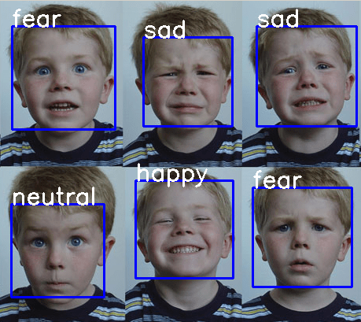
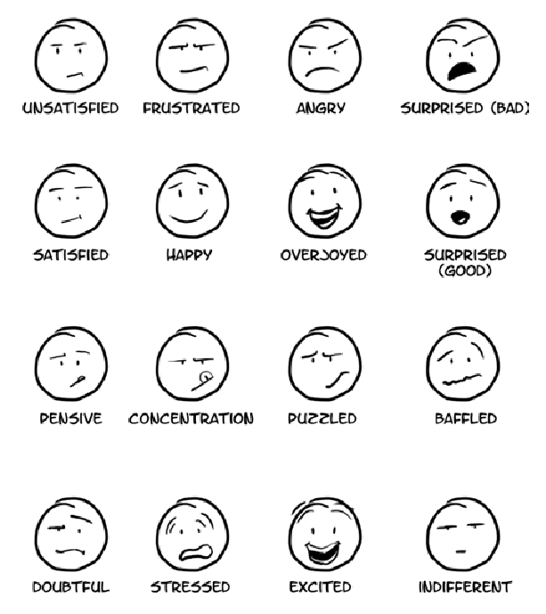
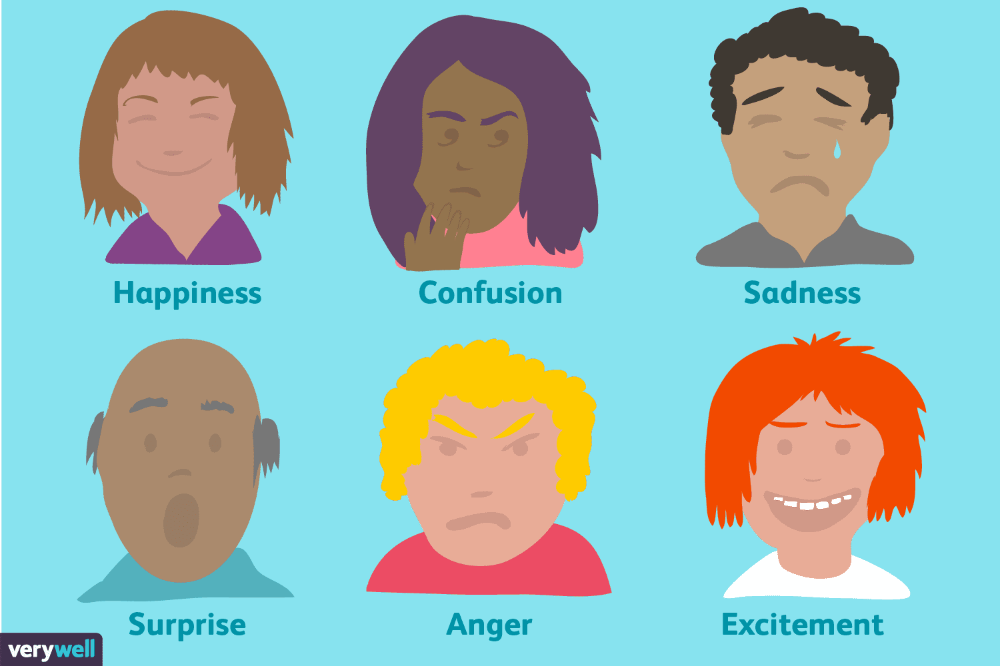
Emotion Recognition

Slide 12
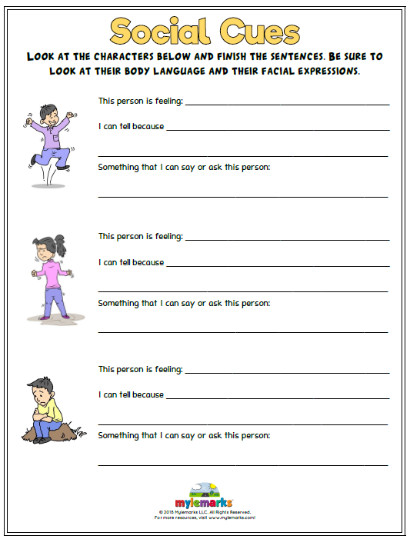
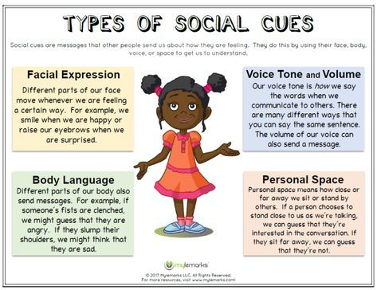
Social Cues

Slide 13
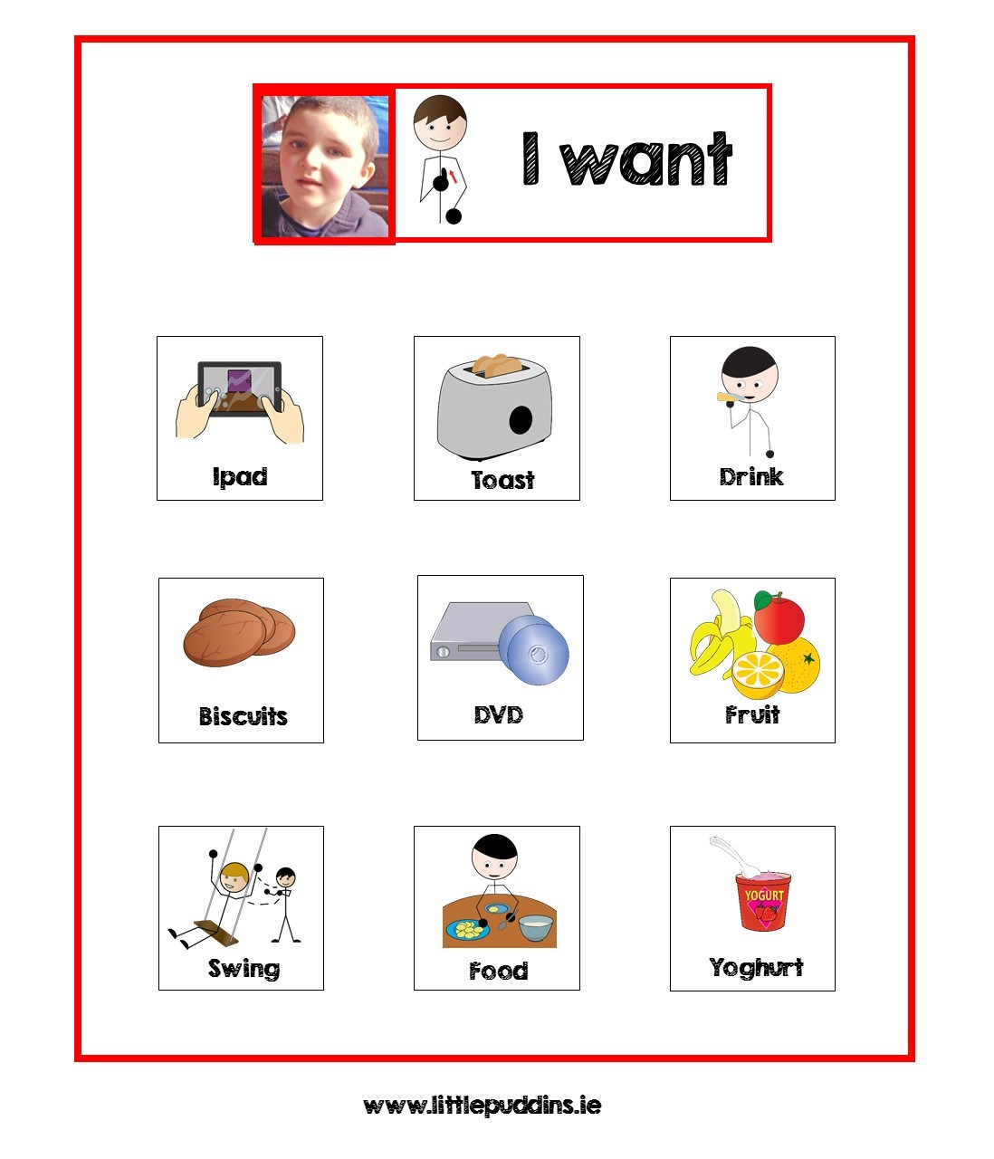
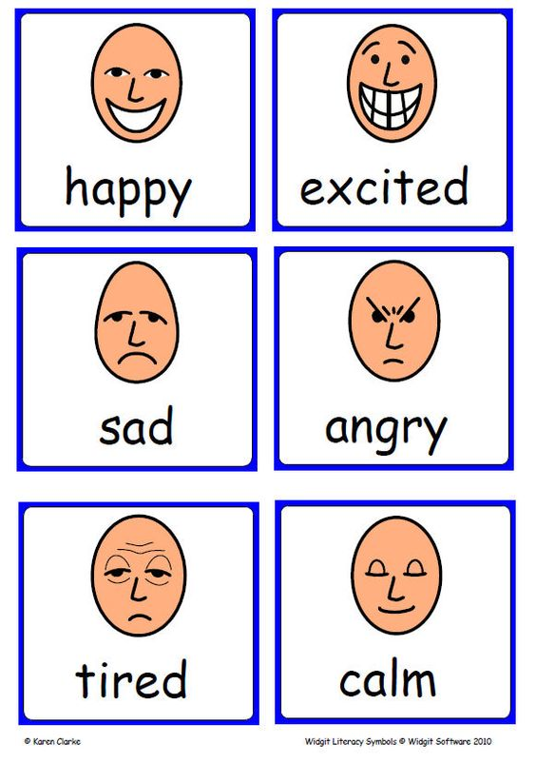
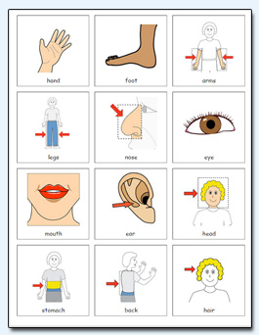
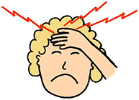


Alternative Communication and PECS (Picture Exchange Communication System)

Slide 14
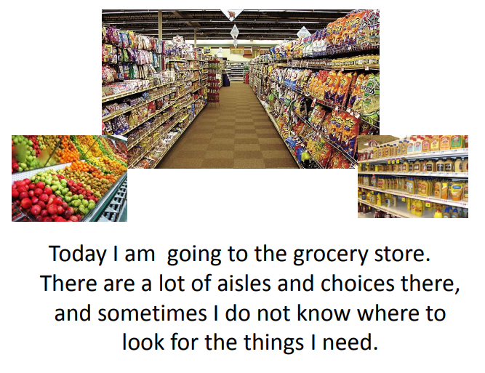
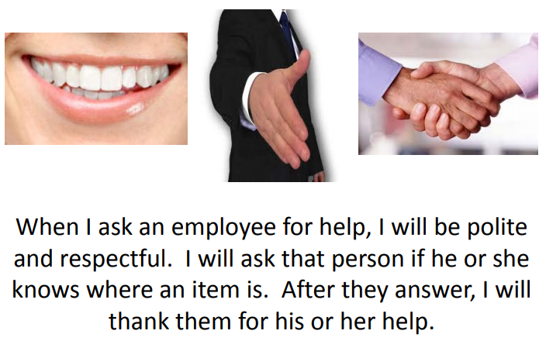
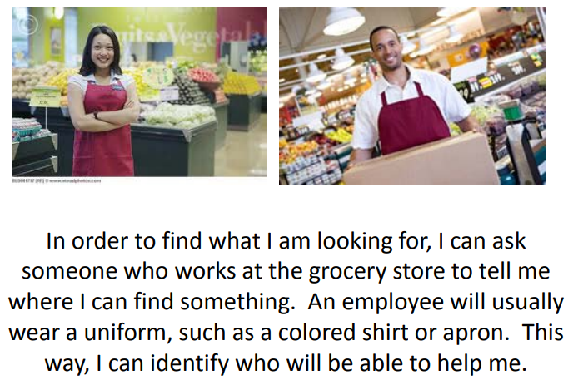
Social Stories
Social stories are a tool that describe social and other situations to individuals in an understandable way supplementing verbal communication.

Slide 15
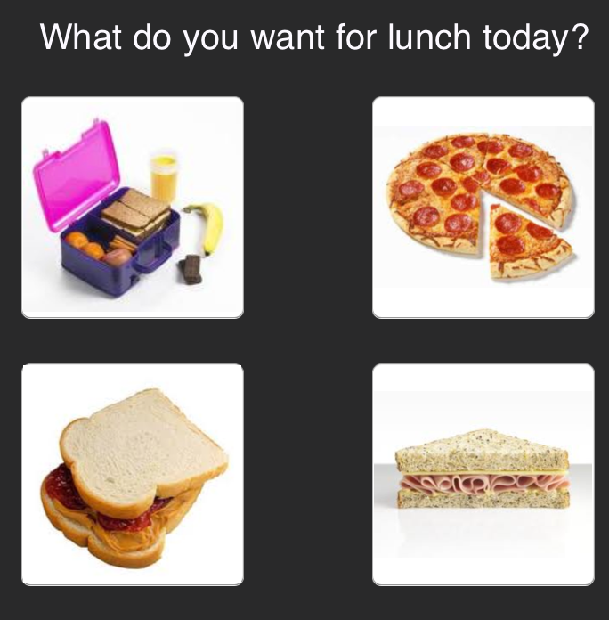
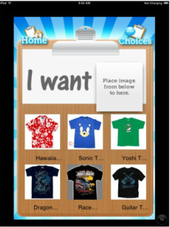
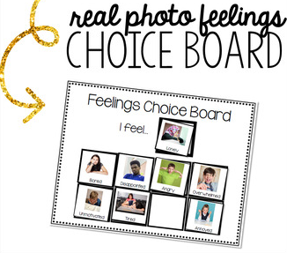
Choice Boards

Slide 16
Information Processing and Executive Functioning
Executive Functioning: the ability to plan, organize, prioritize, apply information, control impulses, use self-control, follow multiple step directions, and adapt to new environments.
Understand verbal and non-verbal communication a person is receiving accurately and in a timely manner.
Using expressive communication in a timely and understandable way.
Applying abstract information in alternate settings.

Slide 17
Strategies for Information Processing and Executive Functioning
Visual aides, checklists, and visual schedules. Review and refer to them often.
Use uniform language among staff when possible (scripted responses)
Follow a routine to increase predictability
Utilize one and two step directions if needed
Give an individual as much time as needed to process directions and complete tasks
If tasks are non-preferred, alternate with preferred activities and use positive reinforcement throughout.
Utilize organizational tools (calendars, planners, timers, etc…)

Slide 18
Restricted and Repetitive Behaviors
Repetitive or stereotypical speech, movements, or use of objects
Adhering to routines, ritualized nonverbal and verbal behavior, resistance to change, difficulty with transitions.
Hyperfocus or fixation on topics with abnormal intensity.
RRB Sensory Concerns
Being over-responsive to sensations may be more related to RRB’s than other sensory issues.
Sensory issues may trigger RRB’s as they can increase anxiety. RRB’s may help the person feel a sense of routine and calm.

Slide 19
Sensory Processing
Unusual response to sensory input
Hypersensitivities (over-responsiveness) & Hyposensitivities (under-responsiveness)
Sensitivities may include:
Bright lights Heat
Loud noises Cold
Textures of clothing or food Physical Discomfort
Crowds or tight spaces Balance
Movement Body Awareness
Increased pain tolerance or inability to explain the pain
Sensory concerns may affect a person’s adherence to a hygiene routine
May appear in any setting or interaction regardless of context

Slide 20
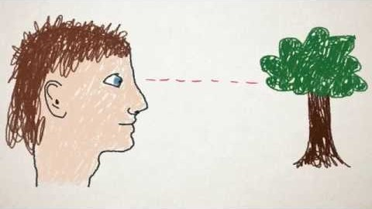

Slide 21
Strategies for Sensory Processing
For hypersensitivity consider….
  What are the external sounds in the environment?
  What are the internal sounds in the environment? (clocks ticking, lights buzzing, etc…)
  Allow extra time for processing conversations.
  Create a quiet space or sensory room to take breaks.
  Visit new environments at quieter times increasing the length of time each visit.
  Noise-canceling headphones or ear plugs to dampen the auditory input.
  Be mindful of the amount of people in a space, are there too many?
  What are the smells in the environment? What is the temperature?
  What is the proximity to other individuals? Who are they?

Slide 22
Strategies for Sensory Processing
For hyposensitivity consider….
  Built in sensory or movement breaks.
  Be prepared with fidgets or preferred items to give sensory input.
  Weighted blankets, trampolines, jumping, swinging, weight-bearing activities, deep pressure, or other items that provide sensory input.
  Build sensory time into a person’s schedule (i.e.-bounce on the trampoline 3x daily)
  Be mindful of the space, is there ample room? Can they stand and move?
  Allow movement and noise, when possible, don’t make someone “sit still” & “be quiet.”
  Be mindful of textures in clothing, food, the environment…

Slide 23
Structure, Predictability, Routine
Narrowed, intense focus on singular items/topics/individuals.
Structure, predictability, and routine may bring a sense of calm and reduce overall anxiety.
These concepts are tied to an individuals RRB’s by incorporating repetitive preferences and needs into their daily life.
May appear in any setting or interaction
At times, hyperfocus may disrupt an individual's life, social relationships, and cause disruptive behaviors.

Slide 24
Strategies for Structure, Predictability, Routine
Organized home environments increasing identification of relevant and nonrelevant information
When typical routines are unavailable (summer break e.g.) incorporating activities that may be similar or decreasing unstructured/down time
First/then statements, sequencing
Consideration of staffing schedules and the effect of changes/coverage
Pre-teaching
Discussion of significant upcoming events, know the person and when best to discuss
Identify socially appropriate ways for the person to incorporate their interests in alternate settings
While engaging with someone, support their interests with small redirections or other engagement opportunities.
Adaptability may begin with small changes/suggestions

Slide 25
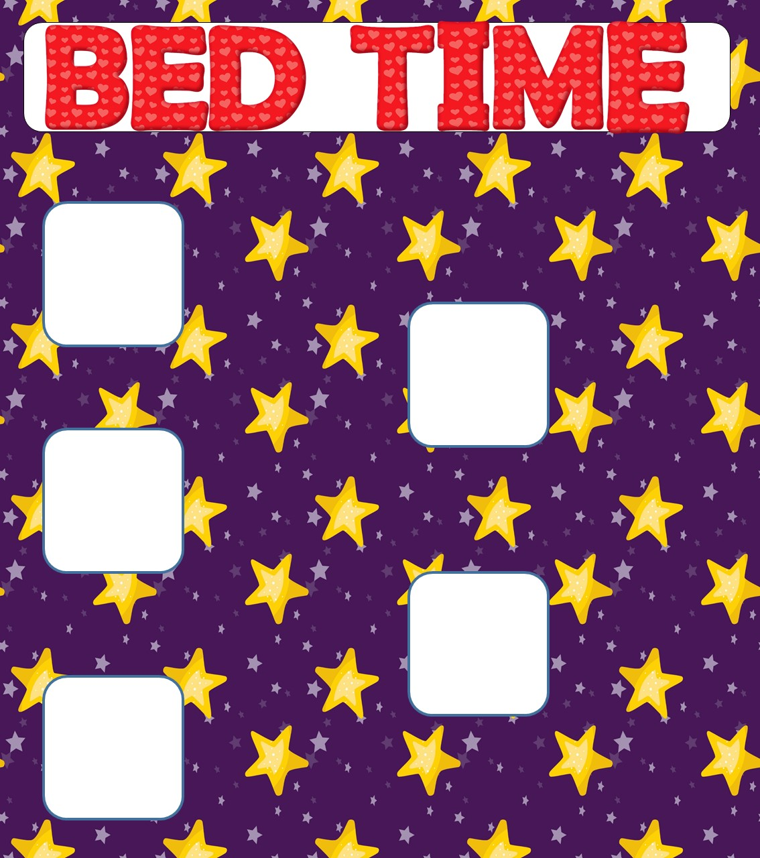
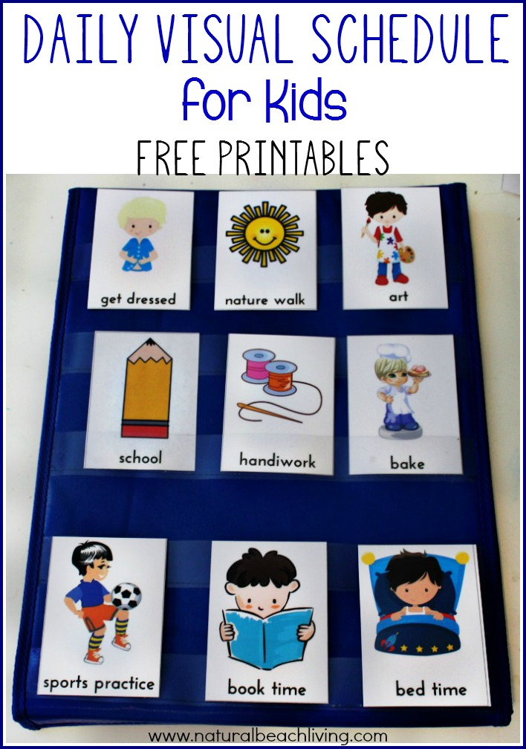
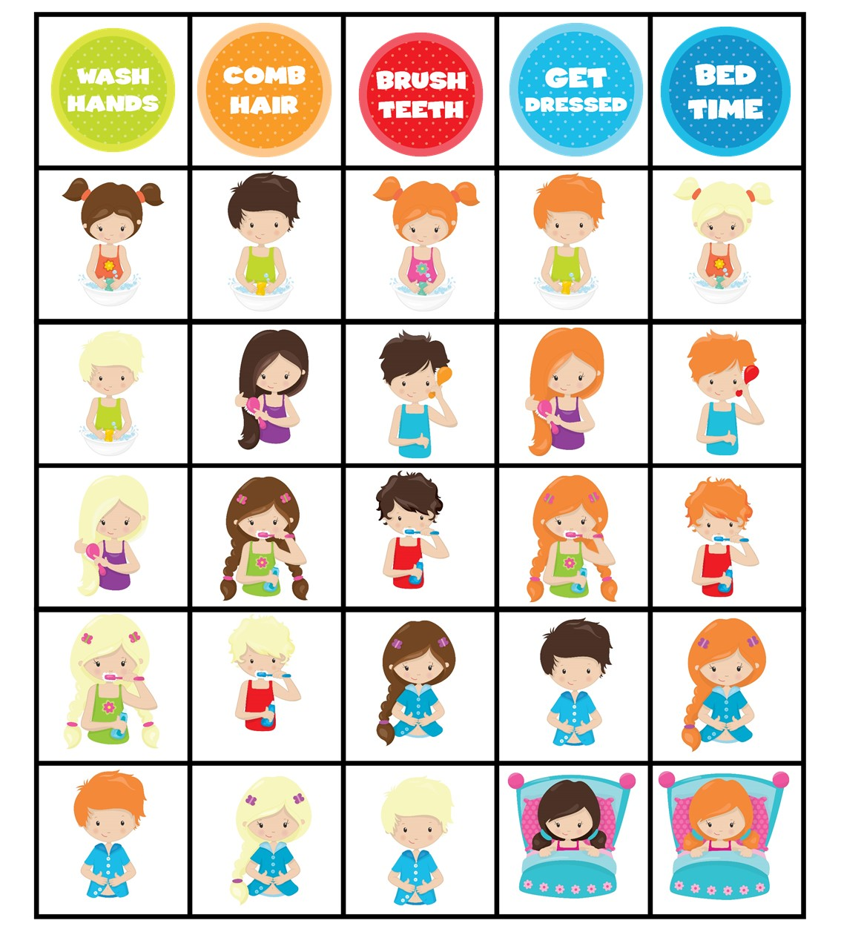
Visual Schedules
Visual Schedules, planners, calendars, review frequently and verbally prompt the person back to the schedule for questions

Slide 26
Transitions
Transitions can be incredibly difficult with individuals with ASD. Stopping one activity and moving to the next can result in immediate anxiety and escalation.
Individuals with ASD may have difficulty shifting attention from one task to another
Transitions can disrupt the persons greater need for predictability and routine
Transitions can be as small as getting out of the car or as large as moving to a new home
Transitioning to a less rewarding activity may lead to problematic behaviors or a slower transition

Slide 27
Strategies to Assist with Transitions
Visual Schedules increasing predictability in the transition
Allowing extra time for transitions as needed but making wait time for the next activity as short as possible
Visual aides, timers, cues
Pre-teaching, count downs, verbal reminders
Planning breaks when needed throughout the transition
Allowing for sensory needs (walking in a crowded hallway while transitioning classes)
Providing fidgets, sensory items, headphones to manage anxiety during transitions
Active listening
Social Stories
Engage in a preferred activity when the transition is complete referencing as needed
during the transition.

Slide 28
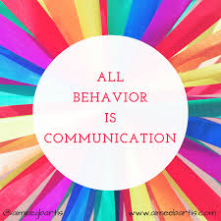
Behavior is Communication Regardless of Diagnosis
Sometimes individuals with ASD engage in challenging behaviors in order to cope with their surroundings, communicate a need or perceived need, express their emotions, deal with hyper or hyposensitivity, handle changes in routine or transitions.
When challenging behaviors occur, look behind the behavior to identify the antecedent or trigger.
Consider the persons needs; sensory, structure, predictability, routine, social and communication barriers, transitions, environment, etc.

Slide 29
Strategies to Support Behavioral Needs
Ignore the problem behavior when possible and safe to do so
Simplify the task or break it into steps
Alternate preferred and non-preferred activities
Analyze and adapt the environment to address sensory and structure/predictability/routine needs
Pre-teach to decrease anxiety
Provide positive praise that is specific and timely
Give the person space and minimize verbal communication if someone is triggered or escalating
Organize and provide structure and routine
Ensure the person has ample processing time
Use scripted responses to increase predictability and ensure there are consistent boundaries in place
Address medical needs and ensure their physical health is assessed by a professional
Train staff on the Autism Spectrum and the needs of the individual

Slide 30

Autism is a way of being.
It is pervasive; it colors
every experience, every
sensation, perception,
thought, emotion, and
encounter, every aspect
of existence.
-Jim Sinclair

Slide 31
Thank You!

Slide 32


