Slide 2
Toll Free: 1-855-643-8180 Email: Kancare.ombudsman@ks.gov Wichita Satellite Office: Aurora Myers, Community Program Specialist Aurora.myers@wichita.edu (316) 978-3566 Follow us on Facebook for resources & updates: @KanCareOmbudsman kancare.ks.gov/kancare-ombudsman-office Stay updated on resources & news by following the

Slide 3
KanCare started in 2013
KanCare Ombudsman Office also started in 2013
Responsive to CMS grant requirements & expectations
The KanCare Ombudsman Office provides reports quarterly and annually to the Bethel Joint Committee on HCBS and KanCare Oversight (at the State legislature) and to the Centers for Medicare and Medicaid Services through KDHE.
Ombudsman information on KanCare website:
www.kancare.ks.gov
https://kancare.ks.gov/kancare-ombudsman-office

Slide 4
KanCare Ombudsman Office
Not a dept. of KanCare – neutral, parallel office
Located under Kansas Office of Public Advocates as of 2022 (KOPA)
Attached to Dept of Administration
Pre-2022: still parallel, but officed in KDADS
(KanCare is KDHE & KDADS)
Report KanCare Ombudsman’s office data to KS Legislature and CMS
Making KanCare better for members

Slide 5
KanCare Ombudsman Office Purpose
Here to assist in KanCare quality of service
Goal is to educate and assist Kansas Medicaid members in navigating the Medicaid system & to help resolve issues they may have with their managed care organizations, providers, state agencies, or the KanCare Clearinghouse.
This includes Medicaid members with long term care services, such as those in nursing homes and with Home and Community Based Services (HCBS).

Slide 6
KanCare Ombudsman Office
Here to assist in KanCare quality of service
Also provide resources to applicants and those seeking KanCare information
Application assistance, eligibility fact sheets, 3-way phone calls to Clearinghouse/MCOs/other systems players
Notes:
* Yellow slides: How do we assist in quality of service

Slide 7
KanCare Ombudsman Office
Here to assist in KanCare quality of service
Provide resources and education for community partners
Application explainers, fact sheets, “Who Should I Call?” guides, community resources, etc
Coming soon: line-by-line application training modules
Attend outreach events, exhibit at conferences
Accept referrals through local networks – Wellsky/Healthify, IRIS/findhelp
Attend regular community partnership meetings –
Listen for trends & concerns and report back to KDHE – create resources to respond

Slide 8
Our Reach
Approximately 430,000 KanCare members in Kansas
One KanCare Ombudsman: Suzanne Lueker (replacing Kerrie Bacon)
Two KOPA FT employees (KC & Topeka)
One WSU satellite office FT employee
Volunteer team (6-20 volunteers across KC/WSU offices)
1-855-643-8180
To assist KanCare members, we have created both the KanCare Ombudsman Volunteer Program and the KanCare Ombudsman Outreach & Resources materials

Slide 9
KanCare Ombudsman Volunteer Program
Services are free, unbiased, and confidential
Trained staff & volunteers answer questions & assist in the resolution of Medicaid-related issues
We work as a team across all offices
Resource-connectors rather than case managers
855-643-8180

Slide 10
Medicare Questions? Not us! But we refer!
Senior Health Insurance Counseling for Kansas – SHICK Counselors
800-633-4227

Slide 11
General Medicaid Questions

Slide 12
Medicare
Medicaid = KanCare
Eligibility is not income-based
Federally-run
Divided into different four parts (Parts A-D) and three levels of service (QMB, LMB, and ELMB)
Must be at least 65 years old
You may qualify earlier if you are receiving retirement benefits before age 65, have a disability, end-stage renal disease (ESRD), or amyotrophic lateral sclerosis (ALS).
Eligibility is income-based
State-run
Divided into different programs (CHIP, Medically Needy, HCBS, etc.)
Must have low income and be: pregnant, a child, a parent/caregiver of child, an elderly person, and/or a person with disability
You may also qualify if you have low income and are receiving inpatient treatment for tuberculosis or have been screened and diagnosed with breast or cervical cancer through the Early Detection Works program.
Notes:
Someone may have both Medicare and KanCare (Kansas Medicaid) at the same time (Dual Eligibility).
Someone may even have (1) Medicare, (2) private insurance and (3) Medicaid.
Medicaid is ALWAYS the payer of last resort. Their Medicare pays first, their private/supplemental insurance second, and Medicaid pays last.
Acronyms to know:
CHIP – Children’s Health Insurance Program
HCBS – Home and Community Based Services
QMB - Qualified Medicare Beneficiary (automatically eligible for Medicaid)
LMB - Limited Medicare Beneficiary
ELMB - Extended Limited Medicare Beneficiary
Part A – medical, hospital, and skilled nursing care
Part B – outpatient medical care
Part C – optional buy-in for extra coverage (Medicare Advantage Plan)
Part D – prescriptions

Slide 13
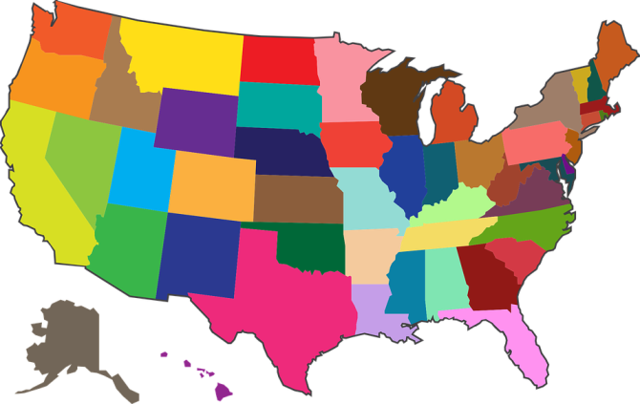
Medicaid Differs State-to-State
Just because a consumer was eligible for Medicaid in another state does NOT mean they will also be eligible in Kansas.
Even if they are eligible in Kansas, the scope of benefits and services may vary as well.

Slide 14
Medicaid Differs State-to-State
Someone who had Medicaid in another state MUST reapply in Kansas.
They must cancel the Medicaid account they have in the state they have left behind.
If they are here and have the intent to stay, they can apply immediately.
Notes:
DO NOT WAIT TO APPLY!

Slide 15
Medicaid Lingo
KDHE & KDADS programs
MCOs (Managed Care Organizations)
Clearinghouse is in Topeka & handles all eligibility & renewal
1-800-792-4884
www.kancare.ks.gov
HCBS/waivers
Notes:
Someone may even have (1) Medicare, (2) private insurance and (3) Medicaid.
Medicaid is ALWAYS the payer of last resort. Their Medicare pays first, their private/supplemental insurance second, and Medicaid pays last.
Acronyms to know:
CHIP – Children’s Health Insurance Program
HCBS – Home and Community Based Services

Slide 16
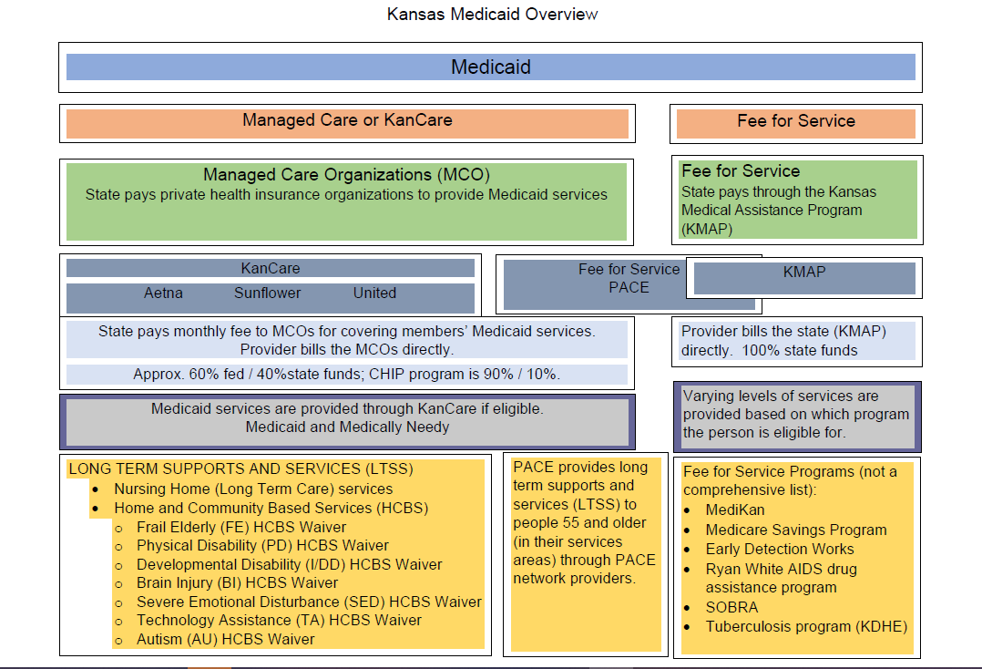

Slide 17
What Just Happened?? – Living Through Medicaid Unwinding
“Unwinding” – end of the COVID Public Health Emergency
In April, members began receiving renewal packets for the first time in 3 years
Clearinghouse still handles eligibility and all renewal paperwork. Phone calls are still best way to talk to someone about your case.
1-800-792-4884

Slide 18
What Just Happened?? – Living Through Medicaid Unwinding
https://www.kancare.ks.gov/about-kancare/unwinding
https://getcoveredkansas.org/renewals

Slide 19
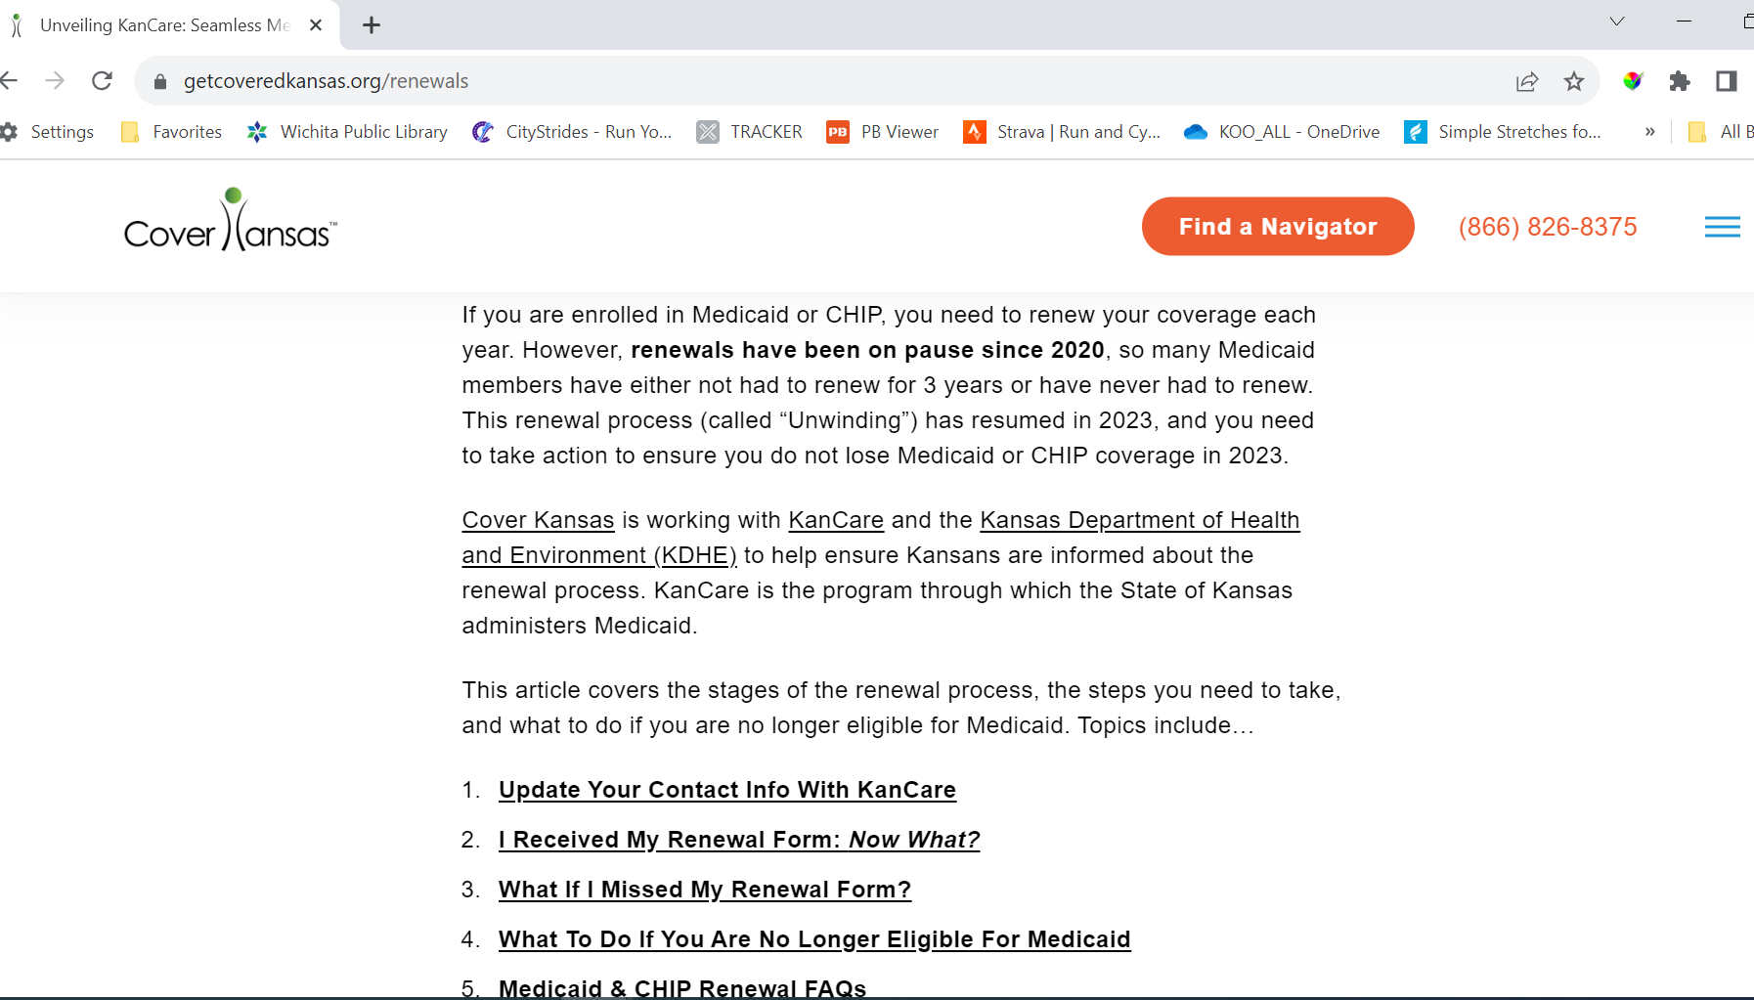
What Just Happened?? – Living Through Medicaid Unwinding

Slide 20
Medicaid
KanCare is provided to all Medicaid consumers.
Medicaid is available to help low-income children and families, elderly and people with disabilities.
FAMILIES WITH CHILDREN programs (separate app packet)
Children under 19 (including those who are in foster care or who get adoption support payments)
Pregnant Women
Adult Parents and Caregivers (caring for children under 19)
ELDERLY & PERSONS WITH DISABILITIES programs (separate app packet)
Elderly (65 and older)
Persons with Disabilities (child or adult) - persons determined blind or disabled by Social Security (SSDI and/or SSI) or in the process of determining if they are approved for Social Security.
Notes:
The following populations may also be eligible for Medicaid (if also financially eligible), but the application they complete is different, and is generally completed at the clinic upon diagnosis of their condition:
Persons receiving inpatient treatment for tuberculosis
Persons screened and diagnosed with breast or cervical cancer through the Early Detection Works program

Slide 21
Elderly & Persons with Disabilities
Health coverage and long-term care for people over age 65 and people with disabilities is available through KanCare.
Participants may also be eligible for Home and Community Based Services (HCBS) as an alternative to institutional care.
HCBS waiver programs (FE, PD, I/DD, BI, SED, AU, TA)
KanCare can be used in conjunction with Medicare benefits and covers some services, including nursing home and long-term care, that are not covered by Medicare.
NF & PACE programs
Participants may also receive financial assistance for out-of-pocket Medicare expenses.
Medicare Savings Programs (can have this AND others)
Notes:
Application: Medical Assistance for the Elderly and Persons with Disabilities

Slide 22
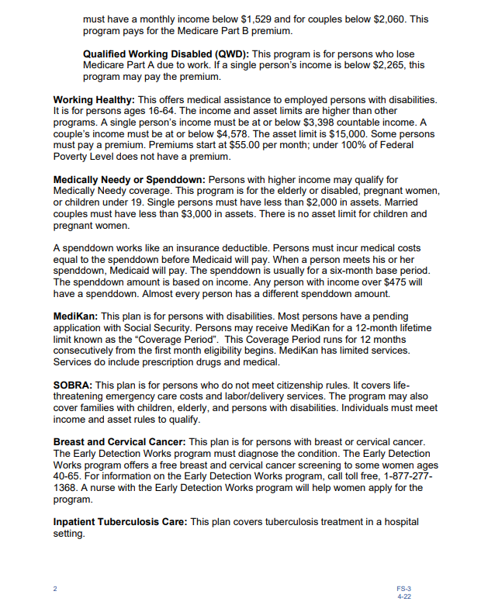
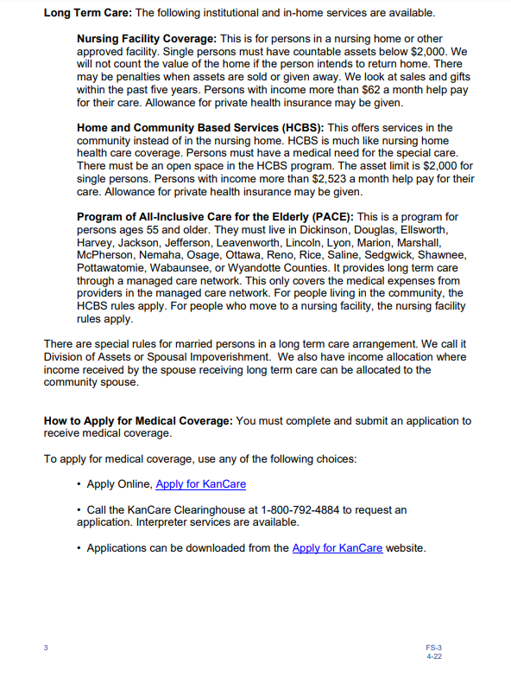
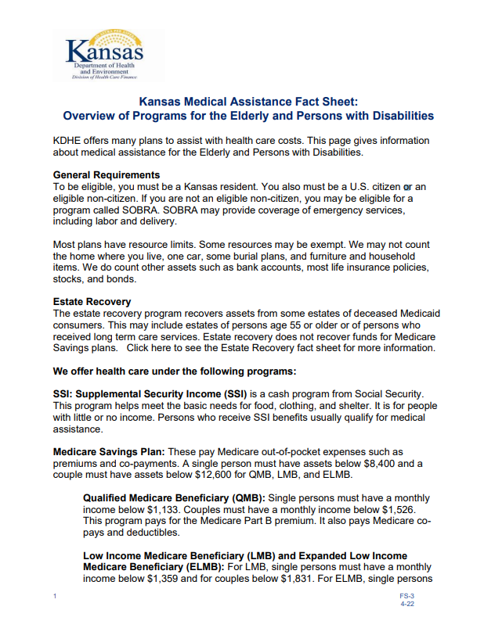
Fact Sheet: Overview of Programs for Elderly and Persons with Disabilities
Notes:
This Fact Sheet gives an overview of all the programs that can be applied for on the “Medical Assistance for the Elderly and Persons with Disabilities” application as well as the general eligibility requirements for each.
Programs:
Medically Needy Program (Spenddown)
Working Healthy
Home & Community Based Services (HCBS Waiver Programs)
Nursing Home or Other LTC Facility
Program of All-Inclusive Care for the Elderly (PACE)
Medicare Savings Program (assistance with out-of-pocket Medicare costs)
MediKan

Slide 23
MediKan
This plan covers individuals with physical or mental disabilities, who have very low income and resources, but do not qualify for Medicaid.
While Medicaid is funded by both state and federal funds, and ran by the state, MediKan is ran and funded only by the state.
Overall, the scope of services covered by MediKan is similar the scope of those covered by Medicaid. However, some restrictions and limitations apply. Services do include prescription drugs and medical.
Notes:
Application: Medical Assistance for the Elderly and Persons with Disabilities
MediKan is different than other KanCare programs because it is not something someone can directly apply for. It is a program that the eligibility team looks into when they know someone is not yet eligible for any other Medicaid program. This sometimes makes people confused.
In general, MediKan pays on everything Medicaid pays on except:
HCBS
LTC
Drug Rehab
Certain Rx
And MediKan does pay as much.
If a provider has a certain item in mind and wants to know if that is going to be paid, they can call KMAP at 1-800-933-6593.

Slide 24
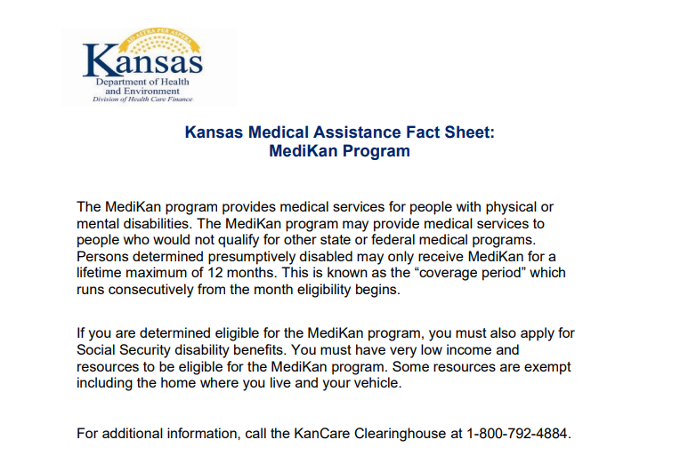
Fact Sheet: MediKan Program
Applying for KanCare may result in receiving MediKan if the person has a pending Social Security Disability case.
Persons may only receive MediKan for a maximum of 12 months.
Notes:
A referral to PMDT to complete a determination for MediKan:
A referral to the Presumptive Medicaid Determination Team (PMDT) by the KDHE eligibility team is necessary in order to complete a disability determination for:
(Tier One): Presumptive Medicaid Disability
(Tier Two): MediKan
If the applicant does not submit documentation proving that they have a pending disability case with the Social Security Administration, the PMDT referral may not take place, and the applicant may be denied KanCare services.
What type of documentation is considered proof? (1) an appointment letter or (2) copy of the appeal with SSA for recently denied disability determination or (3) something from your most recent mail from the SSA that shows you have a pending disability case.
MediKan coverage begins at the first of the month of application.
If the application date is 1-15-23, and it is not fully processed until 2-7-23, the 12-month coverage period will be 1-01-23 to 1-01-24. It is important that applicants get everything in on time and complete, including the PMDT paperwork.

Slide 25
Additional Medical Assistance Programs
The KanCare program also offers coverage to people who have income “over the maximum income level” allowed for Medicaid eligibility.
These individuals must pay a “share of cost” of their medical bills in the form of deductibles or monthly premiums.
These “Cost Share Programs” include:
HCBS Waivers (Client Obligation - monthly premium)
Nursing Home (Patient Liability - monthly premium)
PACE (PACE Participation Obligation - monthly premium)
Medically Needy (Spenddowns - deductible)
Working Healthy (monthly premium)
Notes:
The application for these KanCare Programs: Medical Assistance for the Elderly and Persons with Disabilities

Slide 26
Home and Community Based Services (HCBS)
P5
Notes:
The Home and Community based Services or HCBS waivers are the first type of medical assistance listed on the KanCare application for the Elderly and Person’s with a Disability.
This is where you will commonly see children’s coverage on the E&D app

Slide 27
What is an HCBS Waiver?
An HCBS waiver is a KanCare (Kansas Medicaid) program that provides services to a person in their home and community rather than in an institutional setting, such as a nursing home or state hospital.
An alternative to hospitalization or institutional type of care.
If you or a loved one needs assistance to be able to remain in your home and community, an HCBS waiver may be able to help.
Only covers the recipient – not family members
Financial elig determined by the recipient’s income & assets
https://www.kancare.ks.gov/docs/default-source/consumers/benefits-and-services/fact-sheets/fs-7-home-and-community-based-services-fact-sheet.pdf?sfvrsn=d5e7501b_4 and
https://www.kancare.ks.gov/docs/default-source/consumers/benefits-and-services/fact-sheets/fs-7-s-servicios-basados-en-el-hogar-y-la-comunidad-de-medicaid-(hcbs).pdf?sfvrsn=eee7501b_4

Slide 28
Fact Sheets Galore!
https://www.kancare.ks.gov/docs/default-source/consumers/benefits-and-services/fact-sheets/fs-7-home-and-community-based-services-fact-sheet.pdf?sfvrsn=d5e7501b_4 and Spanish: https://www.kancare.ks.gov/docs/default-source/consumers/benefits-and-services/fact-sheets/fs-7-s-servicios-basados-en-el-hogar-y-la-comunidad-de-medicaid-(hcbs).pdf?sfvrsn=eee7501b_4
https://www.kancare.ks.gov/kancare-ombudsman-office/hcbs-waiver-fact-sheets

Slide 29
7 HCBS Waiver Programs
Kansas currently has seven different HCBS waiver programs, each with a different set of rules.
Autism Waiver (AU Waiver)
Frail Elderly Waiver (FE Waiver)
Intellectual/Developmental Disabilities Waiver (I/DD Waiver)
Physical Disability Waiver (PD Waiver)
Serious Emotional Disturbance Waiver (SED Waiver)
Technology Assisted Waiver (TA Waiver)
Brain Injury Waiver (BI Waiver)
Notes:
Check out the resources at the end of this presentation for a more in-depth look into each waiver program.

Slide 30
Nursing Home (LTC Institutional Facility)
P5

Slide 31
Nursing Home or Other Facility
Long Term Institutional Care
This category of coverage is for children and adults residing in a nursing home, medical or mental health institution or similar facility for a long-term stay.
Like all KanCare programs, financial eligibility is based on income and resources.
KanCare offers LTC coverage to people who have income over the maximum income level. These individuals must “Share the Cost” for their medical expenses.
They are responsible for a portion of the cost of their care in the form of a monthly premium called a Patient Liability.
Notes:
These individuals must pay their Patient Liability (their portion of the shared medical expenses) to the long-term care facility.
The (out-of-pocket) cost of care and services for the person must be higher than the Patient Liability (monthly premium) or the person may be reviewed for a different program or may be denied eligibility.

Slide 32
Program of All-Inclusive Care for the Elderly (PACE)
P. 5

Slide 33
Medicare Savings Program
Notes:
The Medicare Savings Program is not a Cost Share Program, but it is one of the programs you can apply for on the Medical Assistance Application for the Elderly and Disabled, so we are going to review it in this section.

Slide 34
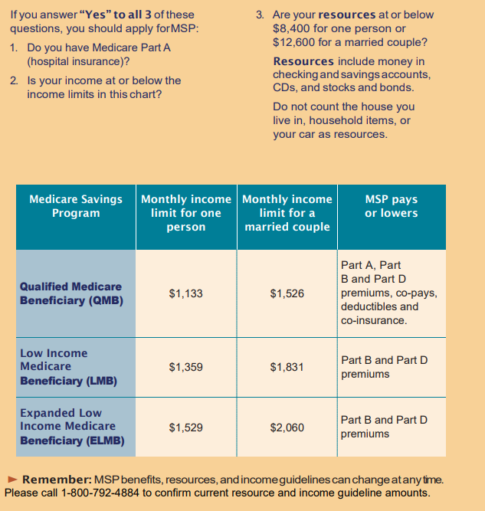
Medicare Savings Program (MSP)
This program is for people who have Medicare and helps with some of the out-of-pockets expenses. This program may pay for Medicare Part A, Part B and/or Part D premiums, deductibles, and copayments (based on income).
Notes:
If you have someone who knows they are not eligible for Medicaid, but they need help with their Medicare premiums and co-payments, they can complete a Medicare Savings Program application. (3 pages in length)
This program will be discussed further in module 5.B MSP and Extra Help
If the applicant checks the box “Medicare costs only (no other KanCare assistance” it may be a good time to stop and ask the applicant if they want to fill out the MSP app instead.

Slide 35
Types of Assistance on the Application for The Elderly & Persons with Disabilities
P1, L5-11

Slide 36
Medically Needy
This program is for:
The elderly (age 65 and over)
Persons with disabilities
Pregnant women
Children under 19
This program is for individuals who make too much income to qualify for Medicaid but qualify anyway because they have consistently high medical bills that will likely impoverish them without the state’s assistance.
They are Medicaid eligible “with a Spenddown.”

Slide 37
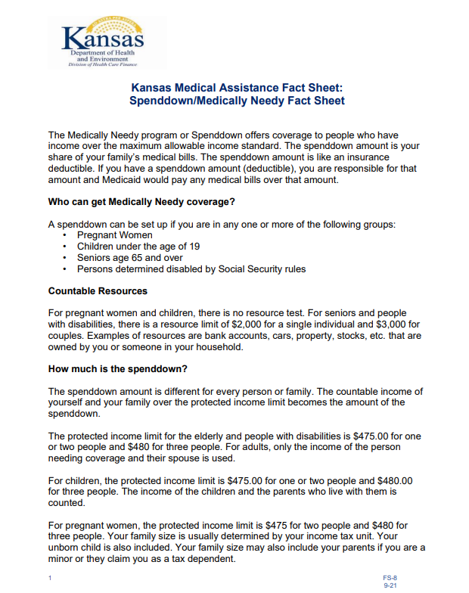
Fact Sheet: Medically Needy
This Fact Sheet gives information about:
The Medically Needy Program & its basic eligibility requirements
Spenddowns and how they are calculated.

Slide 38
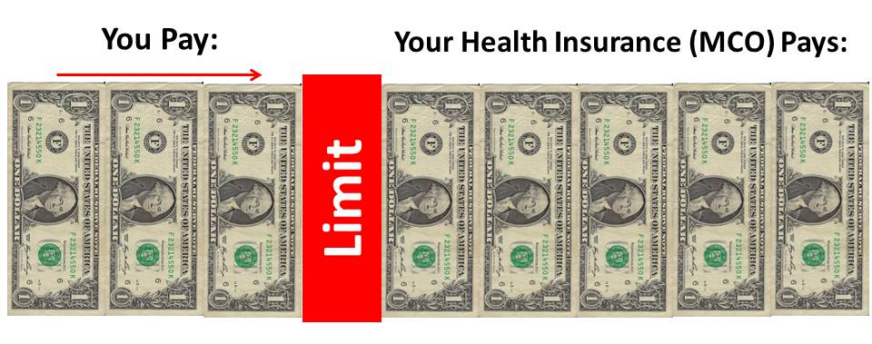
What is a Spenddown?
A Spenddown works like an insurance deductible.
Like an insurance deductible, persons must incur medical costs equal to a set amount (their deductible) before their health insurance provider will pay.
When a person meets his or her deductible (spenddown), health insurance (Medicaid) will pay for covered medical expenses.

Slide 39
Spenddowns
Unlike the average insurance deductible, a spenddown repeats every six months (rather than once per year).
The spenddown amount is based on income.
Almost every person has a different spenddown amount.

Slide 40
The consumer’s medical costs must be consistently high every month to remain eligible:
As long as the KanCare consumer’s medical costs remain consistently high, they will continue to be eligible for Medicaid under the Medically Needy Program.
However, if the consumer’s incurred medical costs do NOT consistently reach the spenddown amount (deductible amount), the consumer is not using the Medicaid coverage, and will no longer be eligible for Medicaid.
Notes:
If the Joe in the earlier example does not incur (close to 100%) $13,290 in medical bills every six months…
He may no longer be eligible for Medicaid.
If his medical bills become consistently high again in the future, he can reapply at that time.

Slide 41
Working Healthy

Slide 42
Eligibility Questions
How can I find out if I am eligible for Medicaid?
Three ways to investigate eligibility:
Applicants may read through the appropriate Fact Sheet(s).
Applicants may complete the on-line Eligibility Check (not a guarantee)
Applicants may apply for KanCare (recommended)
Notes:
The KanCare Ombudsman office does NOT determine if the individual or family is “eligible” for KanCare services.
But there are three ways you can help an applicant to investigate eligibility.
Three ways to investigate eligibility:
Applicants may read through the appropriate Fact Sheet(s).
Applicants may complete the on-line Eligibility Check (not a guarantee)
Applicants may apply for KanCare (recommended)

Slide 43
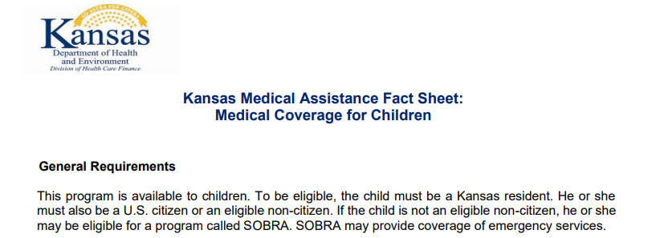
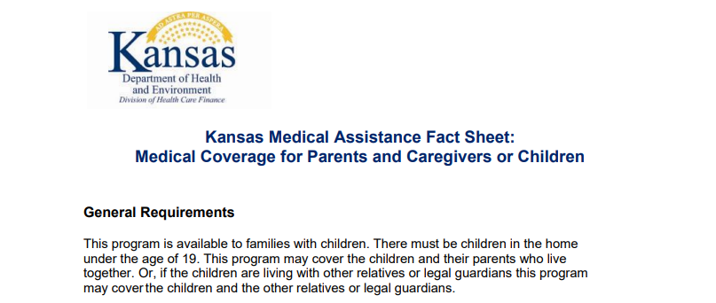
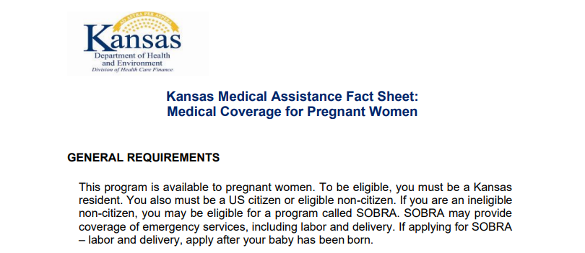
Investigate Eligibility with the KDHE Program Fact Sheets
There is a Fact Sheet for each program that provides an (1) overview of the program and (2) its general eligibility requirements.
Notes:
If you use a Fact Sheet to investigate eligibility, just find the ones that fit the caller’s situation:
Fact Sheets:
Children’s Programs
Pregnant Women Program
Parent/Caregiver (with children under 19)
Elderly (65 and older) and Persons with Disabilities
Each program is different, and they all have their own eligibility rules!
For example, one program may count the child and their parents’ income, and another program may only count the child’s income. Use the KDHE Program Fact Sheets to get to know the different programs.

Slide 44
Another Option to Investigate Eligibility
The online eligibility check tool takes less than 5 minutes!
Answer 11 questions to get an idea of whether you may be eligible or not.
Notes:
You may help individuals to check their eligibility online at: www.applyforkancare.ks.gov
This online tool does not ask for private health information.

Slide 45
Volunteers can type in the information for a caller because there is no Protected Health Information involved.
Notes:
Make sure the individual understands that this is not a guarantee and that you are in no way promising them eligibility.
Example Response to Consumer:
“Based on the information you just gave me and the “Eligibility Check” online tool, you will likely be eligible.”
*Let them know that they would still need to apply to be sure.
*This online tool has limitations: Will not always inform you of programs that you may be eligible for, when those programs allow you to have a higher income but pay a deductible or monthly premium.

Slide 46
Application Process – slides 47-122 Slides 123+ -- Helpful links, How-to’s, FAQs

Slide 47
Application FAQs
How do I apply for KanCare?
Where do I send my Application?
What if I have questions while I am completing the application?
How do I check the status of my application?
What is the average wait time for an application to process?
What can I do if I have been waiting longer than usual for my application to process?
How will I be notified that I have been approved or denied KanCare health coverage?
What if I am denied KanCare services?

Slide 48
Guides available online! https://www.kancare.ks.gov/consumers/apply-for-kancare

Slide 49
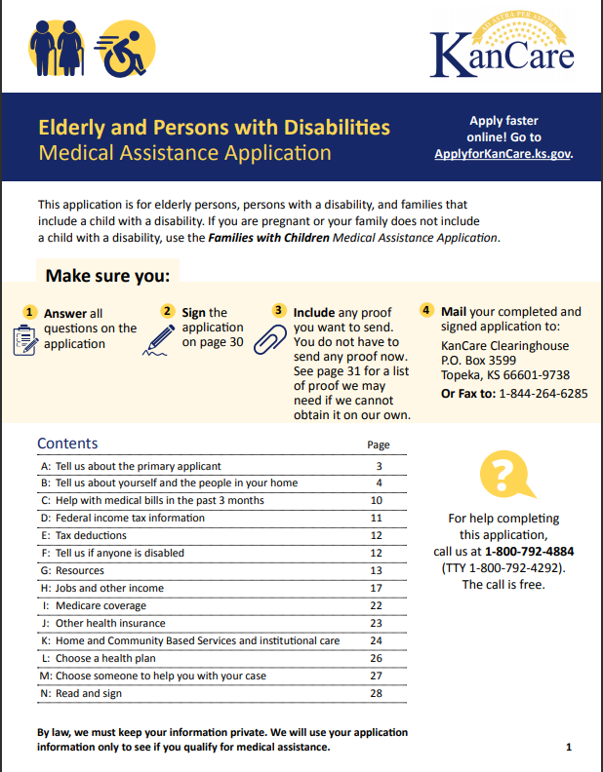
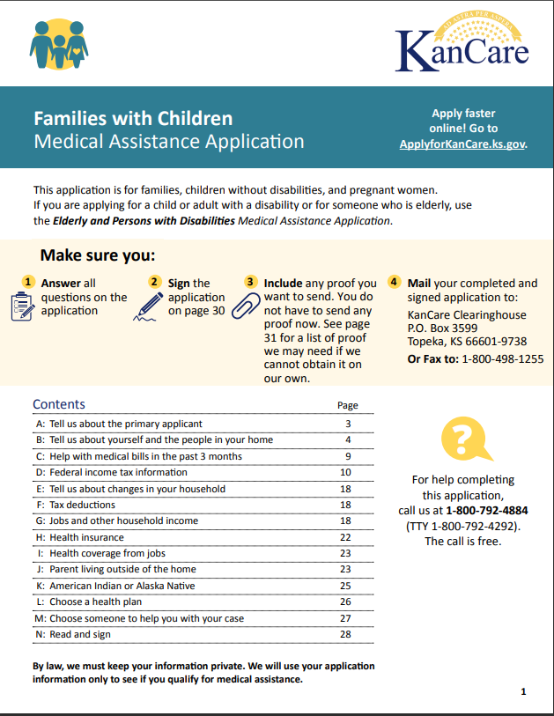
Two Ways to Apply
TWO Types of Paper Applications
ONE Online Application
Notes:
Paper Applications:
a. Application for Families with Children
Children under 19
Families with children under 19
Pregnant women
b. Application for the Elderly and Persons with Disabilities
Elderly (65 and older)
Persons with Disabilities (child or adult)
Clarification on Children under 19:
A child under 19 will use the Families with Children application if applying for regular Medicaid or CHIP. However, if they are applying for the Medically Needy program, Nursing Facility Program, or for an HCBS waiver program, they’ll use the Elderly and Persons with Disabilities application.
Online Application:
There is only one online application. The online application is intuitive and changes depending on the data that is entered by each applicant; it will work for all the possible KanCare programs. URL: www.kancare.ks.gov/consumers/apply-for-kancare Videos have been created to help the applicant navigate the medical Self-Service Portal and they can be found here: https://vimeo.com/showcase/8602150

Slide 50
How to Apply?
To apply for medical coverage, use any of the following choices:
Call the Clearinghouse at 1-800-792-4884 to request an application be mailed to you.
Applications can be downloaded from the KanCare or KDHE websites.
Apply online from the KanCare or KDHE websites.
Notes:
You can attach additional documents to the online version of the application (ex: proof of income, proof of resources, proof of health insurance, etc.).
If the applicant decides to apply online and does not attach copies of these documents to the online application, they can mail or fax the documentation they need (proof of income, etc.) to the Clearinghouse separately. Please do so as soon as possible.
Follow up with the Clearinghouse a few days later to make sure they have received both the application and the separately submitted documentation.
While you have them on the phone, ask if there is any other documentation they need turned in at this time.
Be on the lookout for a letter requesting more information. Responding in a timely manner will help you to avoid delays.

Slide 51
Where do I Send my Paper Application?
You can mail or fax your KanCare Application (along with all the necessary documentation) to the KanCare Clearinghouse:
Mail to:
Kancare Clearinghouse
PO BOX 3599
Topeka, KS, 66601-9738
Fax To:
Fax for Families with Children Department: 1-800-498-1255
Fax for Elderly and Disabled Department: 1-844-264-6285

Slide 52
Before you Start
You can attach additional documents to the paper version of the application (ex: proof of income, proof of resources, proof of health insurance, etc.). Treat it like an essay test, not an SAT.
If the applicant decides to apply online and does not attach copies of these documents to the online application, they can mail or fax the documentation they need (proof of income, etc.) to the Clearinghouse separately. Please do so as soon as possible.
Follow up with the Clearinghouse a few days later to make sure they have received both the application and the separately submitted documentation.
While you have them on the phone, ask if there is any other documentation they need turned in at this time.

Slide 53
Watch THE MAILBOX for Requests for More Information
The KanCare Clearinghouse (CH) may send a letter asking for additional information, which is required to process your application.
Not turning in the requested documentation in a timely fashion will cause delays or a denial in application processing.
Watch for the deadlines on the letters! A missed deadline may cause a denial of services.
The person who applied will be notified by letter if their application has been approved or denied.
With unhoused clientele it is important to note that the mailing address must be filled out, and it can be the shelter address. A physical address is not needed.
An applicant can use a P.O. Box as a mailing address. They must tell the eligibility team where they physically live (in Kansas); that could be “homeless.”

Slide 54
Before you Start
A few themes to address before one begins this process.
Whatever information you claim on the application MUST be backed up (additional documentation).
If someone is in your household, they MUST be on the application.
Fill out EVERYTHING. Don’t leave anything blank.

Slide 55
A Guide to Completing a KanCare Application
For the Elderly and Persons with Disabilities
Get your coffee and buckle up, it is LINE BY LINE

Slide 56
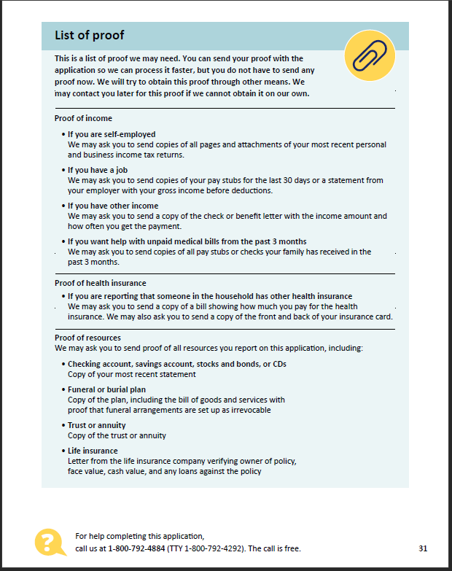
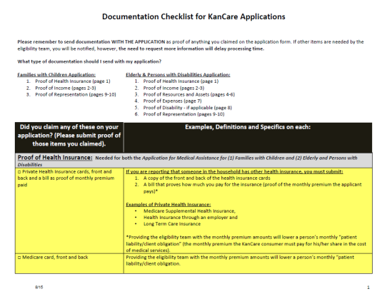
Additional Documentation
When you submit your KanCare application, you will also need to send proof of certain things.
You must be willing and able to provide additional documentation proving any information you claimed on the application form.
(Page 31 of application)
This may include:
Proof of Income
Proof of Resources/Assets
Proof of Health Insurance
Proof of Pending Disability (if applicable)
Proof of Expenses
Proof of Representative
(Documentation Checklist)
Notes:
You should send in the application as soon as it is completed, but whatever you claim must be backed up.
By sending all the required proof up front, your application can be processed more quickly.
There is still the possibility of more information being requested. Watch your mailbox closely.

Slide 57
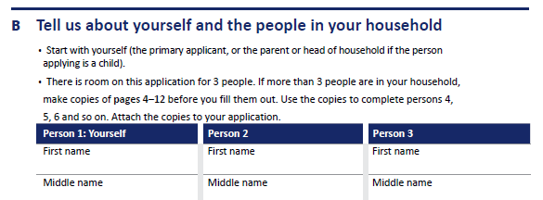
Report Everyone in the Household
If someone is in your household, they MUST be on the application, even if they are not applying for insurance.
If they are not applying for insurance, the information you give on them may be very basic.

Slide 58
Don’t Leave Anything Blank
Fill out EVERYTHING.
If something does not apply to you (the applicant), do not leave it blank.
Put N/A (not applicable) clearly so that the Eligibility Team knows this does not have to be investigated further.

Slide 59
Page 1- Informational Page
- Who can use this application?
Answer all questions
Sign the application
3. Include proof
4. Mail to the Clearinghouse
Who to call for help
Contents

Slide 60
Who Can Use this Application?
P.1
This application is for individuals who are:
Elderly (65 and older)
Persons with Disabilities (child or adult) - persons determined blind or disabled by Social Security (SSDI and/or SSI) or trying to get there (PMDT)
Notes:
Clarification on Children under 19:
A child under 19 will use the Families with Children application if applying for regular Medicaid or CHIP. However, if they are applying for the Medically Needy program, Nursing Facility Program, or for an HCBS waiver program, they will use the Elderly and Persons with Disabilities application.
Note on Waiver Programs (and Proof of Pending Disability):
Adult consumers (18+ years of age), if not already on SSI/SSDI, must apply for SSI/SSDI if applying for any of the following HCBS Waivers: TBI, PD or I/DD.
Children under 18 do not have to apply for SS-DS, even if applying for a waiver program.

Slide 61
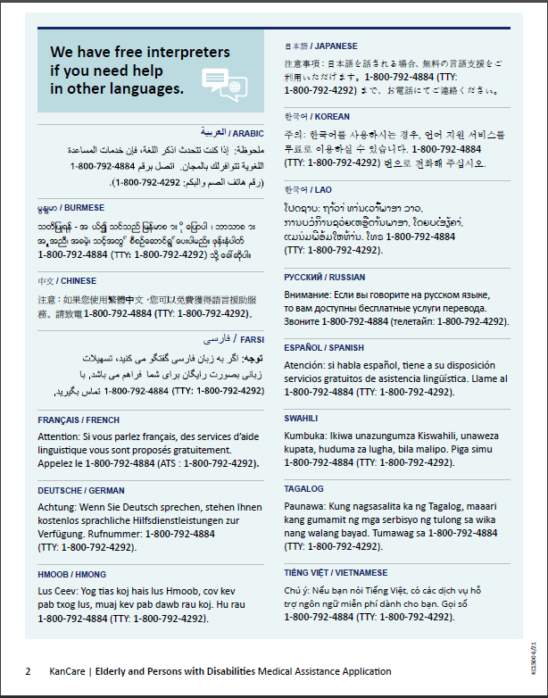
Page 2. - Interpreter Services
This page lists the languages available through free interpretation services.

Slide 62
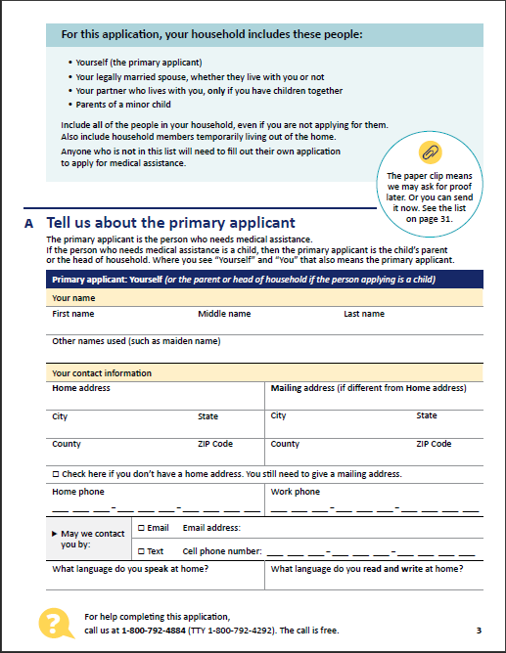
Page 3.A - Tell us about the primary applicant

Slide 63
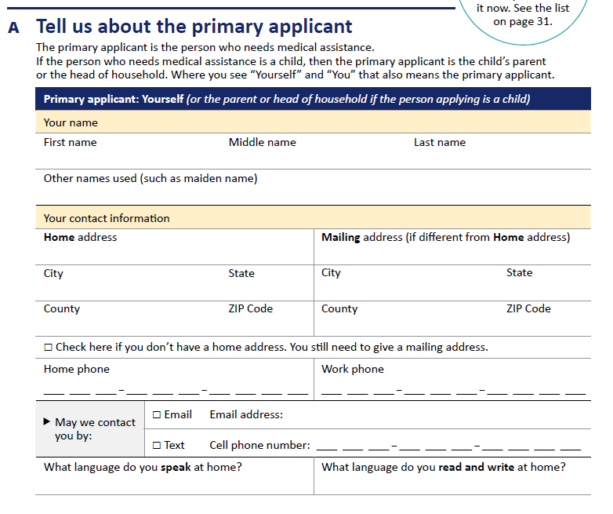
Primary Applicant Contact Information
What’s important to know:
When assisting a nursing facility resident, the home address entered should be the address of the facility where the individual resides.
A correct phone number and correct address are important. Email and text are not important, as KDHE does not currently use these forms of communication.
P3, Section A
Notes:
What if the applicant has a P.O. Box?
An applicant can use a P.O. Box as a mailing address. They must tell the eligibility team where they physically live (in Kansas); that could be “homeless.”
Note to Nursing Homes:
People in Nursing homes must have their residential and their mailing address as the Nursing Home. If they want their mail to go elsewhere, they must have a medical representative.

Slide 64
Page 4. - Tell us about yourself and the people in your household
This page asks for more information about the primary applicant (person 1) and others living in the home.

Slide 65
Who are “Persons One, Two, & Three?”
The individual needing medical assistance should be entered as “Person One” (if they are an adult, 18+ years).
Their spouse would be entered as “Person Two.” The spouse’s information must be entered, even if they do not need medical assistance.
And anyone else living in the household would be entered as “Person Three,” even if they do not need medical assistance.
You will need to attach another sheet of paper if more than three people reside in the home.
P4, Section B
Notes:
If they are not applying for Medicaid coverage: YOU STILL NEED TO INCLUDE THEM.
If they are not applying for insurance, the information you give on them may be very basic.
Each medical program has different income/asset rules.
On the application, list each person who is living in your home. The eligibility worker will decide who must be included in your household for your medical assistance plan.
Different income/asset rules apply to different programs. Sometimes:
For adults: The income/assets of the person needing coverage and their spouse is used.
For adults: The income/assets of only the person needing LTC coverage is being counted, after a Division of Assets has been completed.
For children: The income of the children and the parents who live with them is counted.
For children: The income of only the child is counted.
Some programs count assets/resources, and some do not.
What if individual needing assistance is under 18 years old?
If adult is filling out the application for someone younger than 18, the adult is “Person One,” and the child is “Person Two,” even if the adult does not need medical assistance.

Slide 66
If a family member, friend or neighbor is helping someone to complete the application:
They will not include their information in this section unless they are a member of the household.
Mistake often made on Page 3, Section C:
Many who assist nursing home residents may think they should enter information about themselves here. This is incorrect.
Adult children holding Durable Power of Attorney (DPOA) often enter their information here. This is incorrect (unless they are also living in the household of the individual applying for medical assistance).
P4, Section C

Slide 67
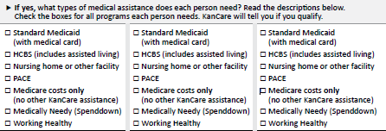
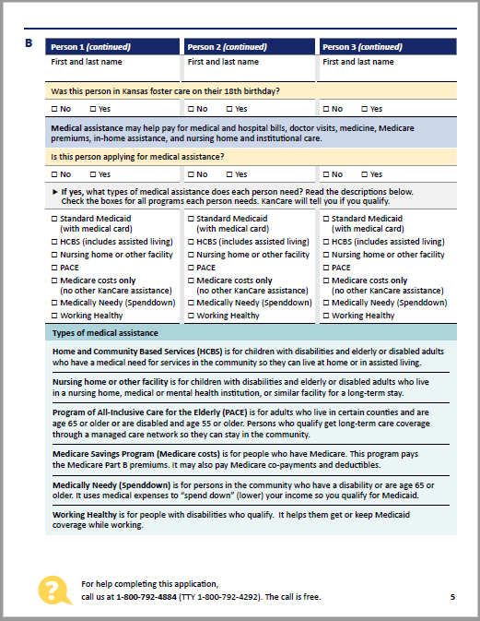
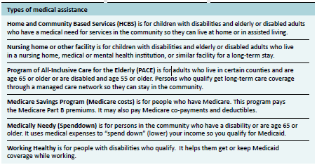
Page 5. – Part B continued & Types of medical assistance
Notes:
The first circled area is where the applicant can check the boxes next to the program(s) they are interested in applying for.
You may notice that “Standard Medicaid” does not have a section in the second circled area where it is further explained. Standard Medicaid is also known as Title 19 and is the type of coverage that members receive once they have met their spenddown through the Medically Needy program. Standard Medicaid is also provided to everyone on other KanCare programs. The maximum income limit for Title 19 is very low and not many people receive only Title 19.
There is also an option for “Medicare costs only (no other KanCare assistance)”. If the applicant is a Medicare recipient, they will automatically be screened for eligibility through the Medicare Savings Program (MSP). If the person applying is wanting to apply for MSP only, then we would suggest they stop filling out the Application for the Elderly and Persons with Disabilities and fill out the much shorter MSP application.

Slide 68
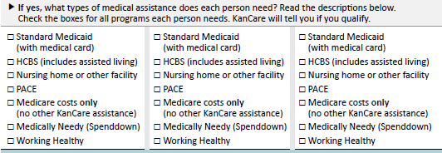
Who Needs Medical Assistance & Which Type
If you have checked “Yes” that this person is applying for medical assistance, be sure to indicate what types of assistance this person needs. Check all that apply.
Notes:
Important Note to Nursing Homes:
Does your facility have both “skilled nursing” and “assisted living” sections? If so, it is very important to know which section the resident is living in. Leaving the correct box blank or marking the wrong “type of assistance” will add to the application processing time.
If the resident applying for medical assistance is residing in the “skilled nursing” section of your nursing home, you MUST check “nursing home.”
If the resident applying for medical assistance is residing in the “assisted living” section of your nursing home, you MUST check “HCBS.”
If you have a family that is helping your resident apply for Medicaid, make sure they know which program to apply for (which box to check). Many families are not familiar with the difference between “assisted living” and “nursing home.”
Another Note to Nursing Homes:
What items must be completed and submitted in order to fully process the KanCare application?
KanCare Application for the Elderly & Persons with Disabilities (KC-1500)
2126 form must be completed and submitted (by the facility, NOT by the consumer) for all admissions and discharges
CARE Assessment (indicates the resident meets the level of care to be in the facility) is completed by KDADS/ADRC.

Slide 69
What type of services does KanCare cover?
P 5, L4
Medical
Hospital Bills
Doctor’s Visits
Medicine
Medicare Premiums
In-Home Assistance Services
Nursing Home Care
Institutional Care

Slide 70
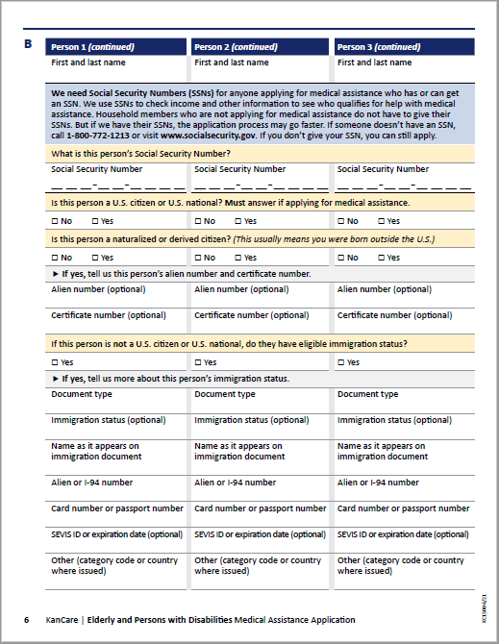
Page 6.B - Person 1-3 Continued
Notes:
Please take note of the circled area. Applicants are asked to continue answering questions about themselves and persons in their household.
It is important to enter the applicant’s social security number AND the social security number for anyone living in the household (even if not applying for medical assistance) to avoid processing delays.
Note: The Eligibility Team needs Social Security Numbers (SSNs) for everyone applying for medical assistance. People on the application who are not applying for medical assistance for themselves may choose not to give their SSN. If someone does not have an SSN, call 1-800-772-1213 or visit www.socialsecurity.gov .
On the line where it asks, “If this person is not a U.S. citizen or U.S. national, do they have eligible immigration status?” you can refer to the Citizenship and Identity Requirements Fact Sheet created by KDHE: fs-1-citizenship-and-identity-requirements-fact-sheet.pdf (ks.gov)
To be considered eligible for any of the KanCare medical assistance programs, non-U.S. citizens must :
Hold legal residency in the U.S. for 5 years or more, or;
Hold a certain immigration status.

Slide 71
Which immigrant statuses do not require 5 years legal residency?
Those individuals with a status listed below (Eligible Non-Citizens, Code: 2043):
Refugees admitted under 207 of the Immigration and Nationality Act (INA) (Code: 2043.01)
Asylees granted asylum under 208 of the INA (Code: 2043.02)
Aliens whose deportation has been withheld under Section 243 (h) of the INA (Code: 2043.03)
Cuban or Haitian entrants as defined in section 501 of the Refugee Education Assistance Act of 1980; (Code: 2043.04)
Non-citizens who are certified victims of severe forms of trafficking, and some family members, who are admitted to the U.S. as refugees under section 207 of the INA. (Code: 2043.11; See KEESM 2144)
See the Medical Assistance for Refugees, Asylees and Immigrants Fact Sheet for more details, and for information on the Refugee Medical Assistance (RMA) program.
Notes:
Additional documentation such as I-94, Travel Documents, Employment Authorization Card (EAD) and Green Card may also be required in these cases. (It is a good idea to send all these documents with your KanCare/Medicaid application.)
See the KanCare Ombudsman General Information Fact Sheet on Medical Assistance for Refugees, Asylees and Immigrants,

Slide 72
Citizenship and Identity Requirements
To be eligible for KanCare, individuals must be a Kansas resident as well as a U.S. citizen or an eligible non-citizen.
SOBRA is a plan for persons who do not meet citizenship rules. It covers life threatening emergency care costs and birth/delivery services.
Persons must meet income and asset rules to qualify.
This fact sheet lists the documents required to prove identity and citizenship.

Slide 73
Page 7.B - Persons 1-3 Continued
This page asks for more information about the primary applicant (person 1) and others living in the home. The two bottom sections with the option to check boxes are optional to fill out.

Slide 74
Page 8.B - Persons 1-3 Continued
This page asks for more information about the primary applicant (person 1) and others living in the home.

Slide 75
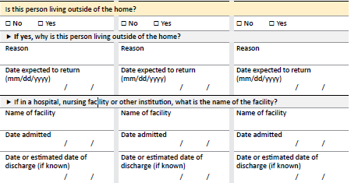
Questions about Current and Previous Living Arrangements
P.8
Is this person living outside the home? Answer “yes” or “no.” If “yes,” explain why they are living there.
If the applicant is residing in a “nursing home,” please answer this question “yes.”
Notes:
Date expected to return: If the stay in a facility is temporary, please indicate the date of potential return to home. If the stay in a facility is permanent, please indicate permanent stay
Name of facility: It is important to list the name of the facility. If this is a “swing bed facility,” please list the hospital name and indicate “swing bed facility” after the name. A “swing bed facility” is an alternative to prolonged acute hospitalization or short-term nursing facility placement for post-acute extended care. The “swing bed” program provides skilled nursing care and rehabilitation services.
Date Admitted & Discharged: it is important for the facility to submit a complete MS-2126 form to verify the dates, to determine eligibility and payment approval. *The applicant may not know what this is; it must be submitted with the application by the long-term care facility.

Slide 76
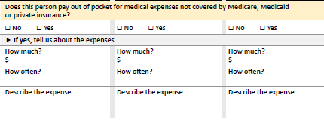
Questions about out-of-pocket medical expenses
P.8
You can enter the applicant’s private or Medicare supplemental insurance premiums here.
If the applicant has ongoing medical expenses that they pay out of pocket for, you can list this here.
Notes:
Consumers may be able to reduce the amount they owe on their Client Obligation, Patient Liability or Spenddown by submitting receipts for medical costs NOT covered by Medicaid or other insurance.
Allowed Expenses:
Health Insurance Premiums
Medicare Premiums
Medically necessary expenses that Medicaid, Medicare and other health insurance does not cover (for self or for spouse’s/dependent family members’ non-covered medical expenses)

Slide 77
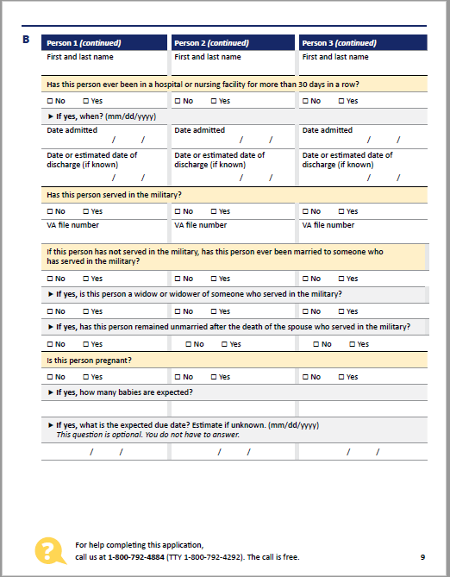
Page 9.B - Persons 1-3 Continued

Slide 78
Ever been in a nursing facility for more than 30 days in a row?
P. 9
Please list the Admission through Discharge dates in mm/dd/yyyy format when answering this question.
This question is specific to an applicant who has a spouse, and the applicant is requesting Nursing Home, PACE or HCBS coverage.
KDHE needs to know the applicant’s first 30 day stay in a hospital or nursing home. This will determine the month and year we request resources to see how much a spouse can protect of the couple’s resources.
Notes:
Have you ever been in a hospital or nursing facility for more than 30 days in a row?
Do you have a spouse?
Are you requesting Nursing Home, PACE or HCBS coverage?

Slide 79
Ever Served in the Military?
If the applicant has ever served in the military, there is the potential of cash benefits from the Veteran’s Administration (VA).
It is required that veterans apply for VA benefits.
If the applicant is a spouse or current widow of a veteran, they must also apply for cash benefits from the VA.
The KDHE Eligibility Team must have verification that the applicant has applied with the VA.
P. 9
Notes:
To apply, the family can contact the VA at 1-800-827-1000 or their local VFW (Veterans of Foreign Wars).
If someone needs to apply for VA benefits, please read the following:
The local Veteran’s Affairs offices across Kansas can…
Help people determine if they are eligible to apply and if not, can write a letter saying that they are not.
Maybe assist them in filling out the application and provide documentation that they have filled out the application. -- Call to confirm.

Slide 80
Also in this section, Page 9…
Is this person pregnant?
P. 9

Slide 81
Page 10.B - Help with medical bills in the past 3 months
Section C asks about medical bills in the past 3 months and any changes in the household in the past 3 months.

Slide 82
Need Help Paying Medical Bills from the Last 3 Months?
P. 10
Including Medicare premiums?
It is important to mark this question “yes” if the applicant needs help paying medical bills that occurred three months prior to the application completion date.
Not ALL KanCare programs are retroactive and able to pay for previous medical bills, but some programs will.
The applicant must mark these questions “yes” to allow KDHE to review their eligibility for the last three months.
Notes:
Note to Nursing Homes:
It is important to mark this question "yes” if the applicant has been a resident in your facility months prior to completion and submission of this application.
For example, if the resident was admitted into the facility in on January 10th but the application was not submitted until February 9th, they must mark this question “yes” to allow KDHE to review the applicant’s eligibility for January.

Slide 83
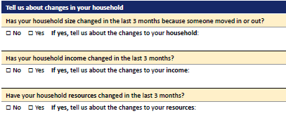
Changes in Household (past 3 months)
P. 10
It is important to document if the applicant was in another living arrangement in the three months prior to the application being submitted.
Where they in another facility, hospital, assisted living, or on their own?
KDHE may determine eligibility for a different medical program in the prior three months based on their living arrangement.

Slide 84
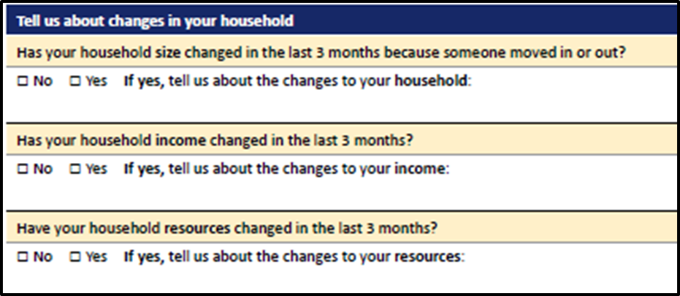
Changes in Income (past 3 months)
P. 10
In some cases, applicants have worked in prior months, but are now unable to work and need medical assistance.
It is important to list any wages and provide copies of pay stubs for each of the prior months the applicant has requested help for medical costs.

Slide 85
Changes in resources (past 3 months)
P. 10
For example:
Did the applicant close a savings account and use the funds to set up a funeral arrangement?
If so, KDHE would need verification that (1) the savings account had been closed and (2) a copy of the funeral arrangements.

Slide 86
Page 11- Federal income tax information
Section D asks the applicant and the household plans to file their taxes
This is aimed at how a consumer WILL FILE their taxes the following April (NOT how they have previously filed).
Please answer the tax information questions for the (1) primary applicant AND any (2) dependents (even if they are not applying for medical coverage).

Slide 87
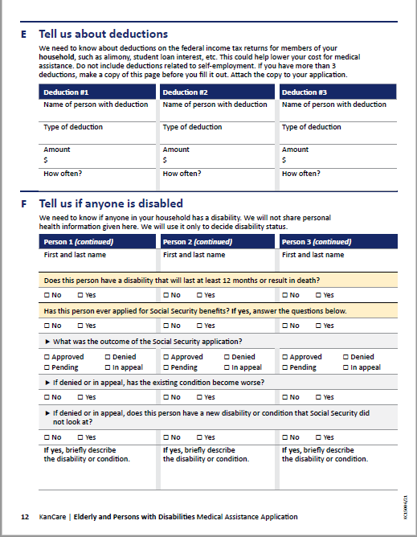
Page 12. E- Tell us about deductions
Notes:
These deductions include and is not limited to:
Alimony
Student loan interest

Slide 88
Page 12.F - Tell us if anyone is disabled
This section asks:
If anyone in the household has a documented disability, lasting more than 12 months or that will result in death
About Social Security Benefits (SSI or SSDI), application for disability benefits or previous denials and appeal dates
Exacerbation of current disabilities (since last filing)
Presence of new disabilities (since last filing)
If the individual has already been determined “Disabled” by the Social Security Administration, they would answer lines
If any of the following questions do not apply to you, put N/A (non-applicable)…Don’t leave anything blank!
Notes:
Note on Pending Disability Cases with Social Security Administration (SSA): If the applicant is claiming they have a disability, that disability must have been determined by the SSA.
If their disability has not yet been determined by SSA, they should submit documentation with the application that proves they are applying for (or appealing a denial of) disability benefits through the Social Security Administration.
What verification documentation is needed to prove a pending disability case with the SSA? (1) an appointment letter or (2) copy of the appeal with SSA for recently denied disability determination or (3) something from your most recent mail from the SSA that shows you have a pending disability case.
Note on SSA Disability Determination and HCBS Waivers: If not already on SSI/SSDI, the consumer must apply for SSI/SSDI if 18+ years old and applying for one of the following HCBS Waivers: TBI, PD and IDD.
Children under 18 do not have to apply for SS-DS, even if seeking HCBS waiver services.

Slide 89
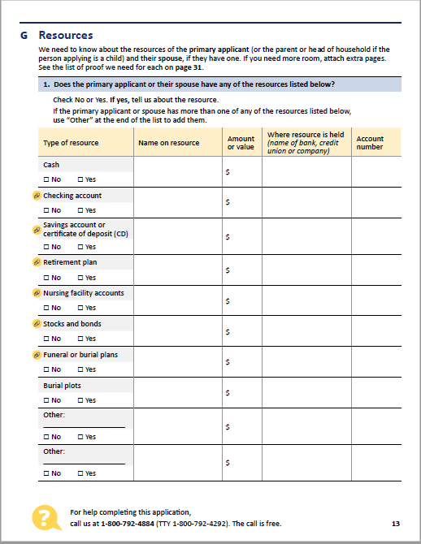
Page 13.G - Resources
BE HONEST & COMPLETE
Note: This page has small paper clip icons next to the resources that require documentation showing proof of the information provided.
Put everything in here- let the eligibility team sort it out.
Not everything you put in this section will be held “against” you.
Deductions exist, so make sure you report all money in each specific category .
Anything you put here will need to be backed up with a statement from the bank or applicable governing body.
Put all vehicle info down as well- anyone in the house owning a vehicle needs to be included.
Notes:
Checking Account:
KDHE needs copies of your checking account (s) statement (s) with a full month of activity.
Provide statements for each month you are requesting coverage.
If you have more than one checking account, please use the extra lines in this section (“Other____”) or add another page.
Savings Account:
Provide statements for each month you are requesting coverage.
If you have more than one savings account, please use the extra lines in this section (“Other____”) or add another page.
Certificate of Deposit:
These are the same as a savings account.
Provide statements for each month you are requesting coverage.

Slide 90
Page 13.G - Resources Continued
BE HONEST & COMPLETE
Note: This page has small paper clip icons next to the resources that require documentation showing proof of the information provided.
Notes:
Retirement Plan:
This could be an IRA, 401k or other account or funds set up for retirement.
KDHE requires a statement which reflects the “owner” and the “balance.”
Nursing Facility Account(s):
Resident Trust Fund OR Resident Care Home Account.
These are the same as a checking account.
Provide statement(s) with a full month of activity.
Provide statements for each month you are requesting coverage.
Stocks:
It is important to indicate the type of stock AND a statement showing the current value of that stock.
Bonds:
Please provide a copy of your bond(s).

Slide 91
Page 13.G - Resources Continued
BE HONEST & COMPLETE
Note: This page has small paper clip icons next to the resources that require documentation showing proof of the information provided.
Notes:
Funeral or Burial Plans:
It is a requirement to verify if a funeral arrangement will be considered a resource to an applicant.
Please provide a copy of the funeral arrangements.
The copy of these funeral arrangements need to contain:
An itemized statement of goods and services,
A statement signed indicating that the arrangements are “irrevocable,” and
How the arrangements were funded
Funeral homes are familiar with these types of requests when an individual applies for Medicaid.
Burial Plots:
Just indicate if they have one.

Slide 92
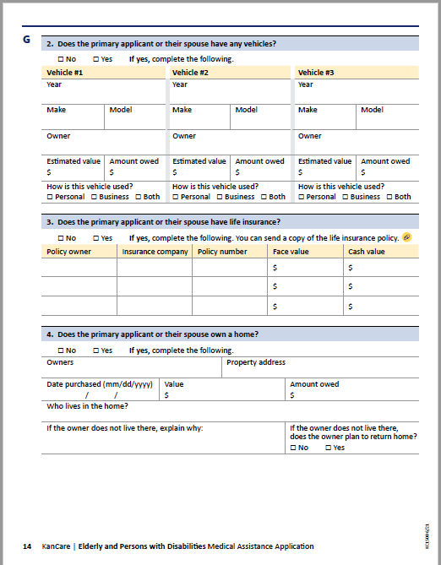
Page 14.G2/G4 - Resources
BE HONEST & COMPLETE
This page asks:
Does the primary applicant or their spouse have any vehicles?
Does the primary applicant or their spouse have life insurance?
Does the primary applicant or their spouse own a home?
Notes:
More on G2: Anyone in the house owning a vehicle needs to be included. The state does not count the home where you live, one care, some burial plans, furniture, and household items.
More on G3: To verify a policy, we ask the applicant request a letter from the insurance company, which contains:
the policy number,
policy owner,
type of policy (whole life or term),
face value,
cash value,
any loans which have been taken out against the policy.
*listing them out like this is easier to read*
Not sending in your “verification of life insurance policies” with your application will increase the application processing time.
More on G4: Does the applicant live in a facility while the spouse still lives in the home? Does the applicant living in a facility (nursing home, assisted living, etc.), intend to return home?

Slide 93
What if the applicant is living in a Nursing Home (or some other LTC facility)?
When answering the question, “If the owner does not live there, does the owner intend to return home?”
If the applicant living in the nursing home gets better, would they return to this home?
If they would want to return home, even if it is wasn’t very likely, it is appropriate to answer this question “yes.”
Notes:
Regarding Nursing Facility coverage: Single persons must have assets below $2000. We will not count the value of the home if the person intends to return home.

Slide 94
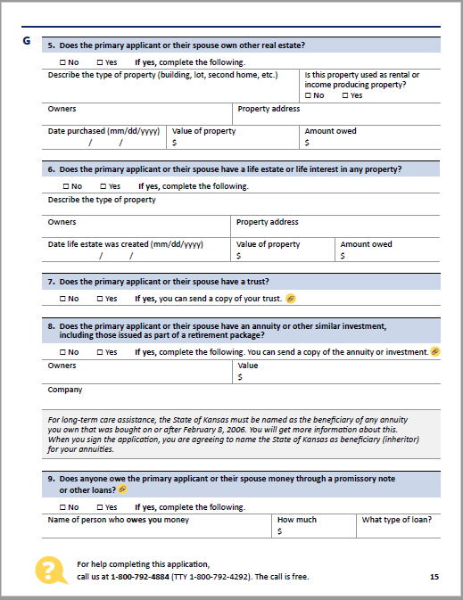
Page 15, Resources (G5-G9)
This question does NOT include the land that the consumer’s primary residence sits on.
If they own other land or buildings, please document that here.
Notes:
The state does not count the following as assets:
the home where you live (or the land that it sits on)
one car
some burial plans
furniture and household items

Slide 95
Page 15, Resources (G5-G9)
Rule of thumb here: If the consumer has no idea what this is, most likely they do NOT have one.
What is a Life Estate? It is a form of joint ownership that allows one person to remain in a home until his/her death. Then the home passes to another owner.

Slide 96
Page 15, Resources (G5-G9)
If the resident owns a “trust,” document it here.
It is also important to document all the “assets” that are part of the trust on page 7 (“Tell us about your Resources”) of the application as well.
If marked “yes,” KDHE will need a full copy of the entire trust along with all the schedules.

Slide 97
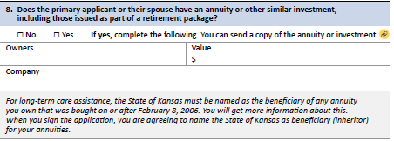
Page 15, Resources (G5-G9)
This section describes annuities owned by the applicant or their spouse.
If the consumer owns an annuity, the state of Kansas must be named as the beneficiary of any annuity which they own that was purchased on or after February 8, 2006.
Notes:
The consumer agrees to make this assignment once they sign the application.
What is an annuity?
An annuity is a fixed sum of money paid to someone each year, typically for the rest of their life. It might be an inheritance passed down or a form or insurance or investment.
Annuity Examples:
“He left her an annuity of $1,000 in his will."
The investor is entitled to a series of annual sums from "an annuity plan."

Slide 98
Page 15, Resources (G5-G9)
This is not about credit cards.
It is about whether someone owes the applicant money, such as…
Did the consumer loan someone $8,000 six months ago?

Slide 99
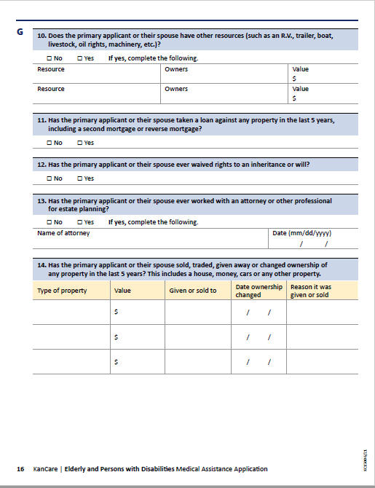
Page 16, Resources (G10-G14)
Other Assets include things such as:
Motorcycles
Tractors
Farm equipment
Trailers
R.V.s
Boats
Livestock
Oil Rights
Machinery

Slide 100
Have you taken a loan against any property in the last five years?
P16, G11
Have you or your spouse taken out a loan against any property in the last five years, including a second mortgage or reverse mortgage?
Reverse Mortgage – a loan available to homeowners 62 years or older that allow them to convert part of the equity in their home into cash.
If the consumer has one, the eligibility team will need the contract from the reverse mortgage that shows the gross amount of money they get from it.
P16, G12
Did you waive any rights?

Slide 101
Estate Planning Attorneys/Professionals?
P.16, G13
Estate Planning is the process of arranging during a person’s life for the disposal of their estate.
If the applicant has paid for someone to help them manage assets, list those professionals here.

Slide 102
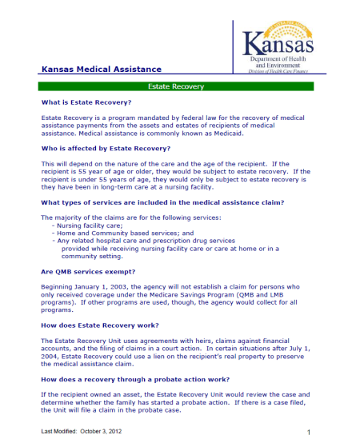
Fact Sheet: Estate Recovery
The estate recovery program recovers assets from some estates (from the estates of certain deceased Medicaid consumers).
This may include estates of persons aged 55 or older.
It also may include estates of persons who received long-term care services.
Most of the claims are for the following services:
Nursing facility care
Home and Community Based Services
Any related hospital care and prescription drug services provided while receiving nursing facility care, care at home, or in a community setting.
Notes:
How do I contact Estate Recovery?
To contact Estate Recovery:
Call 785-296-6707
E-mail to eeseru@khpa.ks.gov
Mail to:
Estate Recovery Unit
P.O. Box 2428 Topeka, KS, 66601
To contact the contractor, Health Management Systems:
Call 800-817-8617
E-mail to: KSestaterecovery@hms.com
Fax to 646-465-6530

Slide 103
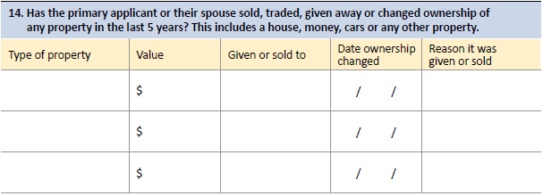
Sold, Traded, Gifted, Changed Ownership of Property in the last 5 Years?
P16. G14
Please document any change in ownership of any property within the last five years in this section.
Sale of vehicles or transferring resources to a trust fund are examples of what should be documented in this section.
This would include giving assets to family members.
Notes:
Important note on Transferring Property for Less Than Fair Market Value:
Gifting, selling or transferring property for less than fair market value can result in a period of ineligibility for Long Term Care coverage (Programs: Nursing Home, HCBS, and PACE).
The KDHE Eligibility Team must look back for transfers within the last 5 years.
For a nursing home, the amount of penalty divided by about $5,000 = months of no eligibility
Example:
A parent gifted their child their $100,000 home; $100,000 divided by $5,000 = 20 months of ineligibility in a nursing home.
If the average stay in a nursing facility is $5500/month, that would lead to an out-of-pocket cost to that parent of about: $110,000.

Slide 104
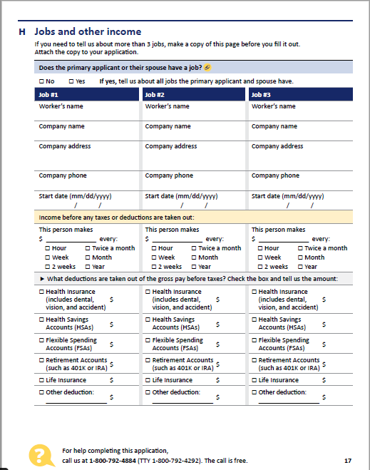
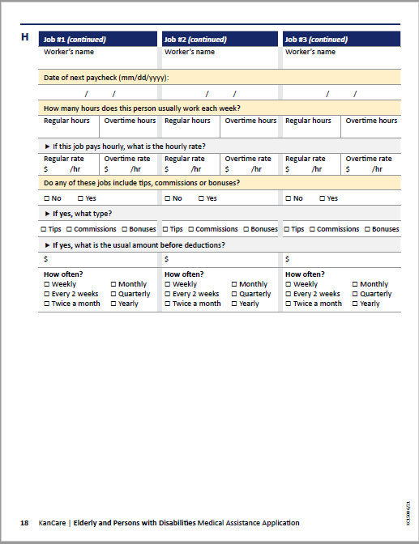
Page 17.H & 18.H Jobs and other income
We will need paystubs for the last 30 days.
Notes:
Asking for Help Paying Medical Bills for the Past Three Months?
If asking for assistance to pay medical bills for three months prior to the date of the application, the eligibility team will need the paystubs for those three months prior to the date of the application.
For example, if I am applying in April, and ask for prior medical help, the applicant will need to send in the paystubs for January, February, March and the paystubs they have for April.
If the person does NOT have their paystubs, they need to ask for a printout of their “gross wages” and the date they received these wages, for these months, from the employer. A “W-2” will NOT be accepted.

Slide 105
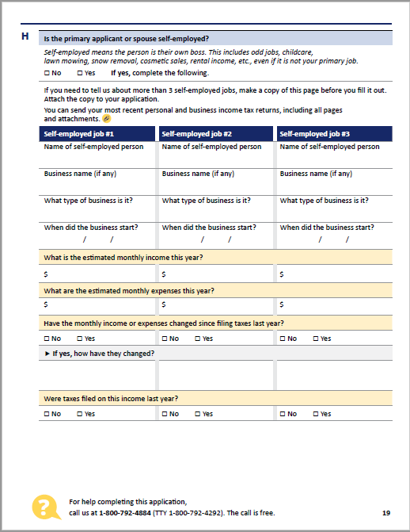
Page 19.H - Self employment
There are several types of “self-employment income” that may be received by an applicant or their spouse.
If the consumer is “self-employed,” the eligibility team will need their last tax return. This will need to be the entire return, not just certain schedules.
Notes:
A few examples include:
Income from farming
Income received from leasing or renting farmland
Income received from leasing or renting a home or other property

Slide 106
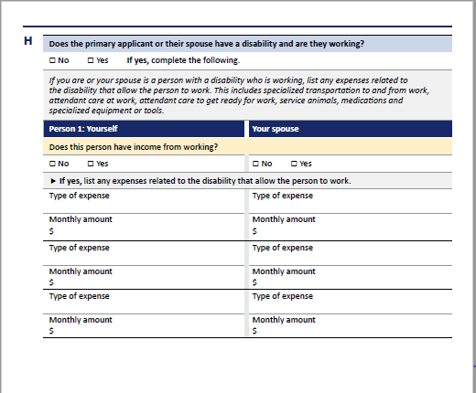
Pg. 20.H - If Disabled and Working, what are your “Work Expenses?”
Examples:
Specialized transportation to and from work
Attendant care at work
Attendant care to help you get ready for work
Service animals
Medications
Specialized equipment or tools

Slide 107
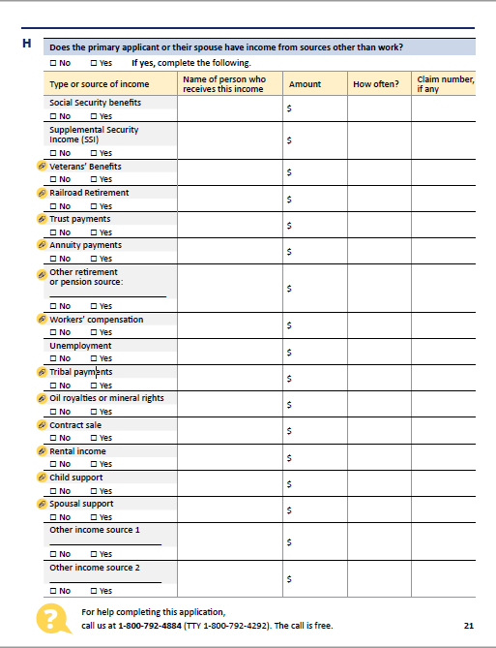
Page 21.H - Other income
This section is used to document income that is unearned, not received from a job or self-employment.
List the “gross amount received” before taxes or other deductions.
Notes:
It is important to list the income of the applicant and the applicant’s spouse. (The eligibility team requires this when determining allocation of income to the community spouse.)
Providing the spouse’s income and verification of income will help speed up the determination process.
Oil Royalties or Mineral Rights:
Please provide the tax return to verify any income earned from oil royalties or mineral rights.
Contract Sale:
A contract sale is a contract in which a property title is transferred only after a buyer makes a certain number of monthly payments. If an applicant is “receiving payments” this is considered “income” and the eligibility team must have verification of the Contract Sale and the income being received.
Rental Income:
If the applicant or spouse owns property or a home and it is being rented, we need verification of the amount received from the rental.

Slide 108
Other Income (cont.)
12
12
12
Include
LUMP SUM payments too!
12
1
Notes:
The focus is on “recurring payments.”
“Lump sum payments” are treated differently, but still need to be listed here.

Slide 109
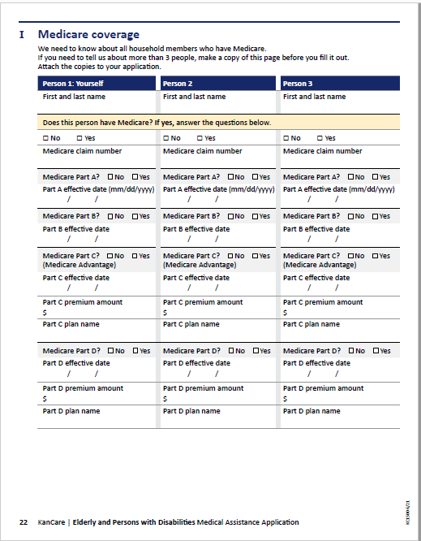
Page 22.I - Medicare Coverage
Answer the questions the best you and the consumer can.
You can find many answers on the Medicare card, or the consumer can call the phone number on the card for answers to these questions.
The KDHE eligibility team has connections with Medicare and can find out most of the Medicare effective dates for you.

Slide 110
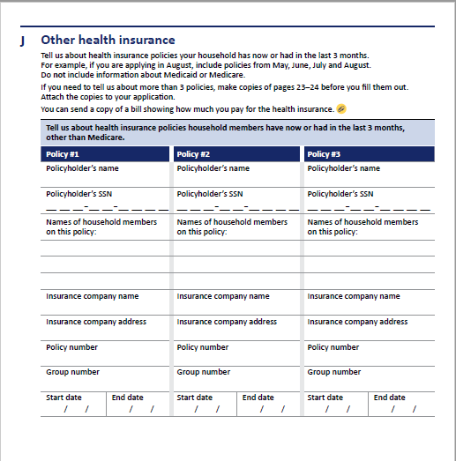
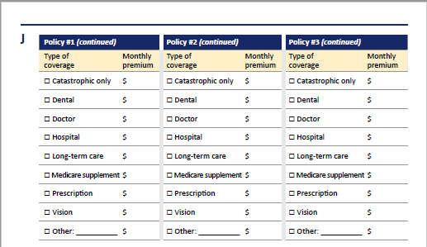
Pg. 23.J - top of Pg. 24.J - Other Health Insurance
Notes:
With “private insurance,” such as Blue Cross Blue Shield (BCBS), use the bottom section to document any private health insurance policies the applicant may have.
Private Health Insurance may include:
Medicare Supplemental Health Insurance Policies
Health Insurance through an employer
Long Term Care Insurance
The eligibility team needs the applicant to submit:
A copy of the front and back of the insurance card
Proof of the monthly premium the applicant pays*
*Providing the Eligibility Team with the monthly premium amounts will lower a person’s monthly “patient liability/client obligation” (the monthly premium the KanCare consumer must pay for his/her share in the cost of medical services).

Slide 111
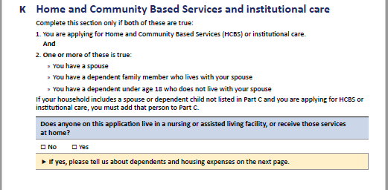
Pg. 24.K bottom half - HCBS and Institutional Care
Notes:
Complete this section if the applicant wants coverage for care in a Nursing Facility (Institutional Care), Assisted Living Facility (which qualifies as HCBS) or other HCBS Waivers or PACE and has “dependent family members.”
Verification of reported shelter expenses for “dependents” must be provided.
A dependent family member could include:
Spouse
Minor Child
Other family member
Dependency may be of any kind:
Legal
Financial
Medical

Slide 112
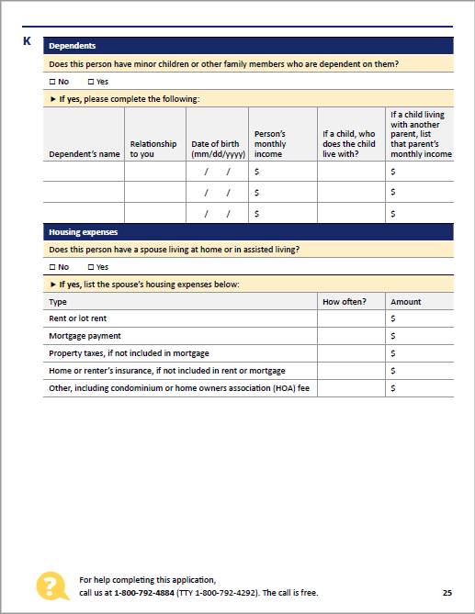
Pg. 25.K - HCBS and Institutional Care (Dependents and Housing Expenses)
Page 25 is a continuation of the information needed if the applicant checked “yes” on the bottom portion of page 24
Notes:
Complete this section if the applicant wants coverage for care in a Nursing Facility (Institutional Care), Assisted Living Facility (which qualifies as HCBS) or other HCBS Waivers or PACE and has “dependent family members.”
Verification of reported shelter expenses for “dependents” must be provided.
A dependent family member could include:
Spouse
Minor Child
Other family member
Dependency may be of any kind:
Legal
Financial
Medical

Slide 113
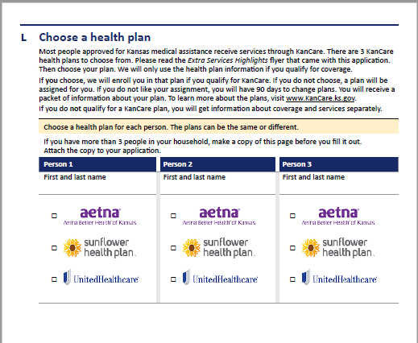
Pg. 26.L - Choose a health plan
In this section, you will choose a health plan for each person who is applying for medical services.
The Managed Care Organizations are:
Aetna
Sunflower Health Plan
United Healthcare
Notes:
If this is left blank, a health plan (MCO/Managed Care Organization) will be chosen for the consumer.
Keep in mind when choosing which MCO:
Talk to your friends, family and doctor.
If not in a nursing home, make sure it is an MCO (Managed Care Organization) or Health Plan that your favorite provider accepts.
Check out the Health Plan Highlights on the KanCare website to compare the “Extra Services or Value-Added Services” that each MCO offers. Does one MCO have more of the “Extra Services” that would be a better fit for you?
URL for Health Plan Highlights: https://kancare.ks.gov/docs/default-source/consumers/choosing-a-plan/2021-english-vas.pdf?sfvrsn=89734e1b_8
Note to Nursing Homes:
Make sure it is an MCO (Managed Care Organization) or Health Plan that your facility accepts.

Slide 114
Pg. 27.M - If you have someone to help you with your case
If you are their Guardian, Conservator, their Social Security Payee, their Power of Attorney…
Please complete this section and submit proof.
Notes:
If a family member, friend or neighbor is helping someone to complete the application:
They may also choose to allow the KanCare applicant to appoint them as their Medical Representative or Facilitator
If the applicant has a Guardian, Conservator, Financial Power of Attorney or Social Security Payee documentation proving this will need to be submitted with the application.

Slide 115
Medical Representative
The Medical Representative can be a relative, neighbor, friend, or other person you trust.
You may NOT name someone who is trying to collect a medical debt against you.
Notes:
Medical Representative:
This person can sign the KanCare application.
This person can answer questions for applicant.
They can use the medical assistance card for the KanCare consumer.
KanCare will share information with this person.
This person will get copies of letters sent to the consumer about their case.
This person will get copies of the consumer’s annual review form and is responsible for completing this review each year and for telling KanCare about changes in the consumer’s situation (address changes, income changes, etc.). This is extremely important in keeping a person’s case open.
Note to Nursing Homes:
It is recommended that everyone in a nursing home have a Medical Representative listed on the application.
However, employees of nursing facilities CANNOT be medical representatives because the nursing home is trying to collect a debt against the applicant.
*punctuation and spacing*

Slide 116
Medical Representative Authorization Form
What if I need to be this applicant/member’s Medical Representative, but I didn’t get signed up at the time of application?
You’ll need a completed Medical Representative Authorization Form submitted to the Clearinghouse, before they will speak to you about the individual’s case.
Notes:
This is the same form you would need if representing someone in a state fair hearing as well.
URL for The Medical Representative Form: http://www.kancare.ks.gov/policies-and-reports/kdhe-eligibility-policy/policy-appendix

Slide 117
Facilitator
Granted limited authority to assist the applicant.
Cannot complete an application or request services on behalf of an applicant, but they can help the applicant fill out your application and help them through the application process.
Can be someone such as a relative, neighbor, friend, medical office staff, or community organization employee.
An employee of a nursing facility CAN be a Facilitator without signing a release of information form by filling out this portion of the application.
Notes:
Facilitator:
KanCare will be able to share information with this person.
This person will get copies of all letters, forms and notices sent to the applicant regarding their application.
This “Facilitator Appointment” will last through the end of the application period.
After the application has been processed, this person will no longer be connected to your case.
Note to Nursing Facilities:
After the application has been processed, and the “Facilitator” appointment has expired, it is not required that the nursing facility submit a new “release of information” form.
The nursing facility will still be able to call the KanCare Clearinghouse and receive information about the status of the application, dates of eligibility decisions, and coverage effective dates , patient liability amount, and name and contact information about the MCO.
Additionally, the nursing facility will also receive notices to inform them of changes to an individual’s patient liability.

Slide 118
Facilitator Authorization Form
What if I need to be this applicant/member’s Facilitator, but I didn’t get signed up at the time of application?
You’ll need a completed Facilitator Authorization Form submitted to the Clearinghouse, before they will speak to you about the individual’s case.
Notes:
The URL for The Facilitator Form: http://www.kancare.ks.gov/policies-and-reports/kdhe-eligibility-policy/policy-appendix

Slide 119
Facilitator Form - Expiration Date
The facilitator authorization form expires 6 months from the date the form is signed, or once the application is completed, whichever is later.
The applicant/member can also choose a different date.
A facilitator appointment of a community organization, medical provider, or staff cannot exceed 12 months.

Slide 120
Pages 28-30 – Read and Signature Page
Notes:
It is important that the consumer and/or the guardian, and/or the conservator to sign this page.
It is also important to read the fine print as it provides important information about estate recovery and consumer’s rights and responsibilities.
*phrasing*

Slide 121
Page 31-32, List of Proof and a Reminder
Notes:
That last page of the application is another checklist that provides you with reminders of what you need to send in “with” the application to speed up processing time.
It also gives you a reminder to sign and date the application. If KanCare receives the application unsigned, it will be considered “incomplete.”
Please remember to send documentation WITH THE APPLICATION as proof of anything you claimed.
If other items are needed by the eligibility team, you will be notified, however, the need to request more information will delay processing time.
Help ensure success by contacting the Clearinghouse when you submit new documentation.
Note to Nursing Facilities:
Be sure to submit the 2126 form and the CARE Score WITH the application.
2126 form: This form tells KDHE when a person moves into a facility or moves out. It is not something that a consumer fills out or is responsible for. The nursing facility needs to submit this form with the application.
A CARE Score: This is part of the Level of CARE assessment that is completed by the ADRC when the individual is admitted to the nursing facility. It is imperative that the nursing facility ensure that the CARE assessment is sent to KDADS to avoid processing delays and ensure the facility is paid for all dates the individual is a resident there.

Slide 122
Printable Applications
Find the PDF for each application packet on the KanCare website.
URL for Printable Applications: http://www.kancare.ks.gov/consumers/apply-for-kancare

Slide 123
Medicaid Related Resources
Find Medicaid related resources on the KanCare Ombudsman “Resources” page.
Notes:
URL to KanCare Ombudsman Resources webpage: http://www.kancare.ks.gov/kancare-ombudsman-office/resources

Slide 124
Application Assistance Folder http://www.kancare.ks.gov/kancare-ombudsman-office/resources
Notes:
URL for Application Assistance Folder: http://www.kancare.ks.gov/kancare-ombudsman-office/resources

Slide 125
Helpful Links
KanCare home website: https://kancare.ks.gov/
KanCare Ombudsman website: https://kancare.ks.gov/kancare-ombudsman-office
Who Should I Call, Consumers: https://www.kancare.ks.gov/docs/default-source/kancare-ombudsman/resources/resources/who-should-i-call-consumers-helpful-numbers-12-2-21.pdf?sfvrsn=d5a3501b_0
Who Should I call, Providers: https://www.kancare.ks.gov/docs/default-source/kancare-ombudsman/resources/resources/who-should-i-call-providers.pdf?sfvrsn=bca1501b_4

Slide 126
Helpful Links – to get to videos --
Apply for KanCare: https://www.kancare.ks.gov/consumers/apply-for-kancare
Scroll down

Slide 127
Helpful Links – to get to guides --
Apply for KanCare: https://www.kancare.ks.gov/consumers/apply-for-kancare
Guides by section

Slide 128
Helpful Links – to get to “How to use the Self Service Portal” videos --
Apply for KanCare: https://www.kancare.ks.gov/consumers/apply-for-kancare
Click Here

Slide 129
Helpful Links – to get to videos --
Apply for KanCare: https://www.kancare.ks.gov/consumers/apply-for-kancare
Click Here

Slide 130
Helpful Links – to get to videos --
Apply for KanCare: https://www.kancare.ks.gov/consumers/apply-for-kancare
Click Here

Slide 131
Helpful Links – to get to videos --
Apply for KanCare: https://cssp.kees.ks.gov/apspssp/ssp.portal/informationLinks/trainingLinks;acsspCookie=-6_vOdrsOSnsJr6mZsvwjWUNEyAspmzGZc0FvJfbG6e3HtJyXPo3!-1927165001
Click Here

Slide 132
Helpful Links – to get to videos --
Apply for KanCare: https://vimeo.com/showcase/8602150

Slide 133
Helpful Links – to get to in-person assistance--
https://www.kancare.ks.gov/kancare-ombudsman-office/resources AND SCROLL DOWN

Slide 134
Helpful Links – to get to in-person assistance--
https://www.kancare.ks.gov/kancare-ombudsman-office/resources AND SCROLL DOWN

Slide 135
Helpful Links – to get to in-person assistance--
https://www.kancare.ks.gov/docs/default-source/default-document-library/application-assistance-guide-jan-2022.pdf?sfvrsn=a8a1501b_0

