Slide 1
Alliance is a nonprofit, statewide association comprised of Intellectual and Developmental Disability (IDD) case management and provider agencies, businesses serving the IDD community, and disability advocacy organizations.

Slide 2
Colorado’s Employment First Journey
Senate Bill 16-077 (2016)
Senate Bill 18-145 (2018)
2019 Budget Appropriation
Senate Bill 21-095 (2021)
Senate Bill 21-039 (2021)
Colorado’s Employment First legislation creating the Employment First Advisory Partnership (EFAP).
Implemented Employment First provider competencies, Discovery funding, and data collection.
The Colorado Legislature approved funding to initiate the state’s Office of Employment First.
Sunset review of the EFAP - continuing the partnership indefinitely.
Eliminates the use of subminimum wage certificates and addresses structural & fiscal barriers to successful implementation of CIE.
Notes:
Ellen
There are over 35 states with some type of effort focused on Employment First. At least 21 of these states have an official state policy, stating that employment in the community is the first and preferred service option for people with disabilities.

Slide 3
Senate Bill 16-077 (SB16-077)
Employment First for Persons with Disabilities
Notes:
Tom
Original mandate was to bring state departments to a common table to identify barriers and make recommendations to increase competitive integrated employment outcomes for the state.
Partnership, authorized for 5 years, included existing entities: SRC, Workforce Development Council, EFSLMP core state advisory group, and state departments (Labor, HCPF, Human Services, Higher Ed, Education, Behavioral Health), in consultation with SELN re: best practices in EF and CIE. SRC created a Memoranda of Understanding (MOU) that all mandated state departments approve as a part of being on EFAP.
Additional stakeholder participation was also required (more on this under EFAP slides)
Law established the duties of the EFAP, including a strategic plan to expand CIE outcomes for persons with disabilities. In developing the strategic plan, the EFAP must make recommendations to ensure that CIE is the primary objective and preferred outcome for all working-age persons with disabilities; identify barriers to CIE, problematic regulations that make it more difficult for employers to hire PWD, training and knowledge gaps, and data available and lacking to measure progress toward CIE, and make recommendations relating to prevocational services to ensure they are limited and reasonably lead to CIE.
EFAPs initial recommendations are presented to legislative committees of reference in 2017 and consisted of 8 recommendations.

Slide 4
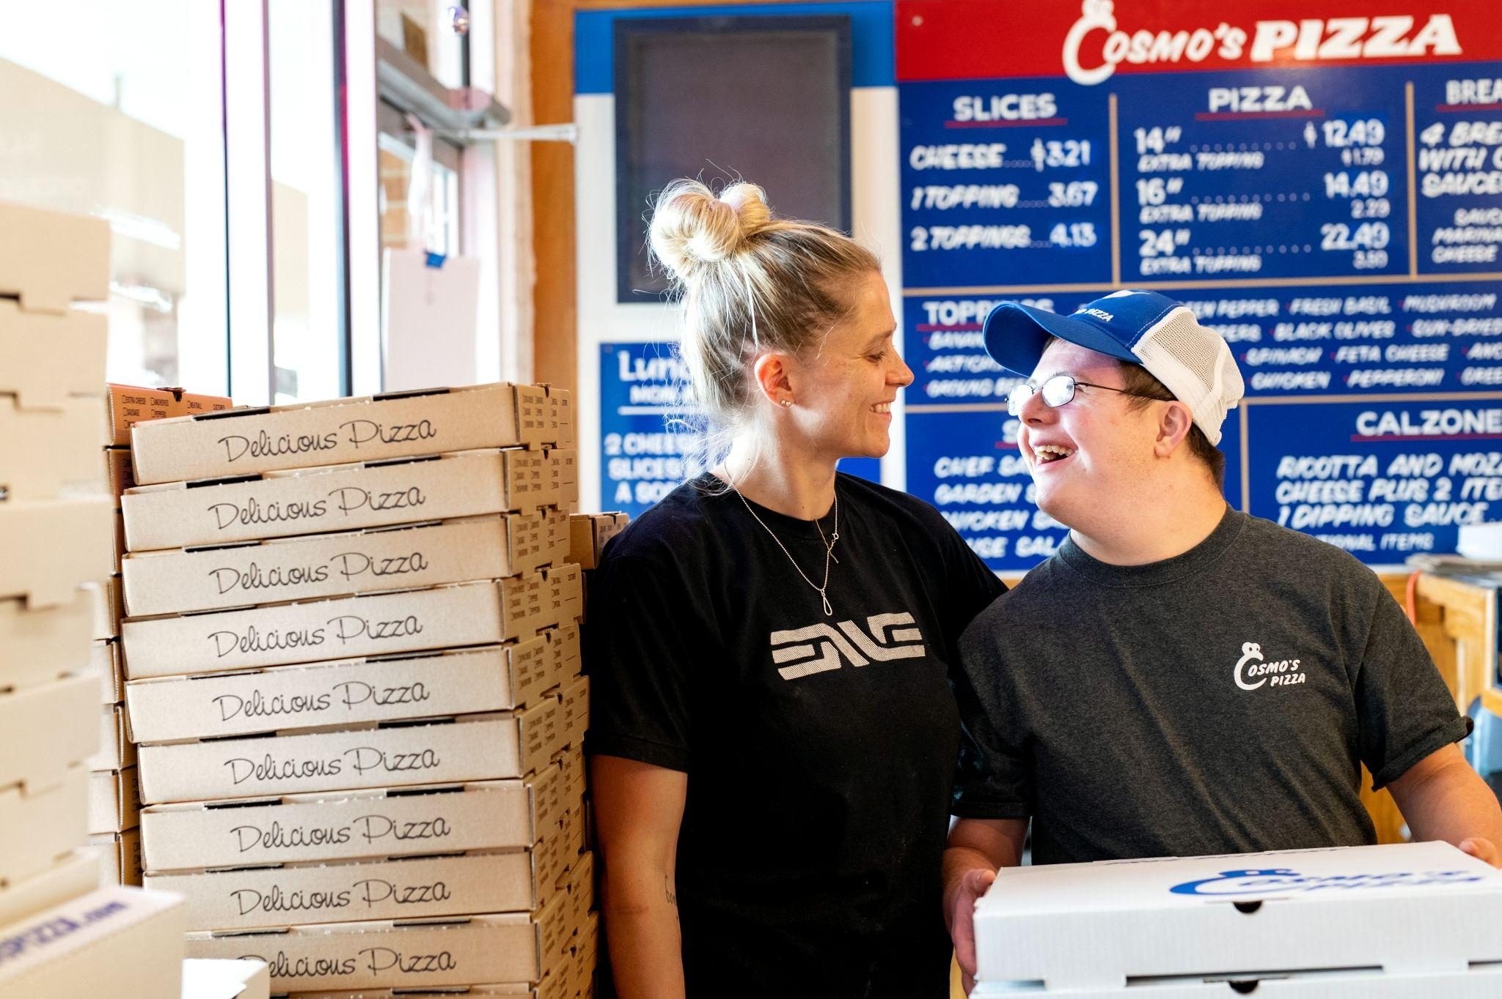
Origin of SB16-077
Grassroots advocacy effort
Lead advocacy organization: The Arc of Larimer County (Fort Collins, Colorado) who established group of like-minded champions
Identified a champion in state government to reach across parties
Process was iterative
Engaged groups thought to oppose the bill
Testimony by employers, family members, advocates, people with disabilities
Notes:
Tom
First draft was based on outcomes of the lawsuits won by the Department of Justice in Oregon & Rhode Island.
Second draft was less prescriptive and made it cost neutral by placing EFAP under the State Rehabilitation Council (SRC) - which already existed.

Slide 5
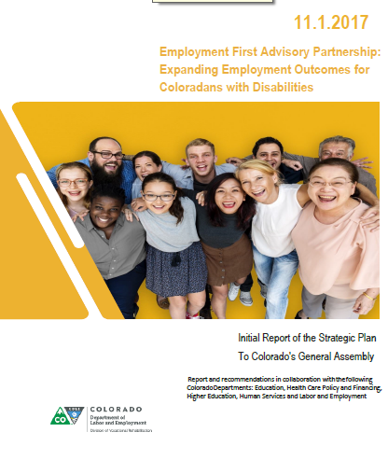
Outcomes of SB16-077
Codify Employment First principles in law
Bring state departments and stakeholders together to identify barriers and make recommendations to increase competitive integrated employment outcomes
Employment First Advisory Partnership authorized for 5 years
EFAP’s initial recommendations are presented to legislative committees of reference in 2017:
EFAP 2017 Strategic Plan
Notes:
Tom

Slide 6
EFAP Members
Stakeholder Participation From:
The Department of Healthcare Policy and Financing (HCPF)
The Department of Education (CDE)
The Department of Higher Education (CDHE)
The Department of Human Services (CDHS)
The Department of Labor and Employment (CDLE)
University of Colorado, JFK Partners, Colorado Office of Employment First
Representatives of a national association of persons supporting the implementation of employment first policies
Advocates for persons with intellectual and developmental disabilities
Persons with disabilities who have secured or are seeking competitive integrated employment
Members of the community who are not connected to any service agency
Notes:
Tom
The EFAP has 6 mandated partners but is composed of self-advocates, families, community members, and professionals.
Partnership, authorized for 5 years, included existing entities: SRC, Workforce Development Council, EFSLMP core state advisory group, and state departments (Labor, HCPF, Human Services, Higher Ed, Education, Behavioral Health), in consultation with SELN re: best practices in EF and CIE. SRC created a Memoranda of Understanding (MOU) that all mandated state departments approve as a part of being on EFAP.

Slide 7
About the EFAP
Purpose
EFAP focuses on the multi-stakeholder leadership, collaboration, and passion needed to make systems change for the benefit of people with disabilities, businesses, and the Colorado economy.
EFAP Vision Statement: All Coloradans with disabilities are included in the workplace and recognized for their interests, strengths, and contributions.
Mission: Develop a strategic plan to expand competitive integrated employment outcomes for persons with disabilities through Employment First policies and practices.
Notes:
Tom

Slide 8
About the EFAP
Beliefs
Real work for real pay contributes to living well and builds a diverse and thriving economy.
All people with disabilities have the right to information, effective quality supports, and the opportunity to obtain real work for real pay in their chosen career path.
Innovation and continuous improvement practices are utilized to realize a more prosperous and equitable future.
Collaboration and leadership are fundamental in changing the culture to ensure all people with disabilities have the opportunity to prosper and thrive.
We believe in zero exclusion.
Notes:
Tom
EFAP values cultural awareness and recognizes that cultural differences impact employment opportunities and outcomes.
Zero Exclusion: – everyone, including people with significant barriers to employment associated with disability, has the right to equal opportunity for real work and real pay.

Slide 9
Duties of the EFAP
C.R.S. 8-84-304 - Duties
Make recommendations to ensure that competitive integrated employment is the first and preferred outcome for all working age persons with disabilities regardless of level of disability
Identify barriers to competitive integrated employment
Identify barriers for employers to hire persons with disabilities
Identify training and knowledge gaps
Identify the data available and gaps in data collection
Make recommendations relating to pre-vocational services
Notes:
Tom
As noted in the Colorado Revised Statutes, the EFAP are mandated to make recommendations for CIE and look for barriers and gaps to making it successful while decreasing pre-voc services to be used as temporary.

Slide 10
Learn More about EFAP
With the EFAP continuing, Colorado is positioned to continue developing recommendations and systems innovation to help Colorado become a model state in implementing the Employment First framework.
Additional Resources on the EFAP:
EFAP webpage
EFAP 2019 Annual Report
EFAP 2021 Member Orientation Packet
Notes:
Tom
EJ comment: I moved a couple of reports

Slide 11
Senate Bill 18-145 (SB18-145)
Implement Employment First Recommendations
Notes:
Ellen

Slide 12
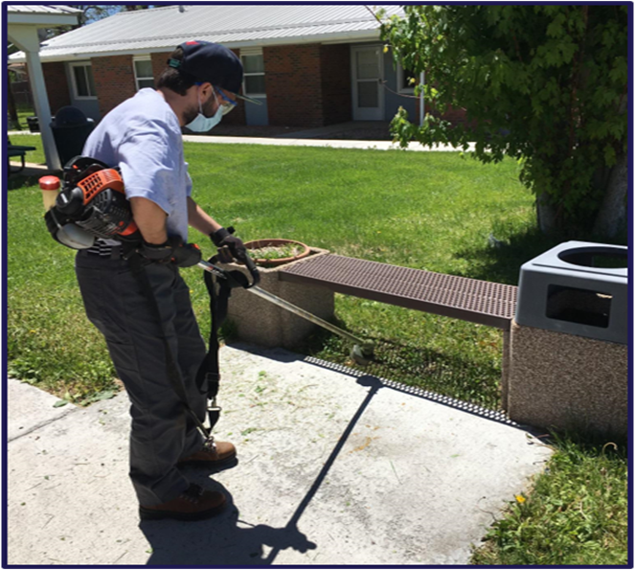
Origin of SB18-145
Grassroots advocacy effort
Lead advocacy organization: The Arc of Larimer County (Fort Collins, Colorado) who established group of like-minded champions
Identified a champion in state government to reach across parties
Based on recommendations from EFAP in 2017
Worked with community stakeholders such as Alliance
Notes:
Ellen

Slide 13
Outcomes of SB18-145
Minimum training requirements
Providers of individual supported employment must obtain a nationally recognized training certificate or certification
5-year timeline (until June 30, 2024)
Cost of training and staff time funded
Data collection on employment outcomes
Number employed and served in employment a day services
The sector of employment, average wage and hours per week
The total number of people eligible for employment services
The number earning less than minimum wage
Notes:
Ellen
Goal of data collection is to help Colorado track its progress over time and inform future policy decisions.
https://hcpf.colorado.gov/supported-employment-program

Slide 14
Nationally Recognized Training and Certification
Senate Bill 18-145
Medicaid & DVR
Reimbursement for
Professional Development!
Requirement to earn Nationally Recognized Training or Certification by June 30, 2024
For more information go to:
HCPF Supported Employment
Notes:
Ellen - can I change this slide?
Provider Training Requirements
Providers of individualized supported employment must obtain a national recognized training certificate or certification
5-year timeline
Reimburses for cost of the training and cost of the person’s time.

Slide 15
Data Collection Outcomes of SB18-145
Health First Colorado (Medicaid Program) collects and reports on employment outcome data of employment outcomes and service use, including:
Number employed and served in prevocational services, community-based non-work, day habilitation, and other employment or day services models
The sector of employment, average wage and hours per week
The total number of people eligible for employment services
The number earning less than minimum wage
Notes:
Ellen

Slide 16
2019 Budget Appropriation
Increased Capacity for Competitive Integrated Employment
Notes:
Patricia
Facebook https://www.facebook.com/COEFtalk
Instagram @coeftalk
LinkedIn https://www.linkedin.com/in/colorado-office-of-employment-first
Subscribe to communications / newsletters
www.employmentfirstcolorado.org

Slide 17
Funding to Build Employment First Capacity
Division of Vocational Rehabilitation
Funds to implement Employment First Initiatives, including Customized Employment Expansion
Colorado’s Medicaid Program
Funds for Supported Employment Incentive-Based Pilot
Colorado’s Office of Employment First
Funds to create the Colorado Office of Employment First
Funds to develop Colorado Disability Benefits 101 website
Notes:
Patricia

Slide 18
Senate Bill 21-095 (SB21-095) EFAP Reauthorization
Notes:
Tom
SB21-095- Extension of EFAP
Origins
EFAP and the departments involved all saw the value EFAP provides
Because it is housed under SRC, again no additional cost.
Outcomes
Continues EFAP indefinitely; creates a hiring preference pilot program for people with disabilities applying for jobs at state departments
Continues to have associated state departments, community stakeholders, advocacy, and people with cross disabilities all at one table – COEF was added as mandated partner PHenke
Keeping an ongoing focus on the recommendations and updating them as necessary to address changing environments.
Minimizes the chance of things stagnating or falling through the cracks.

Slide 19
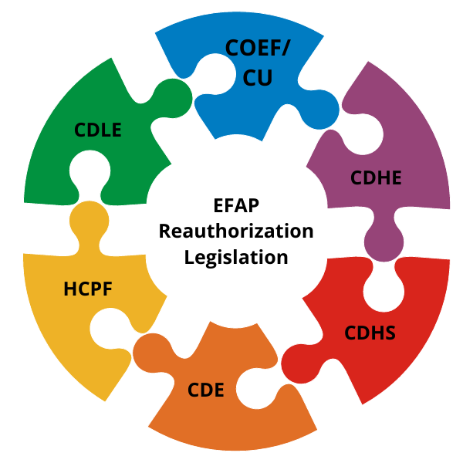
Origin & Outcomes of SB 21-095
With automatic sunset approaching, partners agreed on benefits of continuation
EFAP continued indefinitely
SB21-095 continued the existing collaborative partners of EFAP and now also names the Colorado Office of Employment First, JFK Partners within the Department of Pediatrics of the University of Colorado School of Medicine, Anschutz Medical Campus as an agency member.
Notes:
Tom

Slide 20
Senate Bill 21-039 (SB21-039)
Elimination of Subminimum Wage Employment
Notes:
Ellen

Slide 21
Origin of SB21-039
In 2018, The Arc of Colorado and Disability Law Colorado approached Alliance
Alliance full-day membership meeting to build consensus of members
The Arc, Alliance, and DLC formed a facilitated stakeholder group with representatives from providers, DD Council, people with IDD, and family advocates
7 months to craft bill concept
Expanded stakeholder outreach in fall/winter
Intended to not just end subminimum wage employment, but to address systemic barriers to people working in CIE

Slide 22
Outcomes of SB21-039
Bill failed in 2020 due to COVID; reintroduced in 2021 as SB21-039
Subminimum Wage Elimination provisions:
Immediately closed the door to new SMW hires and certificates
4-year timeline to phase out existing SMW programs (July 1, 2025)
Robust accountability provisions for existing SMW employers:
Submit data on the number of employees, hours per week worked, and wages per hour or piece rate earned
Transition plans with measurable benchmarks and data on employment transitions, with annual updates
State monitoring to ensure benchmarks are being met, with technical assistance
Opportunity to have independent advocate involved in transition discussions
Notes:
Alliance legislative talking points: https://www.alliancecolorado.org/_files/ugd/da982c_d4dc6980325f4568835a58d7fa2efb60.pdf
Alliance talking points on impact on jobs https://www.alliancecolorado.org/_files/ugd/ef6d52_96f7a779f52d4fc9badac18d5fcb9d44.pdf

Slide 23
Outcomes of SB21-039, continued
Provisions to address other systemic barriers:
Directed EFAP to make actionable recommendations in 2022 on:
Payment reform
Adequate reimbursement rates
Unit caps on services
Medicaid waiver and state regulatory barriers
EFAP 2022 Recommendations for Addressing Structural and Fiscal Barriers to Phasing Out Subminimum Wage Employment
Creates new waiver services: Benefits Counseling and “Supervision”
Eliminates plan spending limits for Individual Job Coaching and Development
Expands Medicaid Buy In option for all people with IDD to allow for increased earnings
Notes:
Note: transition funding for providers was negotiated out of the bill; timeline was also a point of negotiation

Slide 24
Outcomes of SB21-039, continued
As of July 2023, subminimum wage was phased out in Colorado
One year earlier than required by the legislation
We are still waiting on the final report from Health Care Policy and Financing
Providers seem to feel this process was a success
Notes:
Note: transition funding for providers was negotiated out of the bill; timeline was also a point of negotiation

Slide 25
Contact us at info@alliancecolorado.org or 303.832.1618
Follow us on social media!
Facebook: @AllianceCOIDD
Twitter: @Alliance_CO
YouTube: Alliance Colorado
Instagram: alliance_coidd
Tom Knost
Senior Director of Programs at Continuum of Colorado
Alliance Employment Committee Chair
t.knost@continuumcolo.org
Josh Rael
Executive Director at Alliance
ANCOR Board Member and State Association Executive/GR Chair
jrael@alliancecolorado.org

