Slide 1
Addressing Trauma in the IDD System

Slide 2
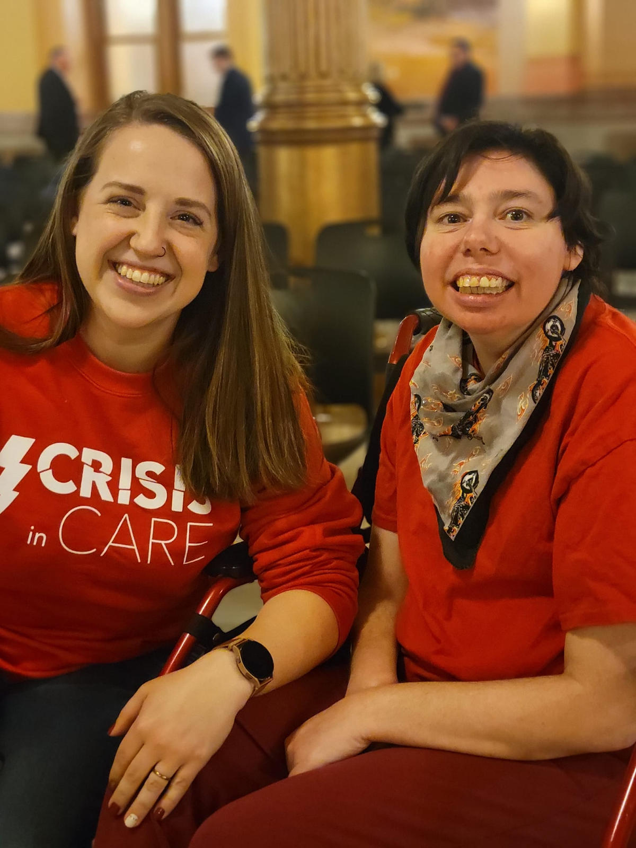
PRESENTER
Rachel Neumann
Chief Operating Officer, COF Training Services
Rachel Neumann's experience with individuals with intellectual and developmental disabilities (IDD) began when her sister was diagnosed with Aspergers at age three and continued as she studied, volunteered, and worked in the field. Neumann graduated from Ottawa University with a BS in Psychology and Biology. Neumann has been working in the I/DD field for 10 years. Neumann has held many different positions ranging from direct care to case management, including multiple supervisory positions in her time at COF, where she currently serves as the Chief Operating Officer. In addition to her work at COF, Neumann has participated in advocacy through Kansas’s statewide trade association, InterHab, crafted statewide legislation, and participated in multiple national leadership programs in the field.
Notes:
[Right-click image and select Change Picture…]

Slide 3
A note about today’s topic:
Please be advised this training will include description and discussion of traumatic events and may be triggering. Please feel safe to pause and return or check out to take the space you need.

Slide 4
Learning objectives
Define Trauma
Recognize the impact
Identify importance of tic
As members of the IDD community and field, it is critical that we understand trauma and Its prevalence in this field.
Going beyond the prevalence, understanding the impact trauma has empowers us to support and heal from it.
Trauma informed care is widely accepted as the most effective approach to healing through traumatic experiences.

Slide 5
The more we understand trauma, the better we can do our job, no matter what that might be.

Slide 6
Topic 01
Define trauma and its prevalence among the IDD community
Topic 02
Recognize the impact of trauma in all areas of individual’s life
Topic 03
Identify the importance and methods of using trauma-informed care
Notes:
Change Image by right-clicking image and selecting “Change Picture > …From a File”
You can duplicate this slide and move the arrow to the appropriate Topic
The current topic line should be displayed in white font

Slide 7
What is trauma?
Trauma is the results from exposure to an incident or series of events that are emotionally disturbing or life-threatening with lasting adverse effects on the individual's functioning and mental, physical, social, emotional, and/or spiritual well-being
Trauma is personal and subjective
Notes:
It results from exposure to an incident or series of events that are emotionally disturbing or life-threatening with lasting adverse effects on the individual's functioning and mental, physical, social, emotional, and/or spiritual well-being. (Trauma-Informed Care Implementation Resource Center, 2018)
Trauma is personal: It’s about how one feels about the events that occurred and not the events themselves. So just because you experience trauma from something, does not mean someone else who was in the same event will experience trauma. Trauma is subjective. Two people could be in the same car accident and one person could walk away fine, sleep well, and get right back on the road. The other person may sweat every time they get behind the wheel or maybe never drive a car again. (Center for Substance Abuse Treatment, 2019).

Slide 8
How does an experience translate to trauma?
Traumatic evens are experienced differently by each person. Someone response to a traumatic event depends on various factors. Some of those factors include:
Age and Autonomy
Intrinsic capacity to process
Extrinsic Support
Affects someone’s ability to remove themselves or keep themselves safe through a traumatic experience
The relationships and people around the person through the event to process and support their coping/healing
Interpersonal mental and emotional resources that enable the individual to process the event(s) that occurred.
Notes:
Someone’s response to a traumatic event or ability to cope through that event (resilience) is dependent on many things:
Age and dependence on others
Intrinsic mental and emotional capacity to understand and reflect & Access and skill to exercise executive functioning (Substance Abuse and Mental Health Services Administration, 2014)
Extrinsic support around them to process and assist with coping It is important to understand the personal implications.
As humans we compare ourselves constantly.
When we see someone coping with the same life experience differently than us, it is critical that we remember there is a reason they are responding different.
When someone (including yourself) is expressing trauma, it is important that we don’t express judgment regarding whether the experience was “bad enough” to warrant it.

Slide 9
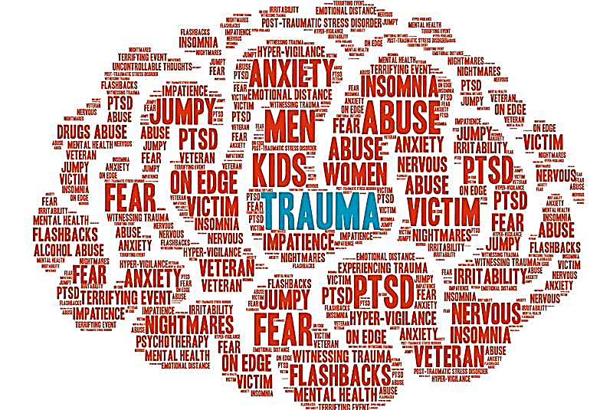
Traumatic Experiences
Episodic Events
Cultural Trauma
Betrayal Trauma
Secondary Trauma
Trauma can occur due to natural disasters (storms, floods, fires, pandemics)
This trauma is passed down from generation to generation
Trauma induced by a caregiver that the individual trusts
Trauma from being exposed to someone else’s traumatic experiences (witnessing it or hearing stories)
Notes:
As we mentioned in a previous slide, Trauma is personal and just because an event occurs, does not mean that the event was traumatic for a person. However some common causes of trauma are
Episodic trauma Traumatic events are marked by a sense of horror, helplessness, serious injury, or the threat of serious injury or death.(CDC, 2023), often caused by events such as natural disasters, pandemics, fires, floods, random acts of violence.
Cultural Trauma- occurs when members of a group feel they have been subjected to a horrendous event that leaves indelible marks on their group consciousness, forever marking their memories and changing their future identity in fundamental and irrevocable ways.(Prevention Institute , 2022)
Betrayal trauma which occurs when the people or institutions on which a person depends for survival significantly violate that person’ s trust or well-being: Childhood physical, emotional, or sexual abuse perpetrated by a caregiver are examples of betrayal trauma.(Freyd PhD, 2022)
Secondary trauma Secondary traumatic stress is the emotional duress that results when an individual hears about the firsthand trauma experiences of another.the essential act of listening to trauma stories may take an emotional toll that compromises professional functioning and diminishes quality of life(Peterson, 2018).

Slide 10
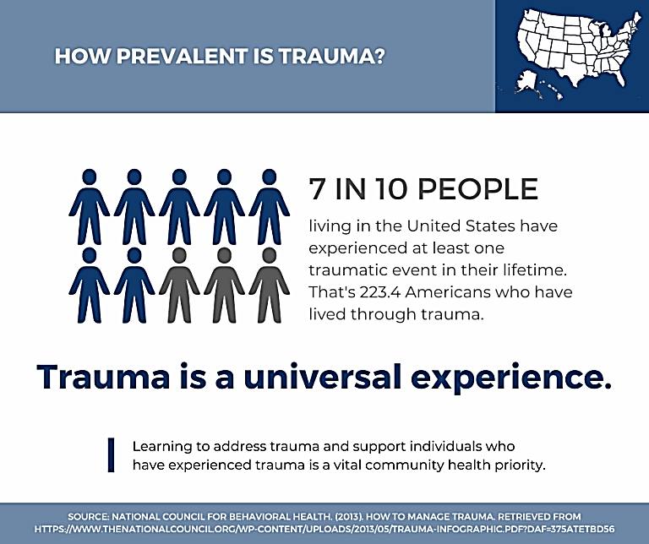
Prevalence of Trauma in Gen. Pop.
70%
Of adults have experienced some form of trauma
Notes:
70% of adults in the U.S. have experienced some type of traumatic event at least once in their lives. That’s 223.4 million people. (National Council of Wellbeing , 2022)

Slide 11
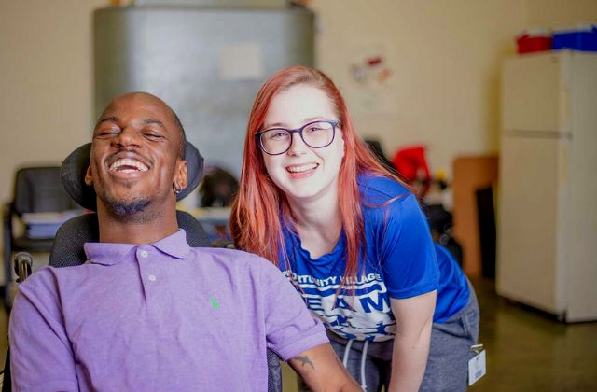
Prevalence of trauma in caregivers
Between 40% and 85% of helping professionals develop secondary trauma, compassion fatigue, and/or high rates of traumatic symptoms (OLGA Phoenix, 2020)
Personal history of trauma
Being overworked and overwhelmed
Having limited professional experience
Having limited training on trauma
Working with a high percentage of traumatized individuals
Working with individuals who are underserved and disadvantaged
Working for poor pay, under stressful conditions with limited resources
Evidence shows “helping professionals” have a higher than average ACE score (Marcal, 2017).
Notes:
Trauma in caregivers: Between 40% and 85% of “helping professionals” develop secondary, compassion fatigue and/or high rates of traumatic symptoms (OLGA Phoenix, 2020)
with risk factors including
Personal history of trauma
Being overworked and overwhelmed
Having limited professional experience
Having limited training about trauma
Working with a high percentage of traumatized individuals
Working with individuals who are underserved and disadvantaged
Working for poor pay, under stressful conditions with limited resources (OLGA Phoenix, 2020)

Slide 12
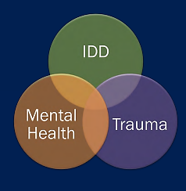
Prevalence of trauma in individuals with IDD
6x more likely to experience abuse or neglect
4x more likely to be victims of crimes
3x more likely to experience rape, sexual assault, robbery
3x more likely to be sexually abused
(Texas Health and Human Services, 2015)
Notes:
People with disabilities are more vulnerable at every point in the “lifecycle of a traumatic event.” Because of limited knowledge, social skills, and verbal skills, they are more vulnerable to being exposed to abuse. Caregiver stress is also highly correlated to the prevalence of abuse and it appears that increased caregiver stress and the vulnerability of this population increase the prevalence of abuse. They are less likely to tell someone about the abuse (they may also be seen as less credible by someone if they report abuse). If exposed, they may be limited in their ability to make sense of the experience. They are likely to display more trauma-related symptoms and behaviors. Their capacity to heal may be limited by their disability. They face immense stigma and marginalization by society at large which may be traumatic in itself or make traumatic experiences worse. (Wilcox, 2011)

Slide 13
Our brains are wired for connection, but trauma rewires them for protection. That is why healthy relationships are difficult for wounded people.

Slide 14
Topic 01
Define trauma and its prevalence among the IDD community
Topic 02
Recognize the impact of trauma in all areas of individual’s life
Topic 03
Identify the importance and methods of using trauma-informed care
Notes:
Change Image by right-clicking image and selecting “Change Picture > …From a File”
You can duplicate this slide and move the arrow to the appropriate Topic
The current topic line should be displayed in white font

Slide 15
Biology of stress response- “The hostile takeover”
Sounding the alarm- ANS response
Physical preparation for survival
1
2
When threat is perceived, the ANS responds often before you have a chance to recognize what is happening
This is not a conscious decision but based on evolutionary survival response and previous experience
Hormone release
Rapid breathing
Increased BP- blood & energy to vital organs/muscles
Dilated eyes-visual acuity
Shuts down non-essential functions (e.g. digestion)
Rewriting survival code
3
The Five F’s
4
Fight
Flight
Freeze
Fawn
Flop
Following these episodes, brain “debriefs” and rewires without conscious input. This can create a faulty alarm system.
Behaviors are communication AND Behaviors are trauma response.

Slide 16
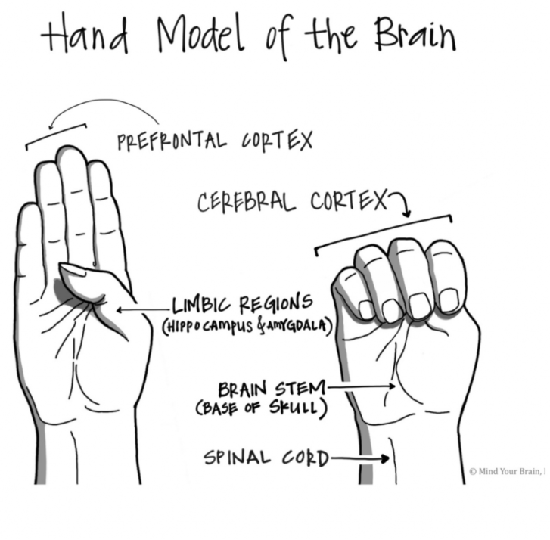
How stress impacts the brain
Downstairs brain, animalistic- emotions, memories, survival
Responsible for how we form attachment (early childhood- age 4)
Upstairs Brain, wise/thinking brain- imagine, problem-solve, analyze
Develops through young adulthood (25)
Shut off by stress response
Can be permanently disrupted or underdeveloped due to chronic stress/trauma
Flipping your lid- lose ability to effectively communicate or respond with reasoning
Trauma and chronic stress weakens brain connection between upstairs and downstairs brain
Behaviors of survival are reciprocal to relationships (Van der Kolk, 2014).
Notes:
People with disabilities are more vulnerable at every point in the “lifecycle of a traumatic event.” Because of limited knowledge, social skills, and verbal skills, they are more vulnerable to being exposed to abuse. Caregiver stress is also highly correlated to the prevalence of abuse and it appears that increased caregiver stress and the vulnerability of this population increase the prevalence of abuse. They are less likely to tell someone about the abuse (they may also be seen as less credible by someone if they report abuse). If exposed, they may be limited in their ability to make sense of the experience. They are likely to display more trauma-related symptoms and behaviors. Their capacity to heal may be limited by their disability. They face immense stigma and marginalization by society at large which may be traumatic in itself or make traumatic experiences worse. (Wilcox, 2011)

Slide 17
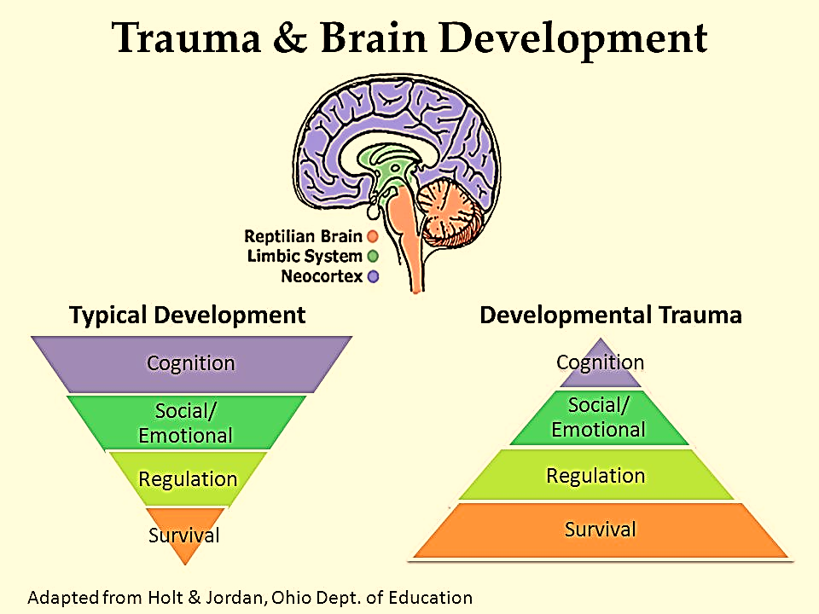
If you run into a bear, the stress response can help save you. But what happens when the bear comes home every night?

Slide 18
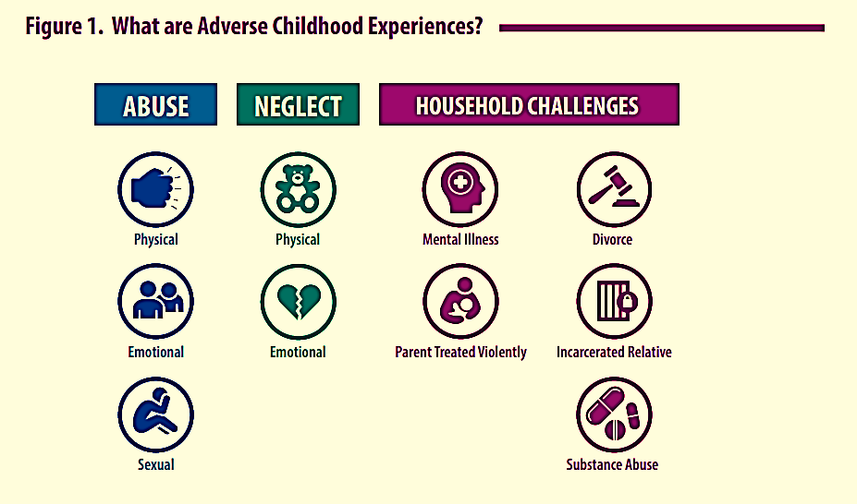
Adverse Childhood Experiences
→ACEs←

Slide 19
Prevalence of ACEs
69%
1 in 8
ACEs are most often enacted by caregivers.
Individuals with IDD have higher likelihood of always being reliant (to some degree) on caregivers.
Gen. Pop. Have 1+ ACE(s)
Gen. Pop. Have 4+ ACEs
92%
1 in 5
IDD Pop. Have 1+ ACE(s)
IDD Pop. Have 4+ ACEs

Slide 20
Key considerations with ACEs
Awareness promotes prevention
When prevention isn’t possible, identify and provide TIC through ACE
Establish Counter-Aces
Caregiver trust and safety
Predictable home routine
Strong friendships
Comforting beliefs
Positive self-esteem
.

Slide 21
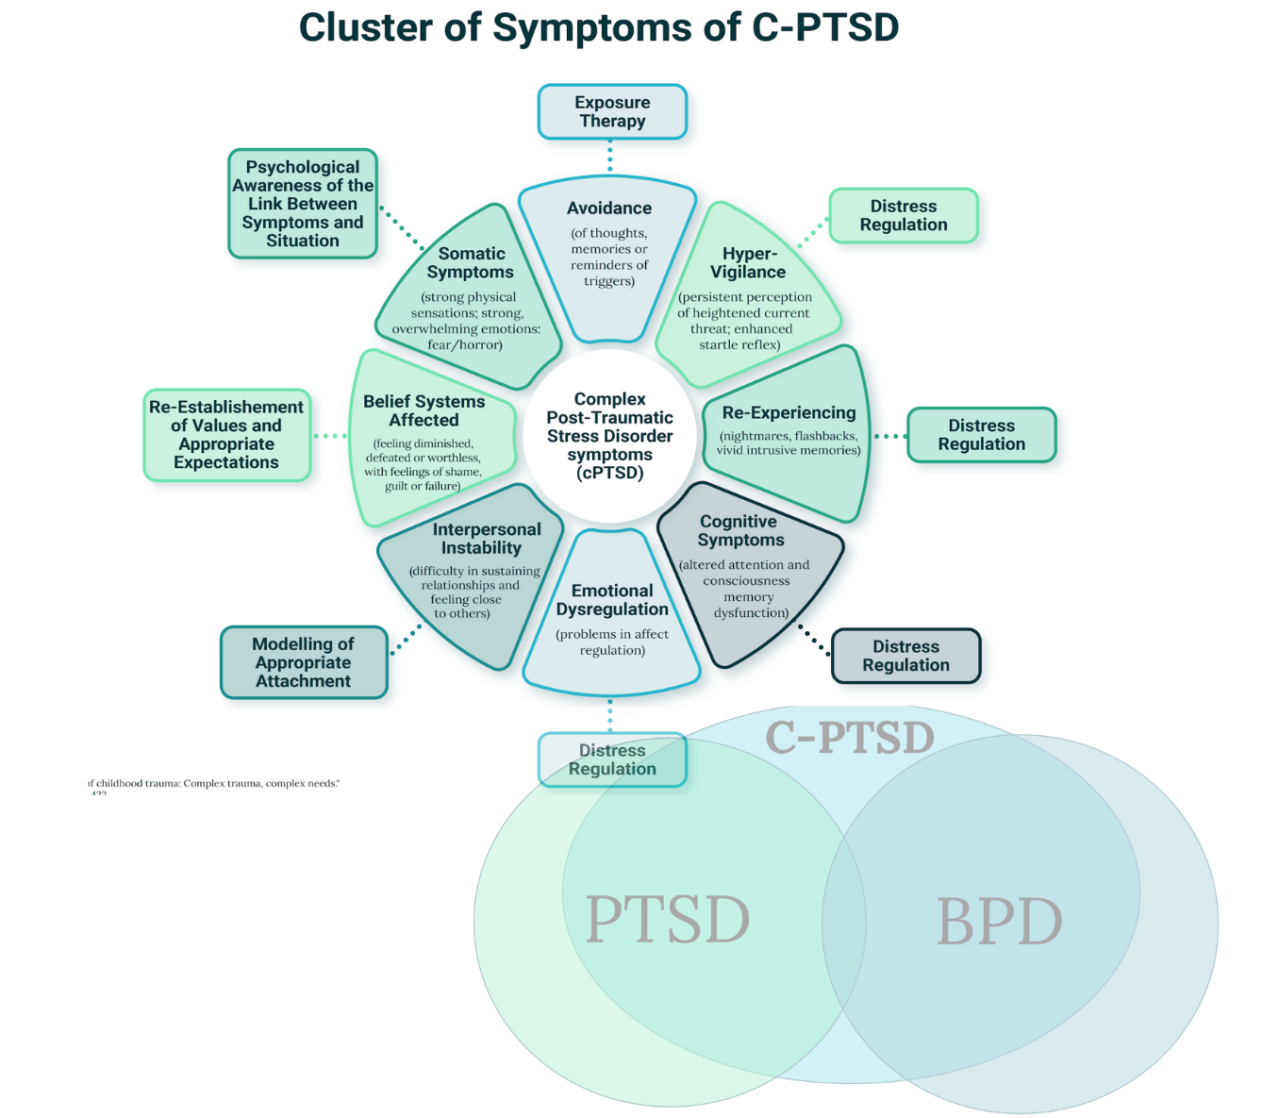
How does trauma present in people with IDD
Chronic Constipation
Incontinence
Body and muscle aches
Self soothing behaviors
Self-injury
Sleeplessness
Decline in skill development
Repetitious statement
Overdiagnosis

Slide 22
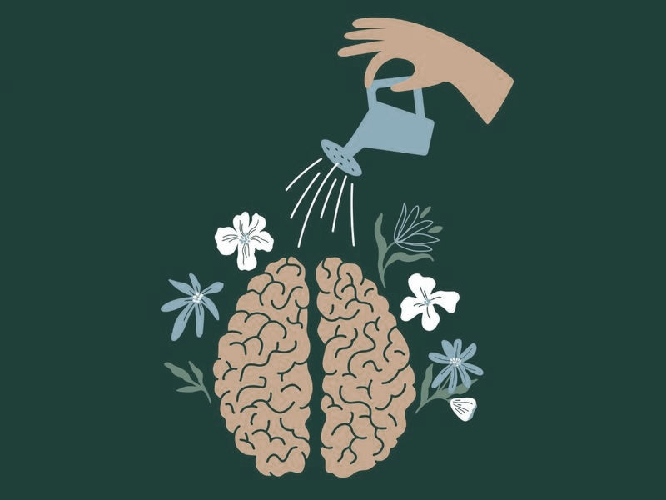
When it feels disheartening to learn how trauma changes the brain, remember that healing changes the brain, too.

Slide 23
Speakers
Who are we?
Topic 01
Define trauma and its prevalence among the IDD community
Topic 02
Recognize the impact of trauma in all areas of individual’s life
Topic 03
Identify the importance and methods of using trauma-informed care
Notes:
Change Image by right-clicking image and selecting “Change Picture > …From a File”
You can duplicate this slide and move the arrow to the appropriate Topic
The current topic line should be displayed in white font

Slide 24
Trauma-Informed care is a proactive approach to safety, creates opportunities for choice, power, and control and reduces the possibility of re-traumatization.
Center for Substance Abuse Treatment | 2019

Slide 25
Understand
Can help to provide caregivers with a complete picture of persons life situation
Why is TIC important?
Connect
Trauma informed care shifts the focus from “what’s wrong” to “what happened”. Through trauma-informed care, experiences and needs are valued, including those of caregivers. It can help build a network of relationships between the survivor, service providers, organizations, friends and family, and the community.
Can increase engagement, treatment adherence and health outcomes
Heal
Can reduce excessive health care costs
Notes:
Trauma-informed care shifts the focus from “What’s wrong with you?” to “What happened to you?” Through trauma-informed care, all experiences and needs are valued, including those of caregivers. This lens reveals a network of relationships between the survivor, service providers, organizations, friends and family, and the community. A trauma-informed approach to care acknowledges that healthcare organizations and care teams need to have a complete picture of a patient’s life situation — past and present — to provide effective healthcare services with a healing orientation. Adopting trauma-informed practices can potentially improve patient engagement, treatment adherence, and health outcomes, as well as provider and staff wellness. It can also help reduce avoidable care and excess costs for both the healthcare and social service sectors.(Center for Health Care Strategies, 2021)
Build treatment approaches that go beyond simplistic behavioral interventions that are informed by a deeper understanding of the indivdual

Slide 26
Considerations for TIC in the IDD field
This field has a long (and recent) history of trauma
We have already learned that in this field, prevalence of trauma is higher in service recipients and service providers
Turnover is more than a financial burden
Many current practices in this field lead to re-traumatization
Often your response either retriggers or empowers
Trauma will travel through the system until the people working in and designing the system actively engage in ending the cycle and healing the trauma from the past.
Notes:
History of trauma in the industry- Eugenics, abandonment of families and communities, institutionalization- abuse and neglect, overmedication and sedation
Turnover- for individuals served with a history of abandonment turnover can lead to perpetuation of abandonment crisis.
Turnover can also be a sign of high caregiver trauma and a flag to invest more in TIC with staff.
Physical restraints, restrictions, excessive labeling, over medications are all examples of interventions that are often retraumatizing
Ex- aggressive behaviors are often result of feeling unsafe and often consequences of aggression behavior increase person’s feelings of danger which reinforces their worries and perpetuates trauma
When you see every interaction as an impact to a traumatized person, you are more likely to proceed with care

Slide 27
The underlying experience of psychological trauma includes disempowerment and disconnection. Therefore, recovery requires empowerment and connection.
These core aspects can be especially difficult for someone with IDD to obtain.
Notes:
Why are the core aspects hard for those with IDD?
Do they really have control over where they live? Most experience limitations financially, functionally, socially, that lend to others making this decision for them. We talk about choices, but where and how do people you serve have access to real, significant choices?
How difficult is it for them to establish connection? Can you imagine most people who “care” for you being paid to be in your life?

Slide 28
Transitioning to a trauma-informed organization
1
TRAINING
2
RESOURCES FOR DSPs
Training can help staff to understand how trauma can affect the individuals they support.
Many of the DSP’s an organization employs are affected by their own traumatic experiences. Most also experience secondary trauma.
THE BENEFITS TO INDIVIDUAS
3
KNOWING THE RISKS
4
People with disabilities are most often abused by caregivers
Trauma informed care starts first at an organizational level, only then can individuals be supported through their traumatic experiences
Notes:
How can organizations help?
Provide all staff training on trauma-Trauma can help staff understand how trauma can affect all areas of an individual's life. Aid them in understanding the neurobiological effects of trauma and understanding that all responses to trauma are typical responses to atypical events.
Provide self-care and wellness resources to DSPs- Organizations can’t expect staff to be experts in aiding in trauma-informed care without having the resources to care for their own self-care and wellness.
Recognize that people with disabilities are most often abused by caregivers-
An organization should seek to Recognize that people with IDD can benefit from therapy (Center for Health Care Strategies, 2021). Increasing the support to individuals can decrease overall health care costs and increase the ability to build individualized care plans that incorporates all of the individual's life experiences

Slide 29
Trauma-informed considerations for Organizations
Train All Staff
Integrate Knowledge
Staff Resources
Actively Prevent Re-traumatization
All staff should be trained in trauma informed care
Trauma informed care should be part of the organization's culture and mission. Create a culture of recovery.
Secondary trauma, compassion fatigue, and burnout. How to recognize, prevent and help
Challenge the status quo. Be conscious of the goal.
Notes:
Training staff: Staff should be trained in trauma informed care including the widespread impact of trauma, signs and symptoms of trauma in patients, family members and even themselves and co-workers.
Knowledge about trauma should be integrated into policies, procedures and practices (Center for Health Care Strategies, 2021 For trauma informed care to be effective it needs to be reflected in every area of the organization. Providers need to understand how trauma can affect treatment presentation, engagement, and the outcome of behavioral health services.(SAMHSA, 2019)
Secondary trauma and stress of caregivers can increase risk of individual with I/DD being re-traumatized in the system. As such a trauma-informed approach with caregivers is paramount
Taking care of you goes hand in hand with taking care of others
As caregivers, we get used to putting others needs above ours at work and it becomes so natural that we can fall into an imbalance of completely neglecting our own needs→compassion fatigue and burnout

Slide 30
Trauma-informed considerations for caregivers
Awareness and Preventative Care
Coping Mechanisms
Know your ACEs/trauma
Recognize trauma response in others- it’s not personal
Pay mind to current traumatic experiences- heal through, not after
Attitude of gratitude
Check in with yourself- Mind Full or Mindful
Build and reinforce your resilience when battery is full
Take a self-care assessment- commit to self-care
Build a wellness plan and be proactive- it’s not just for you
3 R’s- rest, reflect, regroup
Tag a teammate
Go back to the basics
Cognitive reframing
Identify and accept the spectrum of your control and cope accordingly
In your control- Solution focused mindset
Out of your control- Radical acceptance
Mindfulness and progressive muscle relaxation
Just breathe baby!
Roses and candles
Box breathing
7/11 breath
Notes:
Trauma Informed Care isn’t just about providing supports to the clients. Caregivers may also have trauma in their past at the same rate as the general population of 7 in 10 people.
For this reason it is important that you assess yourself when working with others. Burnout and compassion fatigue are frequent concerns for caregivers. Taking care of yourself is as important as caring for others.
Check in with yourself- what percentage is your battery at? Recharge at 50%, not 10%
Self care assessment and lots of other resources from CFDS toolkit in references
Going with your basic needs unmet can hijack a lifetime of coping mechanisms.

Slide 31
Trauma-informed considerations for individuals with IDD
SOCIAL HISTORY & TRAUMA TIMELINES
RECONSIDER WHAT YOU “KNOW” ABOUT BEHAVIOR
1
2
Gather through social history when you can
ACEs
When they share, don’t minimize or question validity
Identify potential future triggers
Reflect on timeline when seeing behaviors
Functional Analysis with trauma behaviors
Setting event may be completely missed
Replacement behaviors
HEALING REQUIRES COMPREHENSIVE & CONSISTENT CARE
PERSON-CENTERED PLANNING OR FILLING BLANKS
3
4
Are you seeking to know them or are you filling a box?
Sensitivity acknowledgment in planning
How can we engage the person and empower them through the planning process
Multi-disciplinary
Staff turnover and training
Empower them to train
Bring back their “anchor”
Notes:
At intake, gather as much social history and maintain it- it is all important but especially the difficult experience. Screen for ACEs
Remember- behaviors are communication AND behaviors are a trauma response. Behavior that is a function of post traumatic stress may serve NO useful function for the person. It may be a visceral reaction based on an altered stress-response system. When trying to identify the setting event, you may focus on current situations and not consider past trauma. When that is the case, you may completely miss the mark. EX- foot meds When someone is re-experiencing trauma, teaching replacement behaviors won’t work
What is your goal in the planning discussion? You can learn more about the person every time you give them a chance to speak. Ex. of empowerment- foot meds continued Build treatment approaches that go beyond simplistic behavioral interventions that are informed by a deeper understanding of the indivdual

Slide 32
3 key points when providing TIC to an individual with IDD
SAFETY
CONNECTION
EMPOWERMENT
Like trauma, safety is personal. What makes you feel safe?
Remember, it is more about feeling safe than being safe
Acknowledge when the person doesn’t feel safe and take the opportunity to connect
Verbally empathize and communicate your desire to help
Build a trusting relationship- start small
Help the person establish an “anchor for safety”
Build relationship skills
Support and promote genuine connection
Building resilience
Help recognize and accept responsibility for future success
Supporting individual in identifying and using values to guide their decision making
Teaching mindfulness and power of breath
Learn to identify and label emotions and triggers
Notes:
Relationships and connection are so important in building resilience and we know this is grossly lacking in lives of many with I/DD
Imagine a life where you had to go through 5 steps, just to hang out with a friend
How can we get out of the way and support natural relationships and friendships?
Adjust behavior planning approaches and intervention
Functional analysis often misses a lot- what about when the behavior doesn’t have a function?
Setting event might be linked to historical trauma- in these cases teaching a replacement behavior has no place
Remember that the root of most trauma responses is a sense of feeling unsafe
At a person centered level, know what makes someone feel safe
In crisis, recognize the root feeling, empathize, identify your desire to help establish safety, and ask how you can help them feel safe
Trust is critical- build trust and reinforce history of the trust exercises

Slide 33
Trauma is common
Much more prevalent in society than we often realize and highly prevalent in our field.
Brief Review
Trauma impacts the whole person
“Unless someone like you cares a whole awful lot, nothing is going to get better. It’s not.”
-Dr. Seus
Therefore our care must address the whole person
Healing is possible
It requires commitment from all parties who play a role

Slide 34
Questions?

Slide 35
CDC. (2023). Coping with a Traumatic Event What Is a Traumatic Event? https://www.cdc.gov/masstrauma/factsheets/public/coping.pdf
Center for Health Care Strategies. (2021). What is Trauma-Informed Care? Trauma-Informed Care Implementation Resource Center. https://www.traumainformedcare.chcs.org/what-is-trauma-informed-care/
Center for Substance Abuse Treatment. (2019). Trauma-Informed Care: A Sociocultural Perspective. Nih.gov; Substance Abuse and Mental Health Services Administration (US). https://www.ncbi.nlm.nih.gov/books/NBK207195/
Freyd PhD, J. (2022, September 16). Definition of Betrayal Trauma Theory. Dynamic.uoregon.edu. https://dynamic.uoregon.edu/jjf/defineBT.html#:~:text=From%20Freyd%20(2008)%3A%20Betrayal
National Council of Wellbeing . (2022). How to Manage Trauma. https://www.thenationalcouncil.org/wp-content/uploads/2022/08/Trauma-infographic.pdf
OLGA Phoenix. (2020, October 16). Painful Truths About Vicarious Trauma: Statistics From the Field. Olga Phoenix. https://olgaphoenix.com/blog/painful-truths-about-vicarious-trauma-statistics-from-the-field/
Peterson, S. (2018, January 30). Secondary Traumatic Stress. The National Child Traumatic Stress Network. https://www.nctsn.org/trauma-informed-care/secondary-traumatic-stress#:~:text=Secondary%20traumatic%20stress%20is%20the
Prevention Institute. (2022). Prevention Institute. Www.preventioninstitute.org. https://www.preventioninstitute.org/suicide-prevention/historical-cultural-trauma#:~:text=Cultural%20trauma%20is%20a%20related
SAMHSA. (2019, January 14). Trauma and violence. Samhsa.gov. https://www.samhsa.gov/trauma-violence
Substance Abuse and Mental Health Services Administration. (2014). Understanding the impact of trauma. National Library of Medicine; Substance Abuse and Mental Health Services Administration (US). https://www.ncbi.nlm.nih.gov/books/NBK207191/
Texas Health and Human Services. (2015). Trauma and Individuals with Intellectual and Developmental Disabilities Holly Fullmer, Senior Policy Advisor for Trauma Informed Care. https://www.hhs.texas.gov/sites/default/files/documents/trauma-and-people-with-intellectual-and-developmental-disabilities.pdf
The Arc. (2011). How Trauma Affects People with Intellectual Disabilities What Is Trauma? How Often Do People with Intellectual Disabilities Experience Trauma? http://www.thearc.org/wp-content/uploads/forchapters/Trauma.pdf Trauma-Informed Care Implementation Resource Center. (2018, March 20). What Is Trauma? Trauma-Informed Care Implementation Resource Center. https://www.traumainformedcare.chcs.org/what-is-trauma/
Wilcox, P. (2011, October 16). Trauma and Developmental Disabilities | Traumatic Stress Institute - Klingberg Family Centers. Traumatic Stress Institute . https://www.traumaticstressinstitute.org/trauma-and-developmental-disabilities/
Marcal, S. Trifoso, S. (2017, May 11). A Trauma-Informed Toolkit for Providers in the Field of Intellectual & Developmental Disabilities. IDD_TOOLKIT_CFDS_HEARTS_NETWORK_5-28_FinalR2.pdf
Van der Kolk, Bessel A. "The body keeps the score : brain, mind, and body in the healing of trauma." New York, New York : Viking, 2014.
References
Notes:
History of trauma in the industry- Eugenics, abandonment of families and communities, institutionalization- abuse and neglect, overmedication and sedation
Turnover- for individuals served with a history of abandonment turnover can lead to perpetuation of abandonment crisis.
Turnover can also be a sign of high caregiver trauma and a flag to invest more in TIC with staff.
Physical restraints, restrictions, excessive labeling, over medications are all examples of interventions that are often retraumatizing
Ex- aggressive behaviors are often result of feeling unsafe and often consequences of aggression behavior increase person’s feelings of danger which reinforces their worries and perpetuates trauma
When you see every interaction as an impact to a traumatized person, you are more likely to proceed with care

