Slide 1

WORKERS’ COMPENSATION AFFECTS OUR
SAFETEY PROGRAM
Brenda Rice
IMA Risk Control Advisor

Slide 2
Workers Compensation
Workers’ Compensation Insurance protects a business and its employees.
Provides benefits to most types of employee injuries that occur on the job.
Workers’ compensation insurance is state mandated, meaning that every state has its own workers’ compensation laws and programs

Slide 3
Return on Investment
Although the workplace continues to become a safer environment for employees, accidents can still occur
* cost a business thousands of dollars every year
* lower productivity and employee morale
* result in increased absences
* ultimately lead to lower profits.

Slide 4
Qualified Worker Shortage
Hire Right to Mitigate Work Related Incidents
Implement a solid plan for recruiting, hiring, and training workers.
The Bureau of Labor Statistics found that nearly 40% of injured workers have been on the job for less than a year.
New workers are more likely to be hurt because they lack the experience and information needed to properly protect themselves
INSURANCE | RISK MANAGEMENT | SURETY | EMPLOYEE BENEFITS

Slide 5
Telecommuters & Work Comp
An injured telecommuter must show the injury occurred “in the course of and arising out of” their employment to prevail on a workers’ compensation claim.
Telecommuting Policy/Procedure to include:
- safety assessment of home / work area
- incident reporting requirement
- training for home work safety
- incident investigation procedures
INSURANCE | RISK MANAGEMENT | SURETY | EMPLOYEE BENEFITS
Notes:
The testimony of the injured worker as to how the injury occurred and whether it occurred in the course of, and arose out of, the employment; and
Doctor’s report that will tie the condition being sought to the mechanism of injury, as described by the injured worker.

Slide 6
WORKERS COMPENSATION . . .What is it?
No Fault System
Pays benefits for accidental injuries and illnesses related to work
Benefits include medical treatment, rehabilitation and income replacement
Income replacement is 2/3 of weekly wage
7 day waiting period – State Specific.

Slide 7
EXPERIENCE MODIFICATION FACTOR
It is an indicator of how safe or unsafe a company has operated.
Based on your loss experience over the past three years, not
counting the most recent year.
2023 Mod is based on 21, 20, 19 losses.
Based on dollar costs of workers‘ compensation injuries
Medical Costs→30%
Indemnity Costs→ 100%
(lost time from work & permanent disability)

Slide 8
OSHA Visits & Experience Mod
Experience Modification Factors can impact your organizations possibility for an OSHA Inspection
  1.00 – Industry Average
  Above 1.00 – increase cost
  Above 1.00 – OSHA Emphasis Group Potential
Number of Injuries – No Impact
Cost of Injuries – Impact

Slide 9
Managing a Work-Related Incident
  Immediate reporting (reduced lagtime)
  Directed medical providers (PPO usage)
  Aggressive Case Management (telephonic and nurse case managers are available as appropriate)
  Return to Work (vitally important!)
  Communication
  (even more and the most vitally important!)
    Employer, Adjuster, Claim Advocate (agency side),
    Nurse Case Manager

Slide 10
Lagtime

Slide 11
Why Are Claims Typically Reported Late?
Employee and Employer attitudes towards workplace injuries
“Macho Syndrome”
Ability for overtime is impeded
Employee doesn’t understand the claim reporting and work comp process
Employees are afraid that they will jeopardize their employment
Many employers and employees are unaware of the benefits of prompt claim reporting

Slide 12

Prompt Claim Reporting Allows For…
Immediate investigation
Decrease in litigation and associated costs
Decrease in work comp fraud due to early identification
Quicker resolution of the claim
Reduction in lost time from work and associated costs
Ensuring the employee receives prompt, necessary medical attention
Promoting a positive workplace culture

Slide 13
Post Accident – claim investigation
Post-accident drug testing?
Do you have any reason to
question ?
Document all events
Obtain written statement from all witnesses
Is there video of accident?
Notify adjuster of any developments in case
Subrogation claim – other party liable?
Rumors of prior injuries and / or outside activities?

Slide 14
Medical Treatment

Slide 15
Medical Treatment
Employer not employee directs medical care - unless employer fails or refuses to direct medical care
Have a list ready for both daytime and after hours authorized medical treatment facilities
$500 Unauthorized Medical

Slide 16
TeleHealth
24/7/365 access to integrated nurse triage & telemedicine, providing the right care at the right time
Triage report is used as the First Report of Injury (FROI), employer is no longer required to report claim to AF Group directly
Ability to direct or soft-channel injured workers to customer’s preferred clinic
Many employees can receive care while staying at work after an injury
Increased use of our provider network physicians can lead to lower overall claim costs.
Improve Lag Time Results
Notes:
Rising in popularity, telemedicine allows your employees to receive virtual medical services following a workplace injury. Telemedicine has grown in popularity throughout the pandemic as employees can receive medical services without physically visiting a doctor’s office or navigating limited clinic availability. In fact, the Workers’ Compensation Research Institute reports that 25 states have either added or expanded telemedicine offerings for treating occupational injuries due to the pandemic. A sign of telemedicine’s acceptance, a recent survey found that 83% of current telemedicine users plan to continue with the service.

Slide 17
Return To Work

Slide 18
Return to Work is a Key Factor!
Written Program reduces unnecessary administrative time, lost days when attempting to coordinate return to work and increases employee accountability.
Employee is transitioned back to full duty.
If refused lost time indemnity benefits can be terminated.
Claims without lost time (or disability ratings) remain as Medical Only.
Result - Cost Savings!
Often results in less litigation, reduces abuse of the work comp system.

Slide 19
Return to Work is a Key Factor!
Allows employer and insurance carrier to maintain control of the claim.
Tends to speed recovery periods and foster good will.
Fact: The longer an employee is off work:
- the more costly the claim will become
- greater chance that they will not return at all
- cost can increase by 2-10 x the original claim

Slide 20
Accident Investigation – FOCUS ON PREVENTION

Slide 21
Why Investigate ? ? ?
Save lives and money by investigating all incidents in your organization. Even a minor incident or near miss can be a warning of a major risk.
Investigate incidents in order to pinpoint the root causes. Addressing these underlying issues allows you to prevent similar incidents from recurring.

Slide 22

Respond, Investigate, and Analyze
Benefits of investigating and analyzing incidents:
Identifying unsafe conditions and behaviors
Identifying needed organizational changes
Providing constructive feedback
Reinforcing best practices
Reducing future incidents
Prioritizing the safety and well-being of
everyone in the organization

Slide 23

Unsafe Acts
Unsafe acts are activities that create or increase the risk of injury or property damage. They result from behavior rather than a lack of skill.
Examples:
Disregard for proper procedures or training
The bypassing or disabling of safety devices
Failure to use proper personal protective equipment (PPE)
Careless, distracted, or unauthorized operation of equipment
Working under the influence of drugs or alcohol
Horseplay

Slide 24
Unsafe Conditions
Examples not inherent to the worksite:
Uneven or slick walking surfaces
Damaged or improperly maintained equipment or PPE
Ergonomic hazards
Improper storage
Inadequate machine guarding
Examples inherent to the worksite:
Extreme temperatures
Heights
Air quality
Other environmental or atmospheric conditions

Slide 25

Common Misconceptions
Avoid making these assumptions:
There can only be one true cause and
solution for the accident.
Incidents only occur when rules are broken.
Someone must be held accountable.
Given the same set of facts, everyone will come to the same conclusion.

Slide 26

The Why Method
Often, the easiest way to get to the root cause of a problem is simply asking
“why did this happen?”

Slide 27

When Is the Time to Investigate?
The time for accident investigation is always as soon as possible.
The less time between the
accident and the investigation,
the better the information that
can be obtained.
Facts are clearer, more details remembered, and the conditions are nearest those at the time of the accident

Slide 28
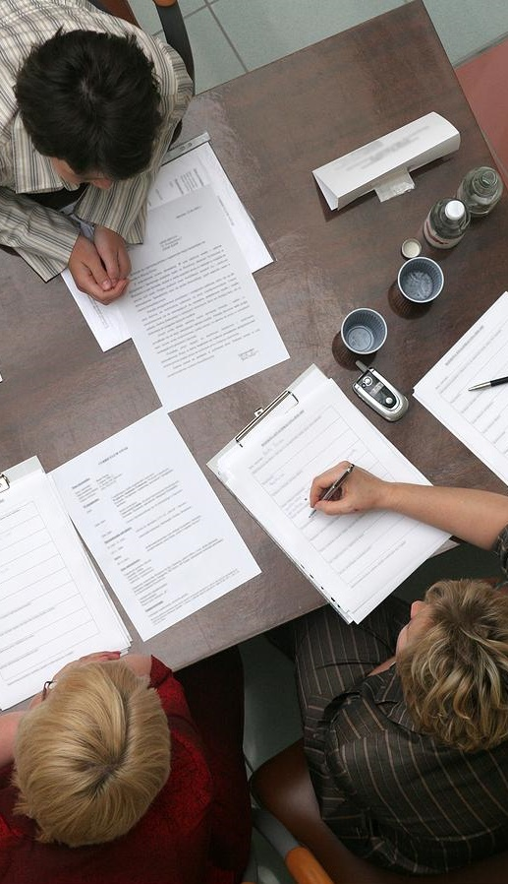
Corrective Actions
Recommendations for corrective actions should address each root cause that was identified in the analysis.
Be specific on how to implement.
Keep your recommendations constructive
and objective.
Identify safety deficiencies. However disciplinary action should be handled separate of investigation.

Slide 29


Slide 30
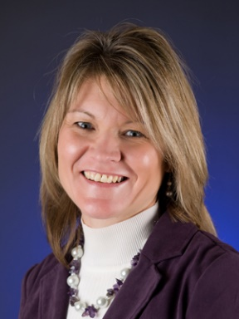
THANK YOU
Brenda Rice
Risk Control Advisor
Brenda.rice@imacorp.com
(913) 912-2932

