Slide 1
Building a Foundation for Employment Support Services
2023
Kansas

Slide 2
The Definition of Community-Based Employment Services
MANAGING CHAOS!!!

Slide 3

Navigating the Landscape
The business of doing business with business!

Slide 4

Two Worlds: Human Services and Employment
This Photo by Unknown Author is licensed under CC BY-SA

Slide 5
Three Customers
Job Seeker
-
-

Slide 6
Three Customers
Job Seeker
-
Employer

Slide 7

Three Customers
Job Seeker
Funding Source
Employer

Slide 8

Job Match

Slide 9
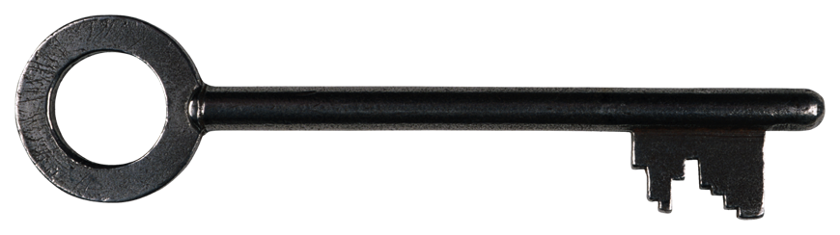
The secret to success!

Slide 10

The 10 yard mile!

Slide 11

Programs

Slide 12
Employment Flow
Referral
High Quality Assessment of Wants and Needs
Plan
Follow Up
Job
Match
Initial Contact
Relationship Building
Proposal
Service After the Match
Network

Slide 13

Dating?

Slide 14
Employment Flow
Referral
High Quality Assessment of Wants and Needs
Plan
Follow Up
Job
Match
Initial Contact
Relationship Building
Proposal
Service After the Match
Network

Slide 15
Allocating Resources
NETWORKING
FORMAL
INFORMAL
JOB
SEEKER
TEAM MEMBERS

Slide 16
Allocating Resources
NETWORKING
FORMAL
INFORMAL
JOB
SEEKER
TEAM MEMBERS

Slide 17


Allocating Resources

Slide 18




Stages of Employment Development
Relationship Building
Initial Contact
Proposal
Service After the Match

Slide 19

Initial Contact - Considerations
Who are you?
What do you want?
WIIIFM

Slide 20
Employer File
DEMOGRAPHICS
CONTACT INFORMATION
RELATIONSHIP MANAGEMENT PLAN
CULTURAL ASSESSMENTS
JSI
FLOW CHARTS

Slide 21
Stages of Employment Development
Relationship Building
Initial Contact
Proposal
Service After the Match

Slide 22
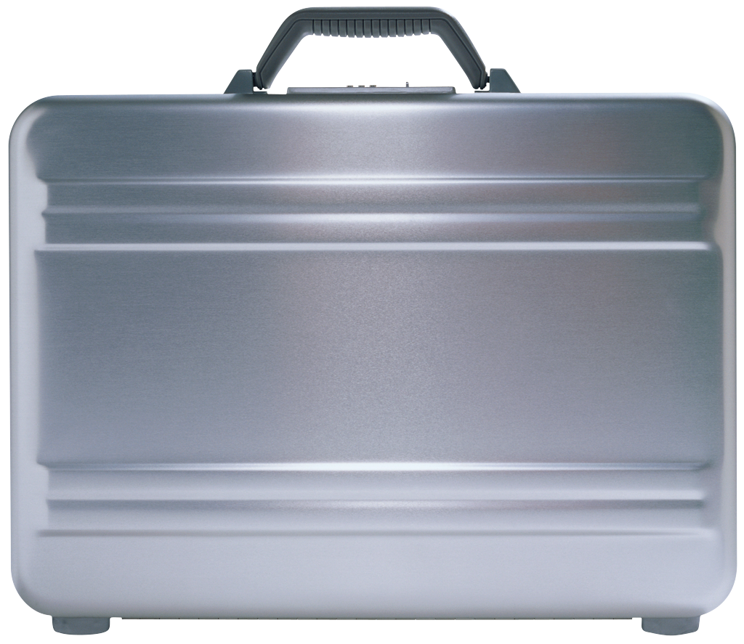
Relationship Building Goals
Assess job/s
Assess the culture
Know your customer
Be welcome back

Slide 23

Relationship Building - Considerations
See the job
Know the direct supervisor
Know the culture and flow

Slide 24
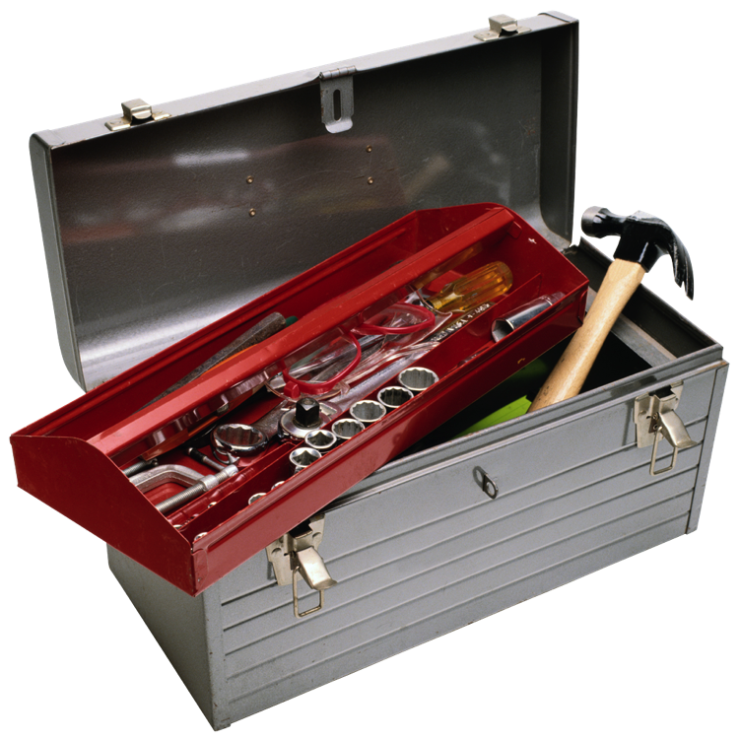
Tools
Skill Inventories
Cultural Assessments
Task and Sequence Analysis
Flow charts and diagrams

Slide 25
Stages of Employment Development
Relationship Building
Initial Contact
Proposal
Service After the Match

Slide 26
Proposal Goals
Know the person
Know the job
Know the resources
Present a clear plan

Slide 27
Proposal - Considerations
Verbal
Follow-up in writing
Know the resources and look for creative options

Slide 28
Gap Analysis
Tool for anyone attempting to increase a person’s performance
Structures the proposal and follow up
Documentation that manages the relationship with all stakeholders

Slide 29
GAP Analysis TOOL
Job Requirement | Person/Status | Supports |  | Progress

Slide 30
Skills in the Tool Box
JOB MODIFICATION, JOB RESTRUCTURING, and TRAINING
TASK and SEQUENCE ANALYSIS
FLOW DIAGRAMS
TECHNOLOGY

Slide 31
Stages of Employment Development
Relationship Building
Initial Contact
Proposal
Service After the Match

Slide 32
Marketing Plan
AGENCY/ORGANIZATION
MANAGEMENT
TEAM MEMBERS
EMPLOYMENT DEVELOPER

Slide 33
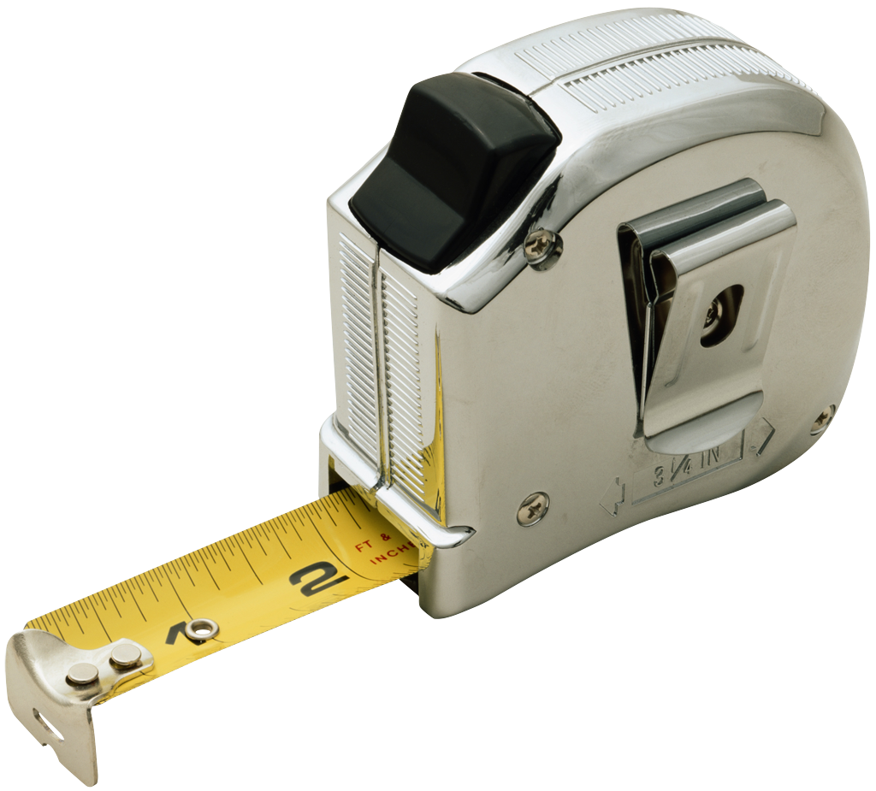
Metrics

Slide 34
EMPLOYERS
NO
MAYBE
YES
Development

Slide 35

Contact Information
Email: McAllinc@AOL.COM

