Slide 1

Advocating for Self-Direction & Engagement
GT Independence

Slide 2

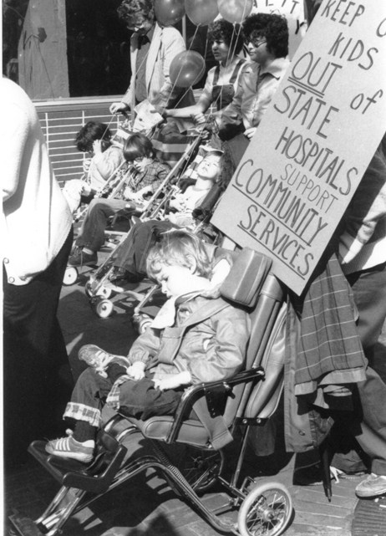
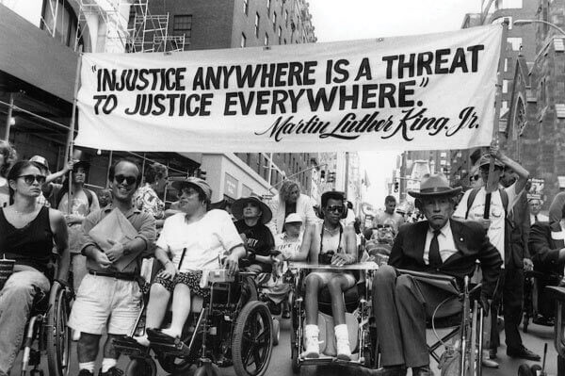
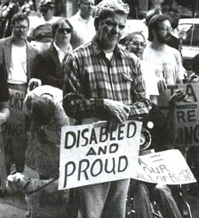
Disability Rights
Disability
Disability Rights

Slide 3
A Brief History
Institutional Population >500,000
Community Mental Health Act
Older Americans Act
Social Security Act
Peak Institutional Population
1950s
1963
1964
1965
1967
1973
The Civil Rights Act
The Rehabilitation
Act of 1973
First Robert Wood Johnson Foundation Grant
1915(c) added to Social Security Act
1991
1990
1983
1975
Disability Rights
1999
Education for All Handicapped Children Act
Olmstead Decision
Americans with Disabilities Act,
IDEA Act
Affordable Care Act,
Veteran-Directed HCBS
2005
2009
2010
2014
20??
Deficit Reduction Act 1915 (i), 1915(j)
Year of Community Living
HCBS Settings Rule
Notes:
The United States has experienced two waves of deinstitutionalization. Wave one began in the 1950s and targeted people with mental illness.[83]
The second wave began roughly fifteen years after and focused on individuals who had been diagnosed with a developmental disability (e.g. Intellectual Disability ).[83]
1963 Community Mental Health Act – JFK called for a “bold new approach” to create comprehensive community care. This authorized federal grants to construct public or nonprofit CMH centers.
1964 Civil Rights Act – discrimination or segregation on the ground of race, color, religion, or national origin.
Not disabilities
1965 Social Security Act and Older Americans Act – allows for a lot of the funding of services today
In 1967 population of I/DD individuals living in State institutions peaked to nearly 200,000 individuals. Today there are almost 30,000 individuals with I/DD in large facilities (>16 residents) and another 30,000 in nursing homes. Minneapolis Tribune did an extensive report on the conditions of these institutions. They found that half of the people living in these institutions had shoes.
1973 The Rehabilitation Act (Section 504) Prohibited discrimination on the basis of physical or mental disability.
1975 Education for All Handicapped Children Act – equal access to public education
1983 1915(c) added to Social Security Act which is where many of the waiver programs operate
1990 – ADA which gave equal treatment and equal ACCESS of people with disabilities to employment and public accommodations the goal of the integration mandate in title II of the Americans with Disabilities Act – to provide individuals with disabilities opportunities to live their lives like individuals without disabilities – has yet to be fully realized.
For those reasons, Congress prohibited discrimination against individuals with disabilities by public entities:
“historically, society has tended to isolate and segregate individuals with disabilities, and, despite
some improvements, such forms of discrimination against individuals with disabilities continue
to be a serious and pervasive social problem.”
Also 1990 – IDEA Act (renamed Education for All Handicapped Children Act) added this IEP process
1991 – 1st Robert Wood Johnson Grant on Self-direction in New Hampshire; I'll tell you about Jack’s Story – the birth of self-direction
1997 – 18 States were awarded RWJ grants (CLS was one of four pilot locations in MI selected)
1999 – Olmstead Decision, Supreme Court Decision – required states to develop plans to provide the opportunity for people to choose where to live including in the community. We'll talk more about Olmstead in a later slide.
2005 Deficit Reduction Act and 1915(i) and (j) - HCBS Waiver training later
2009 – Obama announces “Year of Community Living” on 10th Anniversary of Olmstead
2010 – ACA – maximize independence and self direction, person-centered planning, continued expansion of MFP, 1915(k)
Also 2010 – VDHCBS
2014 – Home and Community Based Settings Rule – “institutional qualities”, delayed until 2023
20?? – What is next? More advocacy is needed.

Slide 4
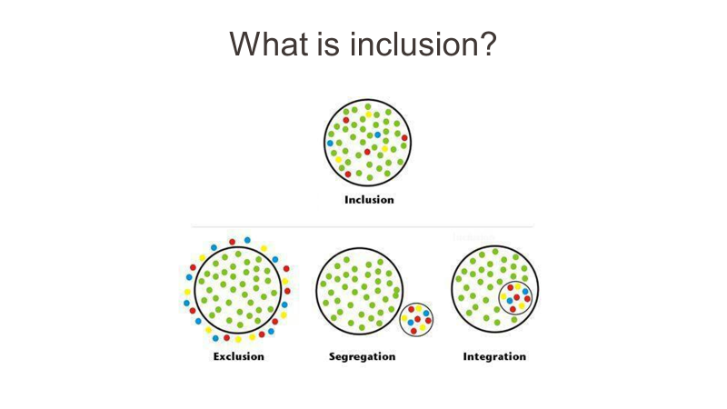

Slide 5

What choices did you make today?
Did you choose when to wake up?
Did you choose whether or not to shower this morning?
Did you choose what to wear?
Did you choose what to have for breakfast or lunch?
Did you choose where you would go today?
Did you choose what you would do today?
Did you choose who you would spend time with?

Slide 6



It’s a way of life!

Slide 7
Principles of Self-Determination
Rights = Choice = Self-Determination
Self-Determination is the right to make your own decisions
The ability and opportunity to be ‘causal agents’ being actors in your lives instead of being acted upon
The foundation of Self-Directed Service & Supported Decision-Making models
Notes:
Self-Determination is not a program…It’s a way of life.
Self-Determination is the inalienable right of all humans, regardless of age or ability, to make choices and have control over their own lives.
To be casual agents, acting in, rather than being acted on.
As individuals and a community we can promote this, by helping others to express their own voice.
As we know from decades of research: when denied self-determination, people feel helpless, hopeless, and self-critical, and experience low self-esteem, passivity, and feelings of inadequacy and incompetency decreasing their ability to function

Slide 8

Principles of
Self-Determination
Freedom
Authority
Support
Responsibility
Confirmation
Notes:
With Self-Determination as the cornerstone of Self-Directed programs, 5 key principles are the foundation.
First and foremost is Freedom. Freedom to take Risks and to Fail, the freedom to learn and grow, and experience, the freedom of choice. And, the Freedom to Determine A Meaningful Life
Second is Authority. The authority to determine what I need help with, as well as how and when that help is delivered, and the Authority to decide who come into my home to deliver that help.
Next is Support. The right to be Supported during the Decision-Making process. To include the people I know and trust that will help me understand my options and assist me in expressing my preferences.
With great freedom and authority comes great Responsibility. Self-directed individuals are ultimately responsible for the wise use of public funds. By working cooperatively with A Financial Manager, ensuring employee time is tracked correctly and submitted on time, and being committed to Train, Supervise, & Evaluate their personnel, the participant takes an active role in quality management.
Finally, Confirmation: Honoring the important leadership role individuals who receive public support play in changing their systems of support. What this means is that systems need to assure that how they are operating on a daily basis validates the person’s right to control decisions about their own lives. It also needs to have solid and ongoing ways for people across disability and aging and their families to have key roles in system design, system change, and the everyday operation of this system.

Slide 9
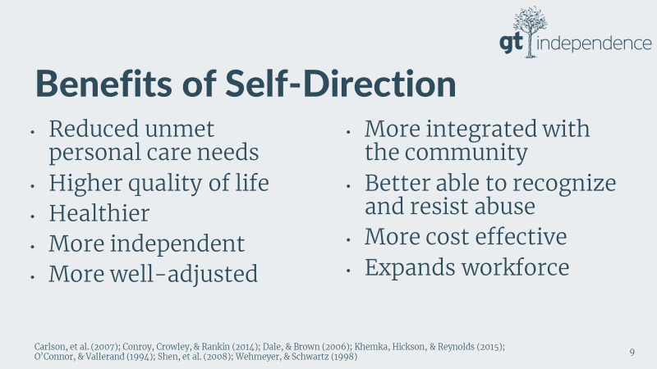
Benefits of Self-Direction

Slide 10
Self-Direction Can Solve Problems
Quality
Self-Direction reduces costs spent on long term services and supports. One study showed a cost savings of 12.4% to 15.5%.¹
We have a growing population of Baby Boomers and a shortage of caregivers. Self-Direction brings caregivers into the workplace who may not otherwise have chosen that particular career path.²
Efficiency
Cost

Slide 11
Barriers to Self-Direction
Not available
Lack of information
Perception of fraud
Stigma
The myth that it’s too much work
Recruiting workers
DOL Rules don’t necessarily align with Medicaid and Program rules

Slide 12
Who Can Self-Direct?
What Services Can You Self-Direct?
Anyone!
  Adults and Children with disabilities or other long-term care needs
  Individuals with mental illness
  Veterans
Any!
  Personal Care, Community Living Supports, Supports Coordination, Respite, Nursing Services, etc.

Slide 13

Advocating for Self-Direction: Get engaged!
Educate yourself!
Learn about your State’s programs
Speak up!
Comment on Policies and Public Comment opportunities
Foster Choice
Get Engaged!
Find Advocacy Groups
Notes:
Read slide
Know, Speak, Act

Slide 14


Our Employees
GT Independence employees say what self-determination means to them.
Notes:
Now lets hear from some GT Staff about what we do
Play video

Slide 15
GT Independence Contacts :We are here to support you!
Andrea Johnson
Director of Operations
AJohnson@gtindependence.com
Office: 269.503.7914
Erica Miller
Program Manager
emiller@gtindependence.com
Office: 269-503-7408 X600
Toll Free: 1-877-659-4500
Rob Lewis
National Director of Business Development
rlewis@gtindependence.com
Office: 269-569-2332
Bill Perez
Director of Relationships
bperez@gtindependence.com
Cell: 786-570-0647
Office: 269-651-6900

Slide 16
Thank You!

