Slide 1
Advance Care Planning: Where Do We Go From Here?
Christina Marsack-Topolewski, PhD, LMSW
Eastern Michigan University
cmarsack@emich.edu

Slide 2
Dr. Christina Marsack-Topolewski is an associate professor of Social Work in the College of Health and Human Services at Eastern Michigan University. She received a bachelor’s of science in Special Education, specializing in Cognitive Impairments, from Wayne State University. She trained under a specialized fellowship at the University of Michigan, receiving her master’s in Social Work and specializing in aging from the University of Michigan. Dr. Marsack-Topolewski received her PhD in Social Work with a dual title in Gerontology from Wayne State University. She has worked with individuals with various intellectual and developmental disabilities for over 20 years. Her research focuses on individuals with IDDs, their caregivers, advance care planning, service delivery, and service utilization. She has over 50 publications in national and international journals, mainly focusing on individuals with IDDs, advance care planning, caregiving, and aging. In addition, she has presented her work locally, nationally, and internationally. Dr. Marsack-Topolewski has been the lead on multiple grant-funded programs tailoring services to individuals with IDDs, older adults, and chronic illnesses. In 2019, she was appointed to the National Task Group on Intellectual Disability and Dementia Practices. She serves as both a board member and co-chair of Membership Affairs. Over the past 3 years, she has provided testimony at the state-level (Michigan) to advocate for two house bills that would provide protections against exploitation for vulnerable adults, such as individuals with IDDs.

Slide 3
IF YOU COULD DESCRIBE THIS LAST YEAR FOR INDIVIDUALS WITH IDD & THEIR CAREGIVERS WITH A WORD, WHAT WOULD THAT BE?

Slide 4
Welcome & Orientation
Thanks for being here today! In the chat, please provide the following information:
Organizational affiliation
Job title
Experience working with individuals with IDD

Slide 5
Today’s Focus: The number of individuals with intellectual and developmental disabilities (IDD) is growing rapidly. Advance care planning is recommended as a best practice. It is important that individuals with IDD are not left out of these conversations.

Slide 6
Today’s Focus: Aims: -Understand… 1) aspects of advance care planning, 2) challenges to advance care planning, 3) benefits of advance care planning, and 4) how to support individuals with IDD, families, and caregivers with planning.

Slide 7
“Advance care planning” – What comes to mind? *Please put thoughts that come to mind in the chat.

Slide 8
DIMENSIONS OF ADVANCE CARE PLANNING
State PCP documents should reflect ACP dimensions
The following ACP dimensions should be included in PCP documents:
Diagnosis / Prognosis
Support Needs
Living Arrangements
Retirement
Finances
Burial Funds
Funeral Arrangements
Decision Making
Guardianship
Advance Directives
(Church, Marsack-Topolewski, McGinley, & Knocke, 2021).

Slide 9
TERMINOLOGY RELEVANT TO ACP
Advance directive
Comfort measure / comfort care
Do-not-intubate order (DNI)
Do-not-resuscitate (DNR) order [in hospital and out of hospital]
Durable power of attorney (DPOA) for health care
End stage
Notes:
Federally legislated Medicaid requirements for recipients with intellectual and/or developmental disabilities (IDD) to have a person-centered plan (PCP) do not specifically state that advanced care plans (ACP) be a component of the plan. However, coronavirus disease 2019 (COVID-19) has provided a salient reminder of the importance of incorporating ACP within the PCP for people who have IDD. As demonstrated by situations arising from COVID- 19, emergencies and crises can dramatically alter access to care for people with IDD. This paper synthesizes results from an environmental scan related to ACP for adults with IDD. Findings suggest that the use of ACP, particularly when such planning processes result in the delineation of roles and documentation of preferences, can be helpful in mitigating the impact of these crisis situations on the person with IDD and their caregivers.

Slide 10
TERMINOLOGY RELEVANT TO ACP Continued…
Health care proxy
Hospice care
Informed consent
Palliative care
Advance care planning (ACP)
Person-centered planning (PCP)

Slide 11
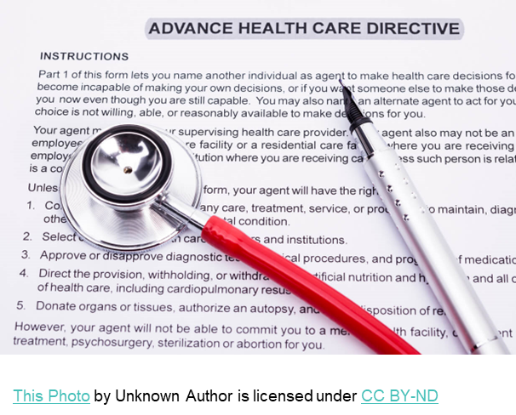
Poll – Question 1: A recent analysis found that approximately what percentage of state PCPs accounted for consideration of advance directives? a. 5% b. 25% c. 45% d. 85%

Slide 12
Poll – Answer 1: A recent analysis found that approximately what percentage of state PCPs accounted for consideration of advance directives? a. 5% b. 25% c. 45% d. 85% B – Approximately 25% of state PCPs documented the presence of advance directives that express the person’s and/or surrogates’ wishes.

Slide 13
Poll – Question 2: This same content analysis found that approximately what percentage of state PCPs accounted for consideration of identifying a person’s diagnosis and prognosis for the purposes of planning? a. 22% b. 45% c. 51% d. 76%

Slide 14
Poll – Answer 2: This same content analysis found that approximately what percentage of state PCPs accounted for consideration of identifying a person’s diagnosis and prognosis for the purposes of planning? a. 22% b. 45% c. 51% d. 76% C – Approximately 51% of state PCPs sought information to identify a person’s diagnosis and prognosis.

Slide 15
ACP for individuals with IDD has lagged behind the general population. (Carr & Luth, 2017; United States Department of Health and Human Services, 2007)

Slide 16
SETTING THE STAGE…
Keep in mind… the number of individuals with IDD reaching advanced age is rapidly increasing. Projections indicate a doubling by 2030 and tripling of the population in the foreseeable future.
-Acharya, Schindler, & Heller (2016)
Notes:
From McGinley & Marsack-Topolewski paper:
The leading causes of death for individuals with developmental disabilities are now similar to those found in the general population, including: respiratory disease, heart and circulatory disorders, and cancer (Landes et al., 2019; Tuffrey-Wijne et al., 2016). The life expectancy of individuals with developmental disabilities has increased in recent years, with the average lifespan now ranging from early 50s to 60s with variability often attributable to the severity of the developmental disability and other co-occurring conditions (Lauer & McCallion, 2015). Older adults with developmental disabilities, however, seem to remain at greater risk for premature and avoidable death when compared to the general population (Landes et al., 2021).

Slide 17
SETTING THE STAGE…
Here are some common medical conditions experienced by those aging with IDD—
Dental pathologies
Sensory deficits (vision, hearing)
Obesity
Pain
Osteoporosis and increased fracture risk
Pain
(Moran, 2017)

Slide 18
SETTING THE STAGE… Other Considerations…
Aging with an IDD may also be associated with-
Increased stress
Experiencing losses
Social isolation and loneliness
Decreased ADL and IADL independence
Unique factors shape the experiences of individuals with IDD
Notes:
From McGinley & Marsack paper
unique factors disproportionately shape the experiences of people with developmental disabilities at the end of life, including: behavioral health needs, complex comorbidities, and polypharmacy (Nicholas et al., 2017; O’Dwyer et al., 2016; Tuffrey-Wijne et al., 2016). Botsford (2000) noted several other individual-level factors that influence the response of people with developmental disabilities to death and dying, including: past learning and experience, intellect, communication skills, and family and staff perceptions of both the person and the circumstances of serious illness.

Slide 19
SETTING THE STAGE…
The life expectancy for individuals with IDD has increased.
Earlier and non-normative health declines
Limited access to quality care
Potential challenges navigating and advocating for care
Fewer financial resources
Family often supports throughout the lifespan
Often living in the family home

Slide 20
SETTING THE STAGE…
The life expectancy for individuals with IDD has increased.
Living with complex medical challenges for longer than the general population
Underutilization of hospice and palliative care services
Higher rates of hospital / institutional deaths

Slide 21
Takeaway
These trends arguably provide all the more reason to invest time and energy into advance care planning.

Slide 22
Despite these trends… Low rates of ACP exist.
A few things to keep in mind:
Older adults with IDD are a growing population
ACP is a recommended best practice for adults with IDD
Medicaid requires recipients with IDD to have a PCP (ACPs are not stated as a necessary component of these plans)
To date, there are low rates of ACP adoption
Maintaining a social support network is key
(McGinley, Marsack-Topolewski, Church, & Knocke, 2021)
Notes:
Federally legislated Medicaid requirements for recipients with intellectual and/or developmental disabilities (IDD) to have a person-centered plan (PCP) do not specifically state that advanced care plans (ACP) be a component of the plan. However, coronavirus disease 2019 (COVID-19) has provided a salient reminder of the importance of incorporating ACP within the PCP for people who have IDD. As demonstrated by situations arising from COVID- 19, emergencies and crises can dramatically alter access to care for people with IDD. This paper synthesizes results from an environmental scan related to ACP for adults with IDD. Findings suggest that the use of ACP, particularly when such planning processes result in the delineation of roles and documentation of preferences, can be helpful in mitigating the impact of these crisis situations on the person with IDD and their caregivers.

Slide 23
Poll – Question 3: How often are ACPs revisiting / updated for the consumers your organization serves? a. quarterly b. yearly c. sporadically d. never

Slide 24
Poll – Answer 3: How often are ACPs revisiting / updated for the consumers your organization serves? a. quarterly b. yearly c. sporadically d. never

Slide 25
Poll – Question 4: What do you perceive as the biggest barrier for helping clients with ACP? a. time b. lack of understanding / expertise c. lack of organizational emphasis and/or procedure to engage in ACP d. emotional nature of planning for consumers / family e. all of the above

Slide 26
Poll – Question 4: What do you perceive as the biggest barrier for helping clients with ACP? a. time b. lack of understanding / expertise c. lack of organizational emphasis and/or procedure to engage in ACP d. emotional nature of planning for consumers / family e. all of the above

Slide 27
BARRIERS TO ADVANCE CARE PLANNING
This Photo by Unknown Author is licensed under CC BY-SA
This Photo by Unknown Author is licensed under CC BY-SA

Slide 28
WHY? Low Rates of ACP and Even Future Planning
Cheung et al. (2020) identified the following barriers:
1. “Limited patients’ participation in autonomous decision making
2. cognitive and emotional barriers to discussion
3. lack of readiness and awareness of early discussion
4. unprepared healthcare professionals and healthcare system.”

Slide 29
WHY? Low Rates of ACP and Even Future Planning
Many families and individuals prolong planning for these reasons…
1. Difficulty identifying caregiving support for the future (e.g., future caregiver[s])
2. Barriers to making plans / decisions (e.g., time)
3. Fear of the unknown
4. Feel the need to make plans and decisions now (BUT not acting)
(Marsack-Topolewski & Graves, 2020)

Slide 30
NOW is the time…
The pandemic has provided a visible reminder of the need for future planning and ACP.
Medicaid requires recipients with IDD to have a person-centered plan (PCP)
No requirement exists for advance care planning (ACP) to be a component of the plan
COVID-19 provides a real reminder to incorporate ACP within the PCP for people with IDD
Crises can dramatically alter access and delivery of care
The use of an ACP can be helpful in diminishing the impact of crisis situations
(Church, Marsack-Topolewski, McGinley, & Knocke, 2021)
Notes:
Federally legislated Medicaid requirements for recipients with intellectual and/or developmental disabilities (IDD) to have a person-centered plan (PCP) do not specifically state that advanced care plans (ACP) be a component of the plan. However, coronavirus disease 2019 (COVID-19) has provided a salient reminder of the importance of incorporating ACP within the PCP for people who have IDD. As demonstrated by situations arising from COVID- 19, emergencies and crises can dramatically alter access to care for people with IDD. This paper synthesizes results from an environmental scan related to ACP for adults with IDD. Findings suggest that the use of ACP, particularly when such planning processes result in the delineation of roles and documentation of preferences, can be helpful in mitigating the impact of these crisis situations on the person with IDD and their caregivers.

Slide 31
WHY plan?... Reasons for Advance Care Planning
Notes:
Reacting, fixating on a thought; being stuck in a perpetual cycle

Slide 32
Now is the Time…
Planning for Long-Term Needs
… to consider future caregivers.
Many parents serve as lifelong caregivers of children with IDD even as both simultaneously age
Individuals with IDD are living longer
Aging parental caregivers likely cannot continue providing care indefinitely
It is important to conduct future planning with family members (i.e., siblings)
Siblings and parents of individuals with IDD indicated family-related and systematic barriers to developing future plans. Siblings desired more communication surrounding planning (Lee, Burke, & Stelter, 2019).
Notes:
Federally legislated Medicaid requirements for recipients with intellectual and/or developmental disabilities (IDD) to have a person-centered plan (PCP) do not specifically state that advanced care plans (ACP) be a component of the plan. However, coronavirus disease 2019 (COVID-19) has provided a salient reminder of the importance of incorporating ACP within the PCP for people who have IDD. As demonstrated by situations arising from COVID- 19, emergencies and crises can dramatically alter access to care for people with IDD. This paper synthesizes results from an environmental scan related to ACP for adults with IDD. Findings suggest that the use of ACP, particularly when such planning processes result in the delineation of roles and documentation of preferences, can be helpful in mitigating the impact of these crisis situations on the person with IDD and their caregivers.

Slide 33
Many benefits of advance care planning
Reasons for Advance Care Planning
ACP can…
result in better-informed care during crises and other situations
promote patient-centered care
contribute to better end-of-life experiences (e.g., dying in a preferred place such as home)
help ensure individuals receive care aligned with personal preferences
reduces decisional burdens
improve quality of life (e.g., decreases use of aggressive treatments, unwanted hospitalizations, length of hospital admissions)
increase likelihood that providers and family understand and follow medical care preferences (when decision-making capacity must be transferred)
(Church, Marsack-Topolewski, McGinley, & Knocke, 2021).
For more information, please see the following: https://www.acpdecisions.org/19-evidence-based-benefits-of-advance-care-planning/
Notes:
Federally legislated Medicaid requirements for recipients with intellectual and/or developmental disabilities (IDD) to have a person-centered plan (PCP) do not specifically state that advanced care plans (ACP) be a component of the plan. However, coronavirus disease 2019 (COVID-19) has provided a salient reminder of the importance of incorporating ACP within the PCP for people who have IDD. As demonstrated by situations arising from COVID- 19, emergencies and crises can dramatically alter access to care for people with IDD. This paper synthesizes results from an environmental scan related to ACP for adults with IDD. Findings suggest that the use of ACP, particularly when such planning processes result in the delineation of roles and documentation of preferences, can be helpful in mitigating the impact of these crisis situations on the person with IDD and their caregivers.

Slide 34
MORE benefits of advance care planning
Reasons for Advance Care Planning
The Vermont Ethics Network: Advancing Health Care Ethics notes the following benefits of ACP:
Helps to ensure that the care that you desire is the care that you receive.
Prevents overtreatment and treatment by default.
Less stress, depression and anxiety for you and your family.
Earlier access and support from palliative care and hospice services.
Improved access to grief and bereavement support.
For more information, please see the following: https://vtethicsnetwork.org/medical-decision-making/advance-care-planning

Slide 35
Many states have a registry for residents to upload their advance directives free of charge.
Reasons for Advance Care Planning
https://vtethicsnetwork.org/medical-decision-making/advance-care-planning
https://www.americanbar.org/groups/law_aging/publications/bifocal/vol_37/issue_6_august2016/tour-of-state-advance-directive-registries/

Slide 36
Relationship between EOL care & ACP
In a nutshell… improve end-of-life care → integrate ACP into our daily conversations and routine planning processes (e.g., into PCPs)

Slide 37
According to McGinley et al. (2021): “When completed across the life course as a collaborative process, ACP has been found to contribute to end-of-life experiences that reflect the values and priorities of the individual with IDD (Bigby et al., 2015; Heller et al., 2017),” (p. 353).

Slide 38
Where do we go from here?
Notes:
Reacting, fixating on a thought; being stuck in a perpetual cycle

Slide 40
STRATEGIES FOR ADVANCE CARE PLANNING
This Photo by Unknown Author is licensed under CC BY-NC
Notes:
Reacting, fixating on a thought; being stuck in a perpetual cycle

Slide 41
Recognize the Moving Target!!! – Things change… planning is sometimes a moving target. -Revisit and discuss ACPs regularly. -Update when needed.

Slide 42
HOW DO YOU ESTABLISH THIS AT WORK?: Other Planning Considerations for Individuals with IDD
01
02
03
04
May have multiple caregivers
Often have multiple prescribers, supports, staff members
As they age, normative and non-normative aging-related changes often occur
Create opportunities for collaborative planning and time for discussion
Update ACPs based on changing needs and factors

Slide 43
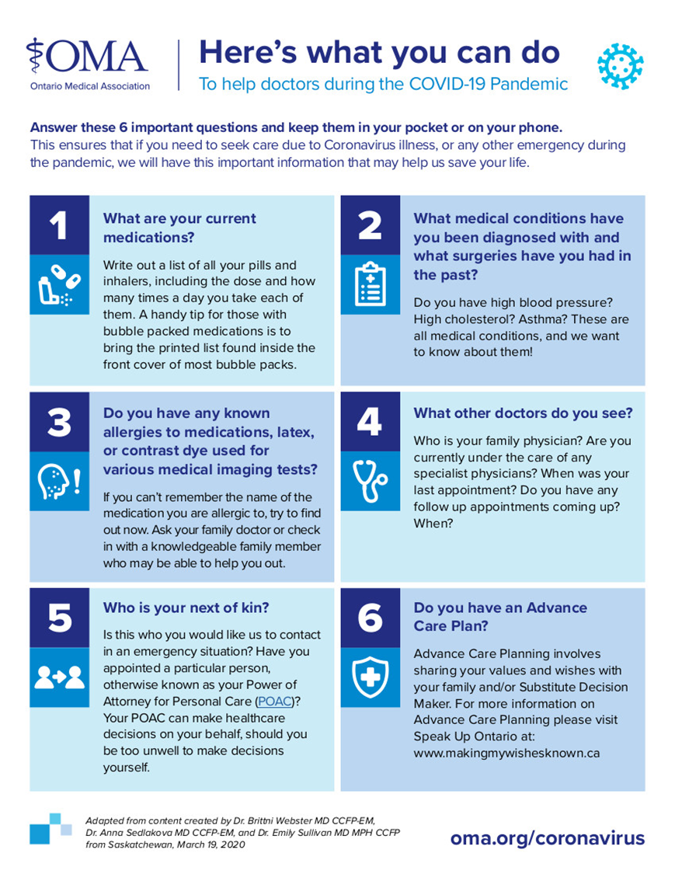
Taken from: https://www.loyalistfht.com/advance-care-planning

Slide 44
Other Things to Keep In Mind…
Incorporate ACP within an individual’s PCP
Should be a collaborative process & informed by key stakeholders
Have relevant conversations regarding ACP with individuals with IDD, clinicians, caregivers
Church, Marsack-Topolewski, McGinley, & Knocke, 2021).

Slide 45
Other Things to Keep In Mind…
Make sure to delineate responsibilities
Use this as a tool for promoting continuity of care
This can be used to decrease the impact when crises situations arise
Church, Marsack-Topolewski, McGinley, & Knocke, 2021).

Slide 46
WHAT IS ONE CONCRETE STEP YOU CAN TALK TO PROMOTE ACP IN YOUR ROLE?

Slide 47
Planning for Planning
Set a roadmap to plan gradually.
Set manageable goals.
Use a team approach to inform the process.
Take breaks.
Make a mental note of progress (big & small).
Keep in mind factors to consider.

Slide 48
FACTORS TO CONSIDER
Individuals with IDD to be involved in planning process
Using a team approach
Consider all aspects of strengths, interests, and needs
Other aspects to consider – physical, medical, mental health conditions
Review, revisit and update based on changing needs & conditions
Know where ACP documents are located
Communicate ACP with relevant parties
Key players should be aware and involved in planning process

Slide 50
Link with Resources
https://infoguides.med.umich.edu/advancecareplanning

Slide 51
“An hour of planning can save you 10 hours of doing.” ~Dale Carnegie

Slide 52
Planning Considerations:
Integrate ACP into our daily lives – these are needed conversations
Use a collaborative process
Prioritize planning and revisiting / updating ACPs yearly and when there are changing needs (e.g., changes in cognitive abilities and decision-making skills)
Be aware of cognitive abilities and capacity to consent
Consider all ACP dimensions
Identify possibilities & options / choices
(Lougheed, 2019)

Slide 54
COMPREHENSIVE ADVANCE CARE PLANNING
State PCP documents should reflect ACP dimensions
ACP documents and planning should consider each of the following:
Wishes for one’s future,
Residential decisions,
Financial considerations,
Occupational and recreational preferences,
Supportive measures to support daily living and life-course transitions,
Maintaining a social support network.
(The Arc Center for Future Planning, 2016; Church, Marsack-Topolewski, McGinley, & Knocke, 2021).

Slide 55
Consider ALL Dimensions of Advance Care Planning
State PCP documents should reflect ACP dimensions
The following ACP dimensions should be included in PCP documents:
Diagnosis / Prognosis
Support needs
Living arrangements
Retirement
Finances
Burial Funds
Funeral arrangements
Decision making
Guardianship
Advance directives
(Church, Marsack-Topolewski, McGinley, & Knocke, 2021)

Slide 56
“A good death does honour to a whole life.”
-Petrarch
Poet: Francesco Petrarca

Slide 57
References
Acharya, K., Schindler, A., & Heller, T. (2016) Aging: Demographics, trajectories and health system issues. In I. L. Rubin, J. Merrick, D. E. Greydanus, & D. R. Patel (Eds.), Health care for people with intellectual and developmental disabilities across the lifespan (pp. 1423–1432). Springer International Publishing.
ACP Decisions. 19 Evidence-based benefits of advance care planning. Retrieved from https://www.acpdecisions.org/19-evidence-based-benefits-of-advance-care-planning/
Bigby, C., Webber, R., & Bowers, B. (2015). Sibling roles in the lives of older group home residents with intellectual disability: Working with staff to safeguard wellbeing. Australian Social Work, 68(4), 453–568. https://doi.org/ 10.1080/0312407X.2014.950678
Carr, D., & Luth, E. A. (2017). Advance care planning: Contemporary issues and future directions. Innovation in Aging, 1(1), 1–10. https://doi.org/10.1093/geroni/igx012
Cheung, J. T., Au, D., Ip, A. H., Chan, J., Ng, K., Cheung, L., ... & Woo, J. (2020). Barriers to advance care planning: a qualitative study of seriously ill Chinese patients and their families. BMC palliative care, 19(1), 1-9.
Church, H. L., Marsack-Topolewski, C., McGinley, J. M., & Knoke, V. (2021). Advance Care Planning Within Individualized Care Plans: A Component of Emergency Preparedness. Developmental Disabilities Network Journal, 2(1), 3.
Heller, T., Scott, H., & Janicki, M. P. (2017). Caregiving and intellectual and developmental disabilities and dementia: Report of the pre-summit workgroup on caregiving and intellectual and developmental disabilities. https://aadmd.org/ sites/default/files/Presummit%20on%20IDD% 20Brief-FINAL80 120 17a.pdf
Lee, C. E., Burke, M. M., & Stelter, C. R. (2019). Exploring the perspectives of parents and siblings toward future planning for individuals with intellectual and developmental disabilities. Intellectual and developmental disabilities, 57(3), 198-211.

Slide 58
References
Lougheed, D. C. (2019). Approach to providing care for adults with intellectual and developmental disabilities. Canadian Family Physician, 65(Supp 1), S14-18.
Marsack-Topolewski, C. N., & Graves, J. M. (2020). “I worry about his future!” Challenges to future planning for adult children with ASD. Journal of Family Social Work, 23(1), 71-85.
McGinley, J., Marsack-Topolewski, C. N., Church, H. L., & Knoke, V. (2021). Advance care planning for individuals with intellectual and Developmental Disabilities: A State-by-State content analysis of person-centered service plans. Intellectual and Developmental Disabilities, 59(4), 352-364.
McGinley, J., Marsack-Topolewski, C. N., Church, H. L., & Knoke, V. (2021). Advance care planning for individuals with intellectual and Developmental Disabilities: A State-by-State content analysis of person-centered service plans. Intellectual and Developmental Disabilities, 59(4), 352-364.
Moran, J. (2017). General aging in intellectual and developmental disabilities: Aging with an intellectual and developmental disability. Center for Developmental Disabilities Evaluation and Research. Presented January 2017.
The Arc Center for Future Planning. (2016). Where to start. https://futureplanning.thearc.org/pages/ learn/where-to-start/expressing-wishes-for-the future
United States Department of Health and Human Services. (2007). Literature review on advance directives (#HHS-100-03-0023). U.S. Government Printing Office.
Vermont Ethics Network: Advancing Health Care Ethics. Advance care planning. Retrieved from https://vtethicsnetwork.org/medical-decision-making/advance-care-planning

Slide 59
This Photo by Unknown Author is licensed under CC BY-NC

Slide 60
ADVANCE CARE PLANNING: WHERE DO WE GO FROM HERE…
CHRISTINA MARSACK-TOPOLEWSKI, PHD, LMSW
EASTERN MICHIGAN UNIVERSITY
cmarsack@emich.edu

