Slide 1
Generationally-Inclusive Organizations:
Strategies for Breaking through Stereotypes & Building Real Connections
Angie Pastorek, PhD | apastorek@gmail.com
February 16, 2023

Slide 2
What’s Shaped Your Career Perspective?
What was your first job?
What did you learn about work from that job?

Slide 3
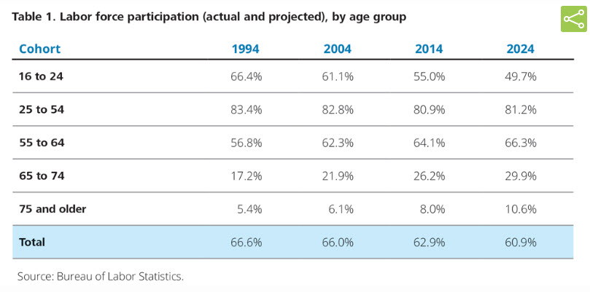
Do These Statistics Surprise You?
Notes:
Https://www2.deloitte.com/insights/us/en/deloitte-review/issue-21/meet-the-us-workforce-of-the-future.html
58% increase in 65 – 74 year olds

Slide 4
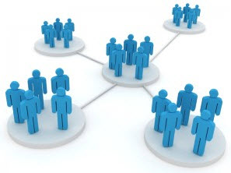
Workplaces & the Places, Ways We Work Continue to Evolve
The Classic Bureaucracy
Clear structure, work-life boundaries.
4. The Pandemic Era.
Remote/Hybrid Work, Work-Life Challenges, Health & Safety concerns. Boundaries blown away, new employee expectations... New approach to communication needed?
2. Cultures & Teams Matrix-managed teams; tech begins to blur work-life boundaries.
3. The Gig Economy Not all workers “employees;” technology-enabled “flexibility.”
Notes:
Shocks and transitions (episodic vs evolutionary change)
Technology, capitalism/profit motive, globalization

Slide 5
Organizational Complexity Makes Effective Communication Challenging
Regulators
Department
Clients
Project
Teams
Interagency Partners
Administrators
Community Members
Accrediting Agencies
Worksite
Colleagues
Vendors / Suppliers
Hybrid
colleagues
Media
Client Families
Xxx

Slide 6
We Navigate a Variety of Interconnected Relationships & Power Dynamics at Work
Societal Trends
Organizational
Teams, Groups
Personal Identity
Individual Coworkers, Supervisors

Slide 7
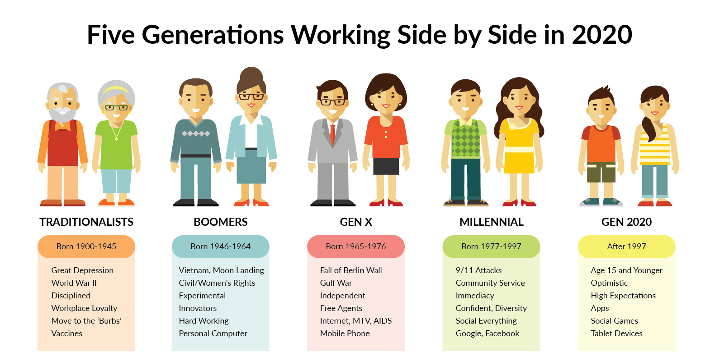
2023
Currently Age 78 - 95
Currently Age 59 - 77
Currently Age 43 - 58
Currently Age 23 - 42
Currently Age 22 <
GenY
GenZ
Born 1928 - 1945
Born 1946 - 1964
Born 1965 - 1980
Born 1981 - 2000
Born After 2000
Notes:
Pew Research Sept 2015: http://www.people-press.org/2015/09/03/the-whys-and-hows-of-generations-research/#key-differences-between-the-generations

Slide 8
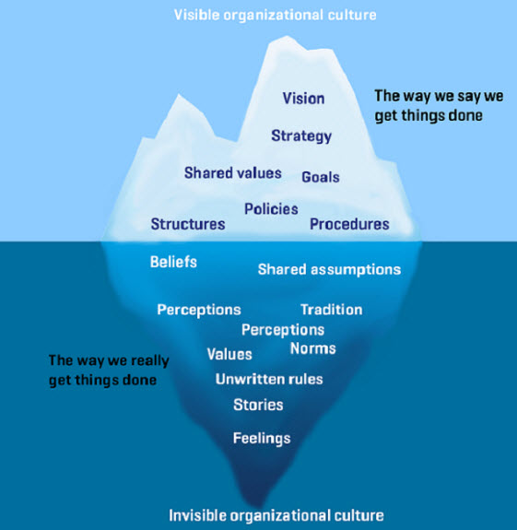
Organizational Cultures are Unique, Dynamic
Organizational Culture: The essence of organizational life
Refers to patterned ways that people behave, communicate, and give meaning to shared social life within an organization.
Notes:
Mark Zuckerburg (2007) – “Younger people are just smarter”
(Pacanowsky & O’Donnell-Trujillo, 1983).
Organization’s personality
If we were to pick personality traits to give to the organization’s you’re currently part of you could easily do that.
I can think of organization’s I’ve been part of that were cheap, serious, informal and relaxed, one that’s fun and unpredictable
Level 1: Behaviors & Artifacts (columns, MU logos, Jesse hall, Memorial union, tiger walk, graduation, Tiger Hotel, 9th Street)
Level 2: Values (Excellence, Discovery, Responsibility, Respect)
Level 3: Assumptions (Education is important and we should all pursue it to the best of our ability)

Slide 9
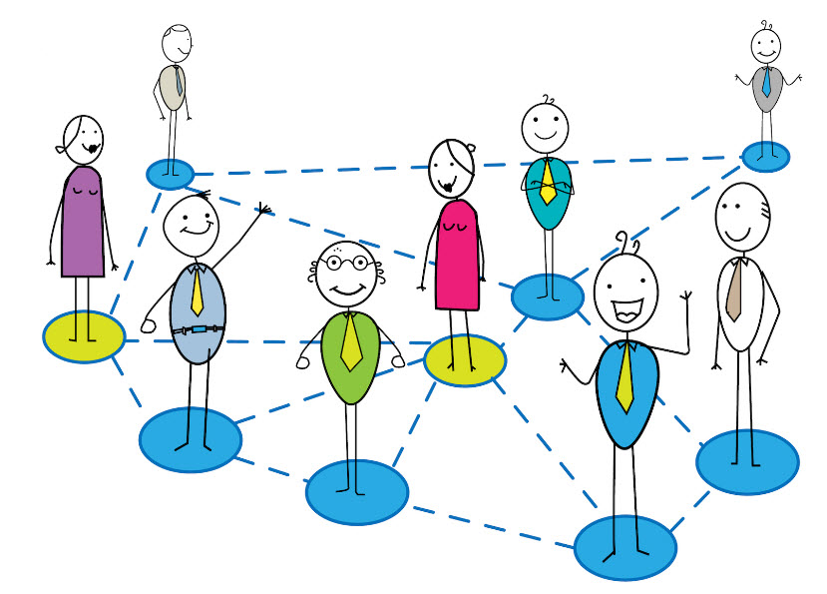
How Culture Shows Up in Everyday Conversations
“Pay your dues” vs. “Ready for a chance”
2. Relationship to/with one’s managers and leaders
Diverse frames of reference – different understandings about what counts as “work,” working hard; different views about work & life
Also includes different communication styles/preferences/biases based on age, race, gender, neurodivergence, etc.
Ageism – stereotypes and prejudice (on both ends of age spectrum)
Role of technology
“Digital natives” – constant, boundaryless connections
…but may not yet appreciate the ways technology use at and for work is different than personal/social use
Ability and desire to work beyond the office; integrate work and life

Slide 10
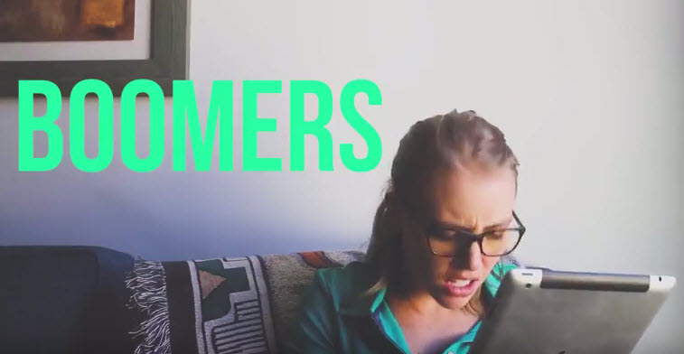
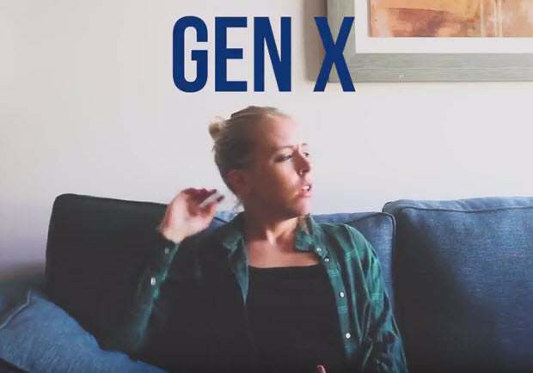
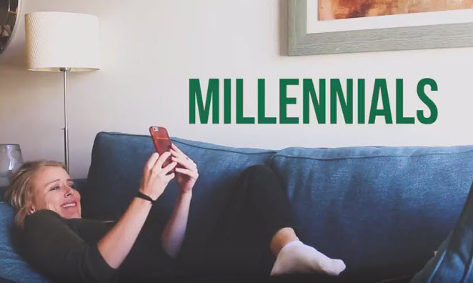
Avoiding Confirmation Bias based on Stereotypes
Stereotype: Vivid and simple generalizations which reduce people to a set of exaggerated, usually negative, character traits
Bias: Cognitive shortcut that costs/categories information quickly.
An inclination toward (preference) or against (discrimination) a social category of people.
Confirmation bias: Seeking information that confirms our initial belief, discarding information that challenges that initial belief
Notes:
https://www.youtube.com/watch?v=o5OoSjH1iIE

Slide 11
4 Types of Generations at Work (Joshi et al., 2010; Costanza et al., 2004)
1. Age (i.e., “Generations”)
2. Incumbency
Group
3. Tenure Cohort
4. Personal Lifestage

Slide 12
At Work, We are Different and Similar
Why do our similarities matter at work?
Why do our differences matter at work?
Which should we be most conscious of? Why?
Notes:
We are similar – how?
Same employer, have skills and talents needed by the org., bills to pay, life outside of work,
Want to learn and grow
COMMUNICATION – We tend to be drawn to, like and trust people we perceive to be like us (age, race, gender, geography, college or high school)
ISSUE – Can lead to overly homogenous/similar teams and organizations…silos and stagnation…..us vs. them talk, conflict
We are different – how?

Slide 13
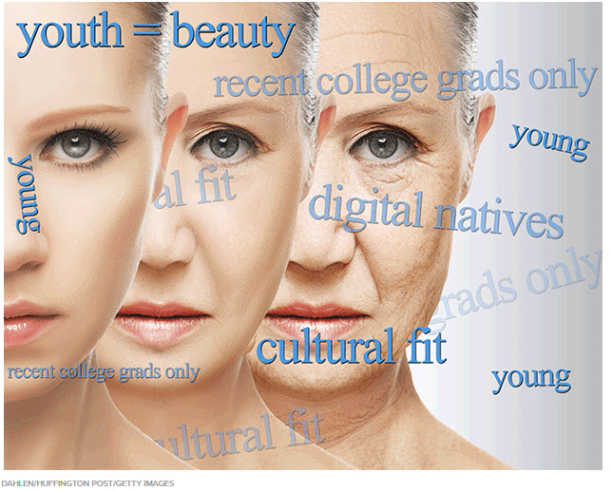
Age-Related Microaggressions Defined
Everyday verbal or behavioral messages (intentional or unintentional) that communicate disrespect through hostile, derogatory, or negative insults to an individual or group because of their age.
“I have children your age!”
“I don’t want any more gray hairs on my team.”
“Why would you rack up so much in college loans? I worked my way through college.”
“Tammy missed the happy hour again. She’s not a very good team player, is she?”
“You’re a 20-something –you should manage our Facebook page!”
“I think that new position would be too fast-paced for Eugene.”
“Do you even know who the Beatles are?
Notes:
AGM
The term micro-aggression was first coined by Dr. Chester Pierce in the 1970s.
video: https://www.youtube.com/watch?v=qN1QTugrQQQ
Basically, what this definition is saying is that people, particularly from marginalized groups, experience micro-aggressions on an ongoing basis through things that are said, done, or that happen in the overall environment. These things may be intentional or not, but either way, they serve to hurt, invalidate, insult, people. While anyone can be the target of a microaggression, typically it is women, minorities, non-native English speakers, people with disabilities, gay and transgender individuals, and other marginalized identity groups that are targets of these constant messages that tell them they don’t belong or they are not ‘normal.’
Most microaggression are unconscious and unintentional. Meaning people say something to you that is derogatory or invalidating, but it wasn’t intended to be so.
Photographer Kiyun asked her friends at Fordham University’s Lincoln Center campus to “write down an instance of racial microaggression they have faced.”

Slide 14
Bias Hiding in Everyday Conversation & Decision-Making
These new kids need to pay their dues, just like we had to.
Do we want a “suit” or a “hoodie” for this position?
We need to correct our seniority mix.
Courtney’s always texting on her phone – does she ever do any work?
She’s going to need a lot of training.
I’m not sure he’d be a good fit – it might not be fast-paced enough for him.
I don’t want any more gray hairs on my team.
We need to hire people who take a more entrepreneurial approach.
Henry is too set in his ways.
She’s overqualified.
We can’t promote him, he doesn’t have enough runway left.
Her skills just aren’t up-to-date.
I’m not sure she’d be a good fit – it might be too fast-paced for her.
Notes:
What’s good for Millennials is good for everyone.

Slide 15
Self-Stereotyping Communication Can also be Problematic
Definition: Drawing on stereotypes of a social identity group in your self-perception and/or verbalizing these stereotypes while communicating with others
Result: Activates others’ stereotypes of a group to which you belong (ex. age); can prime others to perceive you in stereotypical ways.
“There I go again with another of my crazy Millennial ideas! Don’t know what I was thinking….”
“Being a digital native I love technology. We could do all this so much faster with a tool like Teams.”
“Oops, I must be having a senior moment!”
“These changes are just nonsense – yet another flavor of the month. It doesn’t matter what works best for those of us who have been doing this work for years.”
Notes:
What’s good for Millennials is good for everyone.

Slide 16
2023
Currently Age 78 - 95
Currently Age 59 - 77
Currently Age 43 - 58
Currently Age 23 - 42
Currently Age 22 <
GenY
GenZ
Born 1928 - 1945
Born 1946 - 1964
Born 1965 - 1980
Born 1981 - 2000
Born After 2000
Notes:
Pew Research Sept 2015: http://www.people-press.org/2015/09/03/the-whys-and-hows-of-generations-research/#key-differences-between-the-generations

Slide 17
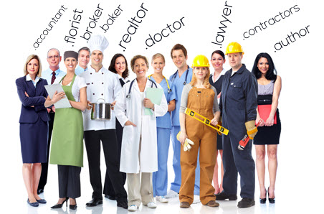
Our Professions, Training are Changing
6 Attributes of a Profession
Body of knowledge
Formal standards of conduct
Social status
Training and education
Self-control (i..e, autonomy)
Social control
Notes:
(Lammers and Garcia, 2009)

Slide 18
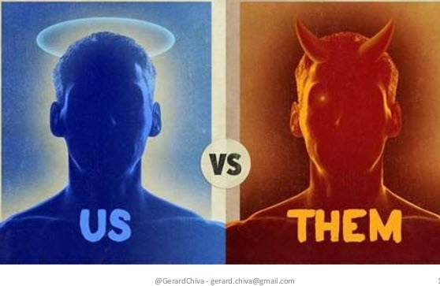
In-groups & Out-groups (Graen and Uhl-Bien, 1995)
Ingroup
People you feel connected to or owe a sense of loyalty and allegiance, such as:
Family
Close friends
Familiar others in your workplace or community
Outgroup
People you feel emotionally and psychologically detached from, such as:
Strangers
Unfamiliar others
Members who belong to a competitive or opposing group

Slide 19
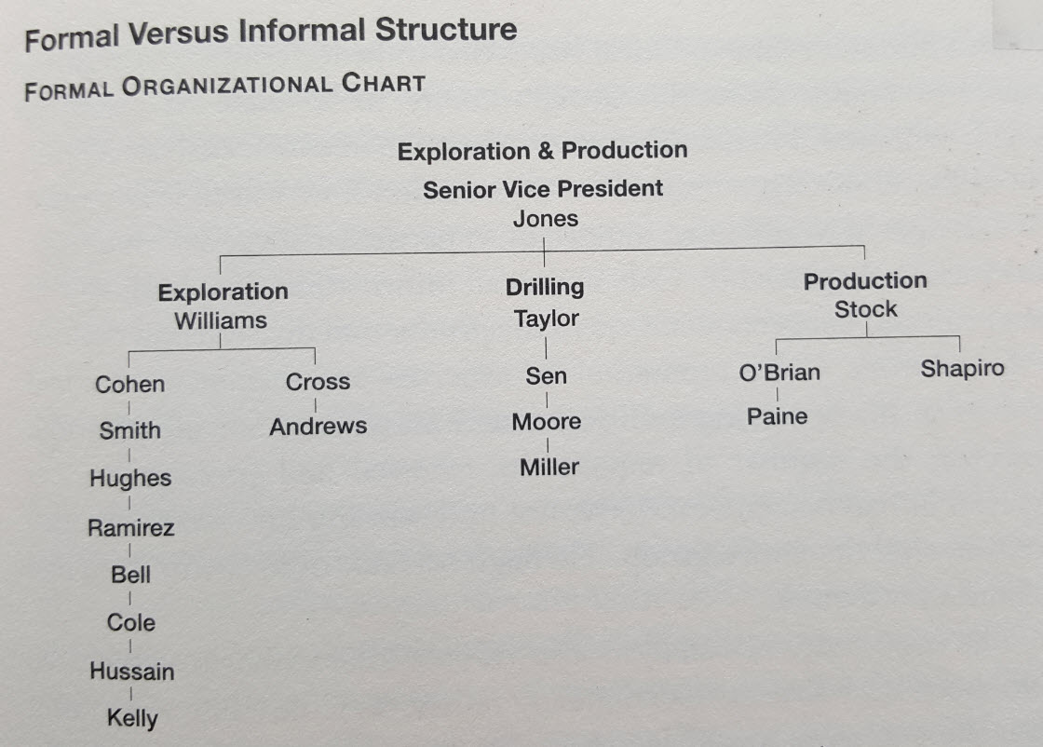
Notes:
YELLOW – Taylor – high in hierarchy AND well-connected in informal network
GREEN – Cole and Kelly – low in hierarchy but very well connected in the informal network
RED – Sen – High in hierarchy but ISOLATED in informal network

Slide 20
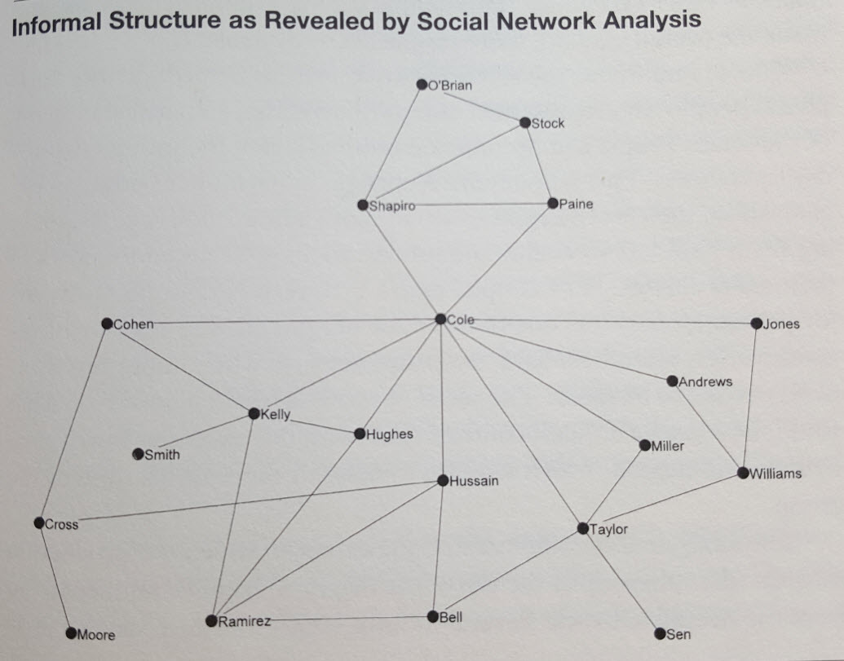
Focus on Building, Connecting into Existing Informal Networks
Notes:
Angie

Slide 21
Research Shows Diverse Teams are More Innovative, Make Better Decisions
Age
Profession / Dept.
Place
TEAM
Organizational
Cohort
Total Work
Experience
Incumbency
Group
Family Status
Job Title / Hierarchical Level

Slide 22
We Navigate a Variety of Interconnected Relationships & Power Dynamics at Work
Societal Values
Organizational
Teams, Groups
Personal Identity
Individual Coworkers, Supervisors

Slide 23
Leverage Your Informal Networks to Help Others
Who is someone who did something to help you get to where you are today? What did they do?
Our informal networks help us:
Make sense of formal messages (“what does this mean?”)
Receive messages early.
Provide additional context, even contradict official messages.
Circumvent formal channels to facilitate access to opportunities.
Notes:
Adler, Elmhorst, Lucas p. 20

Slide 24
Individual Strategies
LISTEN – and ask questions – “When you say ‘She’s underqualified,’ what do you mean?”
Notice who’s in the room – and who isn’t – and advocate for more age-diverse teams.
Catch your own implicit biases
Ex. Having lunch with people around your same age or from your company cohort, job level

Slide 25
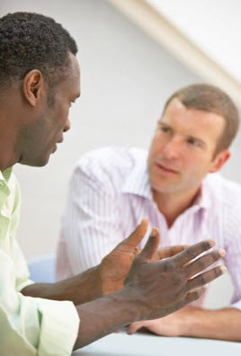
Strategies for Managers & Leaders
First, focus team on collaborating on the task, then shift to more personal relationship building (Edmondsen, 2012)
Explain each team member’s value to the team - technical expertise, organizational knowledge
Diagnose likelihood of identity-based faultlines and monitor for clique formation (Gratton, Voight and Erickson, 2007)
Coach teams through team development process (Hackman and Wageman, 2005)
Spend the money and the time to bring diverse groups of people together physically to collaborate and tackle big challenges, do meaningful work
Now the really tough part:
Check your own assumptions, privilege and biases (and those of people closest to you - peers, trusted advisors.)
Notes:
Honesty, Maxfield and Grenny (2017)– CPR - Content (one-time), pattern (multiple), relationship (impacting ability to work with others)
https://hbr.org/2017/05/how-to-react-to-biased-comments-at-work

Slide 26
For Organizations - Where to Start?
Offer meaningful, ongoing professional development and mentoring
Facilitate cross-generational conversation
Engage in authentic brainstorming
Initiate real conversations about ideas for improving teamwork, career development, network-building
2. Coach supervisors, managers and leaders to let go of traditional, bureaucratic assumptions, biases, approaches
3. Be strategic in team formation and development
Bring age and tenure-diverse teams together to solve “big problems” (will generate appreciation for different perspectives)…then focus on further building social relationships
Offer training on institutional practices, technology AND communication skills

Slide 27
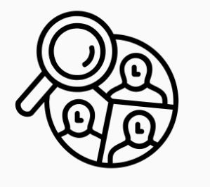
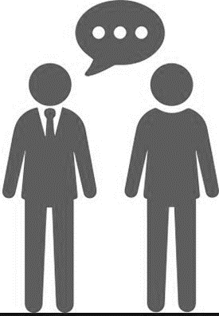
How to Be an ALLY
1. Noticing
2. Assessing
3. Responding
4. Advocating
**Involves RISK**
REQUIRES: Courage Sensitivity Communication Skill ACTION

Slide 28
What do you notice about the work goals of the Generations?
Notes:
Millenials and older workers have same career goals

Slide 29
What do the generations have in common?
We all:
Want meaningful work
We all need organizational support when transitioning into new roles
Want to feel valued
Want recognition (some public, some private)
Want flexibility and work/life integration
All have outside family and/or financial pressures
Are individuals, not just members of a generation
Notes:
The past is present
Age or life stage?
Organizational roots

Slide 30
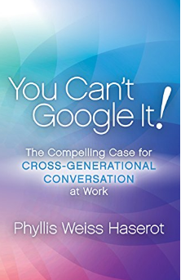
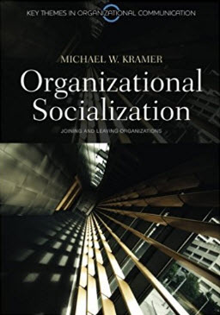
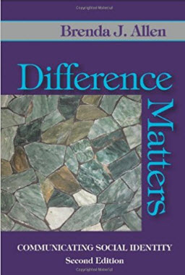
Additional Resources
Questions?...
apastorek@ku.edu

Slide 31
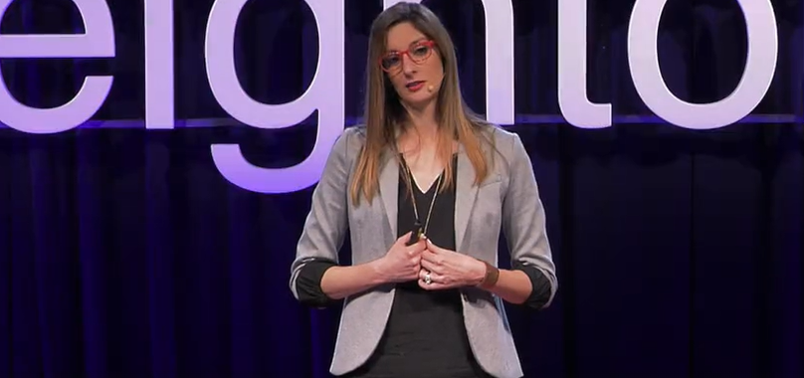
VIDEO: Dr. Leah Gorges TED Talk
“How Generational Stereotypes Hold Us Back at Work”
Notes:
Show from 8:18 to 11:22 (end) https://www.ted.com/talks/leah_georges_how_generational_stereotypes_hold_us_back_at_work

Slide 32
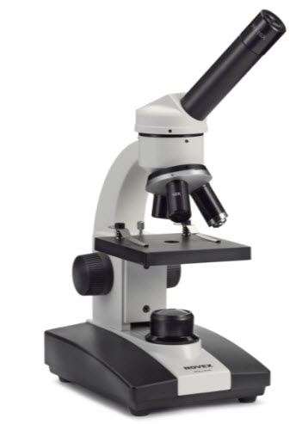
Microscope – Telescope Approach
"When I put on my glasses in the morning, on the left-hand side, I have a microscope, and on the right-hand side, I have a telescope, and I need to balance the two of them.
Diversity is both, but mostly very much the telescope.“
-- 3M CEO, Inge Thulin
Women Leaders | 2011 | 2016
Directors | 18.2% | 23.0%
VP & above | 16.7% | 24.2”

Slide 33
Activity: Case Studies - Unpacking Differences at Work
With your group, read your assigned case study and answer the following questions:
Which of the four organizational generation factors are at play? (Hint: There may be more than one).
Age (baby boomer, millennial etc.), incumbency (who is around you), cohort (people who joined the organization around the same time), and/or personal life stage (20s vs 40s, single vs married, etc.)?
2. What are two specific generations-related tensions or issues you see affecting the primary person in the case (for example, changing views towards parental roles, work-life balance, workplace power dynamics, career development, individual biases, etc.)?
3. What should the individual at the core of the case do next?
4. What is one thing the organization do to help prevent these types of tensions/ambiguities/conflicts for individuals and/or teams going forward?

Slide 34
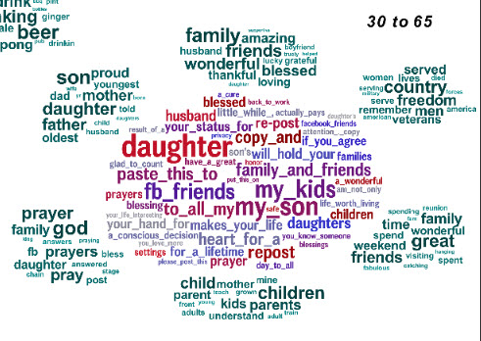
A Sneak Peak into Lifestages
Xxxx
Xxxx
Xxxx
Notes:
PLOS (Schwartz et al. 2013)
Size of word represents strength of correlation to age range, color indicates relative frequency of usage of the word
We analyzed 700 million words, phrases, and topic instances collected from the Facebook messages of 75,000 volunteers, who also took standard personality tests, and found striking variations in language with personality, gender, and age. In our open-vocabulary technique, the data itself drives a comprehensive exploration of language that distinguishes people, finding connections that are not captured with traditional closed-vocabulary word-category analyses.

Slide 35
Why It’s Important to Engage in Cross-Generational Conversation
Solve vexing organizational and societal problems
Build new, regenerative, cross-generational friendships
Expand our mental models
Flex our communication muscles
Set aside our biases – asking questions, listening, seeking to understand
Prepare for the ever-changing nature of work & workplace relationships
Share vital organizational knowledge between generations
Minimize turnover – and “quitting but staying”
Transform information into wisdom
Build an even more inclusive workplace.
Adapted from Haserot (2018) You Can’t Google It: The Compelling Case for Cross-Generational Conversation at Work

Slide 36
Cultural Competency Model (adapted)
Destructive
Oblivious
Competence
Accept, understand and appreciate difference
Ex. Seek to build age-diverse teams, organization
Recognize value of having employee base match customer base and/or society at large
Assume we’re all the same; oblivious to our in-group privilege(s)
Ex. “You can be whatever you want to be, just need to work hard enough, pay your dues.”
Positive bias in terms like “digital natives”; hidden age bias in layoffs explained via corporate-speak like “restructuring,” “right-sizing”
Colorblind approach (failing to directly address identity-based differences) ex. “It’s not about race, it’s about [SES/tenure/personality].”
American melting pot metaphor
See difference & work to
eliminate it
Ex. Displacing older workers in favor of “digital natives”
Notes:
AP
Cultural Destructiveness - See the difference; Seek to destroy or eliminate the difference (i.e. Nazi’s in Europe)
Cultural Incapacity – See the difference -> Make it wrong (An employer who will only recruit from “top business schools” or elite private colleges.)
Cultural Blindness – “I don’t see color / race.” “We’re all the same.”; Melting Pot
Cultural Pre-Competence – Recognize and accept difference, but may not know how to respond to it.
Cultural Competence – Accept, understand and respect/ appreciate difference. [NEXT SLIDE]
Cultural Proficiency - Respond positively and affirmatively to all forms of difference in a variety of personal and professional situations (with crews, shift leads, managers). – Noticing, Engaging, Affirming, Supporting, Advocating.

Slide 37
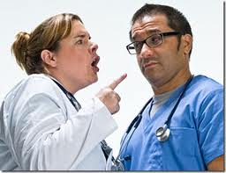
Hierarchical Microaggressions
The everyday slights found in organizations that communicate systemic (de)valuing of a person because of the institutional role held by that person.
-- Young, Anderson, & Stewart, 2014
Notes:
Angela N. Gist
“The everyday slights found in higher education that communicate systemic
valuing (or devaluing) of a person because of the institutional role held by that
person.” (Young, Anderson, & Stewart, 2014, p. 6)
- valuing/devaluing based on role/credential
- changing accepted behavior based on role
- actions (ignoring/excluding/interrupting) related to role
- terminology related to work position
Rationalize this as “paying your dues.” This is not right.

Slide 38
Birth (“Generational”) Cohort Characteristics
 | Traditionalists / Veterans | Baby Boomers | Generation X | Millennials / Gen Y | i-Gen / Gen Z
Date of Birth | 1922 – 1945 | 1946 – 1964 | 1965 - 1980 | 1980 – 2000 | After 2000
1. Core values
2. View of Work
3. Satisfaction comes from
4. Preferred Rewards
5. Communication Style
Notes:
Dainron and Zelley, p. 69

Slide 39
Birth (“Generational”) Cohort Characteristics
 | Traditionalists / Veterans | Baby Boomers | Generation X | Millennials / Gen Y | i-Gen / Gen Z
Date of Birth | 1922 – 1945 | 1946 – 1964 | 1965 - 1980 | 1980 – 2000 | After 2000
1. Core values | Respect, discipline | Optimism, involvement | Cynicism, informality | Clarity, flexibility | Social, connectedness, stabililty
Notes:
Dainron and Zelley, p. 69

Slide 40
Birth (“Generational”) Cohort Characteristics
 | Traditionalists / Veterans | Baby Boomers | Generation X | Millennials / Gen Y | i-Gen / Gen Z
Date of Birth | 1922 – 1945 | 1946 – 1964 | 1965 - 1980 | 1980 – 2000 | After 2000
1. Core values | Respect, discipline | Optimism, involvement | Cynicism, informality | Clarity, flexibility | Social, connectedness, stabililty
2. View of Work | An obligation | Self-fulfillment | Independence | A mechanism for success | Entrepreneurial, open
Notes:
Dainron and Zelley, p. 69

Slide 41
Birth (“Generational”) Cohort Characteristics
 | Traditionalists / Veterans | Baby Boomers | Generation X | Millennials / Gen Y | i-Gen / Gen Z
Date of Birth | 1922 – 1945 | 1946 – 1964 | 1965 - 1980 | 1980 – 2000 | After 2000
1. Core values | Respect, discipline | Optimism, involvement | Cynicism, informality | Clarity, flexibility | Social, connectedness, stabililty
2. View of Work | An obligation | Self-fulfillment | Independence | A mechanism for success | Entrepreneurial, open
3. Satisfaction comes from | A job well done | Making a difference | Changing the rules | Lots of recognition | Opportunity to learn, grow, influence
Notes:
Dainron and Zelley, p. 69

Slide 42
Birth (“Generational”) Cohort Characteristics
 | Traditionalists / Veterans | Baby Boomers | Generation X | Millennials / Gen Y | i-Gen / Gen Z
Date of Birth | 1922 – 1945 | 1946 – 1964 | 1965 - 1980 | 1980 – 2000 | After 2000
1. Core values | Respect, discipline | Optimism, involvement | Cynicism, informality | Clarity, flexibility | Social, connectedness, stabililty
2. View of Work | An obligation | Self-fulfillment | Independence | A mechanism for success | Entrepreneurial, open
3. Satisfaction comes from | A job well done | Making a difference | Changing the rules | Recognition | Opportunity to learn, grow, influence
4. Preferred Rewards | Delayed and intrinsic (did their duty, private praise) | Primarily intrinsic (feeling good about self) | Extrinsic (recognition through time, money, and freedom) | Very extrinsic (recognition through immediate praise, opportunity, status) | Extrinsic (but also appreciate opportunity for meaningful work
Notes:
Dainron and Zelley, p. 69

Slide 43
 | Traditionalists / Veterans | Baby Boomers | Generation X | Millennials / Gen Y | i-Gen / Gen Z
Date of Birth | 1922 – 1945 | 1946 – 1964 | 1965 - 1980 | 1980 – 2000 | After 2000
1. Core values | Respect, discipline | Optimism, involvement | Cynicism, informality | Clarity, flexibility | Social, connectedness, stabililty
2. View of Work | An obligation | Self-fulfillment | Independence | A mechanism for success | Entrepreneurial, open
3. Satisfaction comes from | A job well done | Making a difference | Changing the rules | Recognition | Opportunity to learn, grow, influence
4. Preferred Rewards | Delayed and intrinsic (did their duty, private praise) | Primarily intrinsic (feeling good about self) | Extrinsic (recognition through time, money, and freedom) | Very extrinsic (recognition through immediate praise, opportunity, status) | Extrinsic (but also appreciate opportunity for meaningful work)
5. Communication Style | Formal; letters and memos | Face-to-face discussion, meetings | Direct; comfortable with technology | Constant connection; heavy reliance on technology | Face-to-face conversation & connection, as well as tech
Notes:
Dainron and Zelley, p. 69

