Slide 1
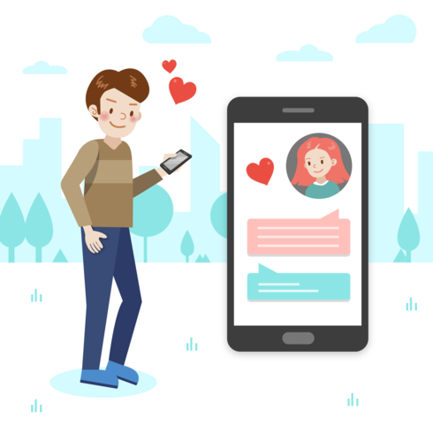
Safely Navigating Online Relationships: Strategies for Supporting Adults with IDD in Safely Engaging in Online Relationships
Kansas Interhab
Mary Jo Krile, Ph.D
Eastern Kentucky University
maryjo.krile@eku.edu

Slide 2
Your Presenter!
Notes:
Why DL: C Story

Slide 3
Agenda
Social Media and Dating Apps
Safe vs. Dangerous Platforms
Strategies for Interacting Safely with Others Online
Setting Digital Boundaries
Real vs. Online Life
Boundaries with Online Interactions
Maintaining Digital Relationships
Types of Online Relationships

Slide 4
Poll Time!
Type in chat, your response to the following question:
What is your role with individuals with intellectual/developmental disabilities?
Service Provider
Family member/relative
Educator
Other

Slide 5
Poll Time!
What is Your Knowledge Level of Using Social Media and Dating Apps?
High! I use them everyday
Moderate. I use them, but could use more information
Not much. I need more information

Slide 6
Online Relationships & Contacts

Slide 7
Types of Online Relationships
Mutual relationships
Friends and families
Strangers who share similar likes, interests, or characteristics
Romantic relationships
Purely online dating
Online dating that eventually transitions to in-person dating

Slide 8
Online Contacts that SHOULD be Had
In case of emergency contacts
Who can I contact on social media when I can’t contact my usual emergency contacts?
Facebook Groups- talk about interests
Have rules and security that is usually taken seriously by administrators
Trusted friends, family, and acquaintances
Celebrities are NOT friends.
If want to follow, only follow a verified page
Look for the white checkmark in blue shape!
Verified Celebrity

Slide 9
The Good, The Bad, and The Ugly
Social Media and Dating Apps

Slide 10
Case Study!
Ella is a 23-year-old with intellectual disability. She would like to use social media to talk to her friends and family. She is also interested in using online dating to find a romantic relationship. Ella is not aware of the dangers of social media use. She also does not know how to combat cyberbullying, predators, being hacked, and scams.
What can we do to help Ella use social media and dating apps safely?
Which social media platforms or apps should she use?
What strategies can we use to help Ella build and maintain positive online relationships?

Slide 11
What is Social Media?
Any online service where users can create and share a variety of content
Most need an account
User has to agree to lengthy Terms and Conditions
Facebook, Instagram, Twitter, Zoom, Google Meet, FaceTime, Snapchat, Email, Discord, Blogs, etc.
Are dating apps social media?
Yes!
Have their own set of terms and conditions

Slide 12
Benefits of Social Media and Dating App Use
Social
Keep in contact with others, able to use accessible language (emojis), able to contact others in case of emergency
Learning
New concepts, more about interests, more exposure to reading/writing
Safe place to learn identity
Self-Esteem
Increase self-esteem by being able to create own self-presentation
Inclusion in Society
Digital world

Slide 13
Risks of Social Media and Dating App Use
Victim
Perpetrator
Cyberbullying
Being threatened
Being hacked
Being asked for personal information
Security
Predators
Being flirted with, asked for sexual pictures/videos/information, sent sexual pictures/videos, asked to meet in-person
Scams

Slide 14
What Makes Social Media and Dating Platforms Dangerous?
Location tracking and sharing
Private messages
Lack of privacy settings
”Self-destructing” messages
Disappear after a certain amount of time
Uncensored photos/videos
Several platforms have taken steps to prevent this
Ability for strangers to send messages to non-friends/followers

Slide 15
Social Media Platforms: Safe vs. Dangerous
Safe for Beginners
Advanced Social Media Safety Skills- Dangerous
Facebook
Instagram
Pinterest
Twitter
YouTube
TikTok
Snapchat
Whatsapp
Kik
Any social media platform that uses location tracking and/or does not offer the option to disable.

Slide 16
Dating Apps
Safe for Beginners
Advanced Social Media Safety Skills- Dangerous
Eharmony
Match
Badoo
Facebook Dating
Zoosk
What to look for in dating apps: Next slide!
Tinder
Omegle
Bumble
Hinge

Slide 17
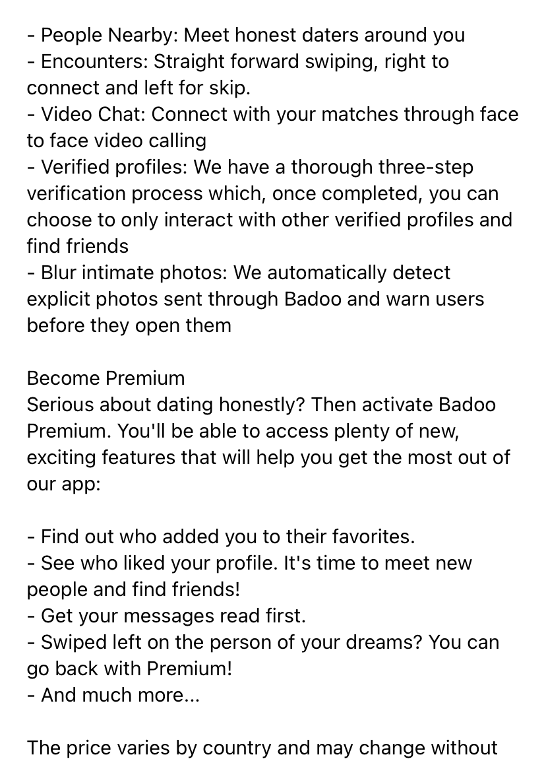
What to Look for in a Dating App
In app video chat
VERIFICATION PROCESS!
Three-step is best!
Blurring of intimate photos with warnings for users
Ability to disable location sharing/tracking
Where to find information: on app information page

Slide 18
Revisiting Ella
Ella is a 23-year-old with intellectual disability. She would like to use social media to talk to her friends and family. She is also interested in using online dating to find a romantic relationship. Ella is not aware of the dangers of social media use. She also does not know how to combat cyberbullying, predators, being hacked, and scams.
What can we do to help Ella use social media and dating apps safely?
Which social media platforms or apps should she use?
What strategies can we use to help Ella build and maintain positive online relationships?

Slide 19
Strategies for Interacting safely when online

Slide 20
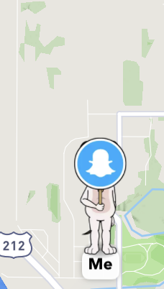
Using Privacy Settings
Keep profiles private!
ONLY go public if have advanced social media safety skills
Facebook: Friends Only
Hide from Google search results
Instagram: Private Profiles
Snapchat: Enable “Ghost Mode”
Twitter: Protect Tweets and toggle off “receive messages from anyone”
All: Disable location services
Dating apps: disable location sharing, if possible.
Check account security prior to using
Look for settings gear to find privacy settings!
Snapchat Ghost Mode

Slide 21
Using Visual Checklists

Slide 22
Providing a Safe Place for Conversations: Top Three Trusted
Prior to using social media and dating apps, identify the Top Three Trusted Individuals
Who do you feel safe going to if something online bothers you or is questionable?
Teachers, Friends, Parents, Family, Relatives, Coaches, etc.
Frequently review Top Three Trusted
Can change over time

Slide 23
Creating Safe Opportunities for Practice
Spot the cyberbullying/predator card games
Ask what steps should be taken when a cyberbully or predator is drawn
Create cyberbullying/predator message identification quizzes in online learning management systems (i.e., Canvas, Moodle, Blackboard, etc.)
Practice writing posts/messages using a graphic organizer template
****As sensitive topics are often present, discuss emotions/feelings after practice situations! Be able/ready to report/investigate any cybercrimes that may be mentioned!***

Slide 24
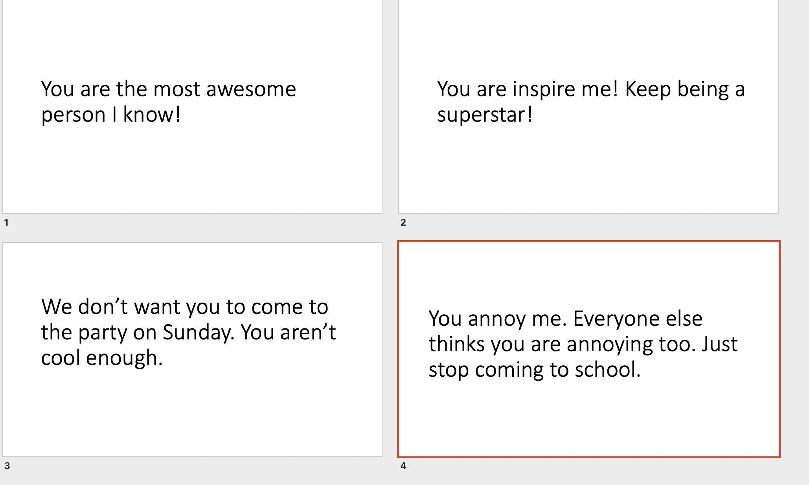
Can play variety of games
Go Fish
I Have, Who Has
Memory
Cyberbullying/Predator Game Cards

Slide 25
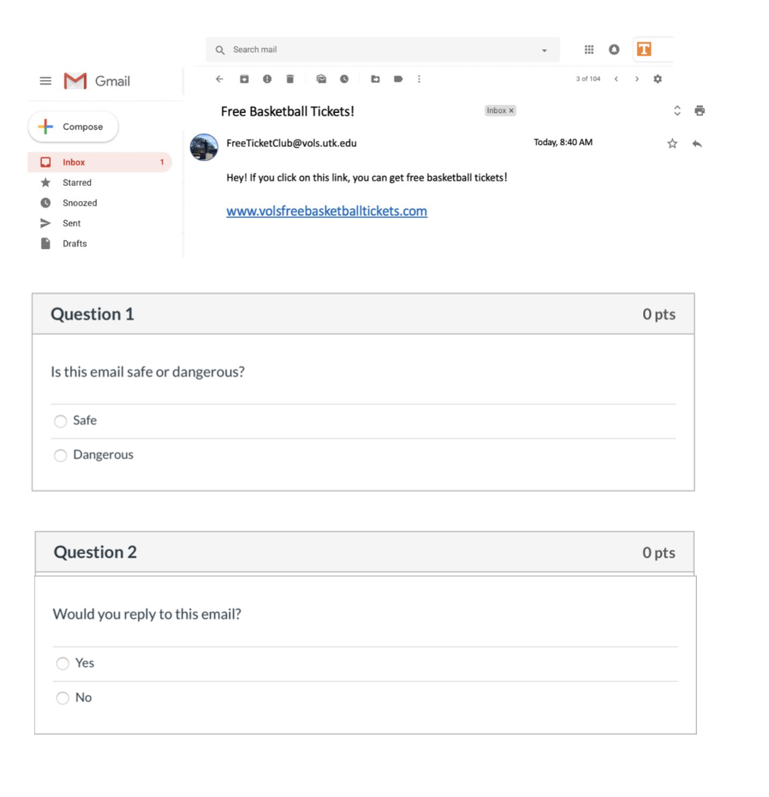
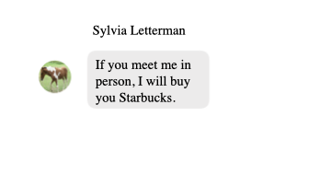
Predator Identification Game Card/
Predator Message for Online Identification Quiz
Identify the Scam Canvas Quiz

Slide 26
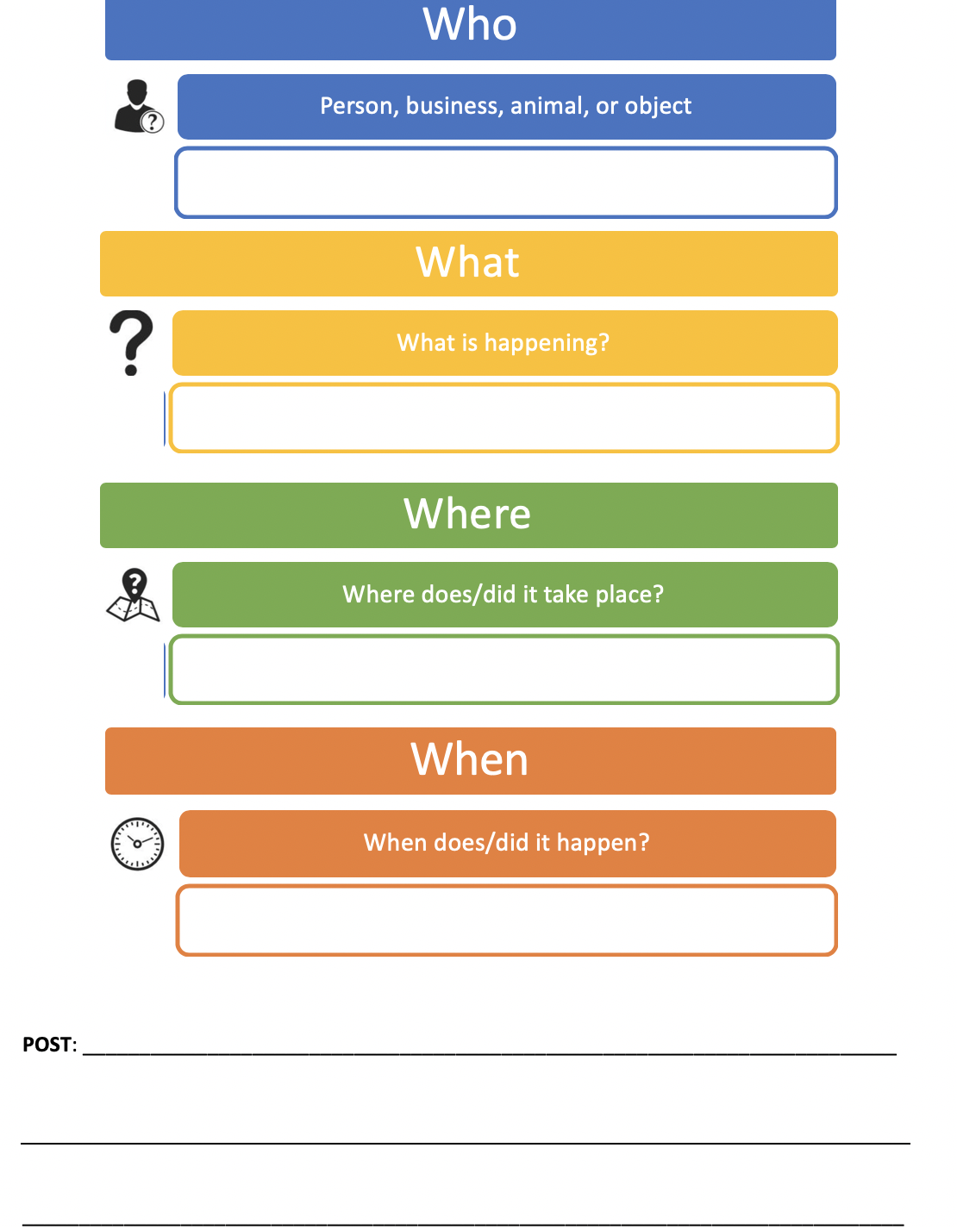
Graphic Organizers
**Can create for dating profiles!
Visual organizers for forming posts, emails, etc.
Writing a social media post graphic organizer

Slide 27
Being Honest and Not Afraid to “Go There”
Social media and dating app use can be scary and intimidating.
We can make it less scary by providing individuals with I/DD the skills needed to be safe online!
We do this by being honest and teaching how to address the situations when they arise.
Have the hard conversations
Don’t talk to strangers online- can be predators who abduct and/or rape if meet in person
If you talk to strangers, don’t give personal information until you have built trust
Don’t send nude pictures- will be stuck on the internet forever (i.e., digital footprint)
Teach how to report and block

Slide 28
Modeling
Model good social media use
Share messages you receive and how you address them
Share both good and bad
Keep it positive!

Slide 29
Spotting Predators: Predator Behavior
Quickly try to be your friend
Ask a lot of personal questions
Do not talk about themselves
If they do, it is something that relates to you
ALWAYS agree with you- most will never disagree with you
Will not post publicly on your social media
Try to make you promise not to tell anyone about them
Try to make you turn against others
“They are horrible. You shouldn’t hang out with them. I wouldn’t treat you that way.”
Groom you- Make you feel special and offer you free things

Slide 30
Addressing Predators
NEVER give personal information until you have gained trust
What does online trust look like?
Person has talked openly about themself- and it sounds similar to you
Person has video chatted with you and shown themselves in camera several times
You have researched the person’s social media profiles and
The profiles exist
The profiles reflect what the person has shared
Power of a Google Search
In dating apps: always use in-app video chat several times before meeting in person
If person refuses to video chat (or video chats without a camera on) or appears much older than they said they are- This is a RED FLAG. End contact immediately
Block and Report ANY predator!!!

Slide 31
Addressing Predators: Meeting Someone In-Person
If meeting someone in person:
Meet in public place
Never get in a car with the person
Tell at least three people that you are meeting someone from online
Have an escape plan: text someone to call with an “emergency”
Communicate your escape plans with others
Have a charged phone and know how to activate SOS on it
Leave phone on the entire time

Slide 32
Addressing Cyberbullying
Individuals with I/DD have identified that it is hard to talk to someone about cyberbullying that has occurred.
Afraid of retributions
Ensure that there is consequences for cyberbullying
Banned from social media
If banned for more than three times, banned for life
Policy
Extreme cases- fines
By reporting, we are preventing the cyberbully from doing harm to others.
Tell a Top Three Trusted individual, block, unfollow, report, unfriend, etc.

Slide 33
Frequent Review
Frequently review:
What you do when:
You spot a cyberbully
You spot a predator
A stranger messages you
Someone asks for personal information
What is personal information
Who are your “Top Three”

Slide 34
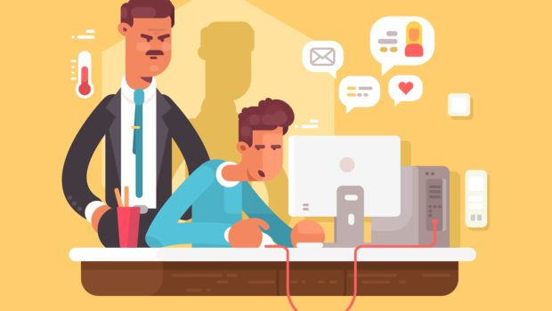
Use of Monitoring
Allow individual with I/DD to have independence online!!!
Be friends/follow them on socials OR have a relative/friend follow them
Have an open rule: ask to see messages, must show messages
If you see something concerning, have an open conversation with the individuals
State why it is a concern/could be dangerous.
Stress importance of safety

Slide 35
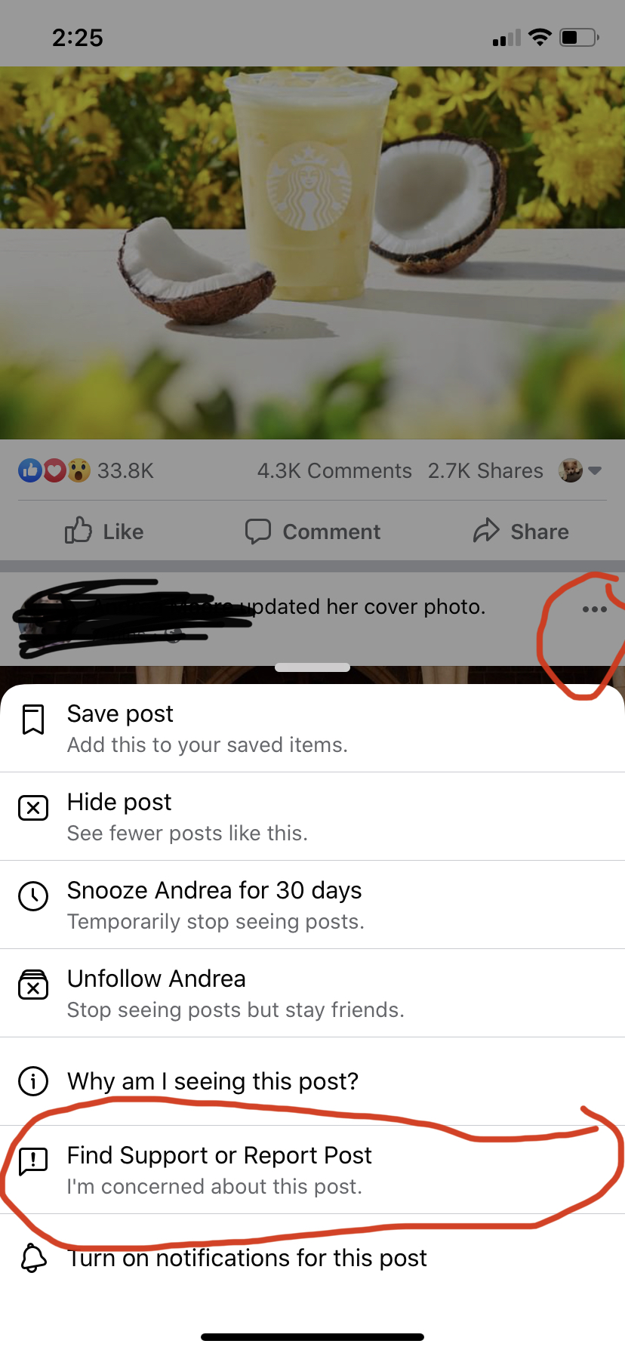
Blocking & Reporting
Look for:
Three dots or three lines- Facebook & Instagram
Profile Picture-Twitter
Settings gear

Slide 36
Revisiting Ella
Ella is a 23-year-old with intellectual disability. She would like to use social media to talk to her friends and family. She is also interested in using online dating to find a romantic relationship. Ella is not aware of the dangers of social media use. She also does not know how to combat cyberbullying, predators, being hacked, and scams.
What can we do to help Ella use social media and dating apps safely?
Which social media platforms or apps should she use?
What strategies can we use to help Ella build and maintain positive online relationships?

Slide 37
Digital Boundaries

Slide 38
What are Digital Boundaries?
Balance between digital life and real life
Ability to place boundaries on online relationships
How much do we message online?
To what extent am I going to let someone online bother me?

Slide 39
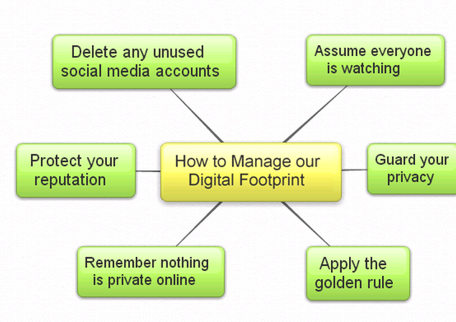
Sexting: When is it Safe?
Only between two CONSENTING adults
NEVER share nude pictures/videos
Teach digital footprint: What you put out in cyberspace, stays in cyberspace forever
If someone sexts without consent, tell a Top Three Trusted individua!

Slide 40
What to Share Online
Black out personal information on pictures using photo app or markup
Identify personal information
Appropriate/Oversharing Posts: Grandma/parent/guardian/teacher/employer rule:
“If you don’t want (Insert person role/name here) to see it, don’t post it!”
Golden Rule Applies Online: Share with others what you want others to share with you.
Keep it Positive! So much negativity is shared online. You have the power to change how you and others feel by keeping your posts/comments positive.

Slide 41
Someone is Harassing, Cyberbullying, Sharing Inappropriate/Bothersome Content
Tell a Top Three Trusted individual
Be honest with the sender
“You are really bothering me. Could you please stop?”
If not: Block/unfollow
Can unblock and refollow when ready
Facebook allows you to unfollow (stop seeing posts/content shared by person), but remain friends
Ignore

Slide 42
Social Media: YOU Have the Power
YOU have the power to only see what you want to see
Don’t have to follow everyone
What is following? Not following someone doesn’t mean you don’t like them!
Feel like you might hurt someone’s feelings by not following them in the socials?
Most often, they don’t know if you are following them
Can unfollow/unfriend whenever you need to!
Algorithms: the more you like posts, the more you see what you want to see

Slide 43
Balancing Real Life with Virtual Life
The power of “looking up”
Reminders to have non-technology time built into the day
Virtual life is different than real life and there needs to be a balance between the two
Technology addiction and digital distraction
Set goal to achieve a lower amount of screen time each day or week
Use visual graph to visualize the progress made on screen time goals
Appropriate amount of non-academic or work-related screen time per day → 2 hours

Slide 44
Maintaining Good Online Relationships

Slide 45
Teaching Appropriate Amount of Contact
How much is appropriate amount of online contact?
Lengthy Messages: Twitter Rule - 240 or less characters
Frequent Messaging: 1-24-1 rule - Send 1 message, Wait 24 hours for reply, If no reply send one more message. Repeat rule as needed
Can be 1-1-1 rule- 1 message, 1 day, 1 more message
If someone doesn’t reply to me, they may not want to talk or could be busy- wait until they reply
If someone is frequently sending you messages, you can block, tell them to stop, or silence.
DOES NOT APPLY IN EMERGENCY SITUATIONS!
Define what emergency situations are

Slide 46
Initiating Online Conversations
Don’t be afraid to reach out to friends and family!
Do not initiate conversations with strangers unless you have looked at their profiles and they appear legit!
If profiles do not show pictures of the individual- RED FLAG
If profile does not have any content on it- RED FLAG
If profile has inappropriate pictures or lengthy links to unidentifiable websites-RED FLAG
Wait for replies! Person will reply when able/ready!
If person doesn’t reply, that’s okay!!

Slide 47
Revisiting Ella
Ella is a 23-year-old with intellectual disability. She would like to use social media to talk to her friends and family. She is also interested in using online dating to find a romantic relationship. Ella is not aware of the dangers of social media use. She also does not know how to combat cyberbullying, predators, being hacked, and scams.
What can we do to help Ella use social media and dating apps safely?
Which social media platforms or apps should she use?
What strategies can we use to help Ella build and maintain positive online relationships?

Slide 48
Agenda Revisited
Social Media and Dating Apps
Safe vs. Dangerous Platforms
Strategies for Interacting Safely with Others Online
Setting Digital Boundaries
Real vs. Online Life
Boundaries with Online Interactions
Maintaining Digital Relationships
Types of Online Relationships

Slide 49
Key Resources
Cybersaftey Resources
Thorn- Hits the tough topics (viewing pornography, sexting, etc.)
Family Online Safety Institute
iGuardians (Department of Homeland Security) – hits on cybercrimes, including predators
NetSmartz
Common Sense Media

Slide 50
BE ON THE LOOK OUT! EXCITING THINGS ARE COMING!
New website resource coming- Digital Citizenship 4 All
Hold all resources created for teaching digital literacy to individuals with disabilities
Parent(s)/guardian(s)/caregiver(s)
Educator
Student
Advocate
Want access when it is released to public? Send email to maryjo.krile@eku.edu and your name will be put on the listserv!

Slide 51
Questions?
Email: maryjo.krile@eku.edu

