Slide 1
BREAKOUT SESSION
Thursday
4:15pm-5:00pm
Room: Birch
Funeral Expense Insurance
All individuals with special needs should have a dignified end of life
The Special Considerations Funeral Insurance Plan
makes this possible . . . for everyone
Special Planning Special Life

Slide 2
Funeral Expense Insurance
What is it
Who Qualifies
How much does it cost
Does it work for spend-downs
How to enroll
Policy values letters
Policy List
Claim Process
Special Planning Special Life

Slide 3
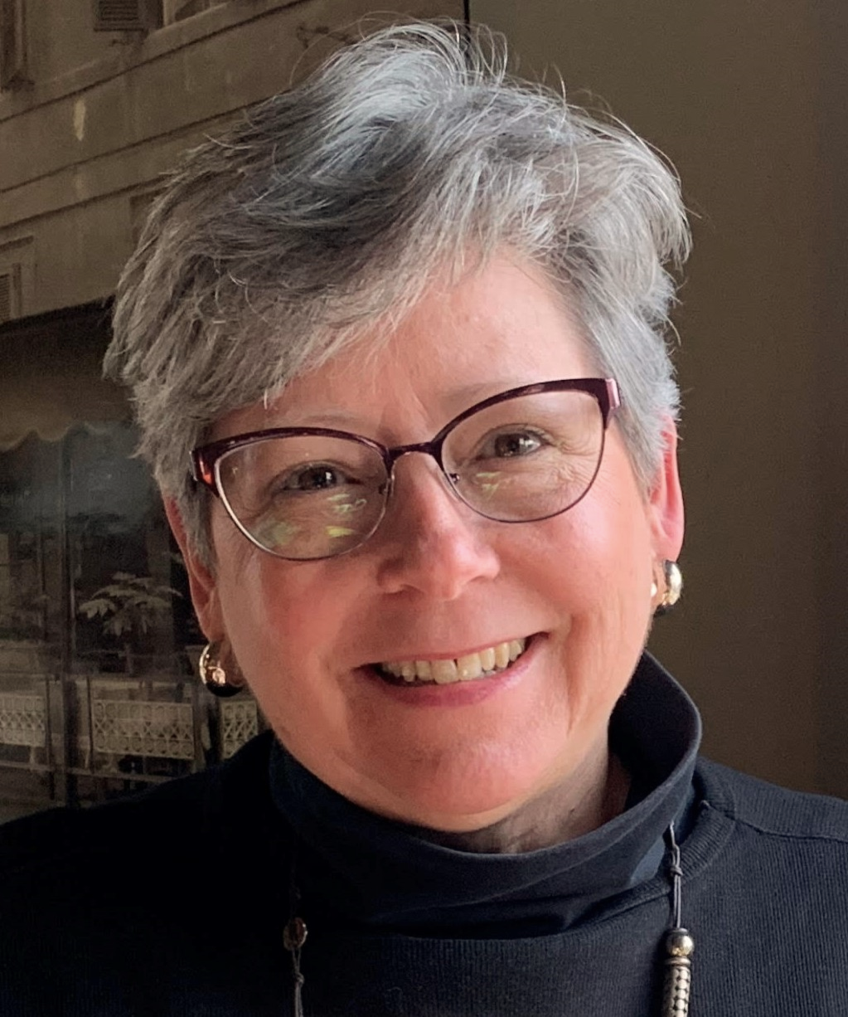
Brenda Hager
Sr. Regional Director
(717) 846-4581
(717) 577-5538
BHager@SpecialConsiderations.com

Slide 4
Who is Special Considerations What makes us different
Why was Special Considerations created?
One of our associates has a son with Down Syndrome. Many years ago, she began looking for burial insurance for him. After being denied coverage many times, she made it her mission to make sure no other family encountered the same struggles. After much research and development Special Considerations was formally started in 2010. Our proprietary product is underwritten by National Guardian Life.
The Special Considerations Team is uniquely qualified to serve the Special Needs Community. We have the tools, knowledge and expertise to ensure all individuals with Special Needs can have a dignified end of life.

Slide 5
What is Final Expense Planning?
Planning ahead to make sure the plans or the funds are in place to cover funeral, cremation and burial expenses
We’ve found that many families, as well as those who provide services for individuals with special needs, can be caught off-guard.
Many people are unprepared for death expenses.
Notes:
Funeral and Burial Expenses are a qualified expense for ABLE accounts, but how can you guarantee there will be adequate funds in the ABLE account at time of need.

Slide 6
Why is Funeral Expense Planning avoided?
Families:
We will get to it later . . .
It’s intimidating, I don’t know where to begin. . .
We’re not emotionally ready to plan a funeral
Providers:
The family will take care of it . . .
It’s complicated . . .
Setting up a Pre-need Plan, choosing Goods and Services at a Funeral Home, is not always practical
Notes:
A Lady had my business card for 5 months. . . . She just couldn’t bring herself to pick up the phone and call me. . . But she eventually did and afterwards she was so happy. She said it was easy and now she had peace of mind.

Slide 7
What are the options?
Notes:
Burial Bank Accounts
limited to $1,500
Burial Trust Account
Accumulation may be insufficient at time of need
Trust fees may be $250+
Ongoing Administrative Fees %
IRS reporting
Funeral Home Preneed Plans
Goods and Services may need to be selected – this can be overwhelming
ABLE Accounts
Funeral and Burial Expenses are an approved use for ABLE accounts, but how can you guarantee there will be adequate funds at time of need?
Special Considerations Funeral Insurance
Burial Insurance/Funeral Expense Insurance is a simiplified way to securely set aside funds for final expenses.

Slide 8
What are the Options to Fund Funeral Expenses?
Burial Bank Accounts
Burial Trust Accounts
Funeral Home Preneed Plan
ABLE Accounts
Special Considerations Funeral Insurance Program
Notes:
Burial Bank Accounts
limited to $1,500
Burial Trust Account
Accumulation may be insufficient at time of need
Trust fees may be $250+
Ongoing Administrative Fees %
IRS reporting
Funeral Home Preneed Plans
Goods and Services may need to be selected – this can be overwhelming
ABLE Accounts
Funeral and Burial Expenses are an approved use for ABLE accounts, but how can you guarantee there will be adequate funds at time of need?
Special Considerations Funeral Insurance
Burial Insurance/Funeral Expense Insurance is a simiplified way to securely set aside funds for final expenses.

Slide 9
Options to Fund Funeral Expenses
Burial Bank Accounts
Limited to $1,500
Burial Trust Accounts
Accumulation may be insufficient at time of need
Trust set-up fees
Ongoing Administrative Fees % and IRS reporting
Funeral Home Preneed Plan
Goods and services need to be selected – this can be overwhelming
ABLE Accounts
Will there be adequate funds at time of need?
Special Considerations Funeral Insurance Program
Easy to implement, provides the funds for final expenses
Notes:
Burial Bank Accounts
limited to $1,500
Burial Trust Account
Accumulation may be insufficient at time of need
Trust fees may be $250+
Ongoing Administrative Fees %
IRS reporting
Funeral Home Preneed Plans
Goods and Services may need to be selected – this can be overwhelming
ABLE Accounts
Funeral and Burial Expenses are an approved use for ABLE accounts, but how can you guarantee there will be adequate funds at time of need?
Special Considerations Funeral Insurance
Burial Insurance/Funeral Expense Insurance is a simiplified way to securely set aside funds for final expenses.

Slide 10
What is Funeral Expense Insurance?
It is a kind of life insurance that can only be used for Funeral, Cremation, and Burial expenses . . .
At time of need, the funds are sent to the funeral or cremation provider.

Slide 11
Special Considerations Funeral Insurance Program
Our Funeral Insurance plan
provides the funds for funeral expenses
Features:
Everyone is accepted
Designed to protect and preserve government benefits
SSI and Medicaid compliant
Immediate Irrevocable Assignment
No additional fees
Enrollment is easy
Can be used at ANY funeral home
or cremation provider
Notes:
.

Slide 12
Special Considerations Funeral Insurance Program
Examples of Final Expenses
Services of the Funeral Director and Staff
Funeral Home Facility
Embalming
Cremation
Dressing/Cosmetology
Clothing for the Deceased
Viewing/Visitation
Funeral Service
Memorial Service
Graveside Service
Clergy Honorarium
Death Certificates
Obituary Notices
Flowers
Memorial Service Meal
Cemetery Charges
Opening and Closing the Grave
Memorial Tree of other Markers
Burial Plot
Casket or Alternative Container
Outer Burial Container
Transfer of the Deceased
Funeral Vehicle-Hearse, Car Limousine

Slide 13
The individual
Who can initiate a plan?
In·i·ti·ate: to act on a process, to begin the process . . .
Who can begin the process?
Parents
Family Members
Guardians
POA’s – Power of Attorney
Fiscal Specialists - Program Specialists
Trustees 1st Party Special Needs Trusts, 3rd Party Special Needs Trusts and PSNT (Pooled Special Needs Trusts)
Rep. Payee’s
Support Coordinators and Service Coordinators
Almost anyone can initiate a plan on behalf of an individual with special needs

Slide 14
Two Plans
Single Premium: One Single Premium payment, Immediate Death Benefit
10-Pay Plan: Paid over-time, Graded Death Benefit

Slide 15
Two Plans
Single Premium: One Single Premium payment, Immediate Death Benefit
Funding Single Premium Plans
Spend-downs
1st Party Special Needs Trusts (Pooled and Individual)
ABLE Accounts
Roll-over from Burial Bank Accounts
10-Pay Plan: Paid over-time, Graded Death Benefit
Premiums are typically billed monthly
Graded death benefit in the first 24 months

Slide 16
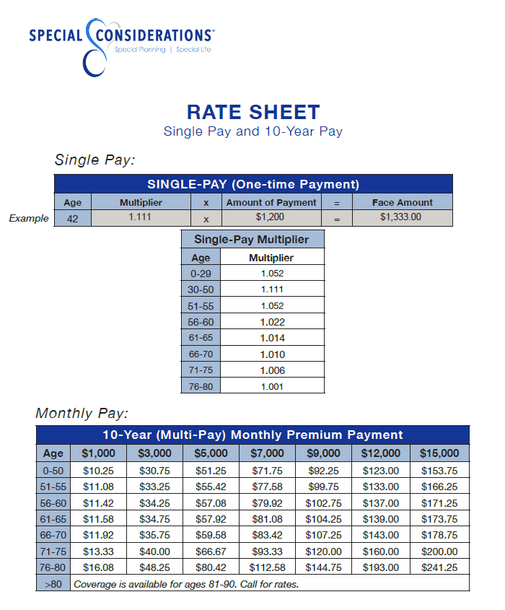
What does it Cost?

Slide 17
Enrolling – Easy 3 Steps
Step 1 – Determine: Single Premium or Multi-pay Monthly Premium
Step 2 – Provide the following: Insured’s Name
Date of Birth
SS#
Step 3 – We complete the enrollment forms
Once signatures are obtained, print the executed forms
Mail with a check directly to the company

Slide 18
Enrolling – Obtaining Signatures
Obtaining Signatures:
When the individual can and wants to be involved,
we encourage them to sign or make their mark
We will also provide guidance and the protocol
for obtaining *signatures. (Depends upon the method of submitting the forms)
*Others may sign on behalf of the insured in certain circumstances
Notes:
We will provide the guidance and protocol for obtaining signatures depending upon the situation
In certain circumstances, others may sign on behalf of the insured

Slide 19
Enrolling – Securely Sending Information
Methods for Securely Sending Enrollment Forms
#1 DocuSign
#2 Secure Email
#3 Fax

Slide 20
When the time comes . . .
When the policy is issued, you’ll receive a Claim Process Card which provides instructions. Funds are typically available within 48-72 hours.
We are associated with hundreds of funeral homes and can provide a referral, if needed.

Slide 21
Tools to Assist our Client Groups
Policy Values Letters
Policy Lists
Informational Brochures

Slide 22
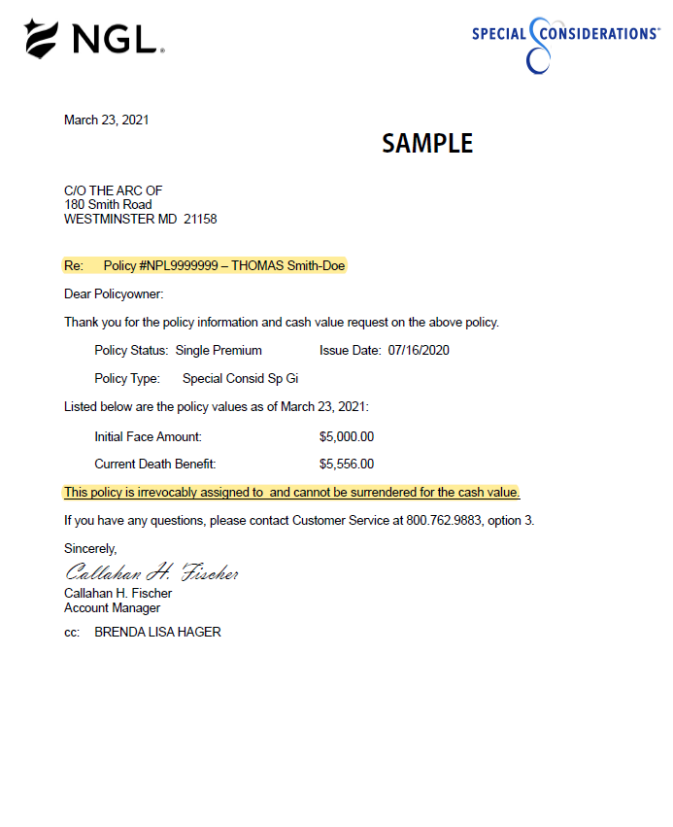
What is a Policy Value letter?
Valuable tool for recertifications
Provides the Initial Face Value/Face Amount
Irrevocable Assignment is clearly indicated

Slide 23
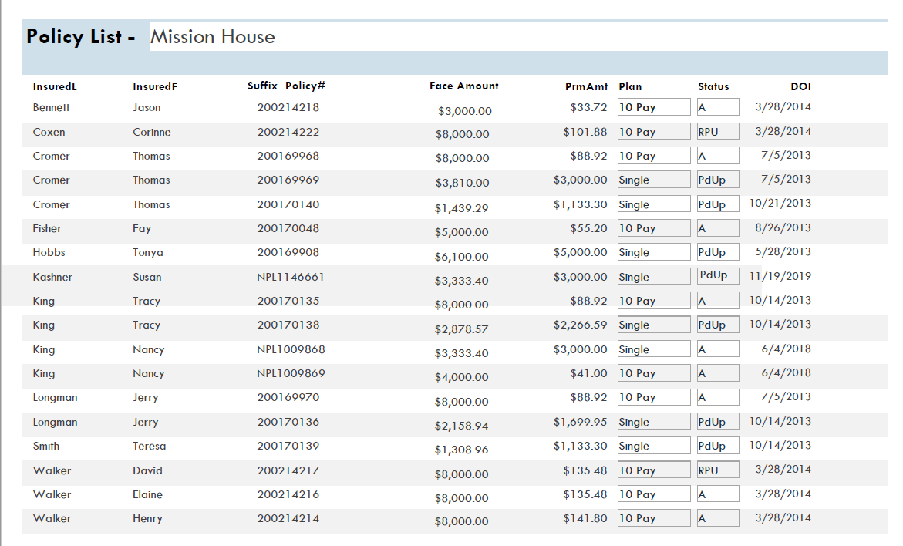
POLICY LIST – What is it and why is it important
Comprehensive List
Who has coverage
Is there enough coverage?
Has anyone left the group?
Payment Status: Paid Up, Active, RPU
We Recommend Annual Reviews
A valuable tool when evaluating spend-down options

Slide 24
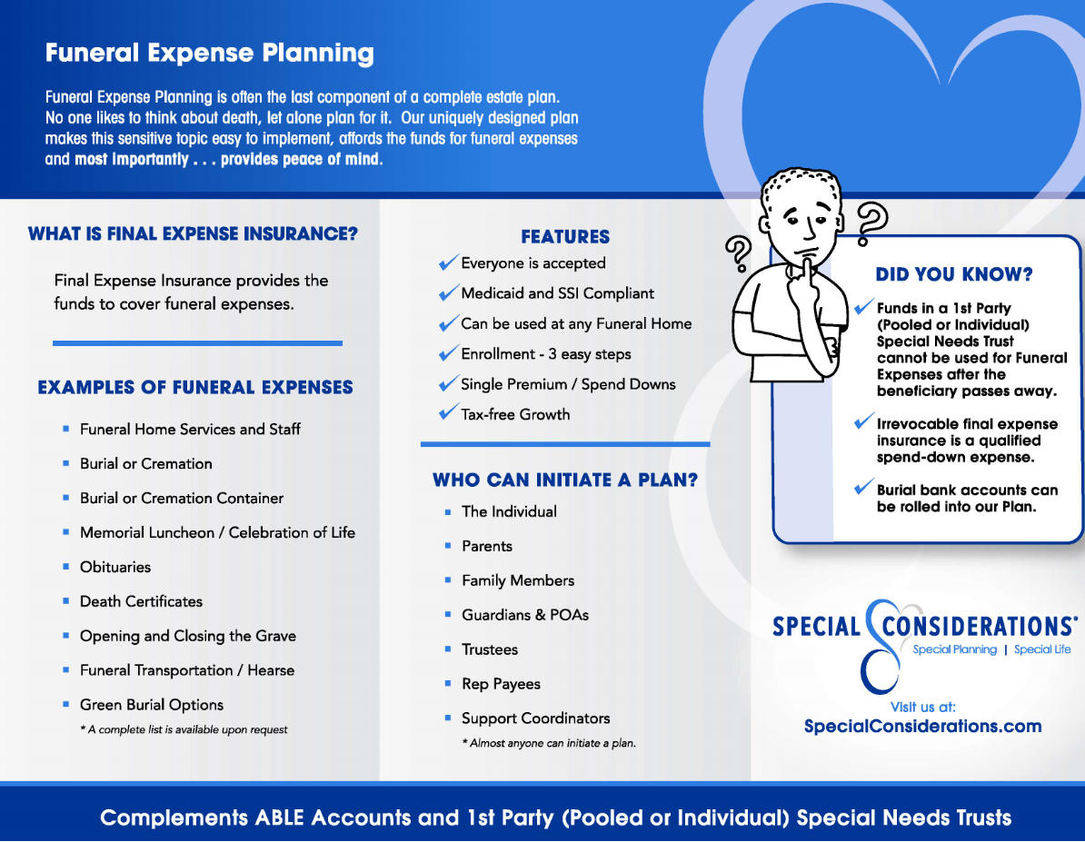
Tools to Assist our Client Groups
Informational Brochures
Digital Brochures
Tri-fold Brochures

Slide 25
Recap
The Special Considerations one-of-a kind Funeral Insurance program provides the funds for final expenses
Everyone Qualifies regardless of medical history
Approved use of funds for spend-downs
Two Plans:
Single Premium Plan - spend-downs or 1st Party Special Needs Trusts
Monthly Pay Plan - pay over-time and fit comfortably in a monthly spending plan
Enrollment Process – 3 Easy Steps
We Make Final Expense Planning Easy

Slide 26
Q&A
Special Planning Special Life

Slide 27
Thank You
Brenda Hager
Sr. Regional Director
(717) 846-4581
(717) 577-5538
BHager@SpecialConsiderations.com
Notes:
Have a great day!

