Slide 1

OSHA Covid-19
Emergency Temporary Standard
Presented By: Brenda Rice, IMA Risk Control Advisor

Slide 2
Overview
  Took effect June 21, 2021 for the following Industries:
  - Hospitals
  - Long-Term Care
  - Ambulatory Care
  - Home Health/Hospice
  - Emergency Medical Services
  - Patient Transport
  Definition of Patient Care:
  - means hands-on, face-to-face contact with patients for the purpose of diagnosis, treatment,
  and monitoring.
  Priorities
  - CMS & Local State Health Guidance is top priority over OSHA
  - Focus on what is needed to maintain you State License and minimize inspection
  deficiencies.

Slide 3
COVID-19 Plan
The COVID-19 plan must address the hazards identified by the hazard assessment and include policies and procedures to minimize the risk of transmission of
COVID- 19 for each employee.
These policies and procedures include, but are not limited to:
      Patient screening and management
      Standard and Transmission-Based Precautions
      Personal Protective Equipment (PPE)
      Aerosol-generating procedures on a person with suspected or confirmed COVID-19
      Physical distancing
      Physical barriers
      Cleaning and disinfection
      Ventilation
      Health screening and medical management
      Vaccination
      Training

Slide 4
Key Items of the ETS
Designated Covid-19 Safety Coordinator – this can be more than one person.
Employee Input
    Safety Committee – Invite to attend covid-19 discussion updates – representation from each department.
    Engagement with employees when conducting assessments
    Shift Change meetings – discuss concerns, needs, etc. Physical distancing
Continued Monitoring/Updating
    Include in Infection Control/QAPI meetings to stay focused of local spread, changes, etc.

Slide 5
Key Items of the ETS
Health Screening/Medical Management
    Limit and monitor points of entry into the facility
    Continue Covid-19 screen of all employees, family, guest, visitors, residents
Communication
      Employee notification of exposure/positive case within 24 hrs – all employees.
      Family communication of positive case.
Covid-19 Positive – Quarantine Pay
    Less than 500 Employees – regular pay for 2 weeks up to $1,400 a week. Third week go down to 2/3 of weekly wage – no overtime calculated (up to $200 a day).
    500 & more employees – regular pay up to $1,400 a week until fully returned.
    https://www.osha.gov/coronavirus/ets/faqs - Question 73

Slide 6
ETS Guidance for Employees – Notification to Employer and Paid¹ Medical Removal for COVID-19
This flow chart explains when you need to notify your employer about COVID-19-related issues, when your employer must notify you about COVID-19 exposures in the workplace, and when your employer must remove you from the workplace.²
SCENARIO 1: YOU ARE COVID-19 POSITIVE
You tested positive for COVID-19 or were diagnosed with COVID-19 by a licensed healthcare provider
Notify your employer immediately
Your employer must remove you from the workplace until you meet return to work criteria
Return to Work
Your employer must decide when you can return to work based on:
Guidance from a licensed healthcare provider
OR
CDC guidance on ending isolation.
SCENARIO 2: YOU ARE SUSPECTED TO HAVE COVID-19 OR EXPERIENCING CERTAIN SYMPTOMS
A licensed healthcare provider has told you they suspect you have COVID-19
OR
You have the following symptoms:
1) A recent loss of taste and/or smell with no other explanation
OR
2) Both a fever (≥100.4°F) and new unexplained cough associated with shortness of breath
Notify your employer immediately.
Your employer must remove you from the workplace and has two options:
Option 1
Keep you removed until you meet return to work criteria
Option 2
Keep you removed and provide a
COVID-19 PCR test at no cost to you
Negative Test
Return to work immediately
Examples of return to work criteria:
Positive Test
You must stay removed until you meet return to work criteria
If you have symptoms:
At least 10 days since symptoms first appeared
AND
At least 24 hours with no fever without fever-reducing medication
AND
Other symptoms of COVID-19 are improving (except for loss of taste or smell).
If You
Refuse Test
You must stay removed until you meet return to work criteria. Your employer does not have to provide medical removal protection benefits (e.g., pay).
SCENARIO 3: YOU HAVE BEEN IN CLOSE CONTACT WITH A COVID-19 POSITIVE PERSON
IN THE WORKPLACE
Your employer notifies you that you have been in close contact with a person at your workplace who is COVID-19 positive at a time when you were not wearing a respirator or other PPE³
Your employer must remove you from the workplace and has two options:
Option 1
Keep you removed for 14 days
Option 2
Keep you removed and provide a
COVID-19 test at no cost to you at least 5 days after the exposure
You have been fully vaccinated against COVID-19 OR had COVID-19 and recovered within the last 3 months AND
Are not experiencing recent loss of taste and/or smell with no other explanation or both a fever (≥100.4ºF) and new unexplained cough associated with shortness of breath
If you have COVID-19 but no symptoms:
At least 10 days since a positive COVID-19 test
No
Negative Test
Return to work after 7 days following exposure
Positive Test
You must stay removed until you meet return to work criteria
If you have severe
COVID-19 or an immune disease:
Follow guidance of a licensed healthcare provider
Yes
If You
Refuse Test
You must stay removed for 14 days. Your employer does not have to provide medical removal protection benefits (e.g., pay).
You do not have to be removed from the workplace
¹ OSHA is requiring medical removal protection benefits to be paid only by employers that have more than 10 employees.
² Your employer may choose to remove or test you for other COVID-19-related reasons not required by the ETS (e.g., additional symptoms from the CDC list or exposure to someone who is COVID-19 positive outside the workplace).
³ Your employer is not required to notify you following exposure to a patient with confirmed COVID-19 if you work in a place where services are normally provided to suspected or confirmed COVID-19 patients (e.g., emergency rooms, urgent care facilities).

Slide 7
Key Items of the ETS
Personal Protective Equipment
    Continue to keep inventory – Burn Calculator
    PPE Assessment – Covid-19 requirements & non-Covid
    Training – donning/doffing/cleaning/disposal/etc.
Ventilation – HVAC
    HVAC Company to state max capacity for systems – MERV 6 or 8
    Majority of HVAC for Long-Term not equipped for MERV 13
Cleaning & Disinfecting
    CDC’s “COVID-19 Infection Prevention and Control Recommendations” and CDC’s “Guidelines for Environmental Infection Control,” pp. 86–103, 147-149.
    Covid positive cleaning protocol
    High touch area cleaning protocol

Slide 8
Key Items of the ETS
Physical & Social Distancing
    6 feet per OSHA and 3 feet for CDC
    Signage to demonstrating practicing safe distancing
Barriers
    Recommend at public facing fixed workstations – front desk
    Physical barriers are not required in direct patient care areas or resident rooms
    Follow the CMS and your local County, State guidance for distancing, barriers, and visitations.

Slide 9
Respirator Program
Nothing Changed with the ETS Program
Fit Testing – Annually
    Recommend 8/1 – 10/31 to complete all employees annual testing – prepare for full season
    New Employee Orientation
Respirator Health Questionnaire
    Do not complete annually
    Update only if significant health changes
    Add to New Employee Orientation

Slide 11
Aerosol-Generating Procedures
Add section to Infection Control Policy/Covid-19 Policy/Infection Control Policy
    California – full written Aerosol Transmittable Disease Policy required.
Requirements for policy
  When an AGP is performed on a person with suspected or confirmed COVID-19, your employer must:
      Provide a respirator and other PPE (gown, gloves, eye protection, and possibly
      face shield)
      Limit the number of employees present during the procedure to only those
      essential for patient care and procedure support.
      Ensure that the procedure is performed in an existing airborne infection isolation
      room (AIIR), if available.
      Promptly clean and disinfect the surfaces and equipment in the room or area
      where the procedure was performed, after the procedure is completed.

Slide 12
RECORDKEEPING
OSHA 300 Logs – no changes to normal recording
    Most Covid-19 cases are not recordable
Covid-19 Log
    Recommend using your current Covid-19 log kept for State, CDC, CMS
Reporting Covid to OSHA
    Contact Brenda Rice or someone at IMA Risk Control
    Fatality – within 8 hours of being designated “work related”
    Hospitalization – within 24 hours of being designated “work related”

Slide 13
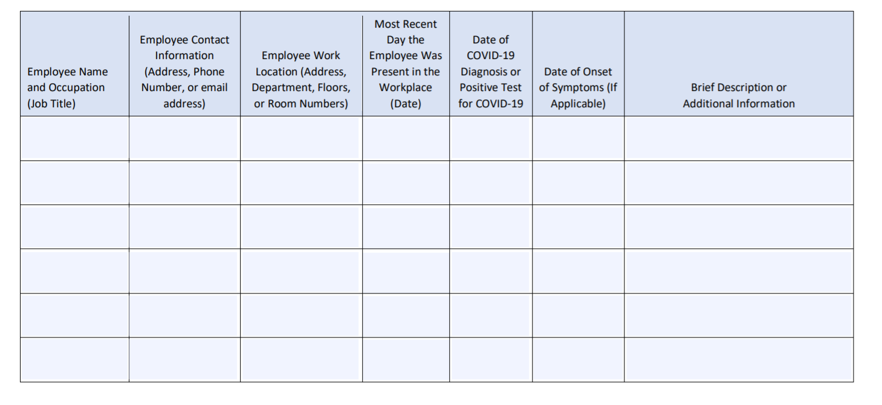
OSHA Covid-19 Log

Slide 14
Anti-retaliation
Section noted in the Covid-19 policy
    Employee right to speak freely about Covid-19
    Employee involvement in company policies/focus
No distinguishing between vaccinated & non-vaccinated
Vaccinated employees to follow same safety protocol as non-vaccinated
Discourage incentive programs for vaccination

Slide 15
QUESTIONS????
Thank You!
Brenda Rice, Risk Control Advisor

